Slide 1
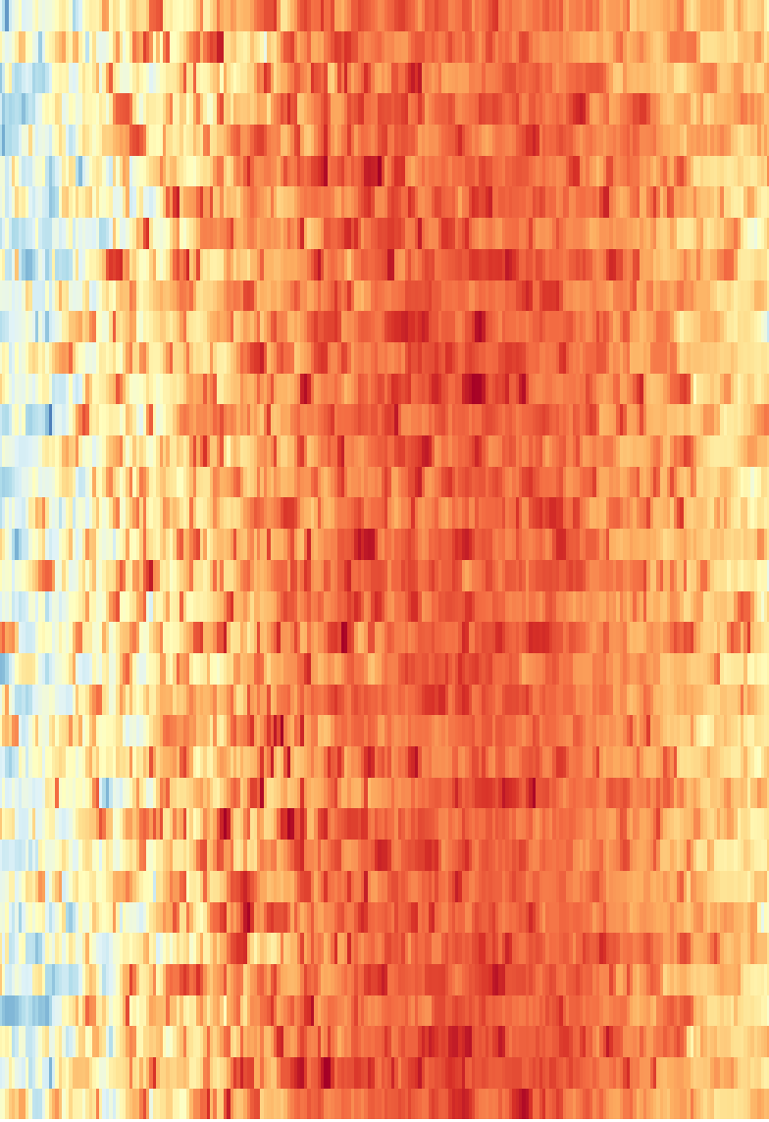
Can we forecast tomorrow’s weather in Cairo?
CAIRO · 1990–2025 · TIME-SERIES EDA
36 years of daily NASA data, explored to answer two questions about tomorrow.
TARGET 1 · REGRESSION
TARGET 2 · CLASSIFICATION
Tomorrow’s mean temperature (°C)
Rain tomorrow? (≥ 1 mm, yes / no)
Esraa · Cairo weather prediction
Right: every day since 1990, by max temperature →
Notes:
Good morning. My project asks a simple question: can we forecast tomorrow’s weather in Cairo? The picture on the right is the whole dataset at once: every day since 1990, one row per year, coloured from blue for cool days to dark red for hot days. I split the question into two targets. The first is a number: tomorrow’s mean temperature in degrees. The second is a yes or no: will it rain tomorrow, where a rain day means at least 1 millimetre. Before building any model, I spent this phase understanding the data, because what we learn here decides which features, which years and which metrics the model will use. In the next ten minutes I’ll show the data, two problems hidden in it, the main patterns, and the number a model has to beat.

Slide 2

36 years of daily data from one free API
THE DATA
36
13,149
8
0
years, 1990–2025
days, no gaps or duplicates
variables, already metric
API keys needed
Fig. 2 · The forecasting pipeline
1 · Collect
2 · Save
3 · Clean
4 · Explore
5 · Baselines
NASA POWER API, one request
Raw JSON + CSV, never changed
Bad values → NaN, no rows dropped
EDA and hypotheses H1–H6
Time split, numbers to beat
Why NASA POWER: free, no key, one consistent daily record back to 1981, and a single repeatable call for central Cairo (30.04° N, 31.24° E).
Cairo weather forecasting · Esraa
Source: NASA POWER, 1990–2025 · 02 / 15
Notes:
The data comes from the NASA POWER API. I chose it for three reasons: it is free with no API key, it has one consistent daily record going back to 1981, and a single call returns everything, so the whole analysis can be repeated. I pulled 36 full years, 1990 to 2025, for central Cairo: 13,149 days and 8 variables, mean, max and min temperature, rain, humidity, wind speed, wind direction and pressure, all already in metric units. Figure 2 is the pipeline I follow. One request collects the data. The raw response is saved exactly as received and never changed. Cleaning turns wrong values into empty cells but never drops a row. Then the exploration, with six hypotheses, and finally a time-based split and simple baselines that any model must beat. One honest limitation: this is model data averaged over about a 50 by 50 kilometre grid, not a weather station, so extremes may look a little milder.

Slide 3
Six questions guided the analysis
RESEARCH QUESTIONS
H1
H2
H3 · key question
Is Cairo warming, and are nights warming faster than days?
Are very hot days becoming more frequent?
Did heavy rain really increase after 2016, or did the data change?
→ Slide 6
→ Slide 7
→ Slide 8
H4
H5
H6
Are cold waves becoming rarer, and which years were the strongest?
Do storms show warning signs in the days before them?
Can Khamasin-like days be detected, and when do they happen?
→ Slide 7
→ Slide 12
→ Slide 12
Cairo weather forecasting · Esraa
Source: NASA POWER, 1990–2025 · 03 / 15
Notes:
Before looking at the patterns, these are the six questions I set out to answer. Two are about temperature trends: is Cairo warming, with nights faster than days, and are very hot days becoming more common. One is the key question of this project, H3: did heavy rain really increase after 2016, or did the data itself change? Then cold waves, whether storms give warning signs in the days before them, and whether Khamasin-like days, the hot, dry desert wind days, can be detected in the data. Each one has a clear answer later in the talk, and the slide number is on each card.

Slide 4
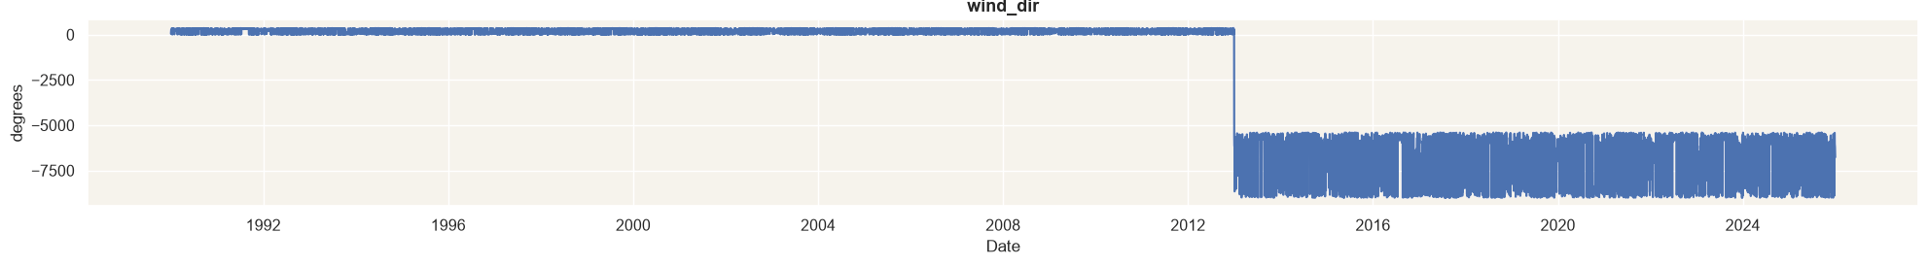
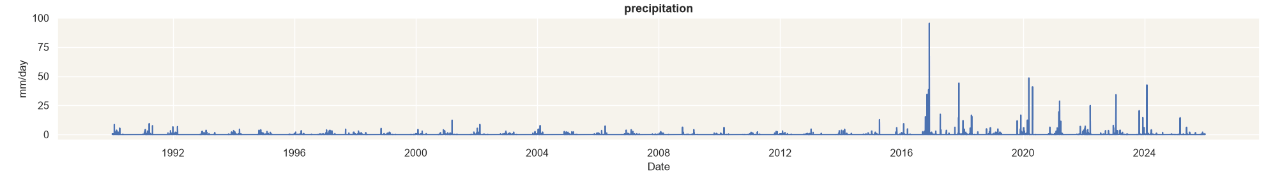
The data looked clean, but hid two problems
DATA QUALITY · −999 CODES → NAN · NO IMPOSSIBLE VALUES
PROBLEM 1 · FIG. 4A
Wind direction breaks in 2013
From 2013 every value is below 0 (down to −9000°), but an angle must be 0–360°: 13 years, 36 % of the column.
→ Left empty, not invented. Valid for 1990–2012 only.
PROBLEM 2 · FIG. 4B
Rain jumps suddenly in 2016
Before 2016 no day reaches 13 mm. After 2016, many days pass 20 mm, up to 95.5 mm.
→ Kept, and tested as hypothesis H3.
Cairo weather forecasting · Esraa
Source: NASA POWER, 1990–2025 · 04 / 15
Notes:
At first the data looked clean. Every day from 1990 to 2025 is there and nothing is duplicated. NASA writes minus 999 for a missing value, so I turned those codes into empty cells before counting anything. All the basic checks passed: no negative rain, no min temperature above the max, humidity always between 0 and 100. But plotting every variable over time showed two problems. First, wind direction, in figure 4a: from 2013 every value is below zero, down to minus 9000, and an angle must be between 0 and 360. Thirteen years going wrong at once points to the data, not the weather. That is 36 percent of the column. I left those days empty instead of inventing values, so wind direction is only valid until 2012. Second, rain, in figure 4b: before 2016 no single day reaches 13 millimetres, and after 2016 many days pass 20. I kept the rain, but treated this jump as a hypothesis to test, and I’ll come back to it.

Slide 5
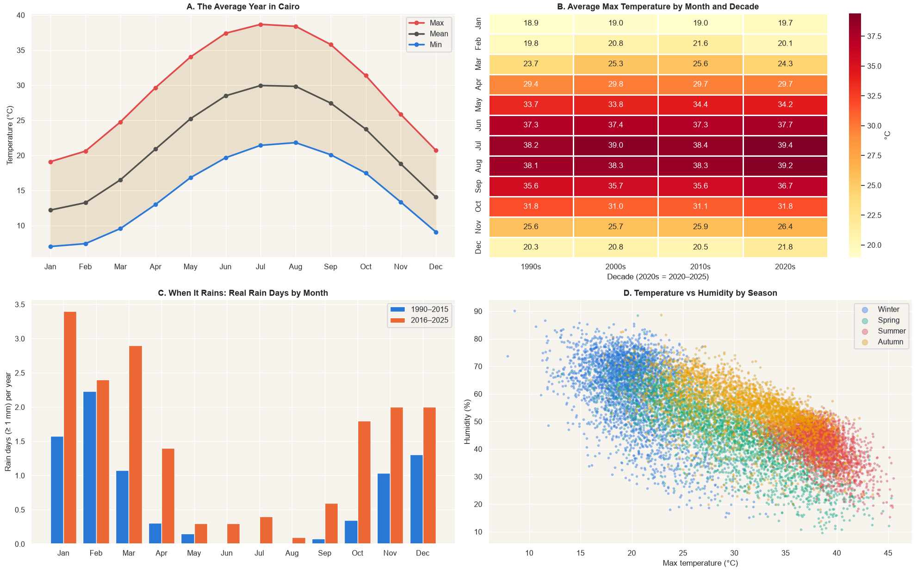
Cairo’s climate at a glance: the season rules
SEASONALITY
Fig. 5 · Cairo climate overview, 1990–2025
A · ~19 °C season swing. Mean from ~12 °C in January to 30 °C in July–August.
B · The 2020s have the hottest summers (July 39.4 °C max).
C · Rain falls October to April, and rain days rise in every month after 2016.
D · Hotter days are drier: humidity moves opposite to temperature.
MODEL INPUT
Day of year as sine and cosine
Cairo weather forecasting · Esraa
Source: NASA POWER, 1990–2025 · 05 / 15
Notes:
Here is Cairo’s climate in one figure. Panel A is the average year: the mean temperature goes from about 12 degrees in January to 30 in July and August, a seasonal swing of about 19 degrees that repeats every year. Panel B breaks the max temperature down by month and decade: the 2020s have the hottest summers, with July averaging 39.4 degrees. Panel C shows when it rains: almost only from October to April, with Mediterranean storms in the cool months, and rain days go up in every month after 2016, which is the jump I will test later. Panel D shows that hotter days are drier, so humidity moves the opposite way to temperature. The decision for the model: the calendar is the most important input, so I give it the day of the year as sine and cosine, which keeps December 31st and January 1st close together.

Slide 6
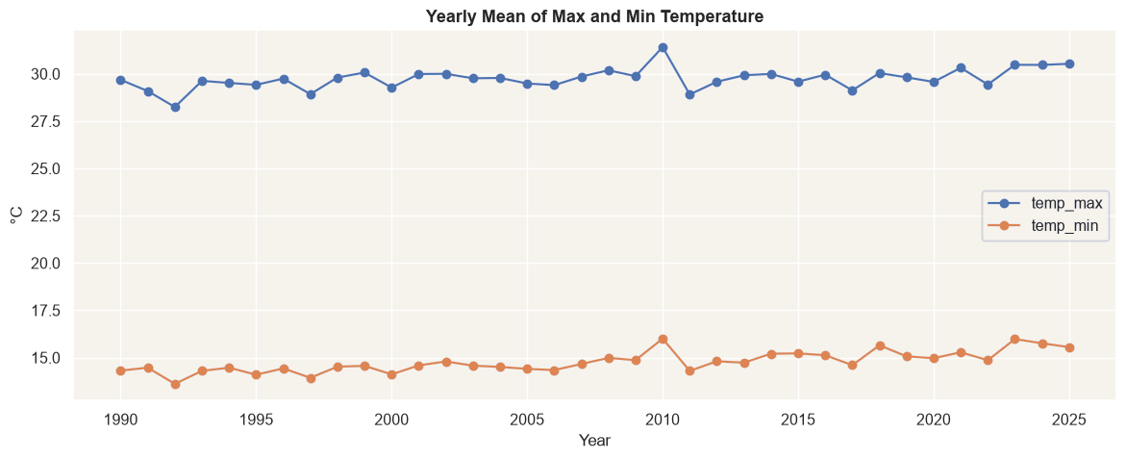
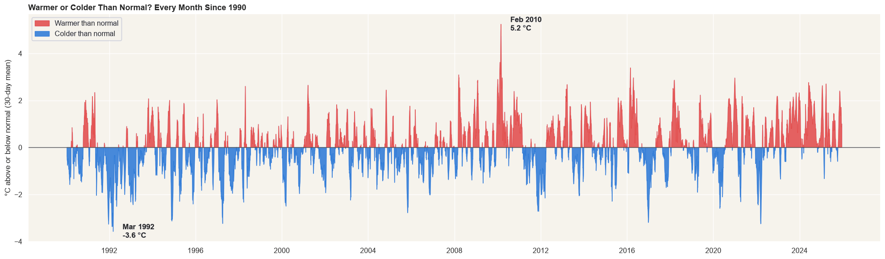
Cairo is warming, and nights faster than days
H1 · LONG-TERM TREND
+0.41 °C
+0.23 °C
2023–25
SO WHAT
per 10 years · nights (min temp)
per 10 years · days (max temp)
among the warmest years
Test years are warmest: watch for a cold bias
Fig. 6a · Yearly mean of max and min
Fig. 6b · Warmer (red) or colder (blue) than normal, 30-day mean
Cairo weather forecasting · Esraa
Source: NASA POWER, 1990–2025 · 06 / 15
Notes:
My first hypothesis was: is Cairo getting warmer, and are nights warming faster than days? In figure 6a I took the yearly average of the daily max, which stands for the days, and of the daily min, which stands for the nights, and fitted a straight line through each. Nights warm by 0.41 degrees per decade, days by 0.23. So yes, Cairo is warming, and nights almost twice as fast. A likely reason is city heat at night on top of regional warming, but this data can’t separate the two. Figure 6b shows the same story differently: each day compared with the normal for its date. The 1990s are mostly blue, colder than normal, and recent years are mostly red. Compared with the 19-degree season this trend is small, but it matters: the test years, 2023 to 2025, are among the warmest, so I will check whether the model forecasts them too cold.

Slide 7
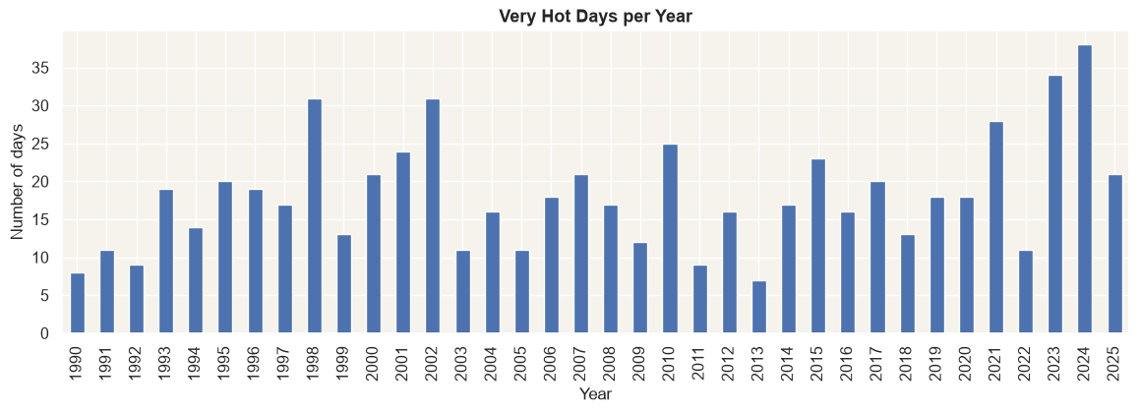
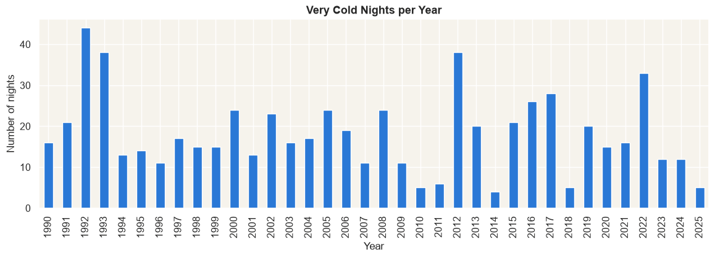
More very hot days, fewer very cold nights
H2 + H4 · EXTREMES
7 → 38 days
20.4 → 15.5 nights
very hot days (max > 40.1 °C): 2013 vs 2024
very cold nights (min < 5.7 °C) per year: 1990s vs 2020s
Fig. 7a · Very hot days per year
Fig. 7b · Very cold nights per year
H2: Partly. 2023 and 2024 are the most extreme, but more years are needed to call it a trend.
H4: Yes, slowly (−1.9 nights per 10 years). Strong cold years still happen, like 2022.
Cairo weather forecasting · Esraa
Source: NASA POWER, 1990–2025 · 07 / 15
Notes:
The next two hypotheses look at the extremes. A very hot day is hotter than 95 percent of all days, which here means a max above 40.1 degrees. In figure 7a the count jumps around a lot, from 7 in 2013 to 38 in 2024, and the two highest years are 2023 and 2024. So for H2, are very hot days becoming more frequent, my answer is: partly. Recent years are the most extreme, but I would need more years to call it a trend. On the other side, a very cold night is colder than 95 percent of all nights, below 5.7 degrees. In figure 7b they fall from 20.4 a year in the 1990s to 15.5 in the 2020s, about two fewer per decade, which fits the nights warming faster that we saw in H1. The coldest years were 1992 and 1993, which may also reflect the global cooling after the 1991 Pinatubo eruption. So H4 is yes, slowly, but strong cold years like 2022 still happen. For the model, this means checking heat-wave errors separately on the test set.

Slide 8
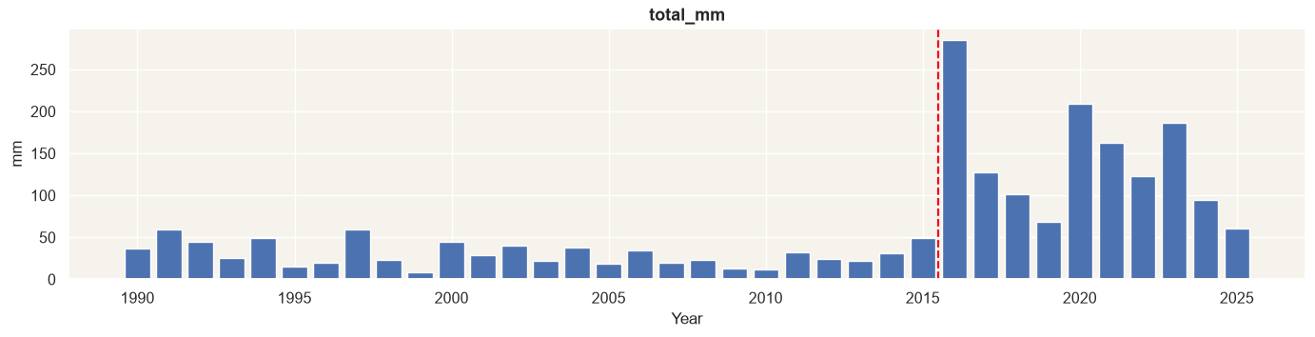
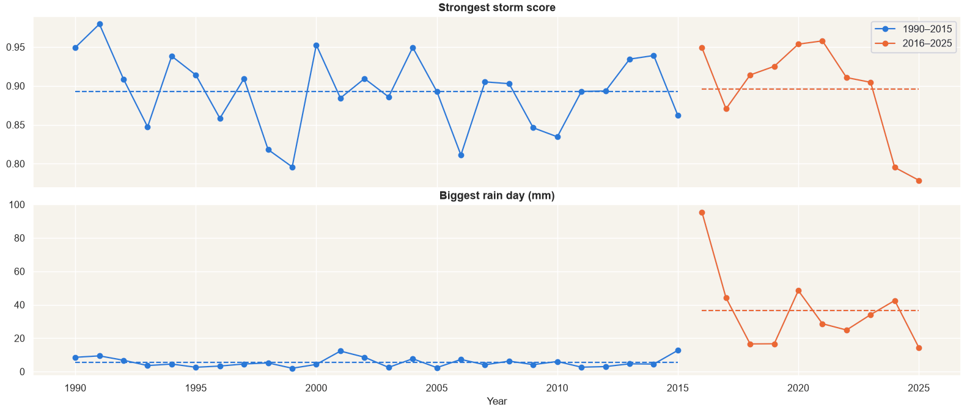
Did it really rain more after 2016?
H3 · THE KEY FINDING
Fig. 8a · Total rain per year: a sudden jump at 2016
Rain days per year
8.1 → 17.6
Heavy rain days (≥ 10 mm) / year
0.1 → 3.8
Total rain per year (mm)
30.6 → 142
WHY IT’S THE DATA, NOT THE WEATHER
Fig. 8b · Storm score flat, rain jumps
1 · Sudden: the jump happens at one year, not as a slow rise.
2 · Unrealistic: 142 mm a year vs Cairo’s normal of ~20–25 mm.
3 · Storms didn’t get stronger: only the rain number changed (Fig. 8b).
Answer: most likely a data change → rain work uses 2016–2025 only.
Cairo weather forecasting · Esraa
Source: NASA POWER, 1990–2025 · 08 / 15
Notes:
This is the most important finding. Figure 8a shows total rain per year, and at 2016 it jumps. Rain days per year go from 8.1 to 17.6, heavy rain days from almost none to 3.8 a year, and total rain grows 4.6 times, to 142 millimetres a year. So did Cairo really get wetter? I don’t think so, for three reasons. First, the change is sudden: it happens at one year, while a real climate change would build up slowly. Second, 142 millimetres a year is unrealistic for Cairo, where the normal is about 20 to 25. Third, and this is the strongest check: I built a storm score from signs that stay consistent across all 36 years, a pressure drop, strong wind, a temperature drop and high humidity. In figure 8b the strongest storm each year stays at the same level before and after 2016, while the biggest rain day jumps from 5.5 to 36.6 millimetres on average. Storms did not get stronger; only the rain number changed. So my answer to H3 is: most likely a change in how the data is produced, not in the weather. That is why every rain analysis and the rain model use 2016 to 2025 only.

Slide 9
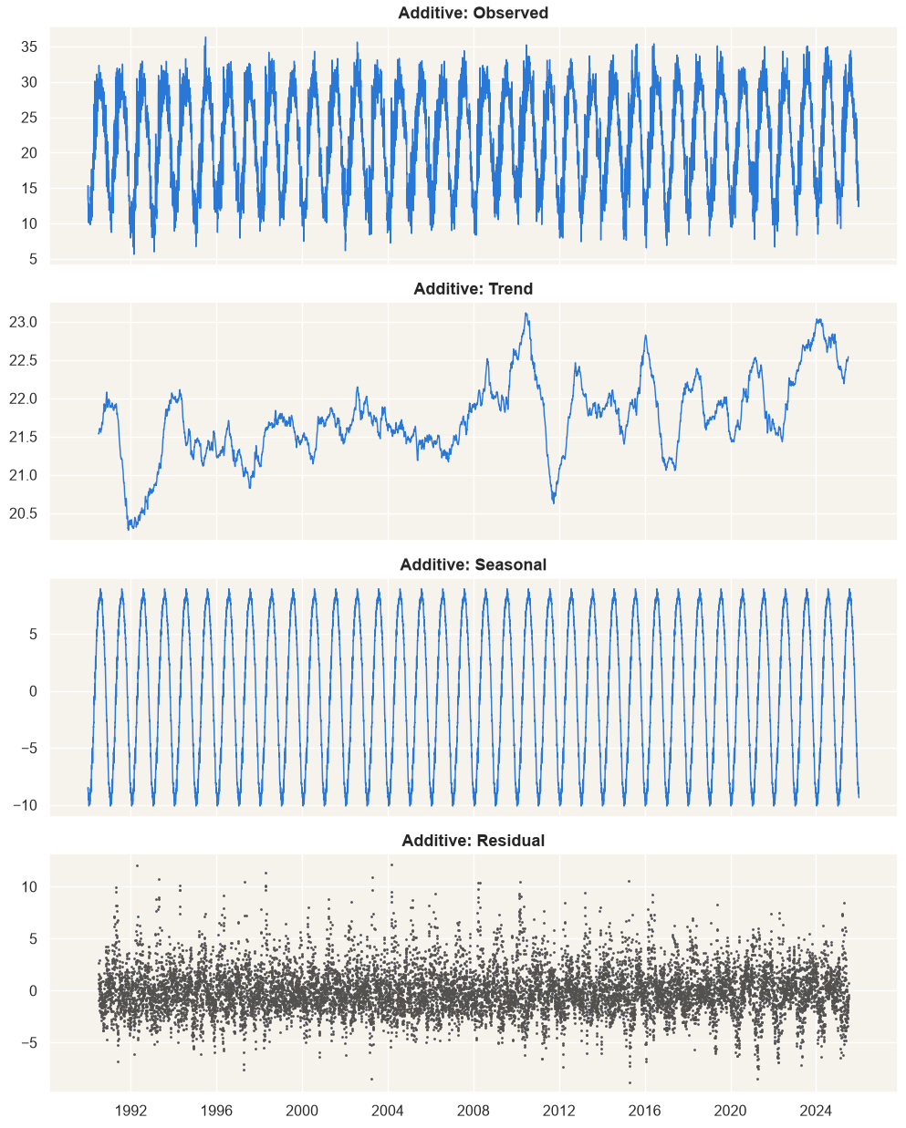
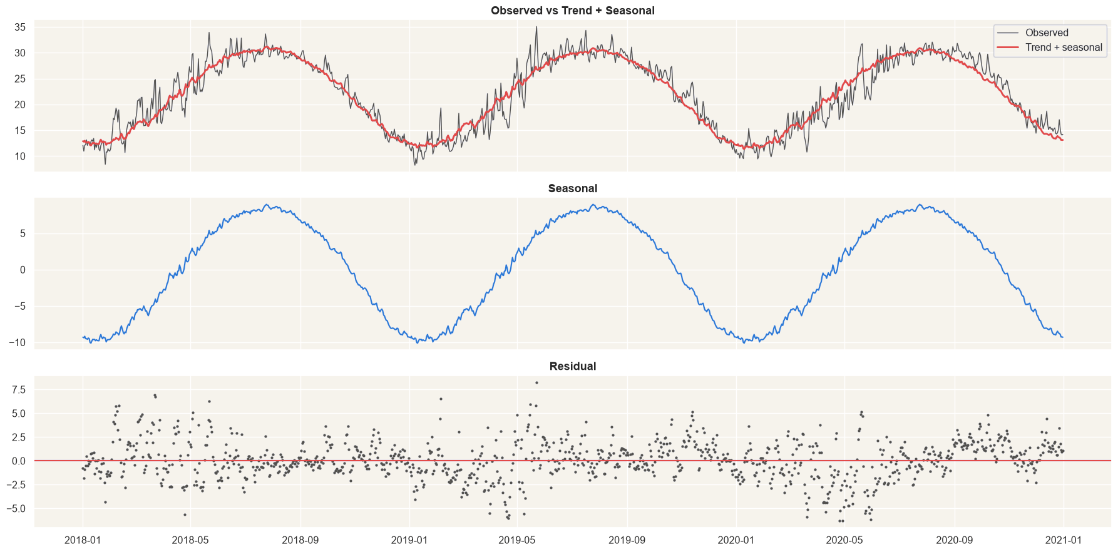
Season, slow trend, and 2.2 °C of daily noise
DECOMPOSITION AND STATIONARITY
19.1 °C
Fig. 9a · Additive decomposition
Fig. 9b · Zoom on 2018–2020
seasonal swing
2.8 °C
trend change over 36 years
2.2 °C
daily residual (std)
SO WHAT
p < 0.001
The calendar explains most of it. The model’s real job is the 2.2 °C left over. No differencing needed.
ADF: stationary, all 3 versions
Cairo weather forecasting · Esraa
Source: NASA POWER, 1990–2025 · 09 / 15
Notes:
To see how much of temperature is just the calendar, I decomposed the series into trend, season and residual, with a 365-day period. Figure 9a is the additive version. The seasonal part swings 19.1 degrees, the trend moves only 2.8 degrees over 36 years, and what is left, the residual, is about 2.2 degrees a day. The multiplicative version gave the same picture, because the yearly swing does not grow over time, so I use the additive form. Figure 9b zooms into 2018 to 2020: the red line, trend plus season, already follows the real temperature closely. Then the stationarity test: the ADF test says the raw series, the series without the season, and the daily changes are all stationary, with p below 0.001. Temperature always comes back to its normal level and does not drift. So no differencing is needed, but the season must still be modeled. The model’s real job is the 2.2 degrees left over, and it has to learn that from recent days.

Slide 10
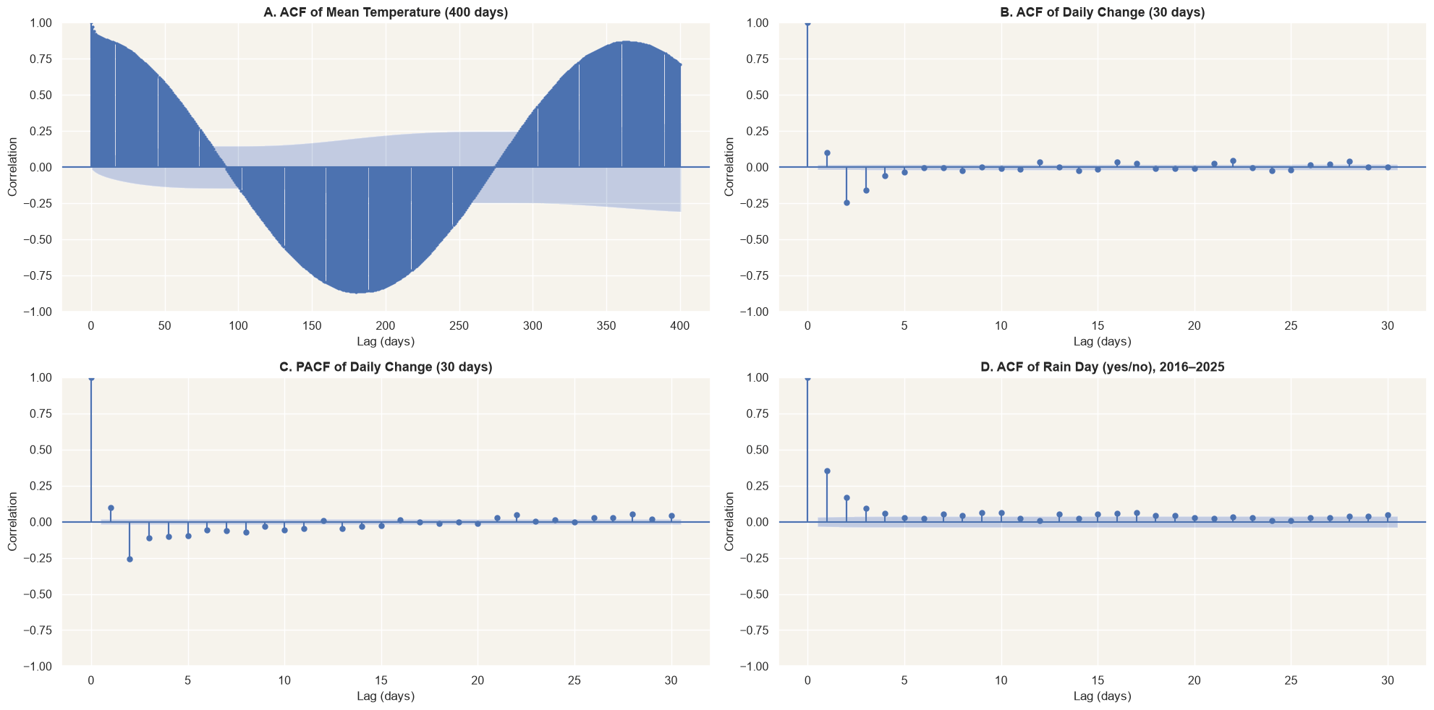
Yesterday is the strongest clue for tomorrow
AUTOCORRELATION · ACF AND PACF
Fig. 10 · A: temperature · B–C: daily change (ACF, PACF) · D: rain days
0.97 → 0.77
lag-1 link, raw → season removed
~5 days
of memory in daily changes (B, C)
39 % vs 5 %
rain tomorrow after a rain day vs normally (D)
FEATURES
Last 1–5 days and short rolling means. Drop lag 365. “Rain today” is the top rain clue.
Cairo weather forecasting · Esraa
Source: NASA POWER, 1990–2025 · 10 / 15
Notes:
Autocorrelation tells us how strongly today is linked with past days, and that decides the model’s inputs. Panel A is the raw temperature over 400 days: 0.97 with yesterday, minus 0.86 at six months and plus 0.86 at one year. That wave is just the season again. When I remove the season, today’s link with tomorrow is still 0.77, while a week ago drops to 0.13 and a year ago is about zero. Panels B and C use the daily change, so the season can’t hide anything: only the last five days or so carry information, and after that the bars sit inside the noise band. Panel D is for rain: after a rain day, rain tomorrow is 39 percent likely, against 5 percent normally, because weather systems last a few days. So the features are the last one to five days and short rolling means. A one-year lag adds nothing, so I drop it. And for rain, whether it rained today is the strongest single clue.

Slide 11
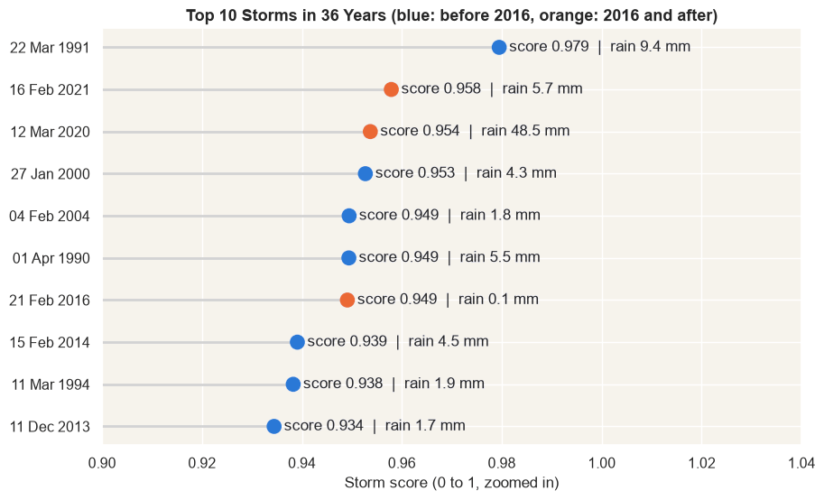
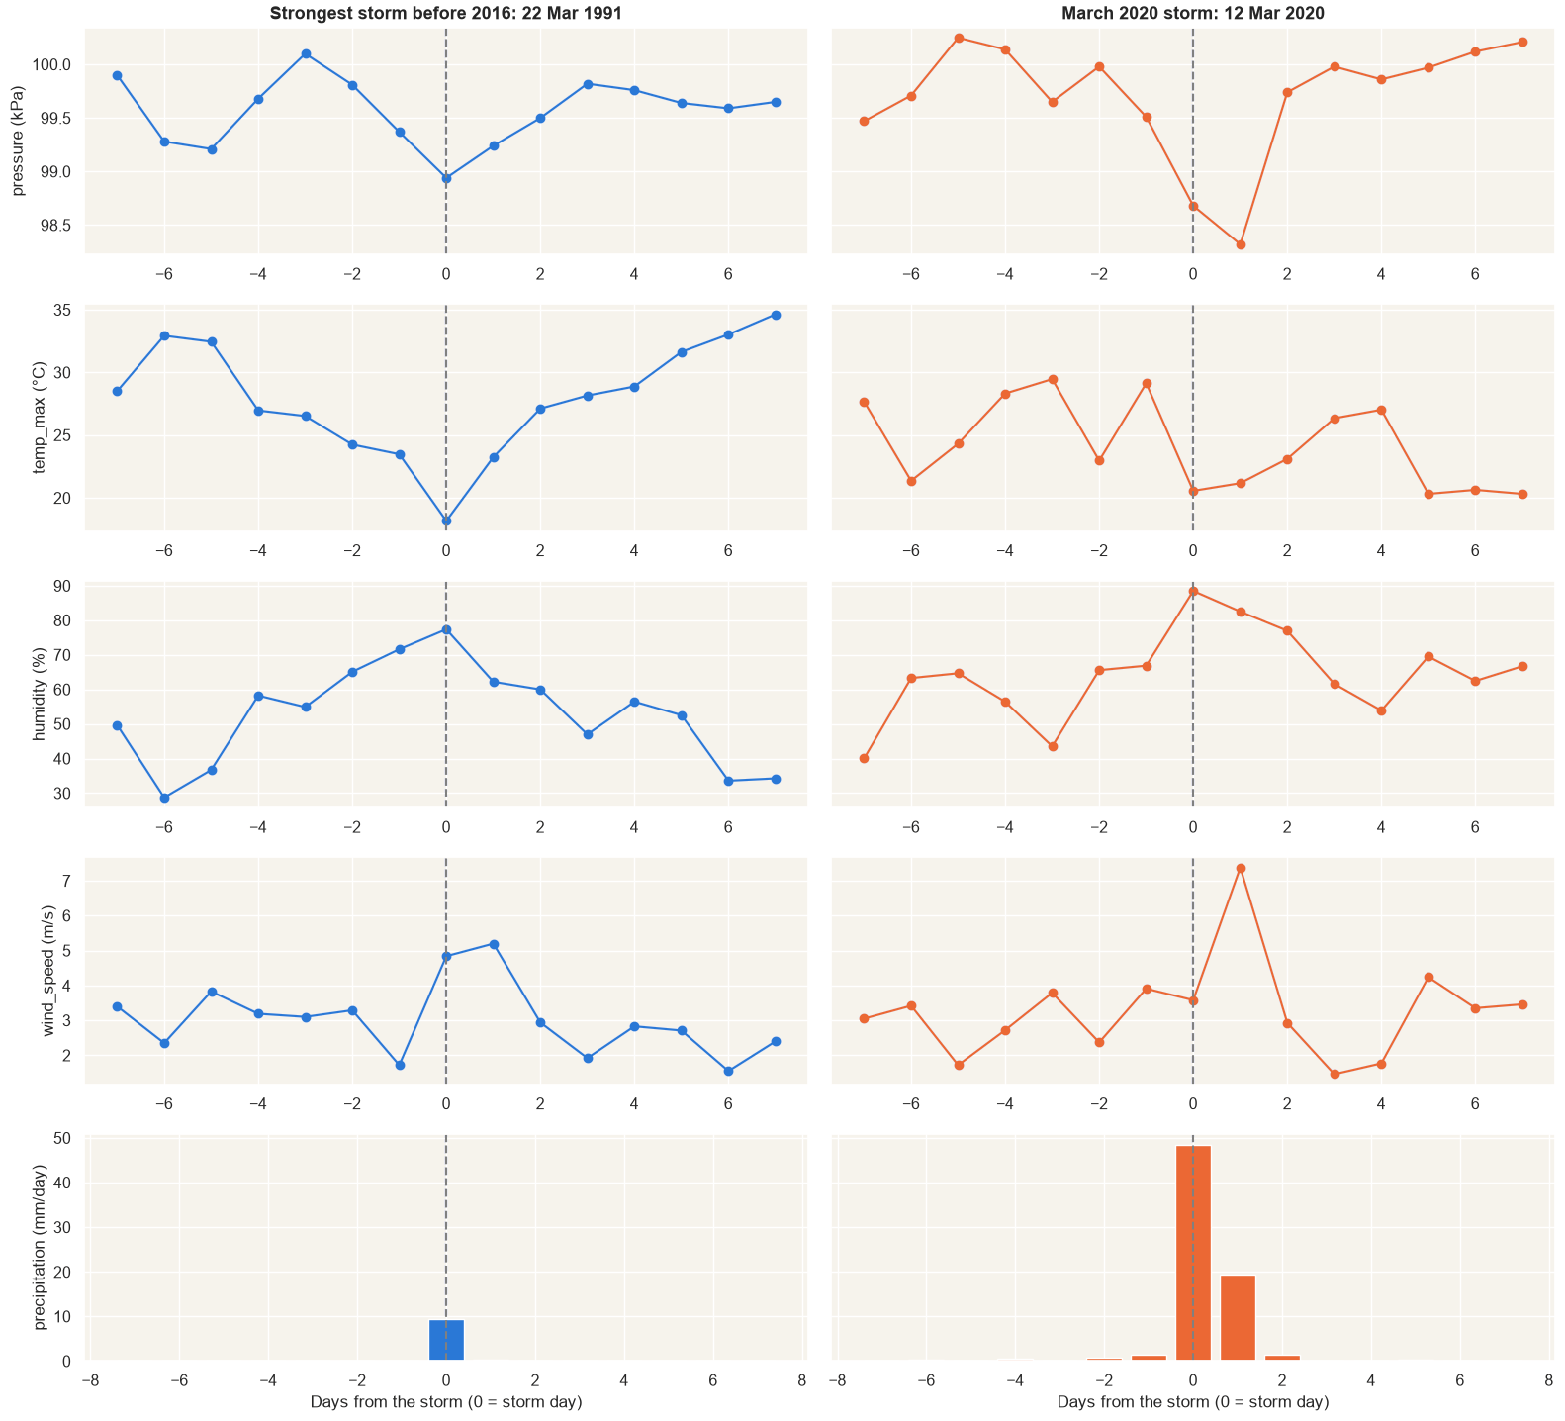
Strong storms, little rain, except March 2020
EXTREME EVENTS · STORM SCORE
Fig. 11a · Top 10 storms (blue: before 2016)
Fig. 11b · Storm anatomy, ±7 days
7 of the 10 strongest storms were before 2016.
Most bring little rain, under 10 mm.
Same steps: pressure falls, humidity rises, temperature drops.
12 Mar 2020: ~5× more rain, and the 36-year pressure low.
Cairo weather forecasting · Esraa
Source: NASA POWER, 1990–2025 · 11 / 15
Notes:
Because the rain amounts aren’t consistent across the years, I compared storms using signs that are: a drop in pressure from yesterday, strong wind, a drop in max temperature, and high humidity. Each sign gives every day a rank from 0 to 1, and the storm score is their average. Figure 11a shows the ten strongest storms in 36 years. Seven of them are before 2016, and most brought little rain, under 10 millimetres. The exception is the 12th of March 2020, with 48.5 millimetres. Figure 11b puts two storms side by side, seven days before and after: the strongest storm before 2016, in March 1991, and the March 2020 storm. Both follow the same steps: pressure falls, humidity rises and temperature drops. But the 2020 storm gives about five times more rain, and pressure reached its lowest value in all 36 years. This supports H3 again: the storms look alike, only the rain number is different. It also tells us that pressure and humidity changes are useful rain inputs.

Slide 12
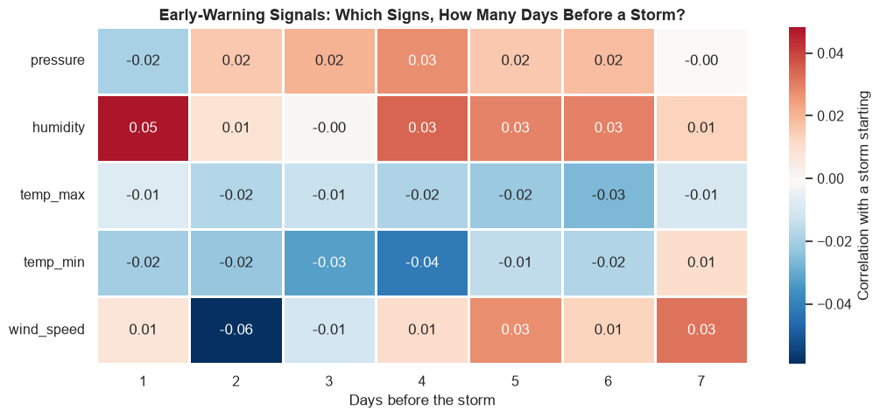
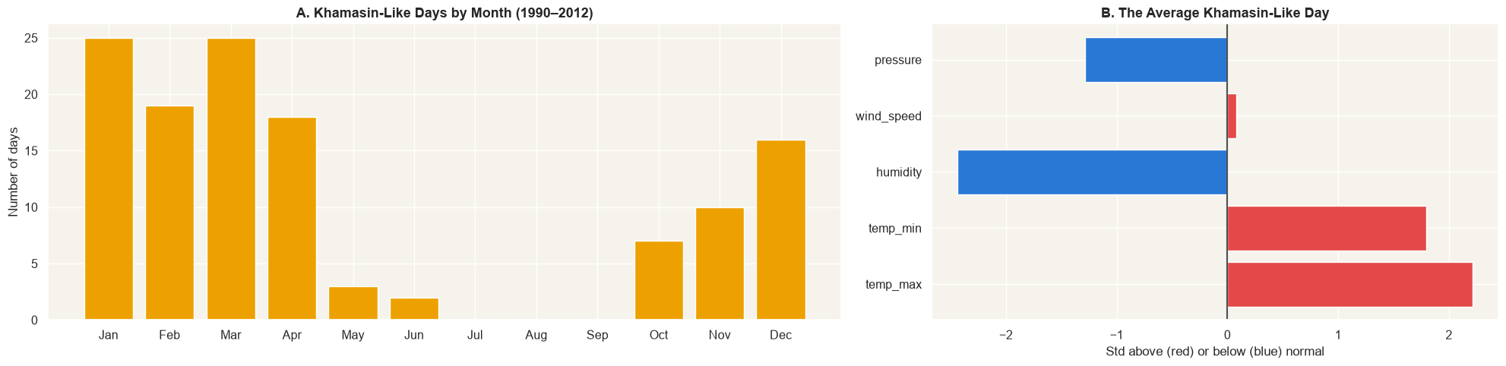
Storms give no early warning; Khamasin days can be detected
H5 + H6 · SIGNALS AND KHAMASIN
H5 · Signs before a storm? Partly.
H6 · Khamasin-like days? Yes.
Heat waves and cold snaps build up over days; storms don’t. All links with a storm starting are tiny (−0.06 to +0.05).
South wind, much hotter and much drier than normal: 125 days in 1990–2012, mostly December to April, with low pressure.
Fig. 12a · Correlation with a storm, 1–7 days before
Fig. 12b · A: Khamasin-like days by month · B: the average one
Limit: wind direction stops in 2012, so it can’t be a model feature.
Cairo weather forecasting · Esraa
Source: NASA POWER, 1990–2025 · 12 / 15
Notes:
The last two hypotheses. H5 asks whether storms have a signature in the days before them. I measured each sign as standard deviations from the normal for its date, and lined up every event as day zero. Heat waves and cold snaps build up over several days, so they do give a warning. Storms don’t: figure 12a shows the correlation between each sign, one to seven days before, and a storm starting, and every value is tiny, between minus 0.06 and plus 0.05. So H5 is partly true, and I expect the rain model to miss many storms. H6 asks whether Khamasin-like days can be detected. I defined them from the data, not officially: a south wind, max temperature at least 1.5 standard deviations above normal, and humidity at least 1.5 below. That finds 125 days between 1990 and 2012, mostly from December to April, a wider season than the usual March to May, and on average they are much hotter, much drier and lower in pressure. The limit is that wind direction stops in 2012, so this can’t be used as a feature.

Slide 13
Every finding becomes a modeling decision
FROM EDA TO MODEL
Slide | What we found | What we do
5, 9 | A strong, fixed yearly season | Day of year as sine and cosine
9 | Temperature returns to its level (ADF) | No differencing
10 | Only the last few days help | Lags 1–5; no lag 365
6 | Slow warming; test years are warmest | Watch for a cold bias on test
— | Spring is the most unstable season | Report errors by month
5, 11 | Humidity and pressure add information | Use them as inputs
8 | Rain is rare and changed in 2016 | Rain yes/no on 2016–2025, F1 and CSI
4, 12 | Wind direction stops in 2012 | Not used
11 | Extreme days are real weather | Keep them
Cairo weather forecasting · Esraa
Source: NASA POWER, 1990–2025 · 13 / 15
Notes:
This table is the bridge from the analysis to the model: every finding becomes one decision. The strong, fixed season becomes the day of year as sine and cosine. Because temperature always returns to its level, no differencing. Because only the last few days help, the inputs are lags one to five, and no one-year lag. Because the test years are the warmest, I will watch for a cold bias. Spring is the most unstable season, with the biggest day-to-day jumps, so I will report errors by month, not only as one number. Humidity and pressure, as differences from normal, are useful inputs. Rain is rare and its data changed in 2016, so rain is a yes or no task on 2016 to 2025 only, judged by F1 and CSI, not accuracy. Wind direction stops in 2012, so it is not used. And the outliers and extreme days are real weather, so they stay in the data.

Slide 14
The number to beat: 1.05 °C
BASELINES AND NEXT STEPS
Fig. 14 · Temperature tomorrow: MAE of simple baselines (°C, lower is better)
NEXT STEPS
Persistence (today)
1.07 · 1.04
1 · Data: same variables from Open-Meteo, so training and live data match
Mean of last 7 days
1.59 · 1.54
Climatology (date normal)
1.84 · 1.79
2 · Features: day of year (sin, cos), last 1–5 days, humidity, pressure
Same day last year
2.56 · 2.27
3 · Models: Ridge, gradient boosting, SARIMAX; logistic regression for rain
Validation 2020–22
Test 2023–25 (trained on 1990–2019)
4 · Validation: walk-forward, one year at a time; test used once
RAIN TOMORROW (2016–2025)
5 · Deploy only if a model clearly beats these baselines
“Always no rain”: 94–96 % accurate, yet 0 rain days caught, so accuracy is not used.
Persistence (rain today): F1 0.36 validation, 0.47 test.
Cairo weather forecasting · Esraa
Source: NASA POWER, 1990–2025 · 14 / 15
Notes:
Before training any model, I need to know what “good” means, so I scored simple forecasts that learn nothing. The data is split by time, never at random: train 1990 to 2019, validation 2020 to 2022, test 2023 to 2025, so a model never sees the future. Figure 14 shows the temperature baselines. The winner is persistence, tomorrow equals today, with a typical error of 1.07 degrees on validation and 1.04 on test, so about 1.05. It beats the 7-day mean, the normal for the date, and especially the same day last year. That is the number a model must beat. For rain, accuracy is misleading: always predicting no rain is 94 to 96 percent accurate but catches zero rain days. So I use hits, misses, F1 and CSI. Persistence again wins, with F1 0.36 on validation and 0.47 on test. Next, I will pull the same variables from Open-Meteo so training and live data come from one source, build the features we found, try Ridge, gradient boosting and SARIMAX for temperature and logistic regression for rain, validate walk-forward, and deploy only if a model clearly beats these baselines.

Slide 15
The calendar and yesterday carry most of the signal
CONCLUSION
WHAT WE LEARNED
LIMITATIONS
Season dominates: a ~19 °C swing; nights warm +0.41 °C per decade.
Model grid, not a station: ~50 × 50 km averages, so extremes look milder.
Short memory: only the last ~5 days help; temperature is stationary.
Rain is rare: 2.9 % of days, October to April, in groups.
Rain: only 2016–2025 is usable, and the test has just 43 rain days.
The 2016 rain jump is most likely a data change.
To beat: 1.05 °C MAE, and rain persistence (F1 0.47 on test).
Wind direction: valid for 1990–2012 only.
Thank you. Questions?
Cairo weather forecasting · Esraa
Source: NASA POWER, 1990–2025 · 15 / 15
Notes:
To wrap up. The calendar and yesterday carry most of the signal. The season dominates, with a 19-degree swing, and on top of it Cairo is slowly warming, nights faster than days. Temperature has a short memory: only the last five days or so help, and the series is stationary. Rain is rare, under 3 percent of days, falls from October to April and comes in groups. The 2016 jump in rain is most likely a change in the data, not in the weather. And any model has to beat 1.05 degrees for temperature and persistence for rain. Three limitations to keep in mind: this is model data on a 50-kilometre grid, not a station, so extremes look milder; rain is only usable from 2016, and the test period has just 43 rain days, so rain scores will be shaky; and wind direction is only valid until 2012. Thank you, I’m happy to take questions.

