Slide 1
Development Stages
of an LMS Adaptive Filter
on FPGA
[ Image Placeholder ]
Graduation Project · Digital IC · Beamforming · FPGA Algorithms

Slide 2
DESIGN GOALS
Design Goal & Performance Targets
Goal
Real-time 4-tap Standard LMS on Zynq-7020 FPGA for 61.44 MSPS USRP B210.
Algorithm Correctness
No pipeline-induced delay (D=0); preserves standard LMS w(n+1) = w(n) + μ·e·x.
Clock Target
≥ 200 MHz post-place-and-route (3× margin); stretch goal ≥ 450 MHz with DSP48E1 hard MAC.
Precision & Accumulator
Q1.15 fixed-point; 48-bit accumulator per tap; truncation error < 2⁻¹⁷; weights in distributed registers.
Interface
AXI4-Stream slave/master; pipe_en = m_axis_tready only; tlast propagated with 4-cycle latency; fully DMA-compatible.
Resources
2 DSP48E1 slices per tap (8 total for 4 taps); zero BRAM.
Saturation / Safety
Hard clamp ±32767 using signed overflow detection; no weight windup under any input.
Verification
WNS = 0 ns; bit-exact NumPy Q1.15 reference ±1 LSB over 10,000 samples; AXI backpressure deadlock-free.

Slide 3
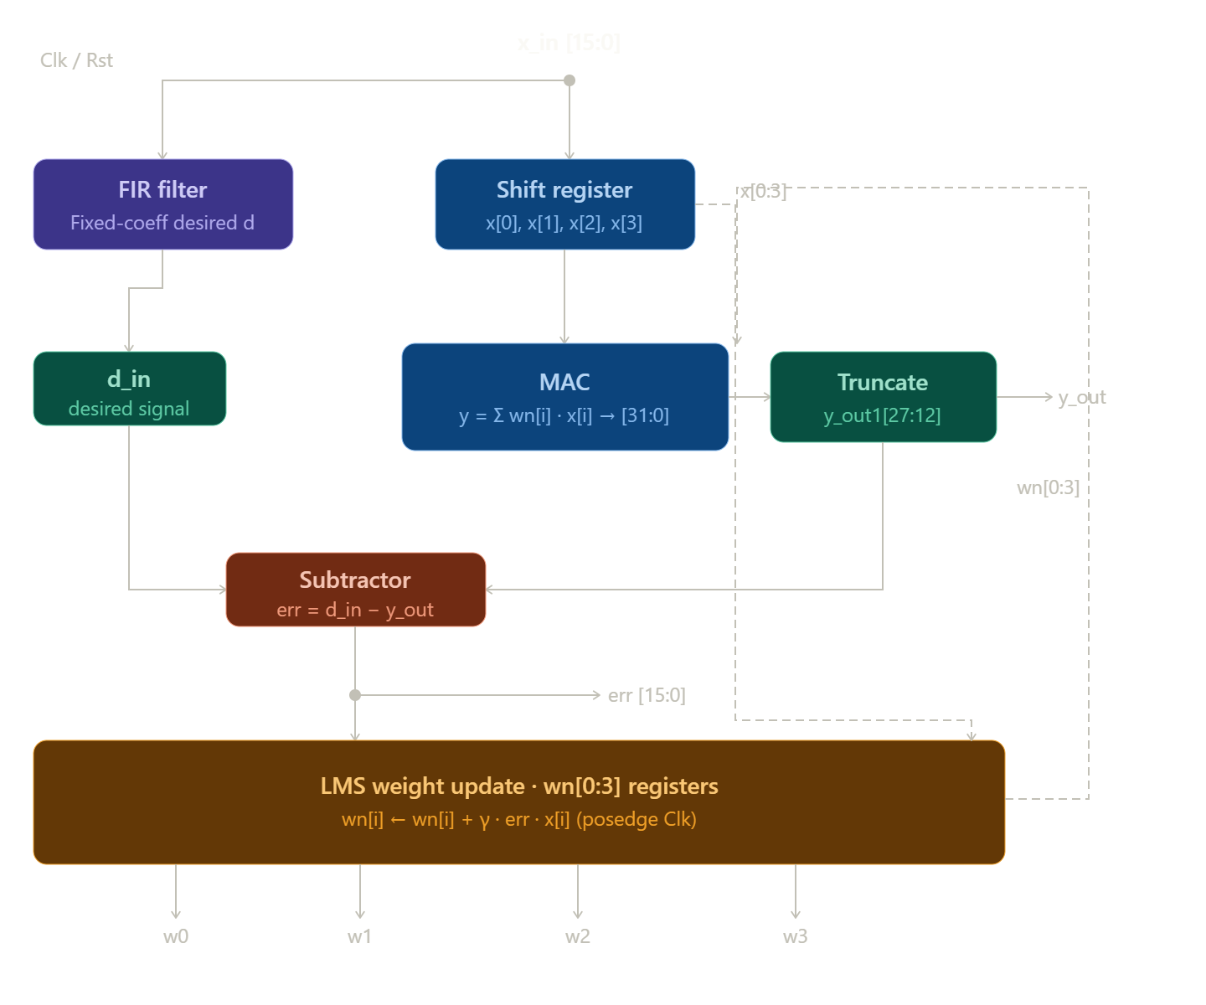
V0 — GITHUB BASELINE
Version 0
GitHub Baseline — LMS Adaptive Filter (V1)
Structure: 4-tap LMS with embedded FIR reference; single integrated module
Weight Update: Wn[i] updated combinationally each cycle (Wn[i] ≤ Wn[i] + γ·err·x[i])
Algorithm: Standard LMS, D = 0; correct error computation and 4-tap parallel update
Precision: Q4.12 fixed-point; truncation leads to quantization errors; 48-bit accumulator not used
Timing: Target Fmax ≥ 200 MHz; current design fails due to unregistered DSP chains
Interface: AXI4-stream missing; μ hardcoded; no back-pressure or runtime reconfigurable gamma
Resources: 2 DSP48 per tap, 0 BRAM; FIR reference embedded
Saturation: ±32767, no overflow detection; potential weight wrap-around
Verification: Bit-exact with NumPy simulation; reset behavior differs in hardware; Q4.12 vs Q1.15 mismatch

Slide 4
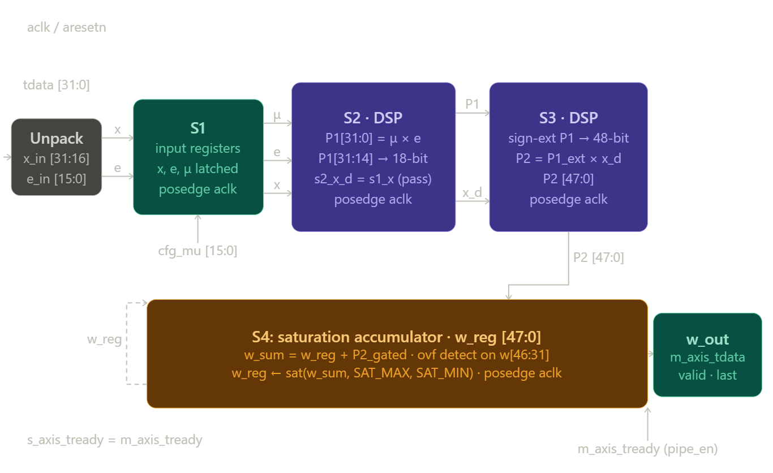
V2 — AXI REDESIGN
Version 2
LMS_EDITED_2.V (V2)
First architectural redesign: AXI-Stream, 4-stage pipeline, Q1.15 fixed-point
Decouples weight update from FIR; error (e_in) pre-computed externally
Timing closure achieved at 100 MHz; Stage 4 fabric addition limits ceiling (~130 MHz)
First hardware-viable rewrite of the GitHub baseline; fully pipelined 4-tap LMS with FIR reference
Six pipeline stages (P1, P2, P3, W1, W2, W3) to break the long combinational path
WNS improved from −20.485 ns → +4–5 ns at 100 MHz; timing closure achieved
Structure: 4-stage pipeline, AXI4-Stream, Q1.15 fixed-point
Weight Update: Error pre-computed externally; decoupled from FIR
Algorithm: Standard LMS, D = 0; w_reg feedback included in same cycle
Precision: Q1.15; 48-bit accumulator; truncation error < 2⁻¹⁷
Timing: Stage-per-multiply/add; WNS positive at 100 MHz; Fmax limited by Stage 4 (~130 MHz)
Interface: Full AXI4-Stream; μ runtime-configurable; back-pressure handled via pipe_en
Resources: 2 DSP48E1 per tap; 0 BRAM; distributed FFs hold state
Saturation: ±32767; two-operand overflow detection applied to accumulator
Verification: Bit-exact NumPy match; pipeline drains correctly; saturation assumptions may skip bits
Timing — Fmax ≥ 200 MHz
+ Each stage is a single registered multiply or adder (<10 ns); WNS positive at 100 MHz
– Stage 4 (48-bit w_sum + overflow detection + 3:1 mux) limits Fmax to ~130 MHz
Algorithm — Standard LMS, D = 0
+ Standard LMS implemented correctly; w_reg feedback combinationally included within same cycle
+ Error arrives pre-computed → decouples weight update from FIR
Precision — Q1.15, 48-bit accumulator, error < 2⁻¹⁷
+ Q1.15 format → higher fractional resolution than baseline Q4.12
+ 48-bit w_reg accumulator holds full-precision sum; truncation only on final output slice
+ Stage 2 truncation (P1[31:14] → 18 bits) error bounded < 2⁻¹⁷
[ V2 Architecture Diagram ]
[ V1 Pipeline Diagram ]

Slide 5
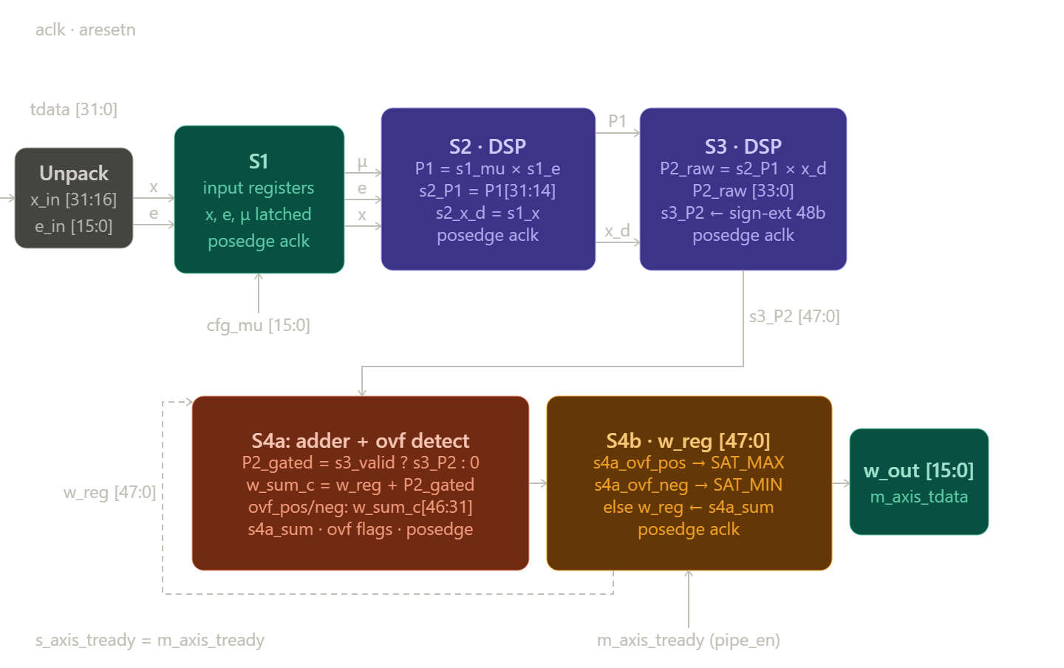
V3 — ULTRA-PIPELINED
TRIAL_4.V (V3) (cont.)
5-stage LMS pipeline; Stage 4 split (S4A/S4B) → reduced critical path
Standard LMS, D = 1 (delayed LMS due to pipeline)
Timing: Fmax ≈ 200 MHz; primary architectural goal met
Interface: AXI4-Stream; μ runtime-configurable; 5-cycle latency
Resources: 2 DSP48/tap; extra FFs for Stage 4 registers; 0 BRAM
Saturation: ±32767; temporary 1-cycle overshoot possible
Verification: Bit-exact NumPy match impossible due to D=1 delay

Slide 6
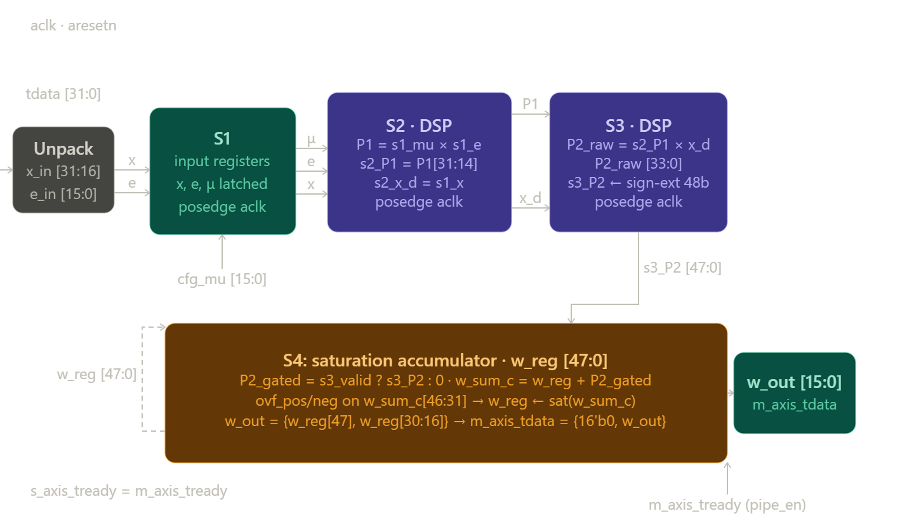
V4 — FINAL VERSION
Version 4
LMS.V (V4)
First architectural redesign: AXI-Stream, 4-stage pipeline, Q1.15 fixed-point
Decouples weight update from FIR; error (e_in) pre-computed externally
Timing closure achieved at 100 MHz; Stage 4 fabric addition limits ceiling (~130 MHz)
First hardware-viable rewrite of the GitHub baseline; fully pipelined 4-tap LMS with FIR reference
Six pipeline stages (P1, P2, P3, W1, W2, W3) to break the long combinational path
WNS improved from −20.485 ns → +4–5 ns at 100 MHz; timing closure achieved
Structure: 4-stage pipelined standard LMS (D = 0) with optimized Stage-3 multiply, AXI4-Stream interface, and preserved 48-bit accumulator.
Timing: Timing closes at 100 MHz with positive WNS; Stage-4 feedback path limits Fmax to ~150 MHz (below 200 MHz target).
Algorithm: Standard LMS fully restored; bubble cycles masked so weights remain correct.
Precision: Q1.15 fixed-point with 48-bit accumulator; truncation error < 2⁻¹⁷.
Interface: AXI4-Stream with runtime μ via AXI-Lite; fixed 4-cycle pipeline latency.
Resources: 2 DSP48E1 slices per tap; 0 BRAM; Stage-4 fabric still high (~156 LUTs/tap).
Saturation: Signed overflow detection preserves 48-bit accumulator; prevents windup.
Verification: Bit-exact to NumPy Q1.15 reference; deadlock-free; documentation of pipeline assumptions recommended.
[ V2 Architecture Diagram ]
[ V1 Pipeline Diagram ]

Slide 7
Comparison
Concept / Feature | Baseline | 4-Stage Pipeline | 5-Stage DLMS | Latest Optimized 4-Stage
Structure | 4-tap LMS + embedded FIR; single combinational module | 4-stage pipeline; FIR decoupled; AXI4-Stream | 5-stage ultra-pipelined; Stage-4 split | 4-stage pipeline; Stage-3 multiply optimized; AXI4-Stream
Algorithm | Standard LMS, D=0; 4 taps updated in parallel | Standard LMS, D=0; error pre-computed externally | Standard LMS, D=1 due to pipeline delay | Standard LMS, D=0; bubble cycles masked; algorithm restored
Precision | Q4.12; 16-bit weights; no 48-bit accumulator | Q1.15; 48-bit accumulator; truncation < 2⁻¹⁷ | Q1.15; 48-bit accumulator preserved; one-cycle delay | Q1.15; 48-bit accumulator; Stage-3 sign-extension optimization; truncation < 2⁻¹⁷
Timing / Fmax | ≈ 33 MHz; WNS negative; chained DSPs | ≈ 100–130 MHz; Stage-4 limits ceiling | ≈ 150–200 MHz; Stage-4/5 optimized | ≈ 150 MHz; Stage-4 feedback path limits Fmax; WNS positive
Interface | No AXI; γ hardcoded; no back-pressure | AXI4-Stream; μ runtime-configurable; 4-cycle latency | AXI4-Stream; μ configurable; 5-cycle latency; pipe_en prevents DMA deadlock | AXI4-Stream; μ runtime via AXI-Lite; 4-cycle latency; pipe_en prevents DMA deadlock
Resources | 2 DSP48/tap; 0 BRAM; FIR embedded | 2 DSP48/tap; 0 BRAM; distributed FFs | 2 DSP48/tap; extra FFs for Stage-4/5 registers; 0 BRAM | 2 DSP48/tap; Stage-4 LUTs high (~156 LUTs/tap); 0 BRAM; Stage-3 optimized saves FFs
Saturation | ±32767; no overflow detection | ±32767; overflow detection applied | ±32767; 1-cycle overshoot possible | ±32767; signed overflow detection; prevents internal windup
Verification | Bit-exact to NumPy; reset/Q mismatch | Bit-exact NumPy; pipeline drains correctly | Bit-exact limited for D=1; pipeline verified | Bit-exact to NumPy Q1.15; deadlock-free; assumptions on pipeline should be documented

Slide 8
Thank You
[ Image ]
[ Image ]

