Slide 1
Heart Disease

Slide 2
Team members :-
Esraa Mohamed Abd El-Ghany
Link to my dataset :- https://www.kaggle.com/datasets/johnsmith88/heart-disease-dataset

Slide 3
Introduction:-
Heart disease is one of the most prominent and dangerous diseases that threaten public health around the world, often leading to heart attacks and strokes. More recently, the amount of heart disease patients has been increasing significantly owing. There is therefore a need to ensure an effective and scalable solution to effectively find and prevent the heart disease within a short and very specific timeline.

Slide 4
1- Describe your dataset in details
(number of attributes, number of records)
- Consists of 14 Attrbuites, and 1025 records of dataset of heart diseases prediction consists of:-
( Age,Sex,chestpaintype,cholesterol, ExerciseAngine, FastingBS, Ca, ,MaxHR, Oldpeak, RestingBP, RestingECG, ST_Slope, target(heart_disease_not), thal (blood disorder))
Attribute Information:
1: Age :
"Age of patient."
2:Sex:
"Gender of patient."

Slide 5
3:ChestPainType :
"Chest pain appears in many forms, ranging from a sharp stab to a dull ache. Sometimes chest pain feels crushing or burning. In certain cases, the pain travels up the neck, into the jaw, and then spreads to the back or down one or both arms"and has 4 values:-
Value 1: typical angina:-
substernal chest pain precipitated by physical exertion or emotional stress and relieved with rest or nitroglycerin. Women and elderly patients are usually have atypical symptoms both at rest and during stress, often in the setting of nonobstructive coronary artery disease (CAD).

Slide 6
Value 2: atypical angina:-
When one experiences chest pain that doesn't meet the criteria for angina, it's known as atypical chest pain. Angina chest pain is a pressure or squeezing like sensation that is usually caused when your heart muscle doesn't get an adequate supply of oxygenated blood.
Value 3: non-anginal pain:-
Non-cardiac chest pain is the term that is used to describe pain in the chest that is not caused by heart disease or a heart attack. In most people, non-cardiac chest pain is related to a problem with the esophagus, such as gastroesophageal reflux disease.
Value 4: asymptomatic:-
Asymptomatic means neither causing nor exhibiting symptoms of disease. Symptomatic means a physical indication (rash, pain, discomfort etc.) of disease or disorder. For example, red spots are symptomatic of measles and chest pain is symptomatic of a heart attack (myocardial infarction).

Slide 7
4- Trestbps:-
The person's resting blood pressure when admitted to hospital (in mmHg).
5- Cholesterol :-
A person's cholesterol is measured in mg/dL.
6- FastingBS:-
The person's fasting blood sugar (glycemic index >120 in mg/dl 1 = true; 0 = false).
7-RestingECG:-
Resting ECG results

Slide 8
Value 0:
probable or confirmed left ventricular hypertrophy according to Estes' criteria .
Value 1:
Normal
Value 2:
ST-wave abnormality (T-wave inversion and/or ST elevation or depression >0.05 mV) .
8- Max_Heart_rate:-
The maximum heart rate for a person
9- Angine_EX:-
exercise-induced angina (1 = yes; 0 = no)

Slide 9
10- oldpeak:-
Resting exercise-induced ST regression relates to "ST" locations on the ECG.
11- slope_ST:-
Straight tilt for the ST portion of the peak exercise .
Value 0:
Upsloping
Value 1:
flat.
Value 2:
downsloping slope.

Slide 10
12 - Ca:-
The number of blood vessels (0:3)
13- thal:-
a blood disorder called thalassemia
Value 0:
NULL (dropped from the dataset earlier)
Value 1:
Fixed abnormality (no blood flow in a part of the heart)
Value 2:
normal blood flow
Value 3:
reversible defect (blood flow is noted but not normal)

Slide 11
14- target :-
Whether or not there is heart disease is the target variable we want to predict.
Value 0:
healthy heart.
Value 1:
Presence of heart disease

Slide 12
2- Some of the changes that occurred in open refine:-
Some column names have changed to clarify what the acronym refers to
Such as:-
chol -> cholester
Cp -> chest_pain_type
fbs -> fasting BS
(2) The translation of the data is as large as possible to make it clear to anyone who sees it .
Such as:-
Sex
1 -> male
0 -> female

Slide 13
3- T-tests in R:-
T-tests in R is one of the most common tests in statistics. So, we use it to determine whether the means of two groups are equal to each other.
The null hypothesis is that the two means are equal, and the alternative is that they are not equal.
**We use t.test() which provides a variety of T-tests:
The types of t test :-
(1)One-Sample
(2) Paired Sample
(3) Independent Samples

Slide 14
(1)One-Sample:
In R, we use the syntax t.test(y, mu = 0) to conduct one-sample tests in R, where
y: is the name of our variable of interest and
mu: mu, which is described by the null hypothesis is set equal to the mean.

Slide 15
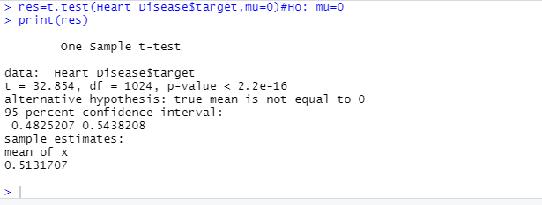

Slide 16
(2)Paired Sample:
We need either of the two vectors of data, y1 and y2, to conduct a paired-samples test. Then, we will run this code using this using syntax
t.test(y1, y2, paired=TRUE).
(3) Independent Samples:-
The independent-samples test can take one of three forms, depending on the structure of your data and the equality of their variances.
The general form of the test is t.test(y1,
Independent-samples T-test where y1 and y2 are numeric
y2, paired=FALSE).

Slide 17
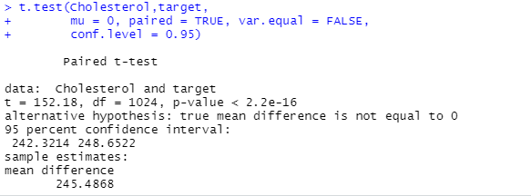

Slide 18
4-Data visualization:-
is the technique used to deliver insights in data using visual cues such as graphs, charts, maps, and many others. This is useful as it helps in intuitive and easy understanding of the large quantities of data and thereby make better decisions regarding it.
Types of Data visualization:
(1) Bar Charts.
(2) Scatter plots.
(3)Histograms.
(4)Pie Charts.
(5)Boxplots

Slide 19
There are 3 types of blood vessels:
1- Arteries
2- capillaries
3- veins
There is an inverse relationship between the number of blood vessels and
the incidence of heart disease.
(The lower the number of blood vessels, the greater the risk of heart disease) .

Slide 20
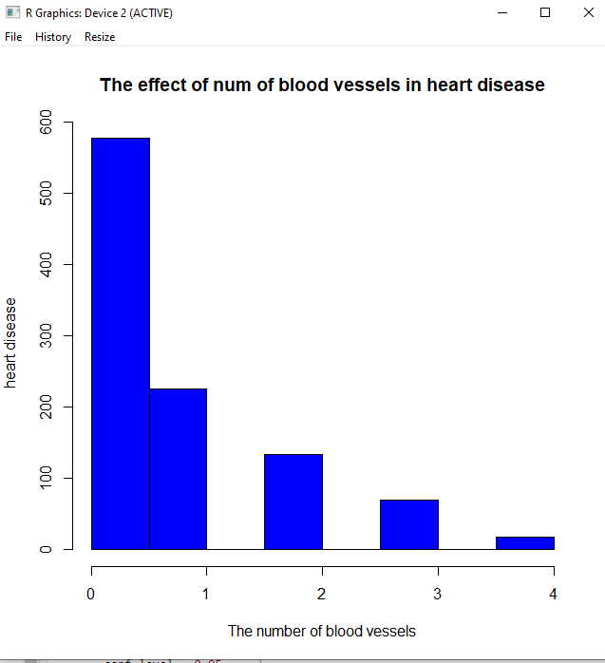

Slide 21
There is a direct relationship between age and the incidence of heart disease
(The greater the age, the greater the incidence of heart disease)

Slide 22
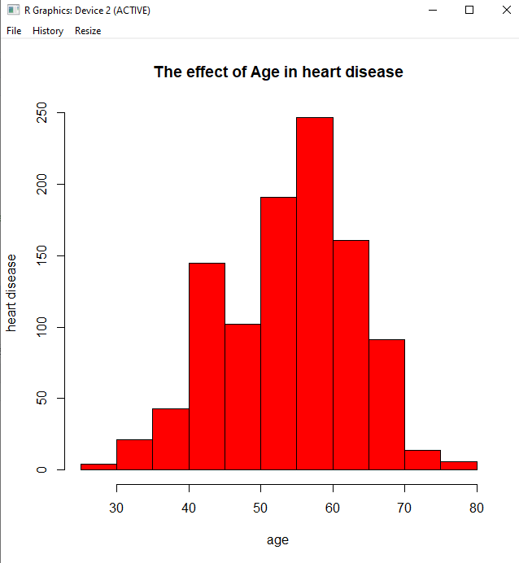

Slide 23
The incidence of heart disease in males is higher than that of women
**barplot
** pie

Slide 24
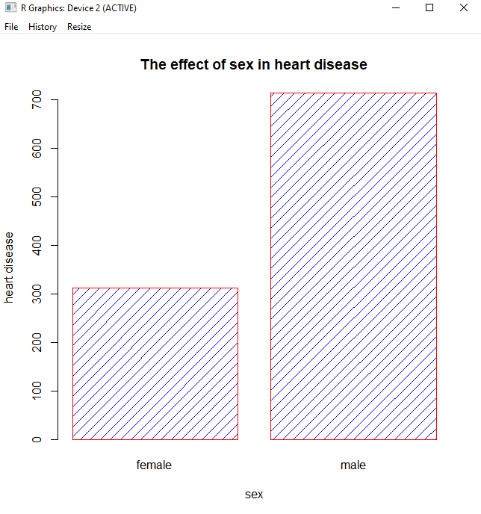

Slide 25
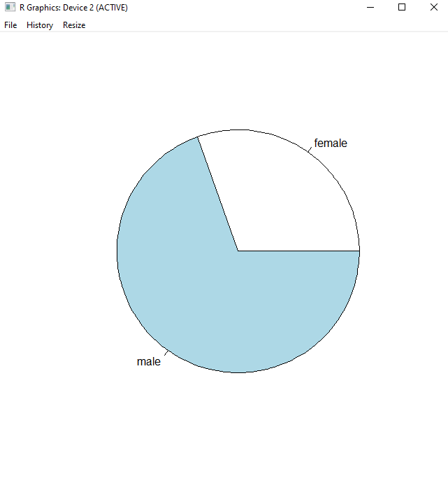

Slide 26
ChestPainType's division by pie charts

Slide 27
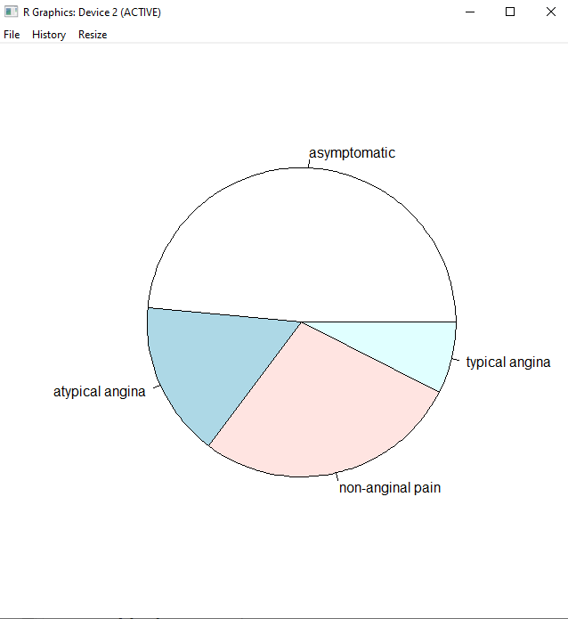

Slide 28
5-
(1)My own ontology or use existing one using Protégé

Slide 29
(2) Annotate My data using Right Field

Slide 30

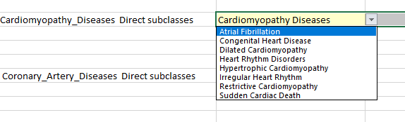

Slide 31

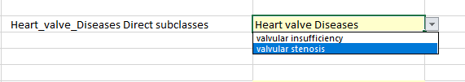

Slide 32
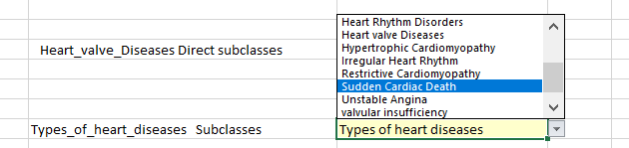

Slide 33
THANK YOU

