Slide 1
Gender Detection from IRIS images
Presented by: Fatma Mohamed, Iriny Adel,
Esraa Sayed , Ahmed Mahdy
Presented to : Eng. Laila Abbas

Slide 2
Agenda:
1- Segmentation
2- CNN

Slide 3
Segmentation
Methods:
1-Daugman
2-Hough Transform

Slide 4
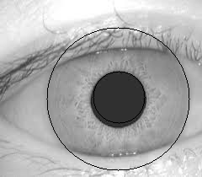
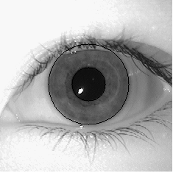
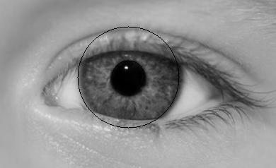
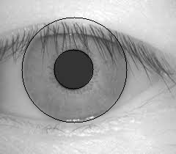
1-Daugman
Right segmentation trials:
One of the codes we tried worked very well on CASIA dataset.

Slide 5
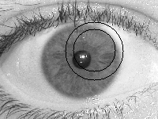
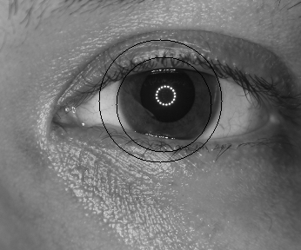
Wrong Segmentation:
Unfortunately the same code did not work with other samples (including our dataset)
The github link for the used code:
https://github.com/mvjq/IrisRecognition

Slide 6
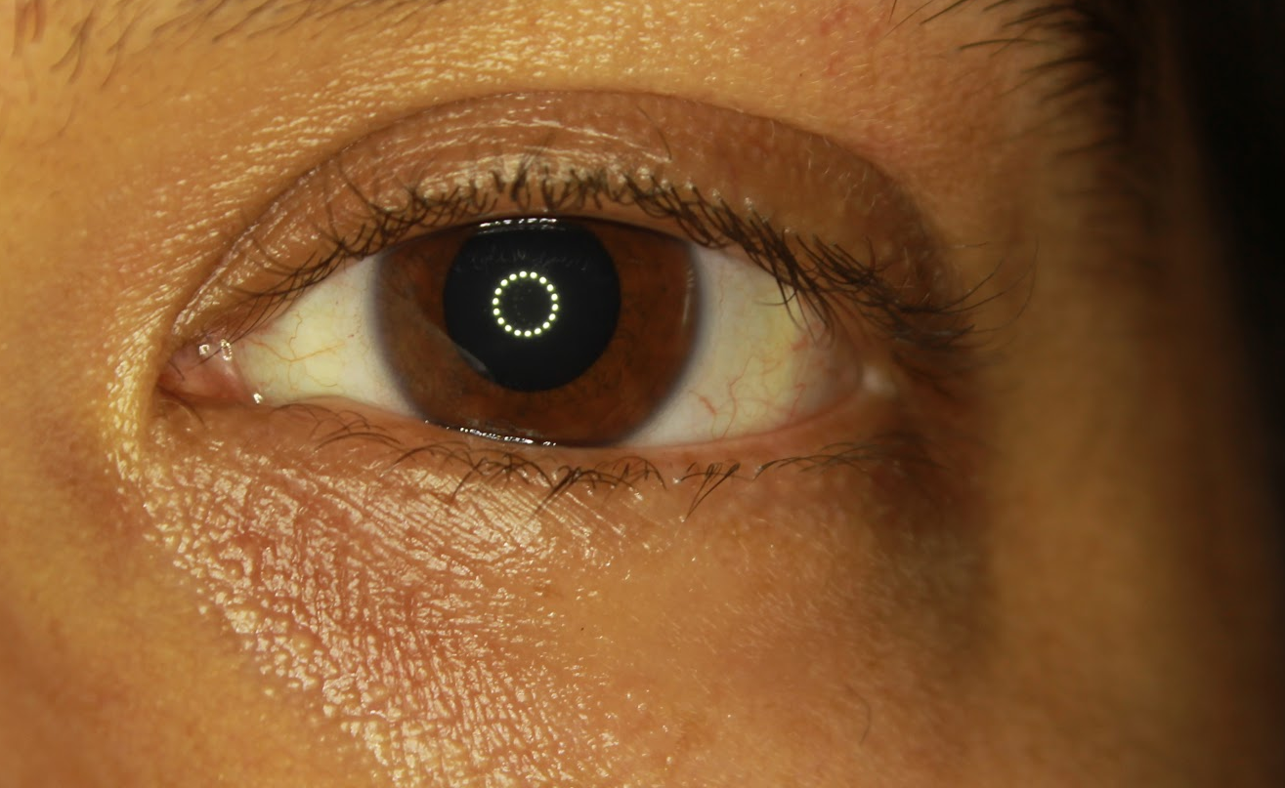
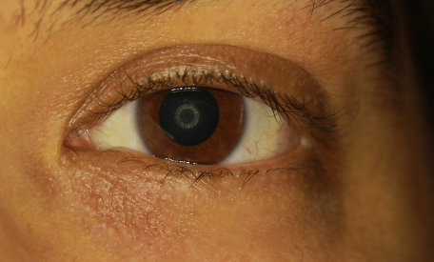
Removing Light Reflections:
Creating a mask , and using cv2.inpaint
Converting RGB to HSV and working on V component

Slide 7
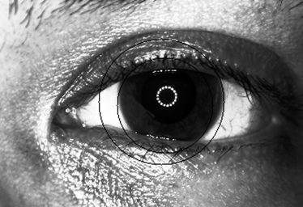
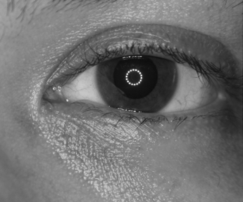
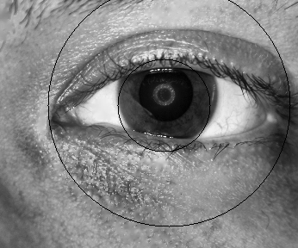
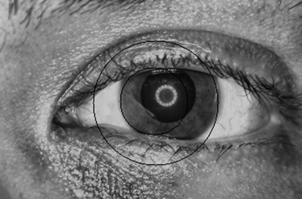
Histogram Equalization (for contrast enhancement):
Histogram Equalization
Clahe
Original Image

Slide 8
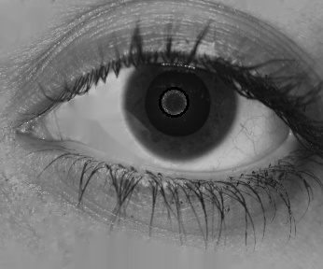
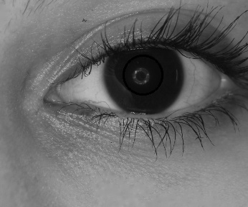
2- Hough Transform:
Hough transform proved partial success in pupil detection.

Slide 9
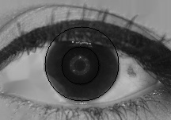
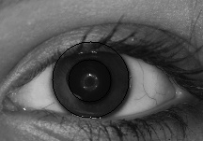
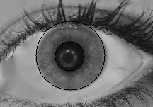
Right Segmentation on CVBL dataset
We tried to change some parameters to detect the iris and there are some success Iris-pupil segmentations.

Slide 10
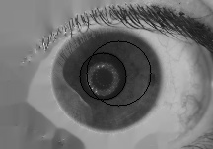
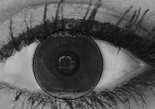
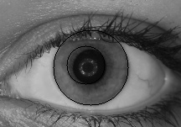
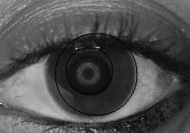
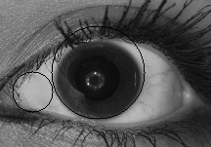
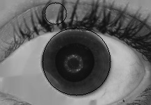
Wrong Segmentation on the same data set
There were also too many false circles were drawn.

Slide 11
Future work on Segmentation problem
So We are planning for further trials by changing some parameters like the min and max radius of the iris, and removing the eyelashes and eyelids.
we hope this helps in improving the segmentation.
The link for the circular hough transform code used:
https://stackoverflow.com/questions/39167828/eye-pupil-tracking-using-hough-circle-transform

Slide 12
Gender Classification from IRIS images
using CNN
1- Data preprocessing:
we categorize the data to Male and Female, then separate each folder to left and right.
Appling CLAHE to enhance images contrast (left data only).
Data splitting (70% train _ 15% validation _15% test)

Slide 13
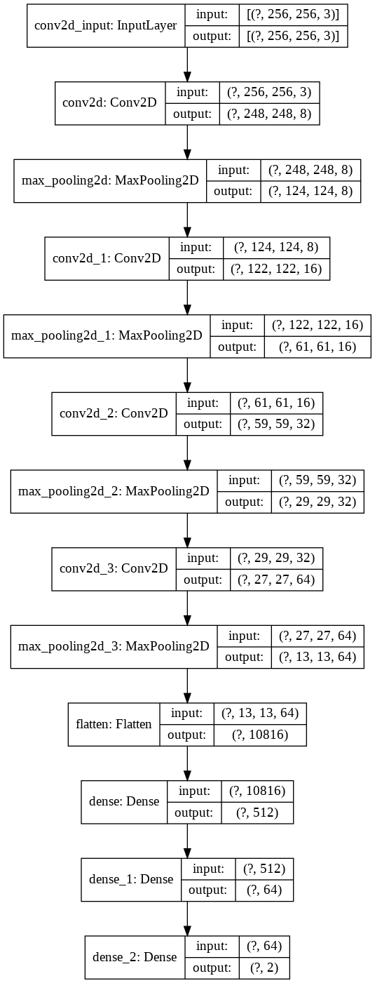
Gender Classification from IRIS images
using CNN
2- Convolutional Neural Network
We built our CNN model from scratch as a First trail!
Model structure as shown.
Results:
Model_accuracy: 0.97 %
Test_accuracy: 0.93 %

Slide 14
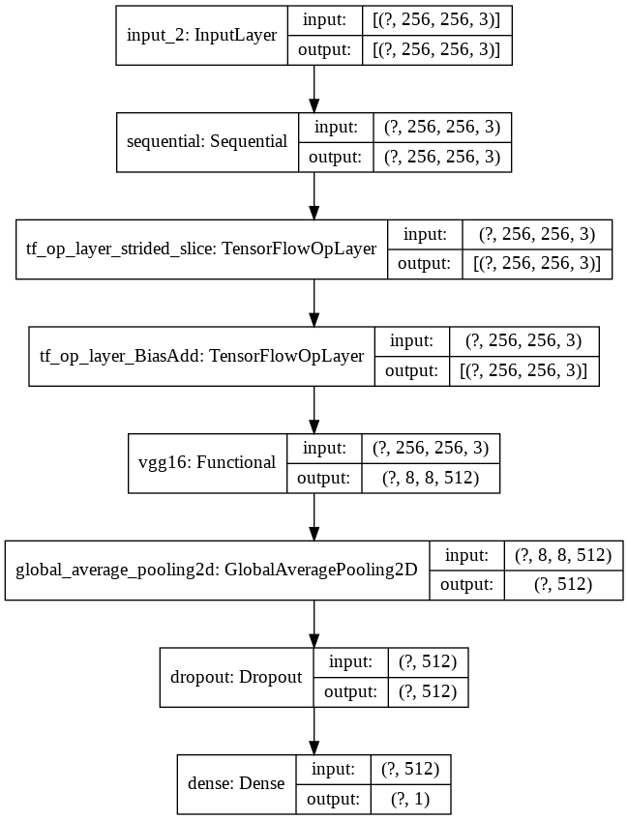
Gender Classification from IRIS images
using CNN
3- CNN model using Transfer Learning
VGG16 Model ( pre-trained on ImageNet dataset)
Data augmentation (random rotation)
Model Structure
Results:
Initial: 80%
After fine tuning: 96%
Test: 95%

Slide 15
References
https://github.com/mvjq/IrisRecognition
https://stackoverflow.com/questions/39167828/eye-pupil-tracking-using-hough-circle-transform
https://github.com/xs2315/iris_recognition
https://gist.github.com/esmitt/61edc8ed6ccbc7a7e857074299449990?fbclid=IwAR2Hdi4mQUGiV0x8uid2uZQYrdN12bZS7ON-4EJ6t8jFwI4v1-WWLkT50j0
https://github.com/mzmmoazam/irisSeg/blob/master/irisSeg/DaugmanSegementation.py
VGG16 based CNN model (Google Drive)
VGG16 based CNN model (Github)

