Slide 1
Gender Classification from IRIS images
Presented by:
Fatma Mohamed Esraa Sayed Iriny Adel Ahmed Mahdy
Presented to :
Eng. Laila Abbas

Slide 2
Problem statement
Biometric identification
Gender prediction from iris
The most accurate biometric identification system
Iris of the two eyes of same individual aren’t comparative

Slide 3
Usage
Identifying a person’s gender from an iris images is related to:
forensics applications
security surveillance systems
Reduces the fake identity of the peoples

Slide 4
History
Research and studies on gender recognition and classification using iris images were first introduced by Thomas in 2007
They examined 5000 left-eye irises
Their method relies mainly on iris segmentation algorithm proposed by Daugman
They choose 7 geometric features from iris images
They used a random tree classification
achieved 80% accuracy
Using only left eye images limits the applicability of their database

Slide 5
Two years later, Hollingworth proved that in the iris images that are segmented by Daugman method
their pixels contain different amount of information
Tapia found that some extracted bands include further information for gender recognition than others
the mutual information technique
resulted in 89% of accuracy

Slide 6
Some other methods uses statistical and spectral features extracted by the wavelet transform
Apply support vector machine for iris recognition
resulted in 83.3% of accuracy
remarkable increase in the processing time
Some methods suggest the use of local binary pattern (LBP) for gender recognition
found great improvement in the gender recognition
resulted in 91% accuracy

Slide 7
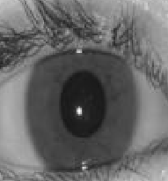
Block diagram of gender prediction
Image acquisition
Pre-processing
Image segmentation
Gender prediction
Classifier
Feature extraction
IRIS normalization

Slide 8
Literature Review
1- Gender Prediction from Iris Recognition using Artificial Neural Network (ANN)
This paper works in predicting the gender using the eye image data.
the image is normalized then the prediction can be done by using ANN.

Slide 9
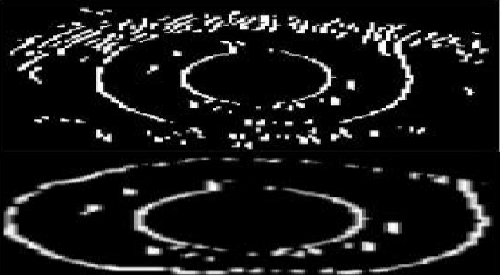
Techniques used:
1- Image acquisition :
IT Delhi data set
2- Preprocessing:
Keras
3- Image segmentation :
Canny edge detection
Circular Hough transform
Thresholding the output

Slide 10
4- Normalization of image :
Daugman’s Rubber sheet model
transform the iris image into its polar equivalent
5- feature extraction :
Artificial Neural Network implementations
6- ANN and SVM classifier :
Backpropagation algorithm
differentiable activation function

Slide 11
In the testing phase
NN Input is the normalized eye image
Transform image to grayscale and then to binary
the features are extracted.
Apply algorithm
Make gender prediction

Slide 12
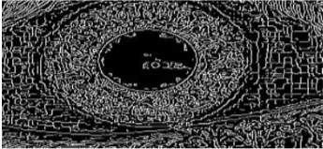
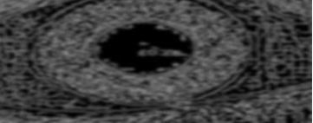
Results:
Applying Canny edge detection
followed by Gaussian blurring to remove noises

Slide 13
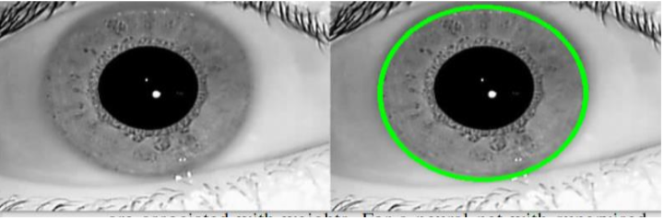
Apply Circular Hough transform is applied
on the Gaussian blurred image
to detect the area of limbic boundary.

Slide 14
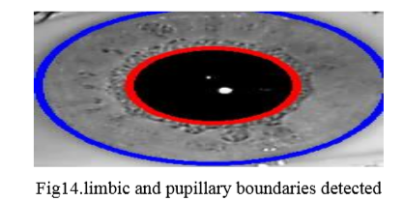
To get the pupillary region alone:
a function is defined to return the rows and columns of the black region (pupil).
Thus it’s easy to find the radius and center of the pupillary boundary from the returned rows and columns.
Using these centers and radius obtained,
the limbic and pupillary boundaries are drawn on the cropped iris image

Slide 15
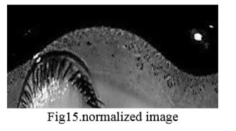
The width of the iris region can be obtained by subtracting the pupillary radius from the limbic radius.
Daughman’s Rubber Sheet model was applied to eye image to get a normalized image.
Then Features are extracted after converting normalized images to gray, and then to binary.

Slide 16
Thus the feature includes
x and y coordinates of the centroid,
area of the region,
the bounding box values (x, y, w (width), h (height)).
From the features calculated, it is noted that:
the area and bounding box calculated from the normalized images of females are smaller than the values obtained from the normalized images of males.

Slide 17
2- Gender Classiﬁcation from Iris Texture Images Using a New Set of Binary Statistical Image Features.
This paper explores the use of a Binary Statistical Features (BSIF) algorithm for classifying gender from iris texture images captured with NIR sensors.
It uses the same pipeline for iris recognition systems consisting of iris segmentation, normalization and then classification.

Slide 18
Techniques used
The input image is segmented in a pre-process step.
The iris region is then transformed to a polar space and codified using BSIF.
Finally, gender classification is performed using a new database and several classifiers
BSIF filters compute the convolution with each normalized masked image.

Slide 19
The problem of this technique is:
BSIF is not straightforward
BSIF can be sensitive to image boundaries and the occlusion mask creating artificial texture which may mislead gender classification results.
The iris is segmented and occlusions are masked
In order to overcome this limitation:
a new set of filters was trained from eye images
different sized filters with padding bands were tested on a subject-disjoint database.
A Modified-BSIF (MBSIF) method was implemented.

Slide 20
Results
This Method achieved better gender classification
results accuracy of 94.6% % for the left eye,
91.33% for right eye .

Slide 21
3- Deep Gender Classiﬁcation and Visualization of Near-Infra-Red Periocular-Iris images
In this paper they discuss automatic pixels feature extraction
Techniques used
1. Bottleneck approach
pre-trained model on a large dataset as a feature extractor.
VGG-16, VGG-19 and Resnet-50 architectures,
They extract the best features along the network
then classify gender using a small dense neural network
2. Fine-tuning
initializing a CNN with pre-trained parameters (weights) instead of random parameters
then perform a small update of the weights which are training of the model but with a new dataset

Slide 22
Convolutional Neural Network (CNN) trained from scratch:
small number of images using the Data Augmentation technique
reached the best classification rate and automatically found the most relevant areas for this task.
Training a model from scratch performed better than using a pre-trained powerful model
Results:
accuracy of 85.48% for gender classification.

Slide 23
4- CVBL IRIS Gender Classification Database Image Processing and Biometric Research, Computer Vision and Biometric Laboratory (CVBL)
It proposes a new method based on Zernike moment-based feature extraction which extract the feature from texture spectral features called SP_ZR.
Techniques used :
Daugman algorithm is used for iris segmentation
extract the Zernike moment
Produce feature vectors
proving the training and testing samples for SVM and KNN classifiers.

Slide 24
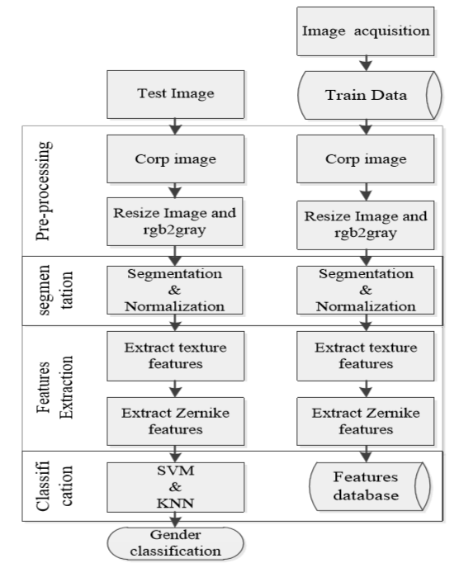
Block diagram for the proposed method

Slide 25
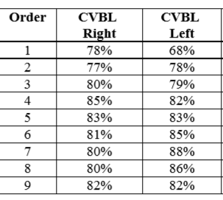
Results
Identification rate of the proposed method in the right and left eyes in 1 to 9TH order moment with KNN classifier

Slide 26
the proposed method performs better on the CVBL_IRIS
The computation time increases as the order of Zernike moment is increased

Slide 27
Database
CVBL_IRIS Gender Classification Database

Slide 28
Database description
The database consists of iris images taken from 720 subjects
including 370 females
350 males in university students
All 4320 images from this database were taken under the same condition and by the same color camera
The age range of the sample population
from 18 to 50 years old
the majority of the population were selected from students with 18 to 25 years old

Slide 29
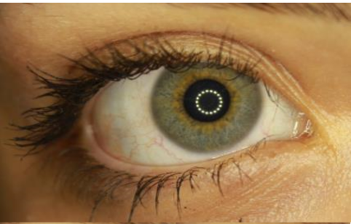
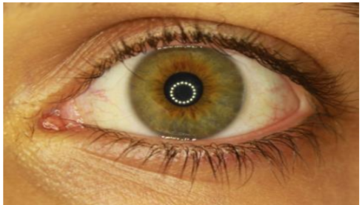
Samples of Database
A left eye iris image taken from a female subject
A right eye iris image taken from a male subject

Slide 30
Thanks

