Slide 1





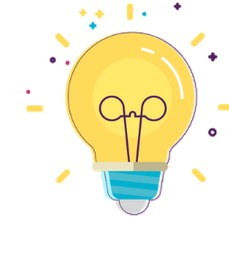

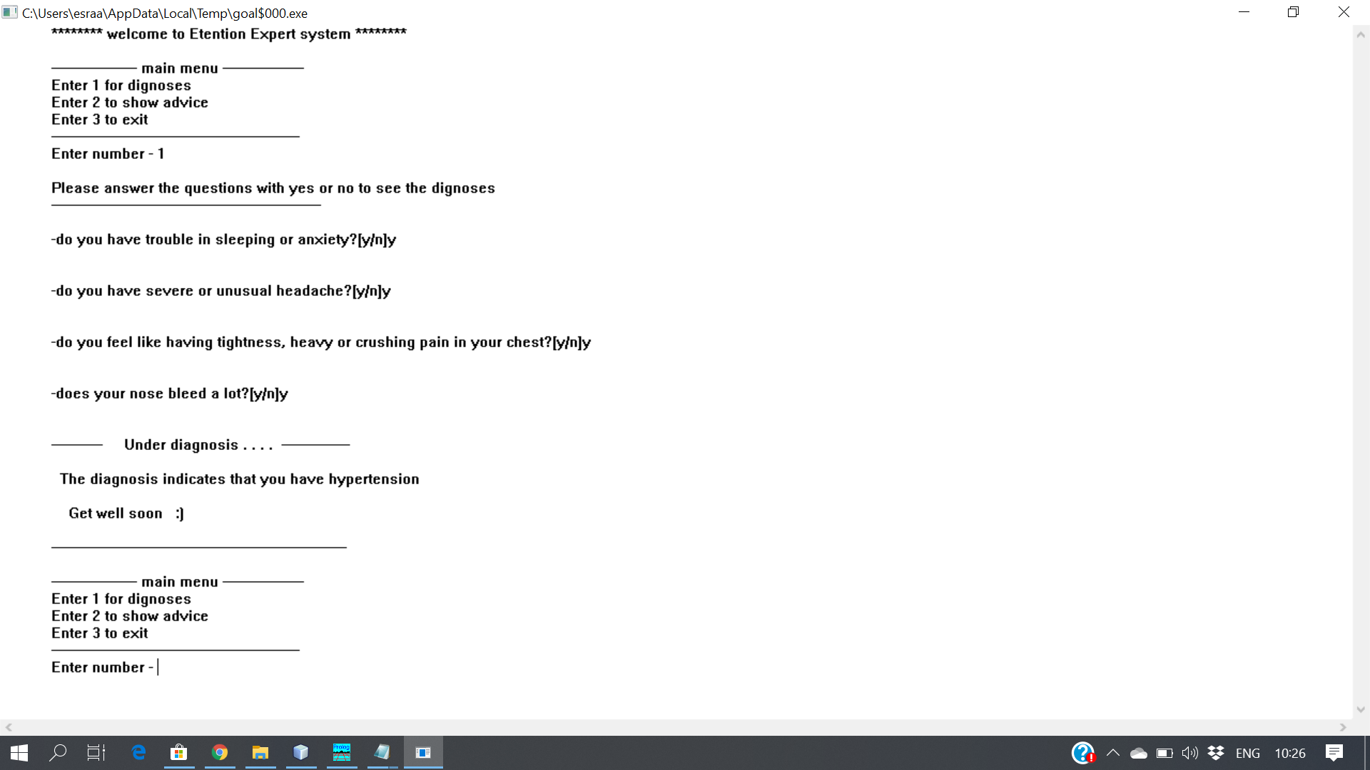
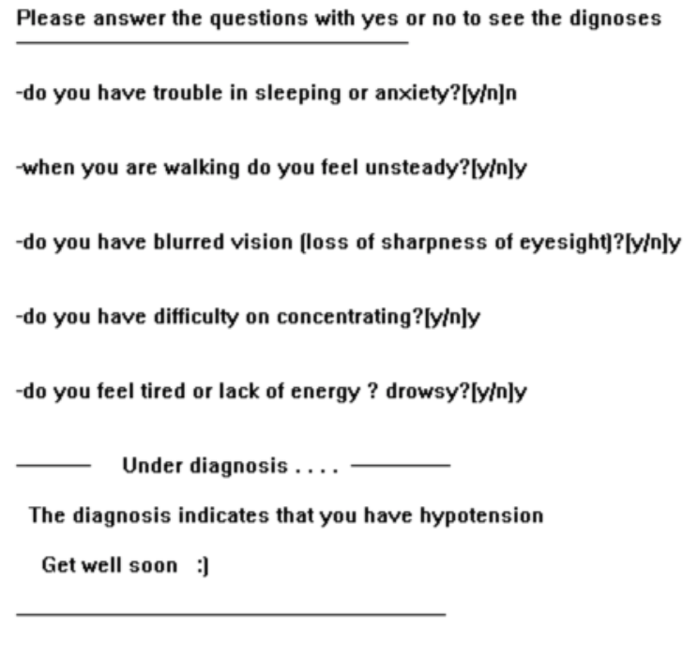
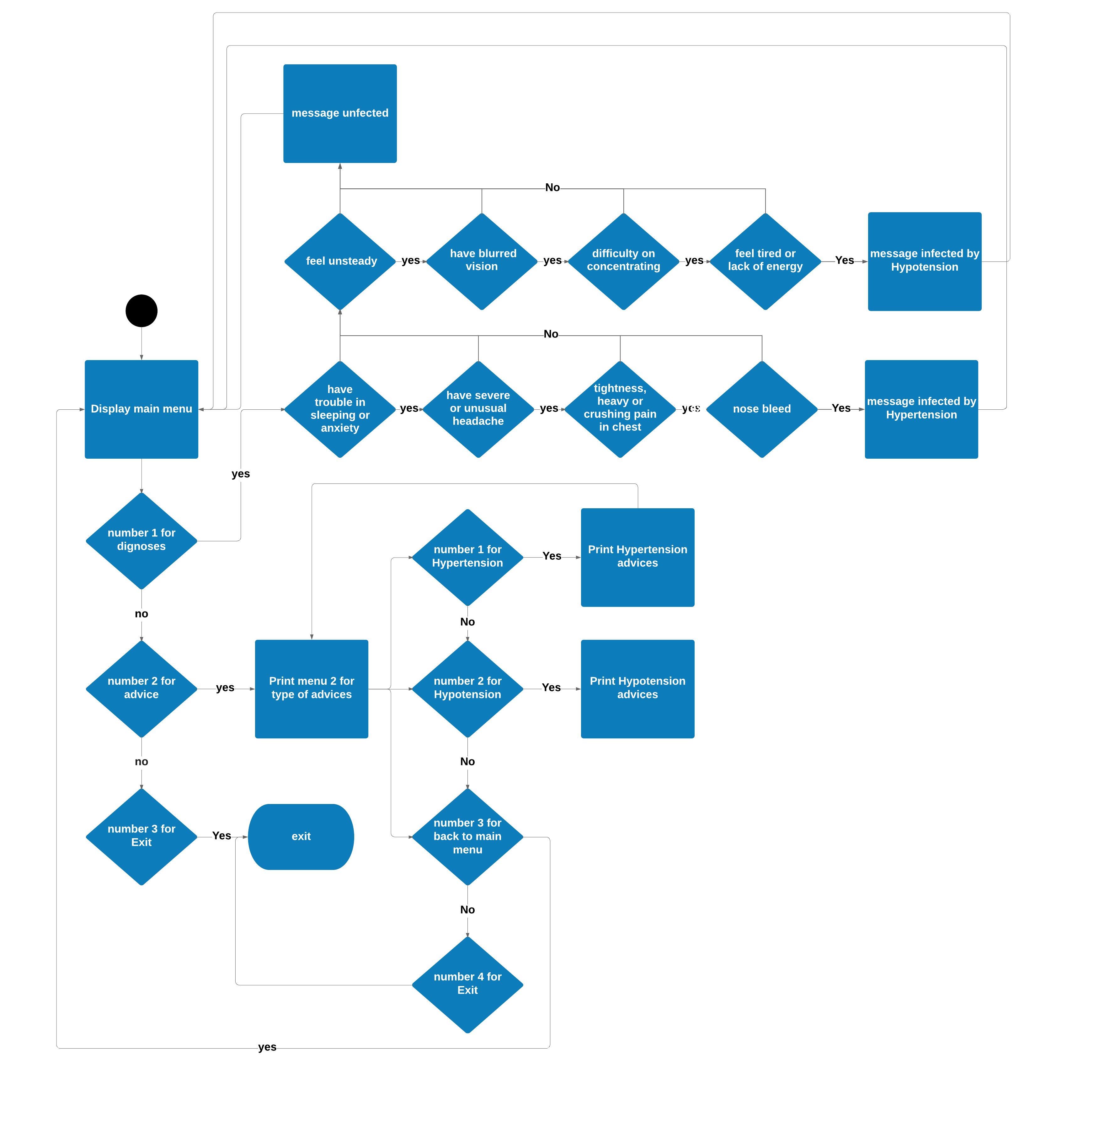
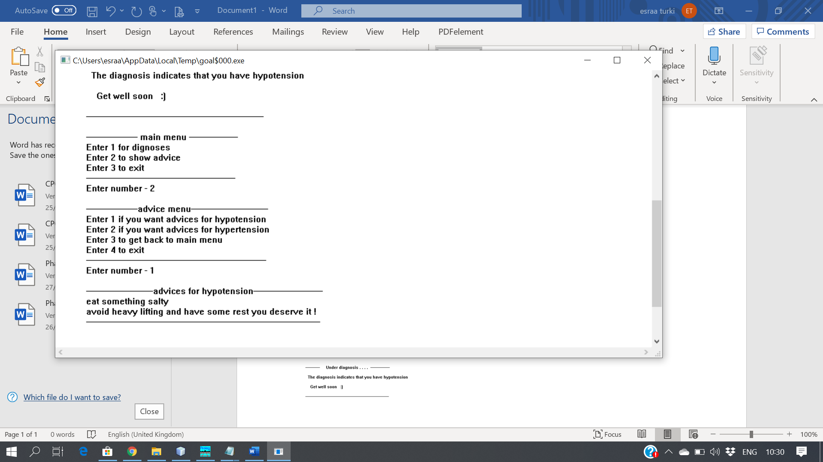
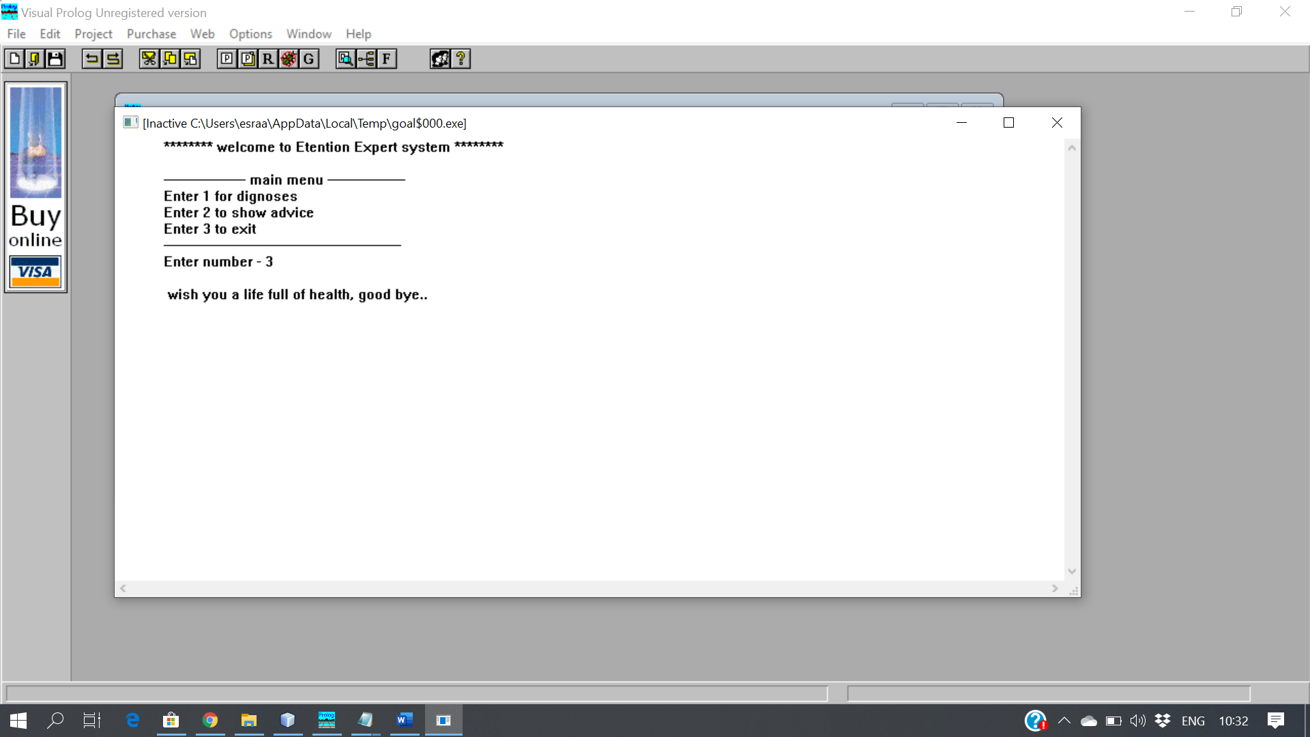




Authors:
Waad AlShanbari, Wed Al-Attas, Esraa Zuhair
Etention
CPCS331 Artiftial Intaligent
Instructor: Dr.nahid Alowidi
Introduction A Huge figure of expert systems is medical. The information obtained from medical expert system is similar to the information
given by proficient in that particular area
Clients of the system
the patients
Goal
The main aim of our medical expert system is to diagnose and give advice about the hypertension
And hypotension
Goal
The main aim of our medical expert system is to diagnose and give advice about the hypertension
Implementation
flowchart
Rules
-Disease(symbol): represent KB information
-Ask(symbol, symbol): questions and answer parameter
-ans(symbol,symbol): determine the disease
-infected(symbol) : if yes -displays all next predicates
Else skip all next predicates
Rules
Disease(symbol)
Ask(symbol, symbol)
ans(symbol,)
infected(symbolsymbol)
references
- https://www.mayoclinic.org
- https://www.healthline.com
- https://www.medscape.com
references
- https://www.mayoclinic.org
https://www.healthline.com

