Slide 1

Titanic Survival Prediction
Esra Eryılmaz
171044046

Slide 2
Problem Definition
The problem is create a model that predicts which passengers survived the Titanic shipwreck with using ​data mining algorithms.
I implement Logistic Regression classification algorithm on Titanic dataset and evaluate performance with other models using the sklearn library.

Slide 3
Dataset : Titanic Dataset
The data has been split into two groups:
training set (train.csv)
test set (test.csv)
The training set used to build my model.
The test set used to see how well my model performs on unseen data. For each passenger in the test set, I used the model I trained to predict whether or not they survived the sinking of the Titanic.

Slide 4
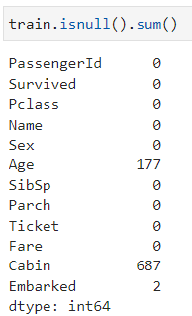
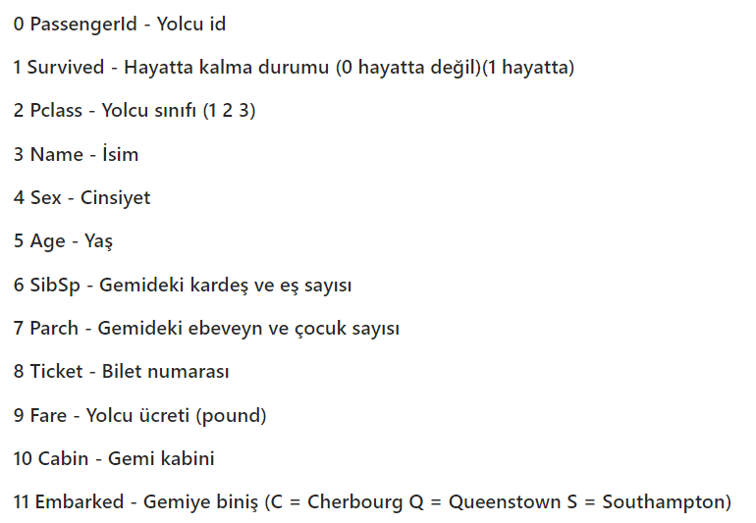
Analyze the dataset
Three attributes (Age, Cabin, Embarked) has null values and I did preprocessing on that attirubutes.

Slide 5
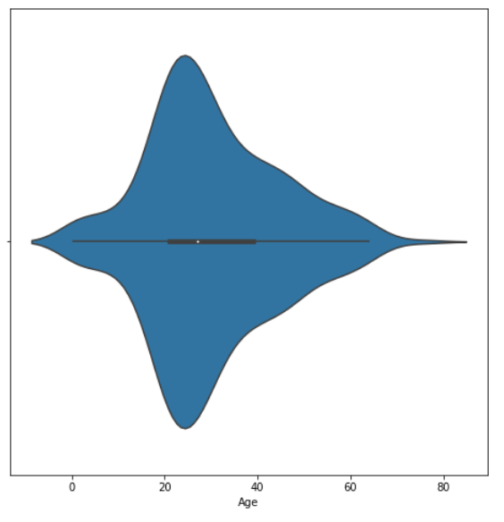
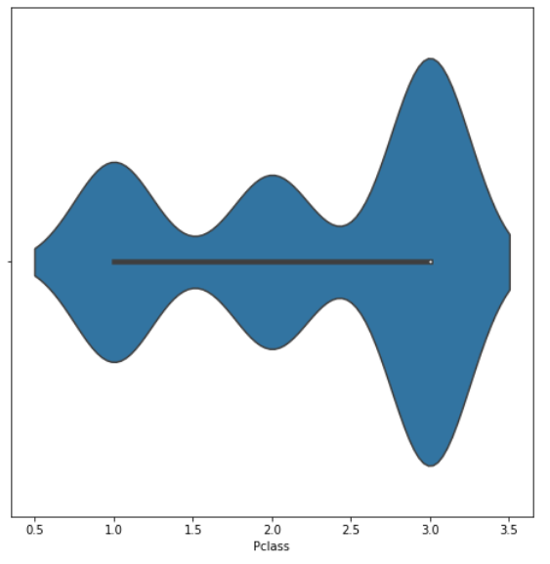
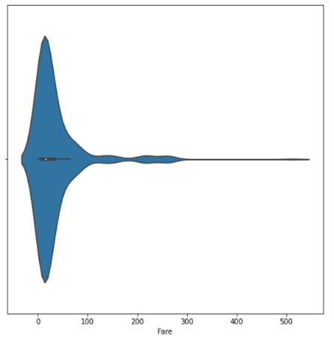
Passengers by Age – Pclass - Fare

Slide 6
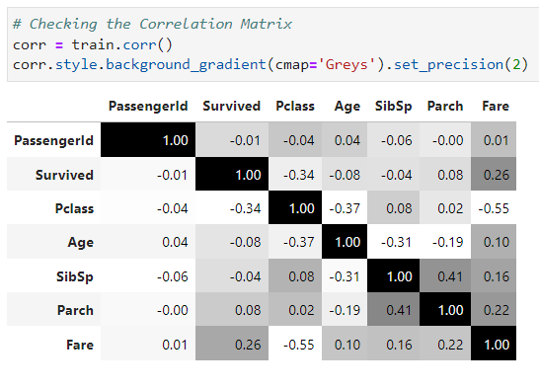
Correlation Matrix

Slide 7
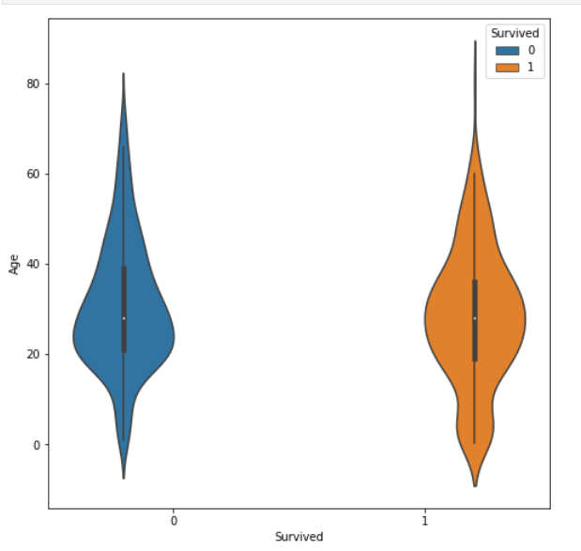
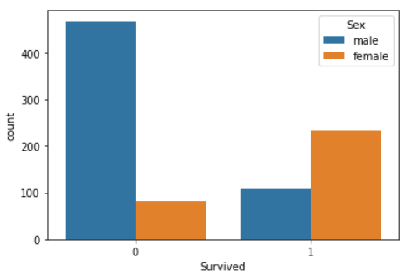
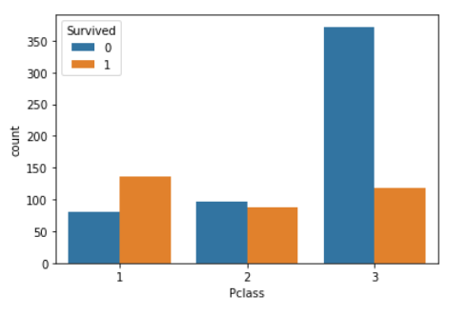
Checking how many people survived according to Age - Sex - Pclass

Slide 8
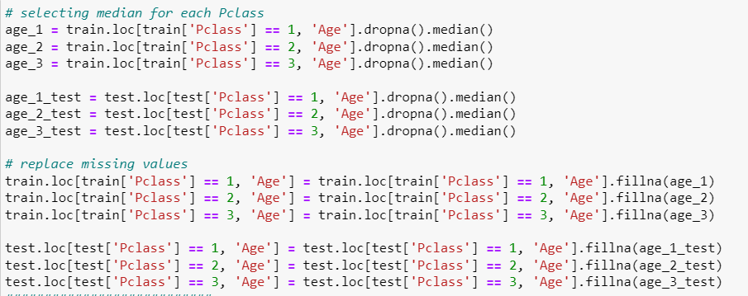

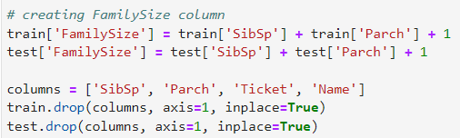
Data Preprocessing
Data cleaning for missing data
- Age
- Cabin has 687 missing values (75% of dataset).
- Embarked
- Fare
Feature Selection
- SibSp and Parch can be combined, I create a new "FamilySize" column.
- Ticket column likely doesn't have any correlation to survival. If there is, that relationship is already captured by Fare and PClass. I drop Ticket column.
- Drop Name column, with the same reason as Ticket.
- I used one-hot encoding to make "Embarked" values into categorical values. {'C', 'Q', 'S’}
- I used one-hot encoding to make "Sex" values into categorical values. {"male" : 0, "female" : 1}

Slide 9
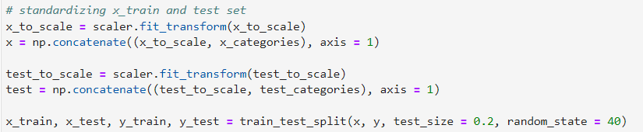
Data Preprocessing
Feature Normalization
- Data Normalization (MinMaxScaler() function does)
- Split x_train, x_test, y_train, y_test
(from sklearn.model_selection import train_test_split)

Slide 10
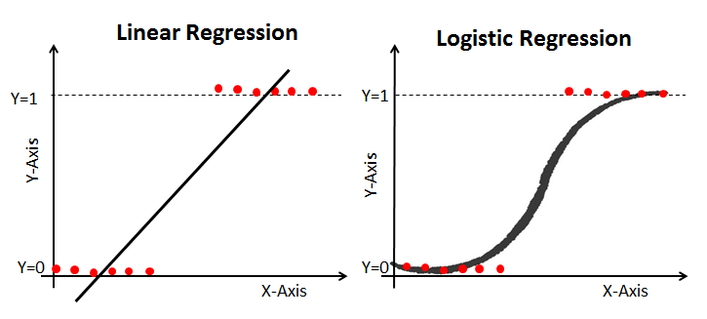
Logistic Regression Classification implementation
What is logistic regression ?
A logistic regression model is a classification model that predicts the probability of an outcome or an event. It does so by fitting the data (independent variables) to the logistic function. As an example, logistic regression can be used to predict the probability of a patient having heart disease, given the patient's age, sex, cholesterol level, blood pressure, and so on.
The logistic function is defined by a sigmoid function, which takes any real number input and output value between 0 and 1. Large positive values will output 1, and negative numbers will output 0.

Slide 11
Logistic regression includes following functions:
(These functions mostly consists of a mathematical expressions)
Sigmoid function = Logistic Regression function
Cost function
Gradient descent function. This function returns the best parameters that minimizes our cost function. To minimize my cost, I used Gradient Descent just like in Linear Regression implementation.
Predict function for predicting Survival. When our sigmoid function outputs a value more than or equal to 0.5, it will output 1 for "Survive", and if the value is less than 0.5, it will output "0" for did not survive.

Slide 12
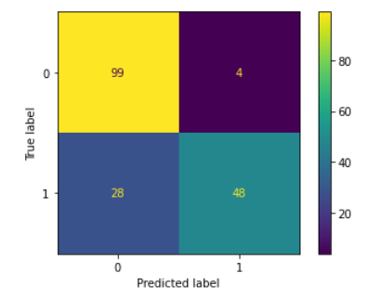
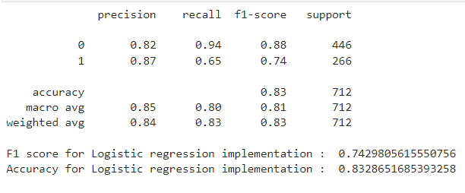

My implementation results :

Slide 13
Other Models (from sklearn library)
Logistic Regression
KNN (K-Nearest Neighbors)
SVM (Support Vector Machines)
Naive Bayes classifier
Decision Tree
Random Forest
Perceptron
AdaBoost

Slide 14
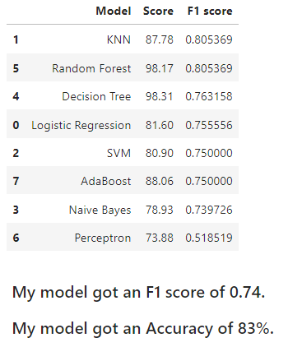
Evaluate results

Slide 15


