Slide 1

CS492 DEMO AND PRESENTATION
Supervisor:
Selim Aksoy
Instructors:
Erhan Dolak
Tağmaç Topal
Team Members:
Doğa Ece Ersoy - 21902487
Doruk Kantarcıoğlu - 21902319
Emre Erdal - 21901597
Esra Genç - 21901962
Kerem Erdal - 21901596
Group:
T2330

Slide 2
Problem Definition
Travimize revolutionizes holiday planning by optimizing travel itineraries based on user preferences.
By combining cutting-edge algorithms with real-time data, it provides users with personalized recommendations for destinations and accommodations, all in one convenient platform.
Travimize differs from all of the existing applications, including TripAdvisor, TripIt and Inspirock, as none of them tries to achieve creating the most optimized travel plan according to the users’ preferences.

Slide 3
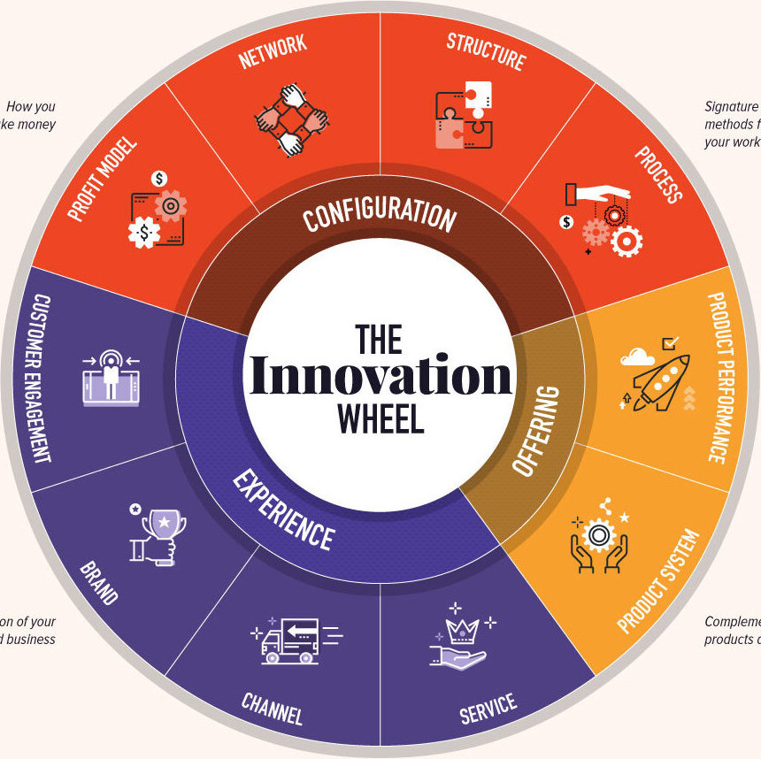
Type of Innovation
With its focus on customer satisfaction and continuous improvement through user feedback, Travimize represents a service innovation that simplifies and enhances the travel planning experience.

Slide 4
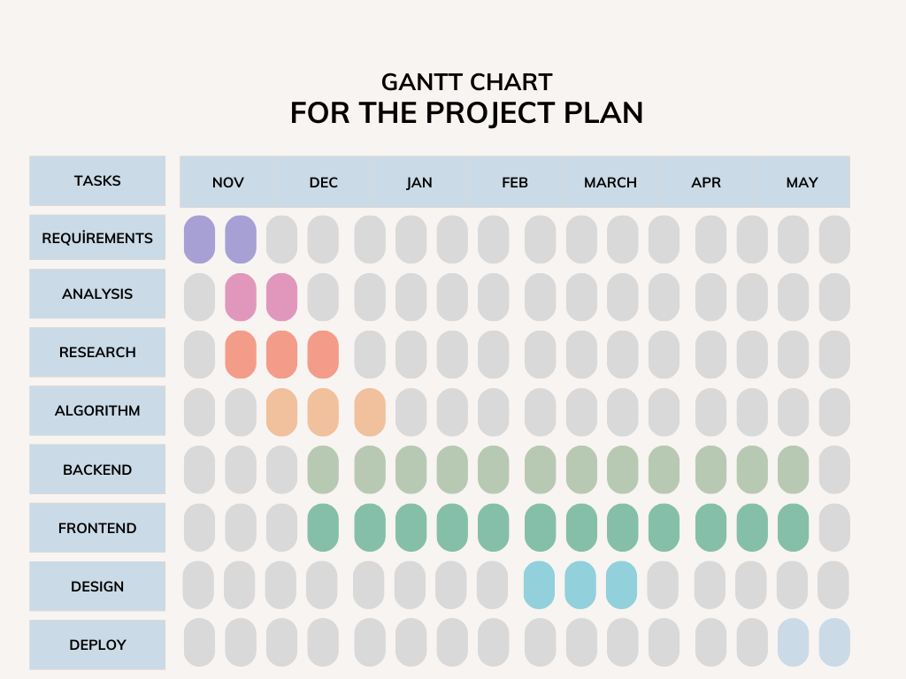

Slide 5
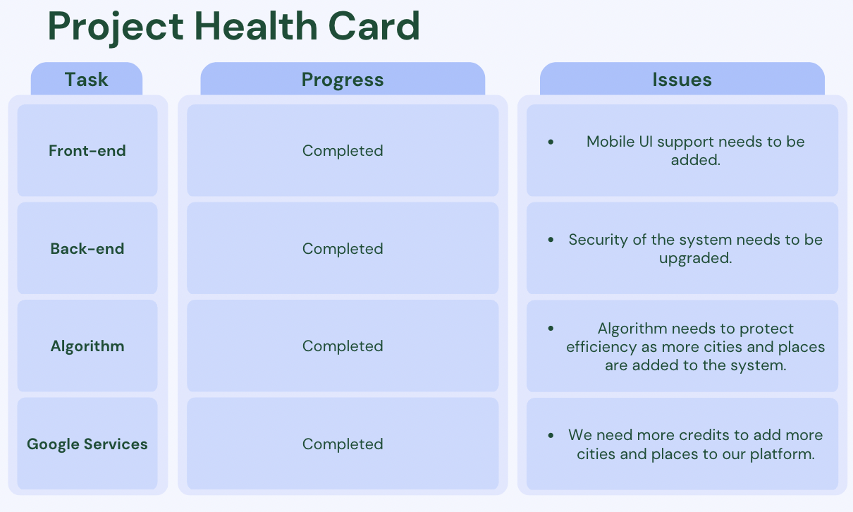

Slide 6
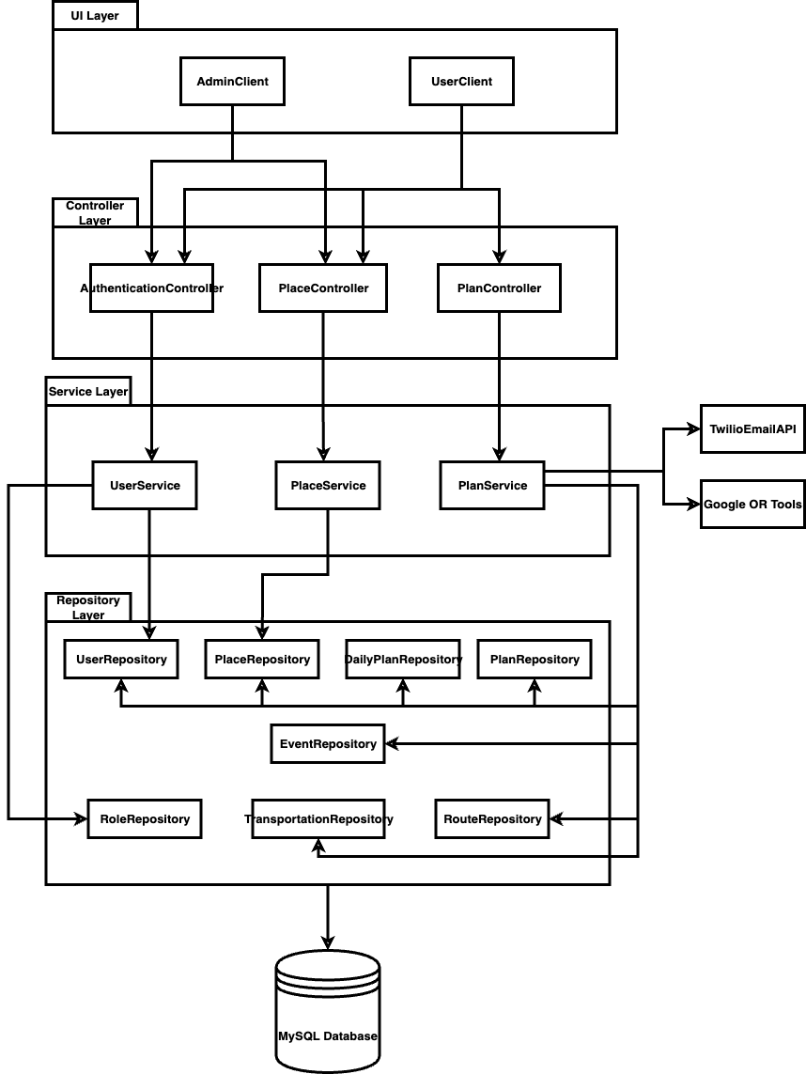
Subsystem Decomposition

Slide 7
DEMO

