Slide 1
Exploration of Worldwide Safety in Relation to Terrorist Attacks
Ali OMAROV
Esra GÜCÜKBEL
Evgenia SLIVKO

Slide 2
Context
User
Terrorist attacks have massive economic and psycological effect on wide range of population. Terrorist attacks should be analyzed in order to prevent them in future.
The analytic experts who works on international relations in Think tanks
Task
Data
Give useful information about terrorist attacks to the users in order to help them to conduct research and prepare analytics to support decision-making by politicians who shape counter-terrorism policies.
Managed by the National Consortium for the Study of Terrorism and Responses to Terrorism (START),
Includes more than 200,000 terrorist attacks dating back to 1970

Slide 3
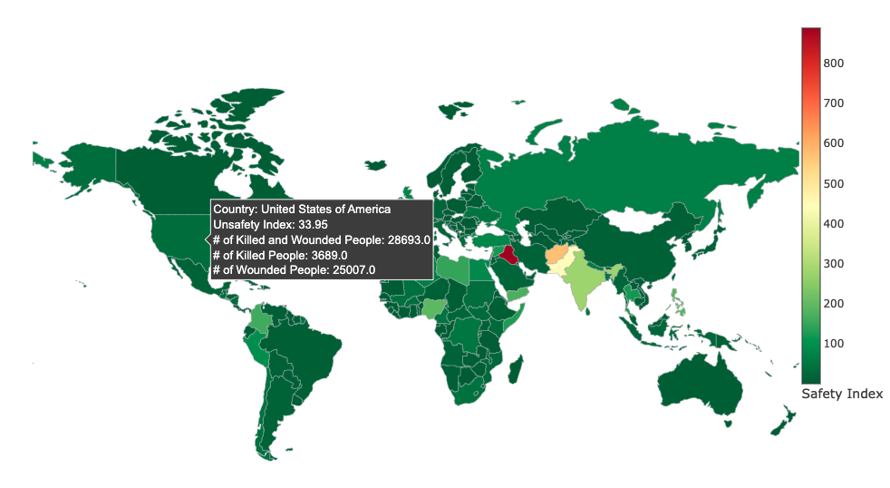

Slide 4
Concept with Design Rationales
Visualization → Design decision ↓ | Safety Map
Representation | Safety index is represented for each country on world map with suitable colors.
Use of timeline | No timeline, since the map should represent current situation based on safety index that reflects safety situation over time period (more recent years have larger weight)
Colors | Green - for safer countries and red - for more dangerous due to perception and associations with traffic lights (green = sage, red = dangerous)
Functionality | Opportunity to have the summary for the country (number of accidents, number of killed and injured people) by mousing over the country Opportunity to choose country to see at more detailed information

Slide 5
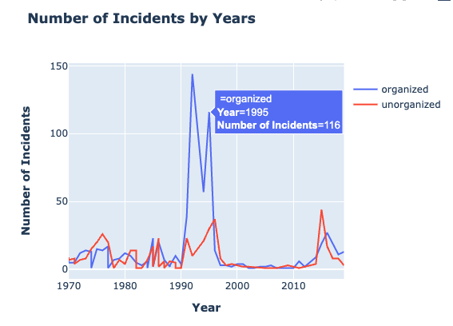

Slide 6
Concept with Design Rationales
Visualization → Design decision ↓ | Graph organized/non organized attacks by year for selected country
Representation | Line chart with two colors for selected country from the safety map. By this way the change in the numbers can be presented on yearly basis.
Use of timeline | Timeline is available for this chart, because the graph consists of its own yearly view(x-axis).
Colors | Blue is used for organized, red is used for non-organized attacks.
Functionality | When the user select country from the map, this graph will be shown. The numbers of organized and non organized attacks are shown with tooltip.

Slide 7
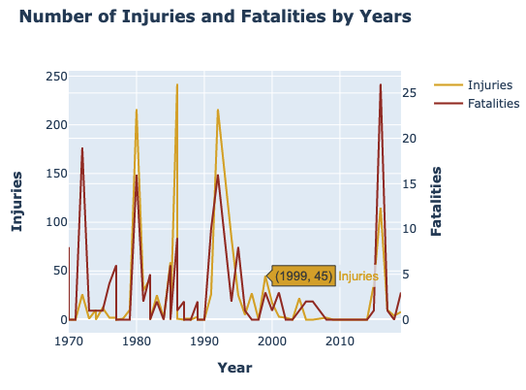

Slide 8
Concept with Design Rationales
Visualization → Design decision ↓ | Graph fatalities/injured by year for selected country
Representation | In order to show the changes in the number of fatalities and injured people over years for selected country the timeline graph has been chosen.
Use of timeline | Yes, the data should be represented over time.
Colors | The colors reflect perception of the level of danger: yellow for the number of injured people and dark red for fatalities.
Functionality | There is no interactive elements since the aim of the graph show dynamics of certain indicators.

Slide 9
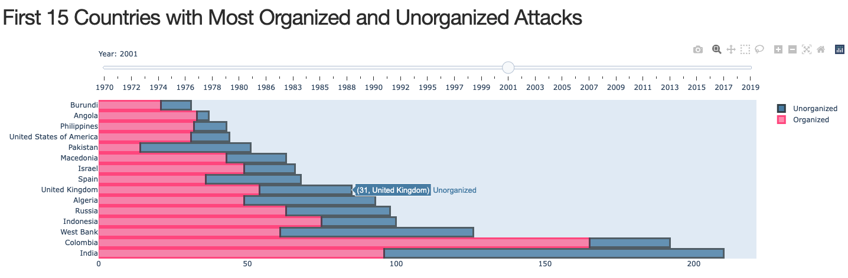

Slide 10
Concept with Design Rationales
Visualization → Design decision ↓ | Bar chart organized/non organized attacks by years
Representation | Barchart with two colors is suitable for visual comparison of two categories of attacks by countries. Chart shows 15 countries with the highest number of attacks, since the researches could be interested in the identification and further analysis of the most unsafe countries for the chosen year.
Use of timeline | Timeline is available as a slider to choose a specific year for analysis, because we aim to show organized and non-organized attacks by years, hence the users are able to perceive the change in top 15 countries by years.
Colors | Unorganized attacks are represented by pink color Unorganized attacks are represented by light blue color
Functionality | User can select their interested year and see which countries have the most number of incidents in this year. Additionally, attack numbers are shown on hover

