Slide 1
Quote Approval Prediction and Discount Optimization for Portfolio Growth

Slide 2
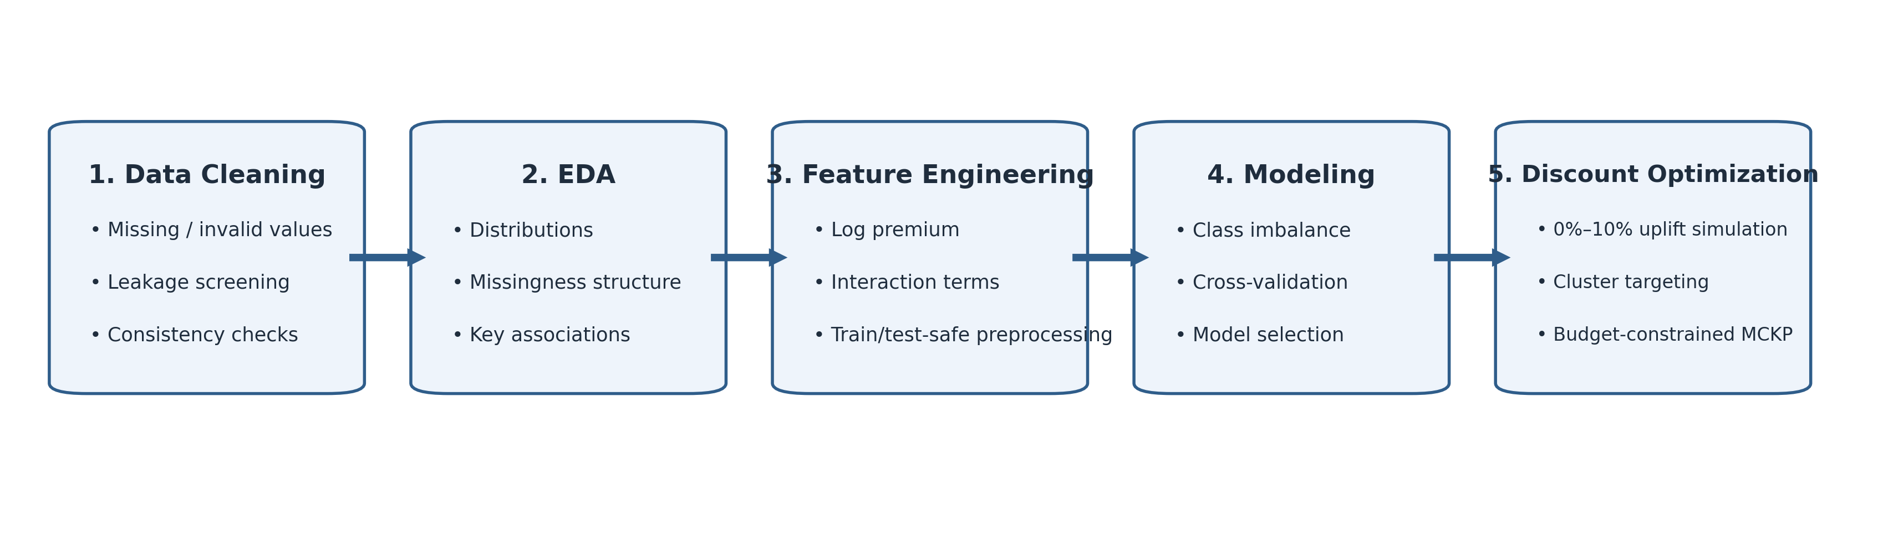
Business Problem and Project Scope
Objective 1: predict whether a customer will accept or decline an insurance quote.
Objective 2: determine how to use up to 10% premium discount to maximize expected portfolio growth with minimum margin sacrifice.
Figure 1: Workflow Diagram
1

Slide 3
Data Quality Review and Preprocessing Logic
Dataset size: 19,085 observations × 14 variables
teklif_onay_durumu: 16,711 not approved (87.56%) 2,374 approved (12.44%)
Data audit: Screened the raw dataset for invalid values, duplicate records, missingness structure, variable-type consistency, and leakage risk.
Invalid placeholder handling: Re-coded yas = 0 as missing, since zero is not a plausible observed age and would otherwise induce measurement bias.
Missingness diagnostics (3.934 % in total): Evaluated the joint missing-data pattern and found that yas and ilce missingness were fully aligned, indicating a systematic, not purely random, mechanism.
Statistical interpretation: This aligned missingness was strongly concentrated in sigortali_tipi = TÜZEL, suggesting the missing-data process is informative and associated with customer type.
Table 1 : Data Dictionary
Variable | Description | Type
teklif_numarasi | Unique quote identifier | chr
hasarsizlik_indirimi_kademesi | No-claim discount level | ord
trafik_basamak_kodu | Traffic insurance step level | ord
marka | Vehicle brand | fct
arac_yasi | Vehicle age | dbl
model_yili | Vehicle model year | dbl
yakit_tipi | Fuel type | fct
il | Province | fct
ilce | District | fct
yas | Insured age | dbl
teklif_primi | Quote premium | dbl
portfoy_ayrimi | Portfolio segment | fct
sigortali_tipi | Insured type (individual / corporate) | fct
teklif_onay_durumu | Quote approval outcome | fct
2

Slide 4
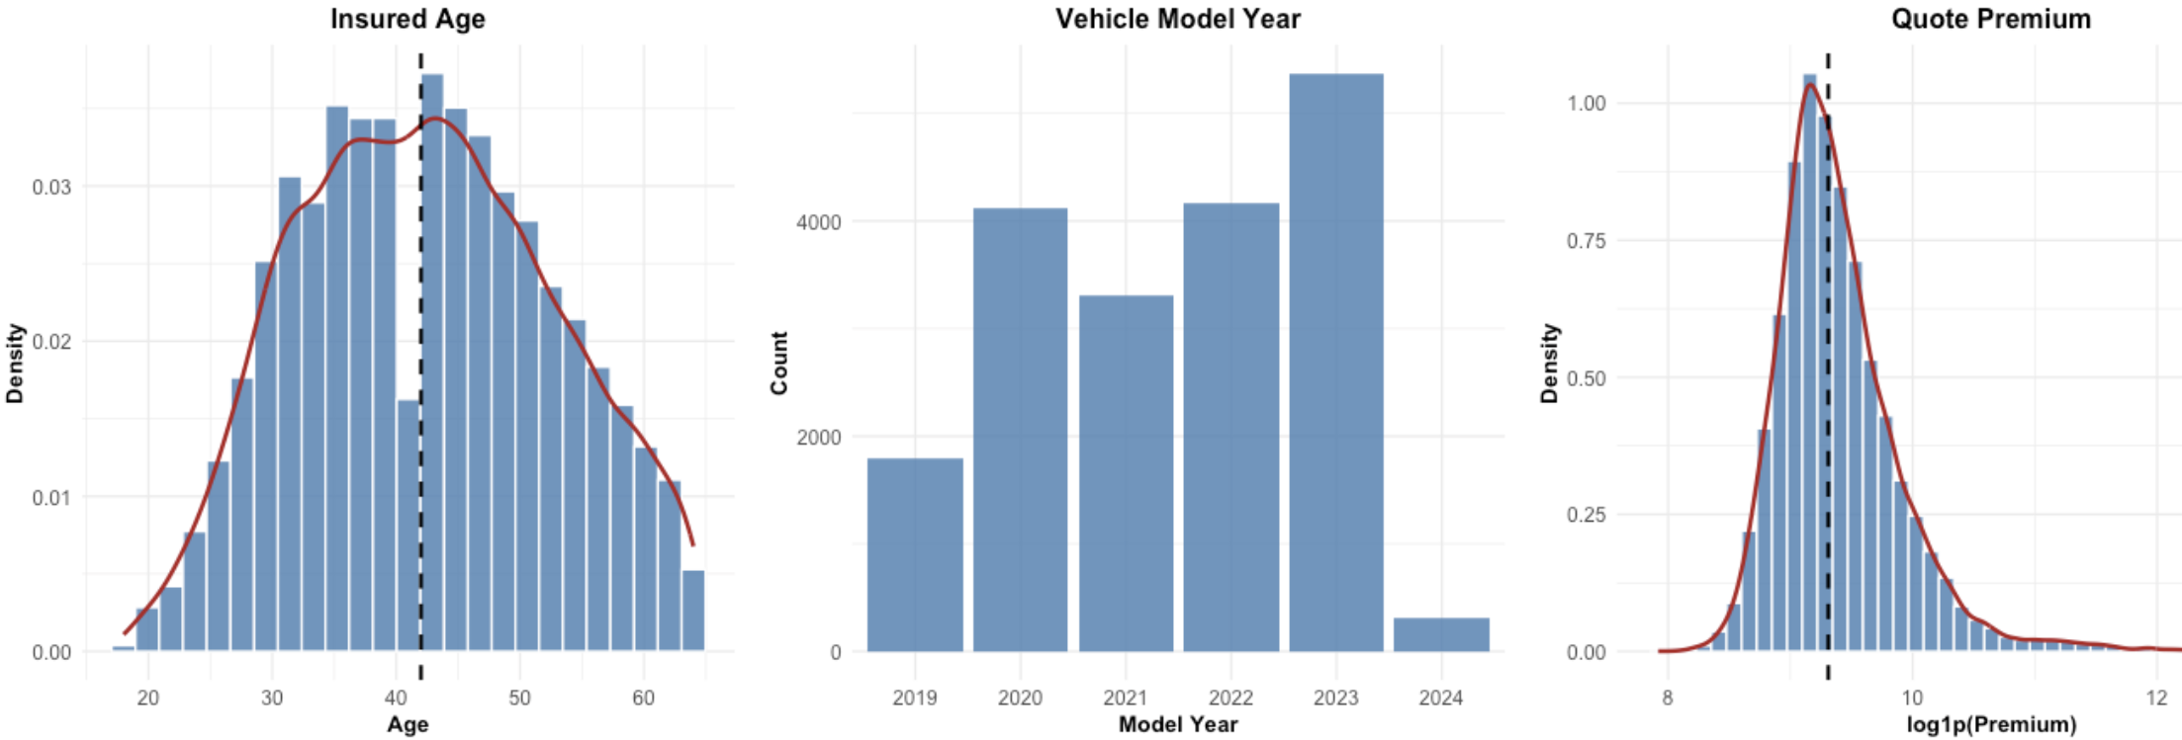
EDA: Distributional and Structural Findings
Quote premium showed a pronounced right-skewed distribution, with a long upper tail driven by high-value but plausible business cases.
Extreme premium observations were retained, since they were reviewed as valid business extremes rather than obvious data-entry anomalies.
A log transformation of premium was applied to reduce skewness, compress the upper tail, and improve scale behavior for downstream modeling.
arac_yasi and model_yili were deterministically redundant, since vehicle age is mechanically derived from model year. To avoid redundant signal and potential collinearity, arac_yasi was excluded and model_yili was retained for subsequent analysis.
Figure 2: Distribution of Numeric Variables
3

Slide 5
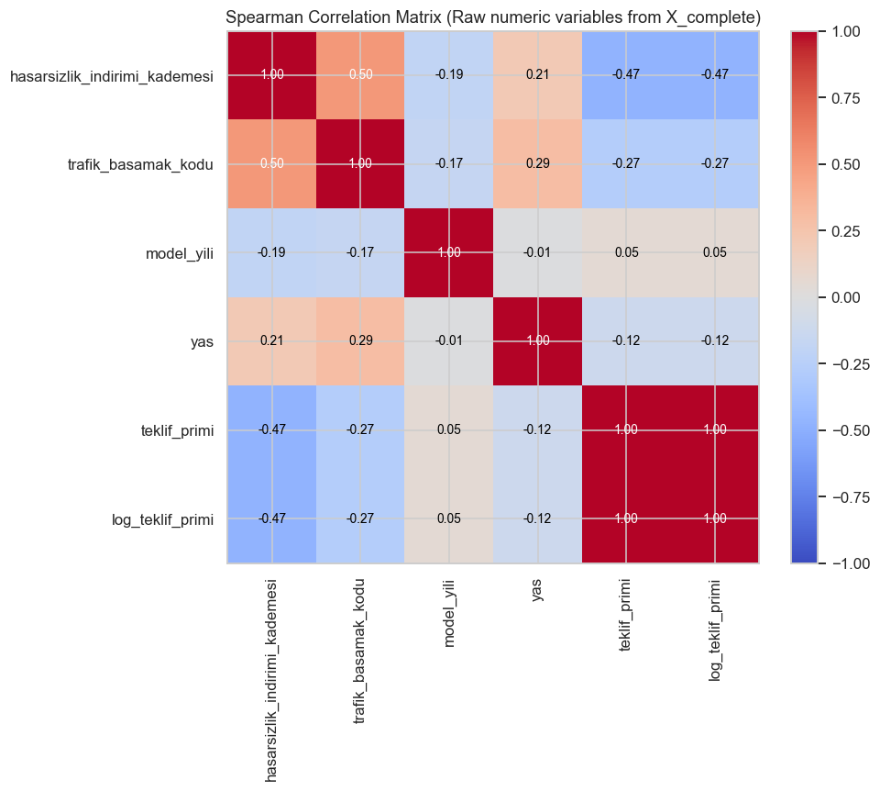
EDA: Association, Confounding, and Interaction
Marginal association: portfoy_ayrimi showed the strongest categorical association (highest Cramér’s V), while teklif_primi was the strongest numeric discriminator (largest absolute point-biserial correlation; Wilcoxon significant).
Premium effect: Premium was negatively associated with approval (point-biserial < 0), but the relationship was moderate, not perfectly separating the classes.
Confounding: Stratified summaries showed that premium, portfolio segment, and insured type varied jointly, so the raw premium effect is partly confounded by subgroup composition.
Interaction: Premium interaction terms improved fit (LR test: p = 0.0021), indicating effect heterogeneity rather than a single common premium slope.
Main finding: The negative premium effect was weaker in YENİ İŞ, while insured-type interaction was comparatively limited.
Collinearity: The main redundancy was arac_yasi vs model_yili; after dropping arac_yasi, remaining collinearity was negligible (adjusted GVIF ≈ 1).
Figure 3: Spearman Correlation Matrix of Numeric Predictors
4

Slide 6
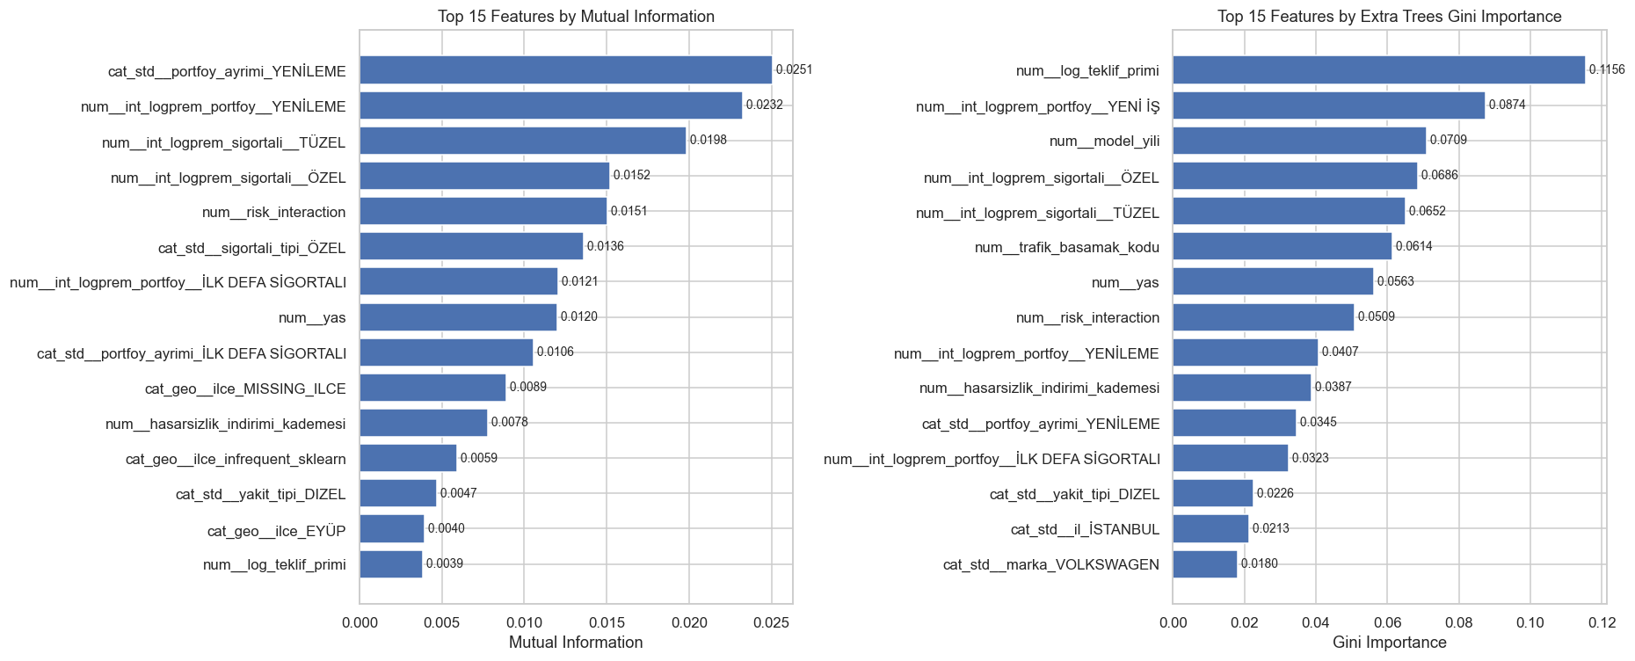
Feature Engineering and Imbalance-Aware Modeling Setup
Split: Stratified 85% / 15% train–test split (16,222 train - 2,863 test observations).
Leakage prevention: All feature engineering and preprocessing were fit after splitting and on training data only.
Key engineered terms: log_teklif_primi, premium interactions, and tariff/discount interaction terms.
Imputation/encoding: Median imputation for numeric variables, separate missing category for ilce, and training-only one-hot encoding.
Feature screening: Mutual Information and Extra Trees Gini Importance showed that log_teklif_primi and its interaction terms were the most informative predictors.
Modeling setup: 5-fold CV on the training set, class-weighted learners, and imbalance-aware evaluation metrics.
Figure 4: Top Features by Mutual Information and Extra Trees Gini Importance
5

Slide 7
Model Families and Hyperparameter Tuning
Several model families were compared:
  - Logistic Regression
  - Elastic Net Logistic Regression
  - Random Forest
  - Extra Trees
  - HistGradientBoosting
  - LightGBM
  - MLP
Hyperparameters were tuned using 5-fold cross-validation on the training set only.
Main optimization metric: ROC-AUC
Cross-validated tuning results showed a very tight leaderboard
Logistic regression (baseline model) remained a strong baseline, indicating that much of the signal is still explainable with relatively simple structure.
Table 2 : Cross-Validated Model Tuning Summary
Rank | Model | Best CV ROC-AUC
1 | extra_trees | 0.758780
2 | hist_gbm | 0.758502
3 | mlp | 0.758215
4 | lightgbm | 0.756593
5 | logistic_l2 | 0.756149
6 | random_forest | 0.756125
7 | logistic_elasticnet | 0.756083
6

Slide 8
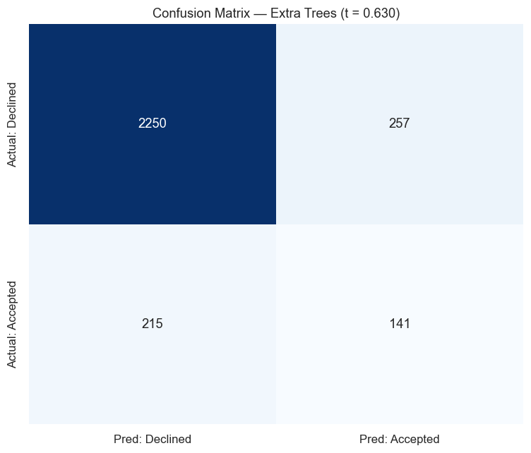
Fınal Model Comparison and Evaluation
Primary selection logic: class-balanced performance was prioritized because the target is imbalanced; Macro-F1 was the main comparative metric, supported by ROC-AUC / PR-AUC from cross-validation.
Extra Trees was retained because it gave the strongest overall balance across classes and the most suitable performance for probability-based targeting.
Ensembling did not help because candidate models produced highly similar predictions, so ensembling added complexity without measurable gain.
The model (Extra Trees) captures nonlinear and interaction-driven structure better than linear baselines.
It remains stronger on Declined than Accepted, which is expected under imbalance.
This is acceptable because the final business use case relies on probability-based targeting, not only hard classification.
Table 3: Final Test-Set Classification Results (Extra Trees)
Class / Metric | Precision | Recall | F1-Score | Support
Declined (0) | 0.9128 | 0.8975 | 0.9051 | 2507
Accepted (1) | 0.3543 | 0.3961 | 0.3740 | 356
Accuracy |  |  | 0.8351 | 2863
Macro Avg | 0.6335 | 0.6468 | 0.6395 | 2863
Weighted Avg | 0.8433 | 0.8351 | 0.8390 | 2863
Figure 5: Confusion Matrix of the
Final Extra Trees model
7

Slide 9
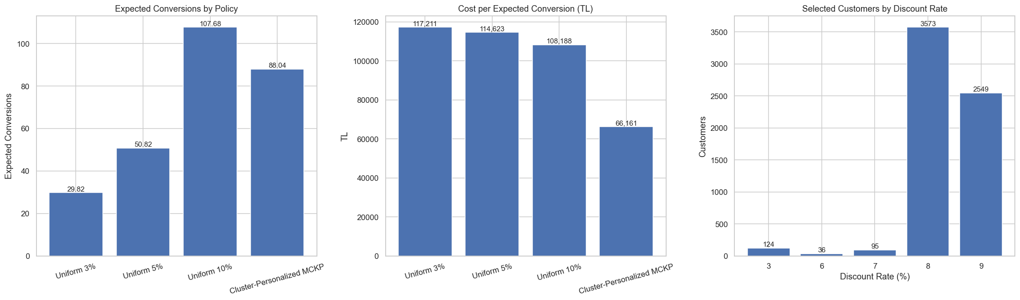
DISCOUNT OPTIMIZATION: TECHNICAL APPROACH AND BUSINESS RESULT
Scope: 19,085 quotes → 8,920 candidates → 6,377 discounted customers
Method: Estimate baseline acceptance, simulate uplift for 0%–10% discounts, select high-response clusters, and optimize discounts under budget.
Result: Personalized policy is expected to create 88 incremental accepted quotes from 6,377 discounted customers.
Comparison: This is higher than Uniform 5% (50.8) and more efficient, with 66,161 TL cost per additional acceptance vs 114,623 TL.
Action: Apply higher discounts only to customers with strong incremental response; prioritize the most efficient clusters first.
Takeaway: Personalized discounting achieves more portfolio growth with less wasted discount than a uniform moderate discount policy.
Figure 6: Policy-Level Impact and Efficiency Comparison
8

