Slide 1
SDS

Slide 2
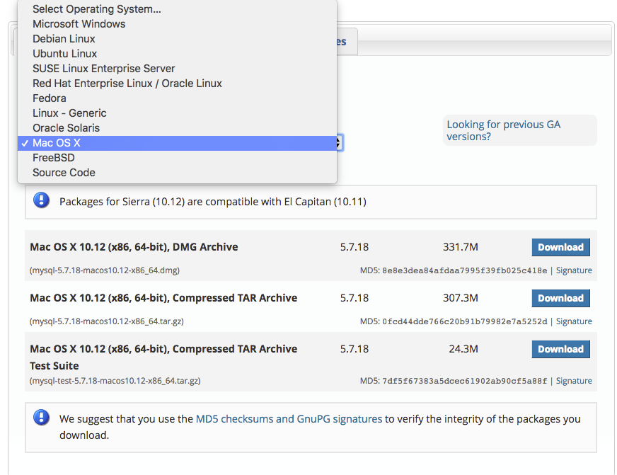
Install MySQL
MySQL community Version
https://dev.mysql.com/downloads/mysql/
Select your appropriate OS
Follow installation instructions
For people with LAMP/WAMP
Its already installed
For people who want to use mariadb
Its ok to do so
Runtime commands will be the same

Slide 3

Administration
Start Stop Restart
/etc/init.d/mysqld start
/etc/init.d/mysqld stop
/etc/init.d/mysqld restart
Login to your mysql instance:
mysql -u root –p password
Create a new user:
Grant privileges:
Flush Privileges:

Slide 4
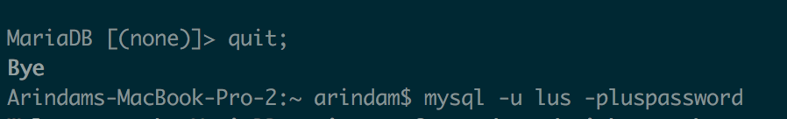
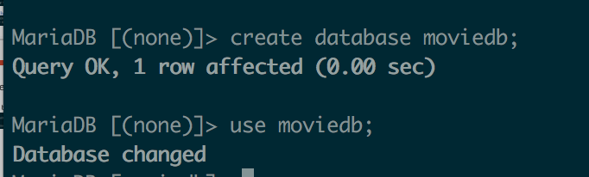
Create Database
Log back in with the new user:
Create the database:
Import the data:
Import the data:

Slide 5
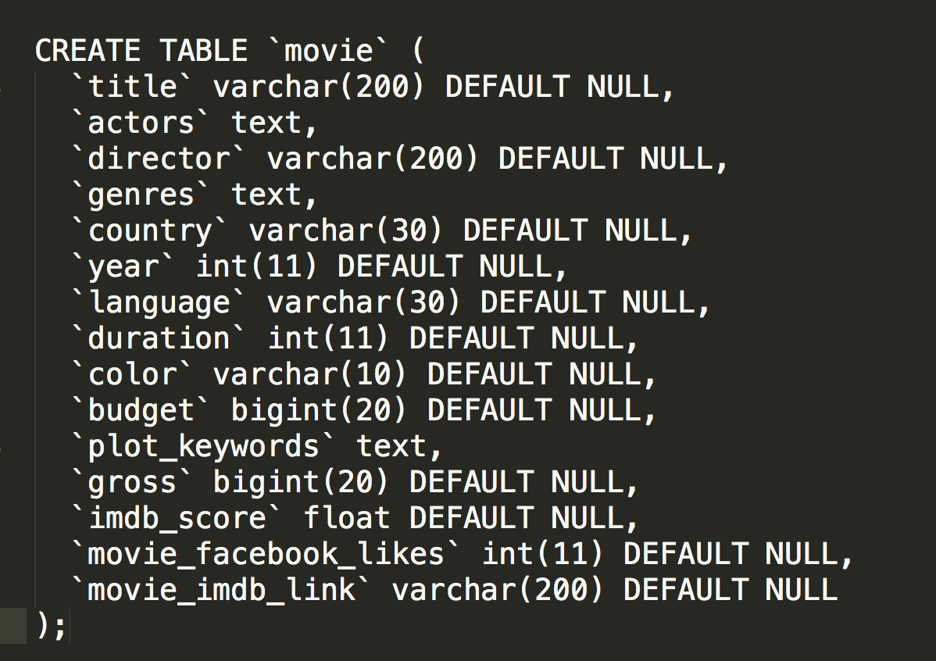
Query the database
Movie Table:

Slide 6
QueryDB.php
Two inputs:
Input (Search Criteria):
Requested concept
Concept value pairs
Output:
value for requested concept
Example:
Input:
Requested Concept (class) = ‘director’
Concept value pair = array(‘movie.name’ => ‘avatar');
Output:
[director] => James Cameron

Slide 7
Chrome Caching Problem
In order to make javascript changes, disable caching in Chrome.

