Slide 1
CI/CD
The power of automation

Slide 2
Continuous Integration
CI is the process/practice of automating the code integration throw multiple contributors into a software project/feature.
Dev team members merge the code into same repository
Builds and TDDs runs, and the code correctness checked before integration.
Now days CI is an essential aspect of development and high- performance software teams.

Slide 3
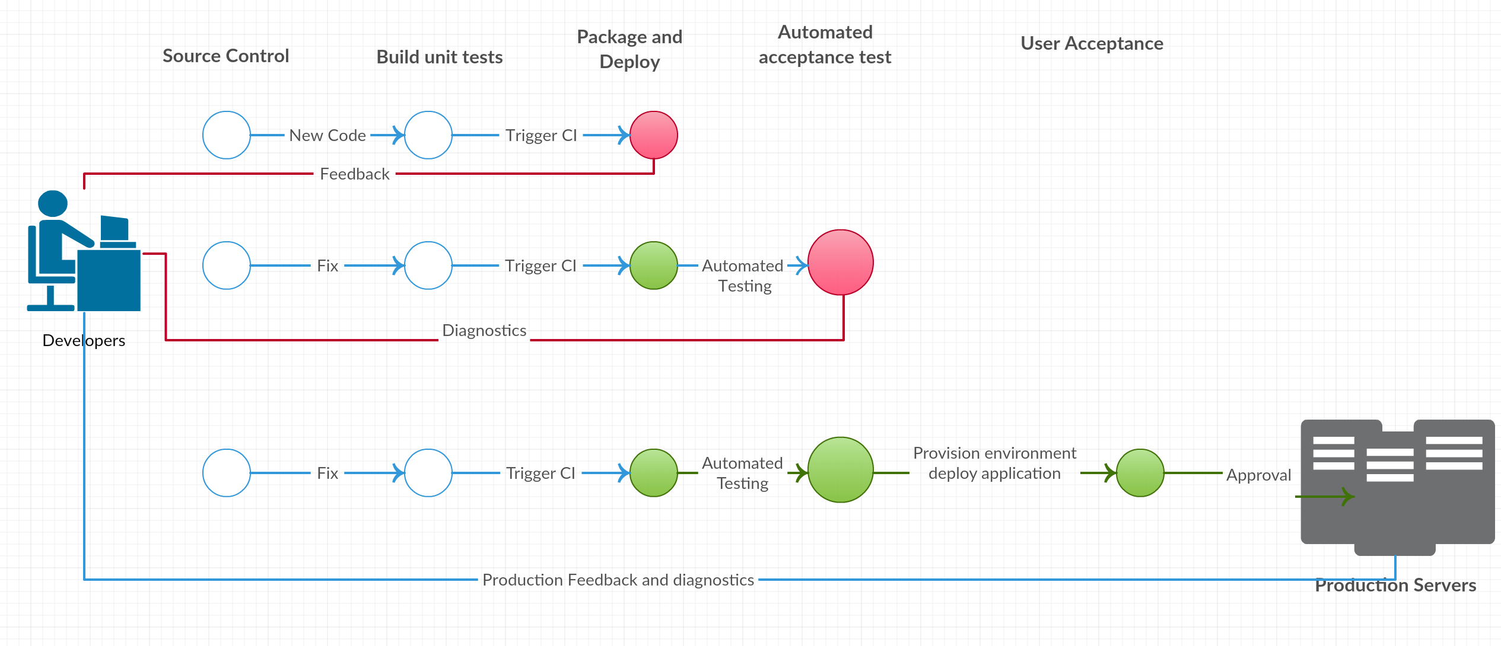
CI Phases

Slide 4
Continuous Delivery
The term CI stands for “Continuous Delivery”
CD is the process/practice to deliver and produce software features in short cycles allowing the software to be reliably released anytime.
CD allowing the incremental updates into production which reduce unexpected performance problems, risk, time and cost.

Slide 5
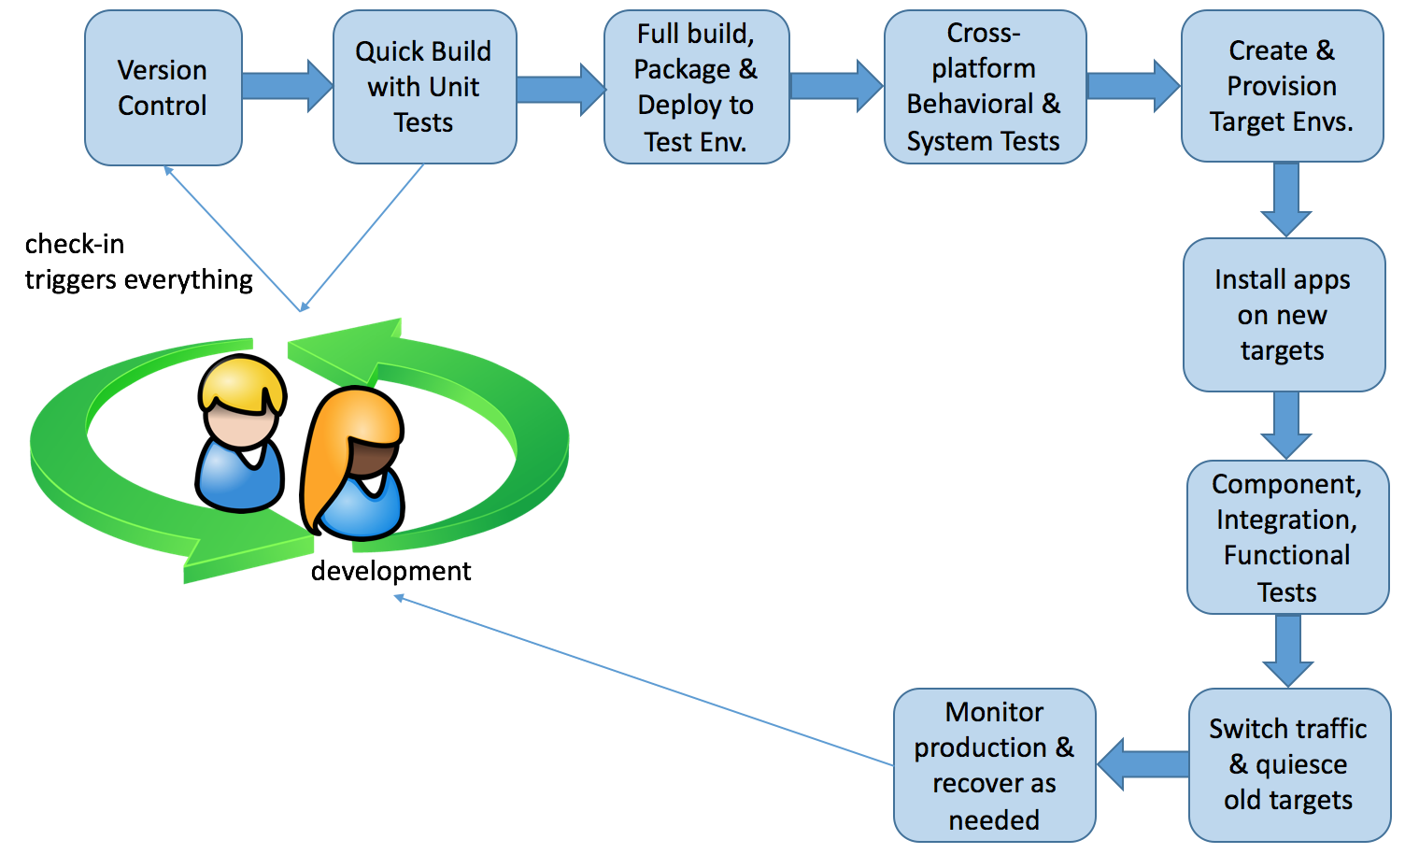
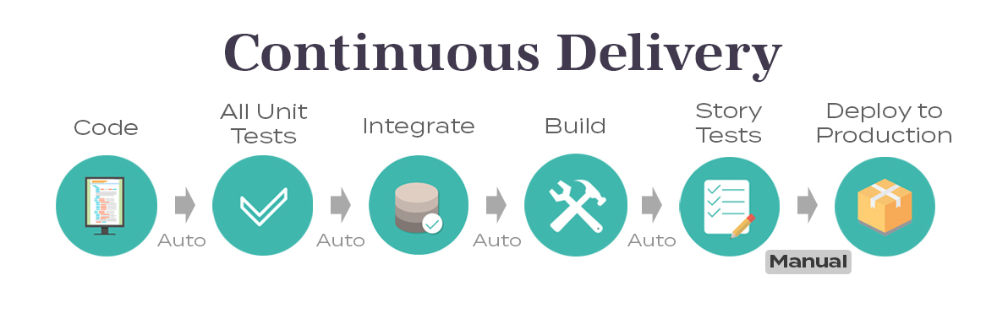
CD Phases

Slide 6
Business Benefits of CI/CD
Integrating CI & CD provides the optimum solution for both integration and delivery. By providing high quality deployable artifacts
Accelerated Release Cycles
With ci/cd the development cycle is now visualized from commit to production.
Production releasing could be done multiple times after testing without considering compare the quality parameters.

Slide 7
Business Benefits of CI/CD (cont’)
Make Revenue
Faster and More Frequent Production Deployments ensures more quicker releases.
Removal of manual checks before deployment means less time to market.
Protect Revenue
Automated smoke test reduces downtime due to deploy related crash or a major bug.
Automated rollback due to a job failure means a fast undo from production to working state.

Slide 8
Business Benefits of CI/CD (cont’)
Detection & Isolation
The small code batches is easier to be reviewed and rectified
Breakdowns and other critical issues can be limited by isolating bugs and vulnerabilities before damage spreading.
Cost Deduction
CI/CD is the perfect solution to shorten time to develop new project and market new feature and that meet the time to market goals of any successful entity.

Slide 9
Business Benefits of CI/CD (cont’)
Reduction of non-critical defects in backlog
Since CI/CD is a time and money saver, it gives developers time to fix older code and make it cleaner and more efficient. The idea that developers cannot only tackle the backlog ,but also work on non-critical defects, is a game -changer brought to teams by DevOps and CI/C
Fail Fast
The faster we detect the errors, the faster we act and fix the issues even before it occurs on production, and that would save a lot of time debugging and testing and also will save money.

Slide 10
Conclusion
Based on AWS documentations
Continuous integration and continuous delivery provide an ideal scenario for your organization’s application teams. Your developers simply push code to a repository and the code will be integrated, tested, deployed, tested again, merged with infrastructure, go through security and quality reviews, and be ready to deploy with extremely high confidence.
When CI/CD is used, code quality is improved, and software updates are delivered quickly and with high confidence

