Slide 1


Challenge: Spacecraft thermal power consumption
Space Power Inventors

Slide 2
SPI CHALLENGE !!
Build an accurate model for thermal power consumption that will increase the spacecraft science return
Science Power
= Produced Power - Platform Power - Thermal Power

Slide 3
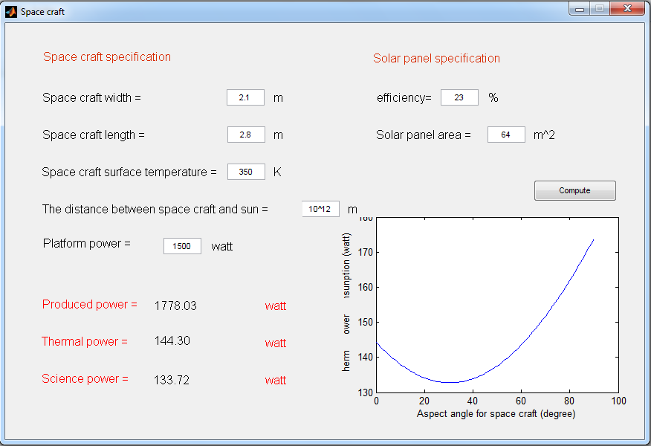
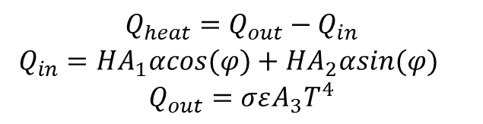
SPI MODEL
$$Q_{heat}=Q_{out}−Q_{in}$$
$Q_{in}=HA_{1}αcos(φ)+HA_{2}αsin(φ)$
$$Q_{out}=σεA_{3}T^{4}$$

Slide 4
SPI INNOVATIONS
Online Model
Notes:
Offline estimation at design time, therefore there is not optimum estimation for power consumption, if used online Estimation during the run time the payload would be used for longer time therefore “optimumim usage of the payload”

Slide 5
FUTURE WORK
TEG
Super Heat Reservoir

Slide 6
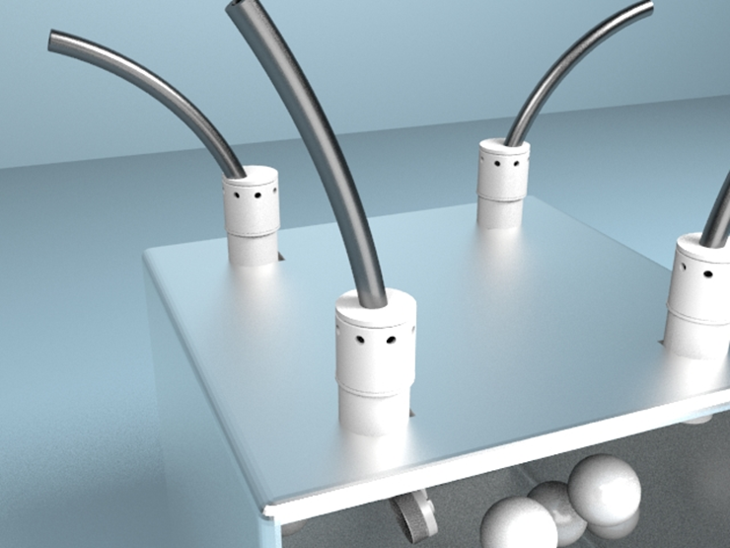
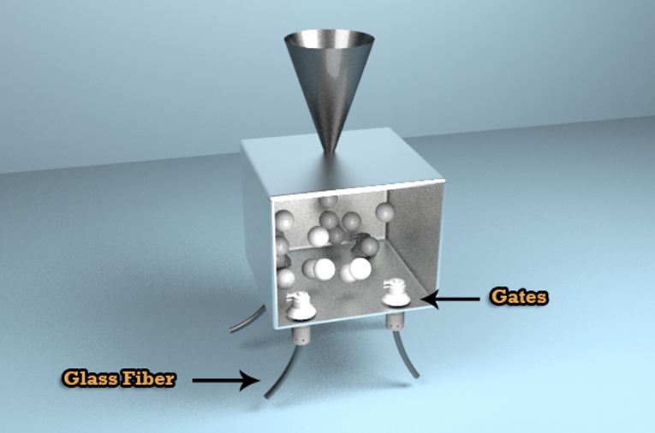
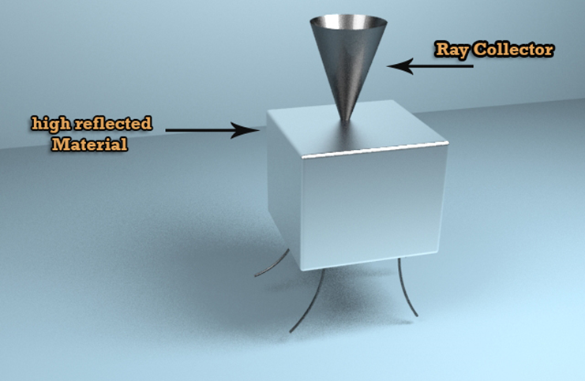
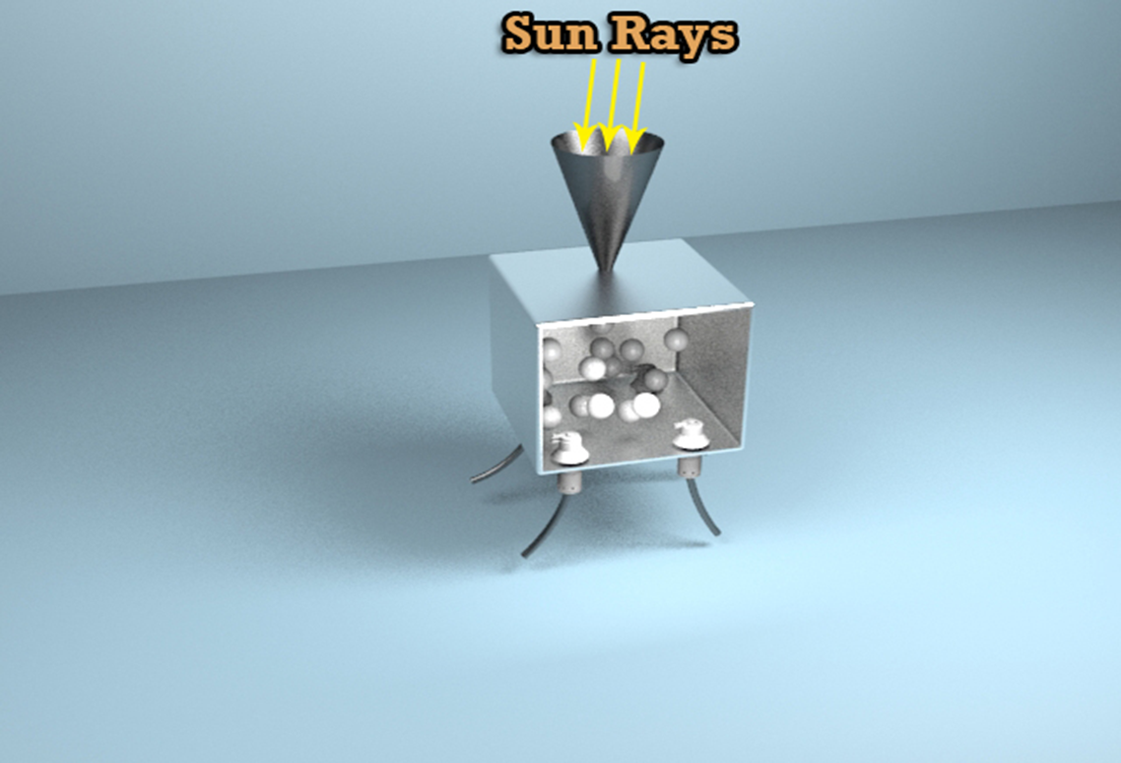
FUTURE WORK
TEG
Super Heat Reservoir

Slide 7

2-Super Heated Reservoir (SHR)
This is a new technique depends on a high absorbtion of the using material to collect a large wide of incident sunlight.

Slide 8

2-Super Heated Reservoir (SHR)
Inside the reservoir there are elements of high absorption material which will work as a battery to save sunrays inside it till reach its max. temperature to radiate this rays again.

Slide 9

2-Super Heated Reservoir (SHR)
Sun rays will be collected in a collector of sunlight rays which will make reflects with different angles inside the reservoir.
This reservoir made from high reflective material to reflect rays inside and outside.

Slide 10

2-Super Heated Reservoir (SHR)
A fiber glass used to transfer produced radiation from the emitted material to the payloads which need heating out of reservoir, by temperature control systems.

Slide 11
There are gates to control radiation transfer to-from the reservoir.

