Slide 1
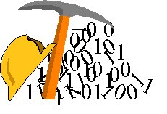
Introduction to Circuits
Engr. Muhammad Waqas

Slide 2
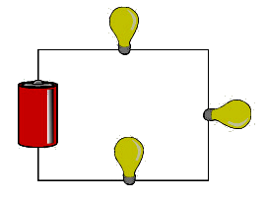
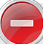





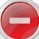

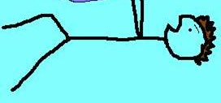
Potential Difference = Voltage
Voltage is a comparison between the pushing force of electrons between two points in a circuit.
“the pushing force”
Symbol for voltage is V
Measured in volts
Units are V
V = I × R

Slide 3
Voltage in Series and Parallel
Series Circuits
  Voltage decreases as electrons cross each electrical load (and lose energy)
  Voltage across the source equals the sum of the voltages across each electrical load
  V_{s} = V₁ + V₂ + V₃
Parallel Circuits
  If the loads are identical, the voltage is the same everywhere
  V_{s} = V₁ = V₂ = V₃

Slide 4
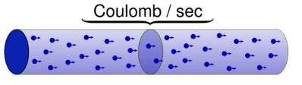
Current
“the number of moving electrons”
Current is the measure of the amount of charge moving past a point in a circuit every second.
Symbol for current is I
Measured in amperes
Units are A
I = V ÷ R
In a series circuit the current is the same at every point in the circuit.

Slide 5
Current in Series and Parallel
Series Circuits
  Current is the same everywhere
  I_{s} = I₁ = I₂ = I₃
Parallel Circuits
  Current is not the same everywhere
  Current entering or leaving the source equals the sum of the current passing through each electrical load
  I_{s} = I₁ + I₂ + I₃

Slide 6
Shopping Mall Analogy – Series
As a class, we are going to the mall on a field trip.
Each student (electron) starts at the ATM (source) to take out $3 (voltage – 3V).
One store (load): the whole class (current) goes to 1 store and each student spends their $3.
  Everyone wants to spend all of their money because it’s a field trip! ☺
  Current stays the same, voltage is the same as the source
Two stores (loads): the whole class goes to each store, spending some of their money at each.
  Everyone wants to spend all of their money, but also wants to buy something at each store!
  Current is the same, voltage of loads will add up to V of source
Everyone meets back at the ATM because they’re broke (V = 0) and have no more money to spend.
  This is the end of the field trip! ☹

Slide 7
Shopping Mall Analogy – Parallel
As a class, we are going to the mall on a field trip.
Each student (electron) starts at the ATM (source) to take out $3 (voltage – 3V).
One store (load): same as before!
  Current stays the same, voltage is the same as the source
Two stores (loads): half of the class (current) goes to one store spending their $3, while the other half goes to the other store, spending their $3.
  Everyone wants to spend all of their money because it’s a field trip! ☺
  Current of loads adds up to A at source, voltage is the same
Everyone meets back at the ATM because they’re broke and have no more money to spend.
  This is the end of the field trip! ☹

Slide 8



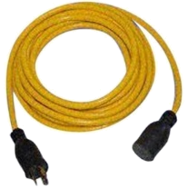
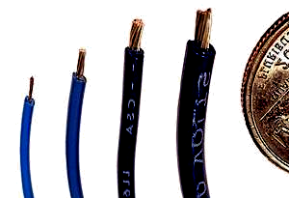
Resistance
“how hard it is for electrons to flow”
Resistance is the amount that a substance or load is opposing the flow of electrons
FOUR FACTORS AFFECTING THE RESISTANCE OF A WIRE
Symbol for resistance is R
Measured in ohms
Units are Ω
R = V ÷ I
Material
Length
Gold is a better conductor than copper
more wire = more resistance
has less resistance than
less wire = less resistance
A 50 metre extension cord has more resistance than a 10 metre extension cord.
Cross-sectional Area
The thicker the wire, the less resistance it has.
Temperature
Electronics work better in the cold because wires have more resistance when they are hot.

Slide 9
More on Resistance
A resistor is any material that can slow current flow and through that converts electrical energy to other forms like heat, light, sound, and motion

Slide 10

Resistance in Series and Parallel
Series Circuits
  Equivalent (total) resistance equals the sum of the individual electrical loads
  R_{E} = R₁ + R₂ + R₃
Parallel Circuits
  Equivalent (total) resistance of the circuit is smaller than the smallest resistance

Slide 11
What We Know...
 | Definition | Units | Symbol
Current | The rate at which electrons move from one place to another | Ampere (A) | I
Voltage (Potential Difference) | Measures the amount of energy given to electrons to move them | Volt (V) | V
Resistance | Degree to which a substance opposes the flow of electric current through it | Ohms (Ω) | R

Slide 12
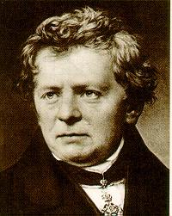
Ohm’s Law
I = V / R
I = Current (Amperes) (amps)
V = Voltage (Volts)
R = Resistance (ohms)
Georg Simon Ohm (1787-1854)

Slide 13

How you should be thinking about electric circuits:
Voltage: a force that pushes the current through the circuit (in this picture it would be equivalent to gravity)

Slide 14

How you should be thinking about electric circuits:
Resistance: friction that impedes flow of current through the circuit (rocks in the river)

Slide 15


How you should be thinking about electric circuits:
Current: the actual “substance” that is flowing through the wires of the circuit (electrons!)

Slide 16
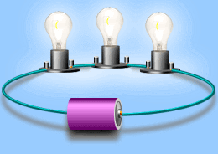
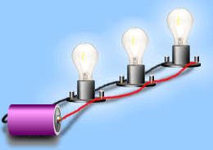
Simple Circuits
Series circuit
  All in a row
  1 path for electricity
  1 light goes out and the circuit is broken
Parallel circuit
  Many paths for electricity
  1 light goes out and the others stay on

Slide 17
Units
Quantity | Symbol | Unit Name | Unit Abbreviation
Current | I | ampere | A
Voltage | V | volt | V
Resistance | R | ohm | Ω

Slide 18
Electrical Energy
Our daily life depends on electrical energy.
We use many electrical devices that transform electrical energy into other forms of energy.
For example, a light bulb transforms electrical energy into light and heat.
Electrical devices have various power requirements.

Slide 19
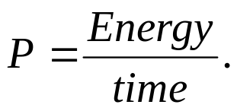
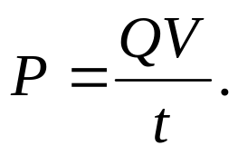
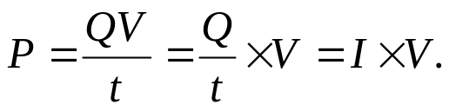
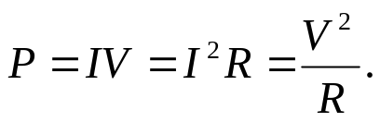
Electric Power,P
Since the electrical energy is charge times voltage (QV), the above equation becomes,
Since the current is charge flow per unit time (Q/t), the above equation becomes,
Since V = IR, the above equation can also be written as,
SI Unit of Power: watt(W)

Slide 20
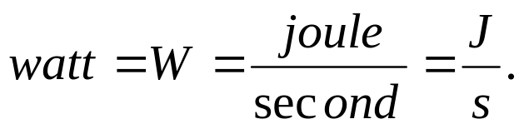
Killowatt-hour (kWh)
The SI unit of power is watt, after James Watt (1736-1819), who developed steam engines.
Utility companies use the unit kilowatt-hour to measure the electrical energy used by customers. One kilowatt-hour, kWh is the energy consumed for one hour at a power rate of 1 kW.

