Slide 1
Equivalent Resistance Method
Engr. Muhammad Waqas

Slide 2
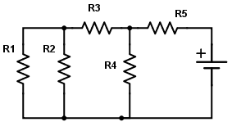
If R1 = 12 K Ω, R2 = 4 KΩ, R3 = 5 K Ω, R4 = 8 K Ω and R5 = 6 K Ω. Vs = 50 V.

Slide 3
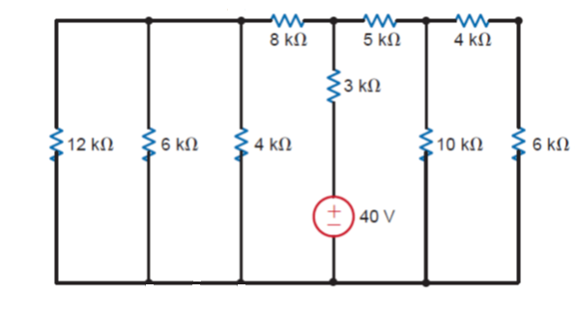

Slide 4
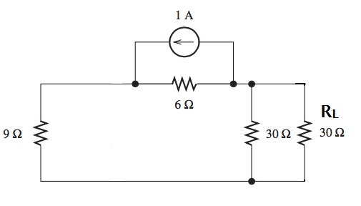

Slide 5
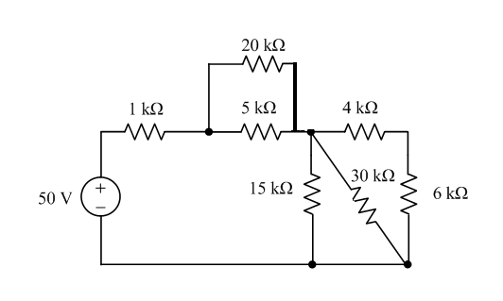

Slide 6
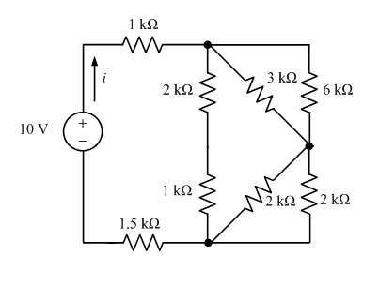

Slide 7
