Slide 1

Thevenin’s theorem
Engr. Muhammad Waqas

Slide 2
Thevenin’s Theorem Procedure
Identify and remove the load
Look in the load terminals and calculate VTH
Remove all sources by replacing:
  voltage sources with a short
  current sources with an open
  If the source has an internal resistance, keep the resistance in the circuit
Look in the load terminals and calculate RTH
Create a series circuit consisting of VTH, RTH, and the load
Calculate the load current or voltage as desired

Slide 3
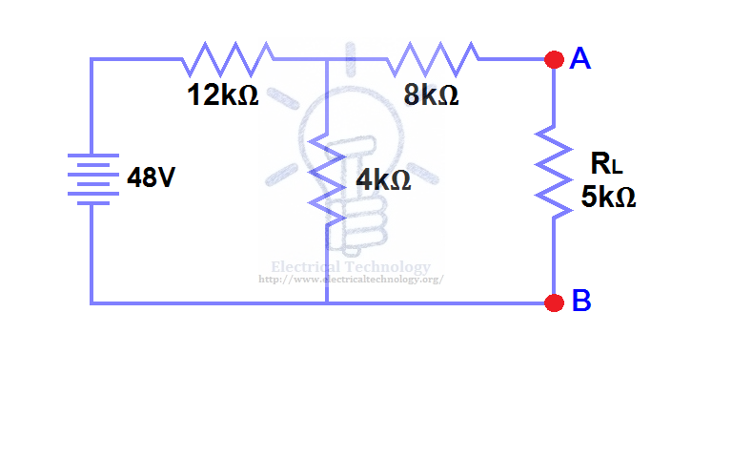
Thevenin Example 1
Identify Load Use RL

Slide 4
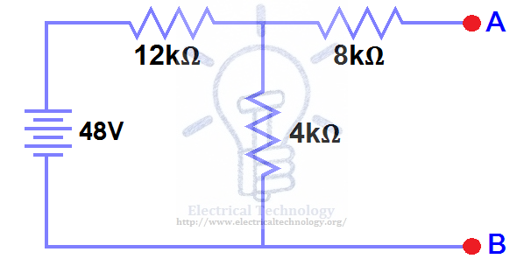
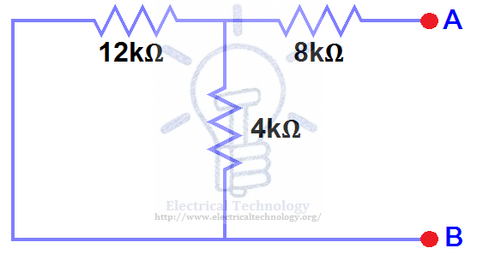
Thevenin Example 1
Calculate VTH
V_{TH}
R_{TH}
Replace all current sources with an open Replace voltage sources
with a short
Calculate R_{TH}

Slide 5
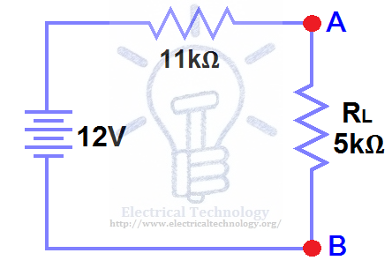
Thevenin Example 1
Calculate VTH Draw Thevenin Equivalent Circuit with
RL as the load
It is a series circuit

Slide 6
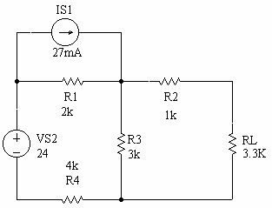
Thevenin Example 2
Identify Load Use RL

Slide 7
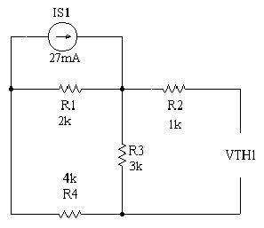
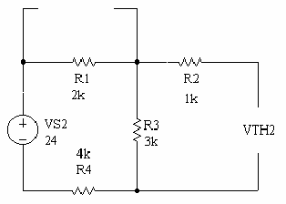
Thevenin Example 2
Calculate V_{TH1} Calculate V_{TH2}

Slide 8
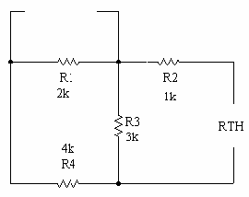
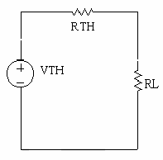
Thevenin Example 2
Calculate R_{TH} Thevenin Equivalent Circuit
        V_{TH} = V_{TH1} + V_{TH2}

Slide 9
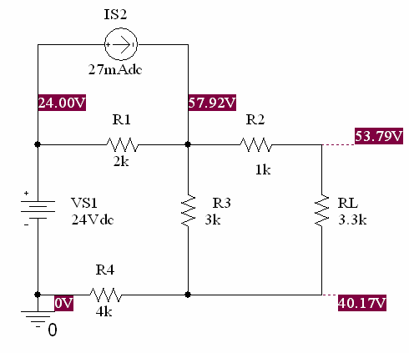
Thevenin Example 2 Solution

Slide 10
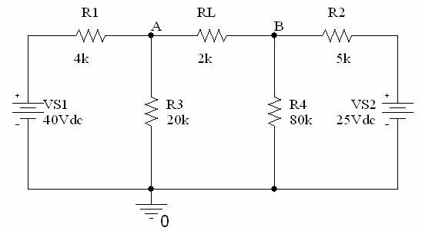
Thevenin Example 3
Identify Load Use RL

Slide 11
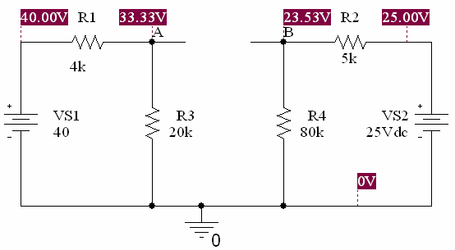
Thevenin Example 3
Calculate V_{TH} = V_{THA} - V_{THB}

Slide 12
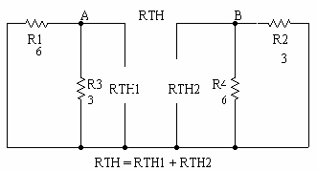
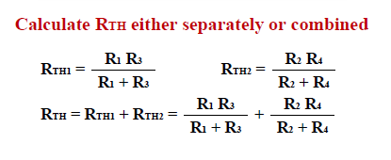
Thevenin Example 3

Slide 13
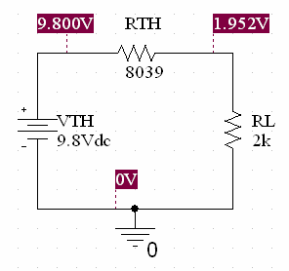
Thevenin Example 3

Slide 14
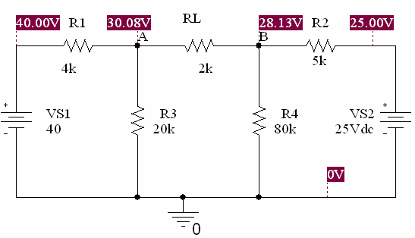
Thevenin Example 3 Solution
V_{L} = V_{A} - V_{B}

Slide 15
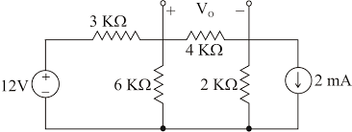
Thevenin Example 3 Solution

Slide 16
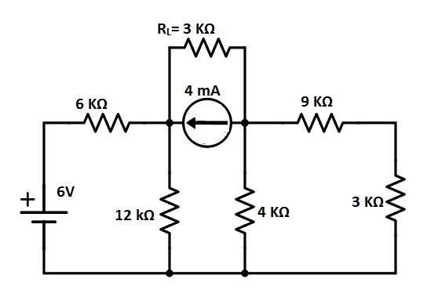
Thevenin Example 3 Solution

Slide 17
Book Source: A

