Slide 1
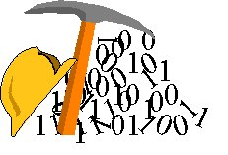
Semiconductors
Engr. Muhammad Waqas

Slide 2
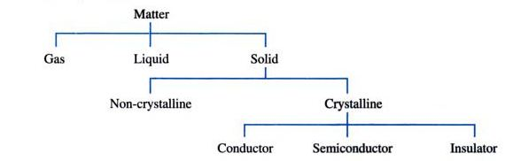
Matter

Slide 3
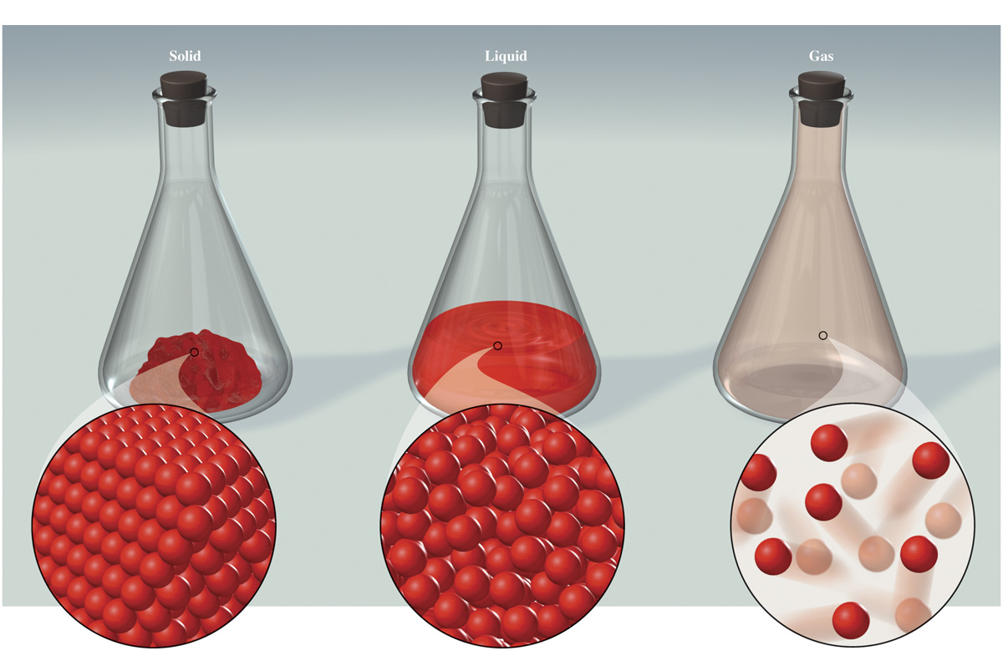
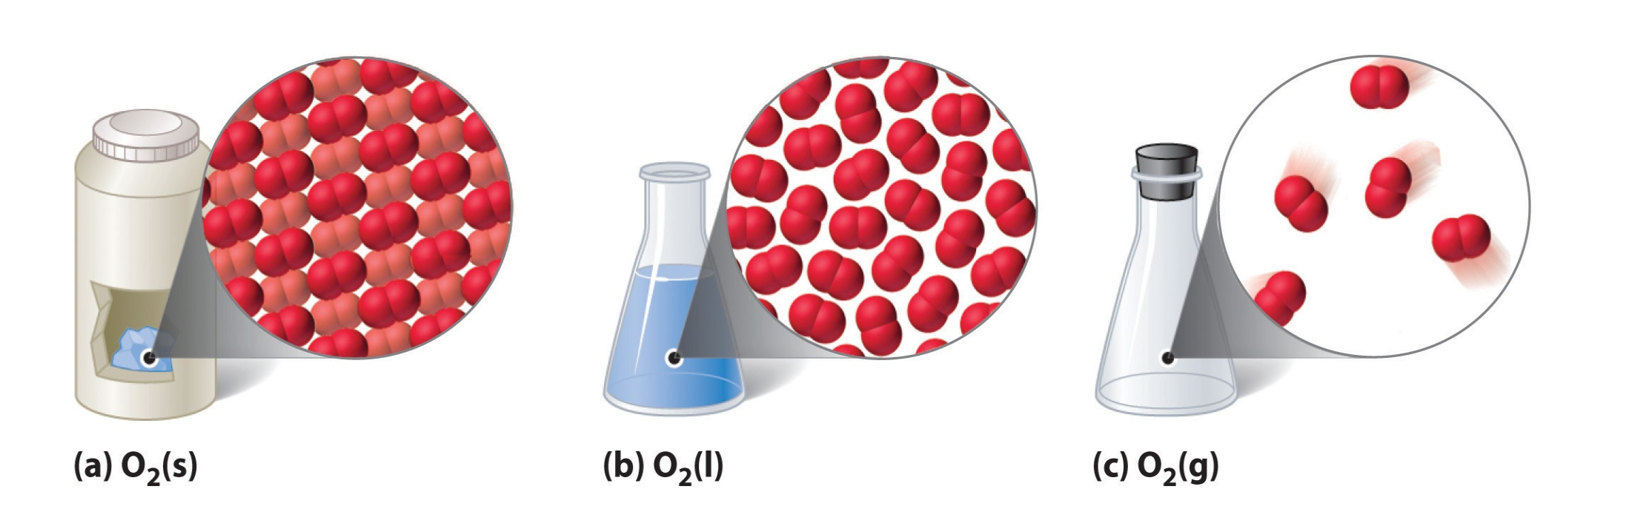
Solid Liquid and Gas

Slide 4
Solids
A crystalline solid has its molecules (or atoms) arranged in a lattice. That is, they are arranged in a regular fashion with equal spacing and angular relationships in all three directions
A non-crystalline solid, also called amorphous, has no such regular arrangement of molecules. That is the only difference.

Slide 5
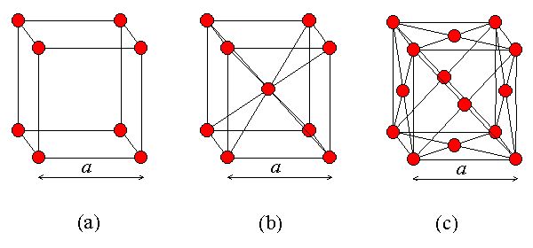
Crystalline Solids

Slide 6
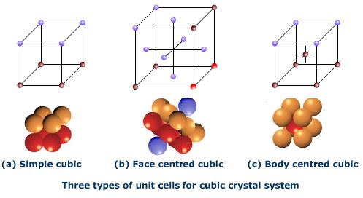
Crystalline Solids

Slide 7
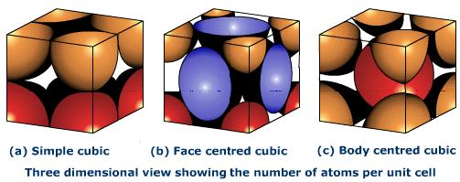
Crystalline Solids

Slide 8
Forms of Matter
Element and Compound (and or Mixture)
Atoms and Molecules
Atomic Structures
  Nucleus
  Electrons
Atomic Number (Z) and Atomic Mass Number (A)
Electron Orbits or Shells
Electron Distribution of Different Shells ( formula 2n²)

Slide 9
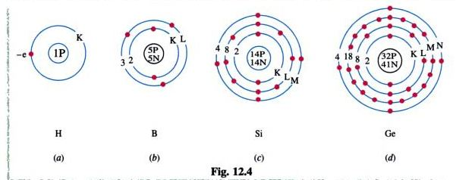
Electron Distribution of Different Shells

Slide 10
Valence Electrons
They determines the Chemical and Electrical Properties of the Element.
One or two valence electrons are good Conductors

Slide 11
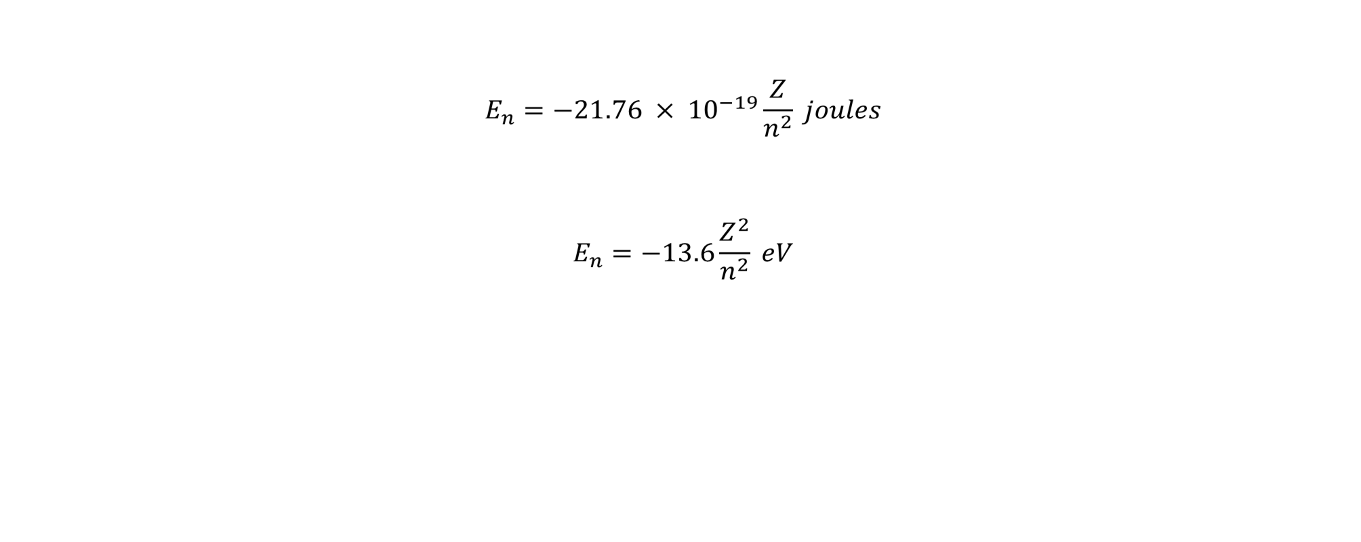
Orbital Energy

Slide 12
Intrinsic and extrinsic semiconductor
Intrinsic = pure
Extrinsic = impure or doped

Slide 13
Doping
Doping means mixing a pure semiconductor with impurities to increase its electrical conductivity
  Can be done in two ways
Increasing the number of electrons by mixing pentavalent elements such as phosphorous, arsenic, antimony (means adding donor impurities)
Increasing the number of holes by mixing trivalent elements such as aluminum, boron, gallium (means adding acceptor impurities)

Slide 14
N-type semiconductor
Has many free electrons in conduction band and few holes
In valence band
Free Electron
Phosphorous atom
14P
14P
15P
14P
14P

Slide 15
P-type semiconductor
Has few free electrons in conduction band and many holes
In valence band
Hole
Aluminum atom
14P
14P
13P
14P
14P

Slide 16
Majority and minority carriers
Electrons are
Majority carriers in N-type semiconductor
Minority carriers in P-type semiconductor
Holes are
Majority carriers in P-type semiconductor
Minority carriers in N-type semiconductor

Slide 17
A diode is formed by putting a N-type
and P-type of semiconductor together
P-N Junction
P type
N type
Anode
Cathode
Note: Both N and P-type of materials are electrically neutral

Slide 18
Migration of holes from P to N And electrons from N to P causes a formation of depletion layer
P type
N type
Anode
-
-
+
+
-
-
+
+
Cathode
-
-
+
+
-
-
+
+
This gives rise to barrier potential(Eγ) preventing further migration of holes and electrons

Slide 19
Forward Biased diode
P type
N type
Anode
-
+
Cathode
-
+
-
+
-
+
R
+
-
Vγ
+
-
VB

Slide 20
Forward Biased diode
The diode behaves like a ‘ON’ switch in this mode
Resistance R and diode’s body resistance limits the current through the diode
VB has to overcome Vγ in order for the diode to conduct

Slide 21
Reverse biased diode
Larger depletion layer
P type
N type
-
-
-
+
+
+
Anode
-
-
-
+
+
+
Cathode
-
-
-
+
+
+
-
-
-
+
+
+
-
+
VB

Slide 22
Reverse Biased diode
The diode behaves like a ‘OFF’ switch in this mode
If we continue to increase reverse voltage VB
breakdown voltage of the diode is reached
Once breakdown voltage is reached diode conducts
heavily causing its destruction

Slide 23
Breakdown
Diode breakdown is caused by thermally generated electrons in the depletion region
When the reverse voltage across diode reaches breakdown voltage these electrons will get sufficient energy to collide and dislodge other electrons
The number of high energy electrons increases in geometric progression leading to an avalanche effect causing heavy current and ultimately destruction of diode

