Slide 1
Clippers and Clampers
Engr. Muhammad Waqas

Slide 2
Application of Diodes
Rectifiers
Transistors
Clipper and Clampers

Slide 3
Clippers
A circuit which cutoff voltage above or below are both specified level is called clipper.
A clipper which removes a portion of positive half cycle of the input signal is called positive clipper.
A clipper circuit that removes the negative half cycle is called negative clipper.

Slide 4
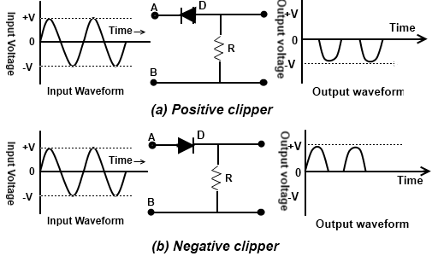
Clippers

Slide 5
Biased Clipper Circuit
If bias voltage is placed in series with diode then the circuit is called biased clipper or limiter circuit.
This bias determines the point where the diode begins to conduct and duration of conduction.
With bias, clipping can be done to any percent of the input signal ranging from 1% to 99%.

Slide 6
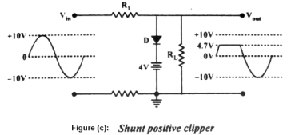
Single End Clipper

Slide 7
Single End Clipper
Figure (c) shows a single end positive clipper.
Notice that the positive terminal of the battery connected to the diodes cathode therefore diode conducts when input voltage reaches at the level of 4.7 volt (VBias + 0.7).
And when diode is conducting there will no current in RL and no voltage will drop across R . So that all the input voltage above this level will be clipped off at the output.
If the bias voltage is varied up or down the clipping level changes correspondingly.

Slide 8
Double Diode Clipper
A circuit that can be used to limit the peaks of both half cycles of an A.C. input signal is called double-end clipper.

Slide 9
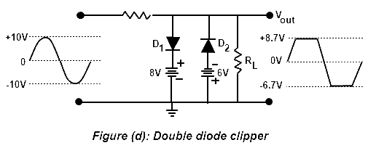
Double Diode Clipper

Slide 10
Double Diode Clipper
Notice that this circuit contains a shunt positive clipper with positive bias and shunt negative clipper with negative bias.
Notice that this circuit contains a shunt positive clipper with positive bias and shunt negative clipper with negative bias.

Slide 11
Clampers
A circuit that places either the positive or negative peak of a signal at a desired D.C level is known as clamping.
A clamping adds a D.C components to the signal and does not change the shape or amplitude of the input signal.
Clamping circuits place the negative and positive peaks of the waveform at a desired DC level.
In other words, these circuits shift the input signal by an amount defined by the independent voltage source. Today, Clamping circuits are also known popularly as Clamped-Capacitors.

Slide 12
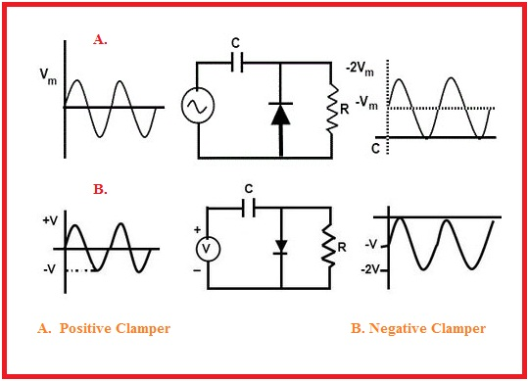
Clampers

Slide 13
Clampers
The basic idea of the clamper circuits are shown in the figure on previous slide.
Here the input signal is a sine wave having a peak to peak value of 10V.
In case of a positive clamper, it pushes the signal to upwards so that the negative peak falls on the zero level.
While in the case of the negative clamper, it pushes the signal downwards so that the positive peak of the signal falls on the zero level.
One thing can be seen that the original shape of the signal is not changed in any of the clamper outputs.

Slide 14
Clampers - Basics
In order to change the dc reference of the input signal, a clamper circuit usually uses:
  A diode,
  Load resistor and
  A capacitor for its operation.
General principle of the clamper circuit is that, the charging time of the capacitor in the clamper must be small compared to the discharging time of the capacitor in the clamper.

Slide 15
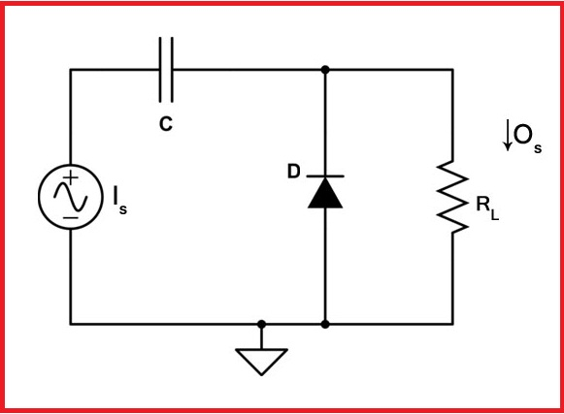
Positive Clamper

Slide 16
Positive Clamper
Figure shows the circuit of a positive clamper.
The input signal I_{s} to the circuit is a square waveform.
The output signal O_{s} will be obtained across the load resistor.
Here C represents the capacitor, D a diode, V voltage supply and R_{L} represents the load resistor.

Slide 17
Positive Clamper Operation
Proper operation of the clamper follows two points:
  Time constant z= R_{L}C must be very large.
  Time constant must be greater than the time period of the input signal.
  During Negative Half Cycle
    D is forward biased.
    D is short.
    Charging Time Constant = R_{f} C is small.
    R_{f} represents forward resistance of the diode.
    Capacitor charges to V volts.
    Voltage across R_{L} is zero.
During Positive Half Cycle
  D is reverse biased.
  D is open.
  Discharging time very large.
  Capacitor remains at V volts.

Slide 18
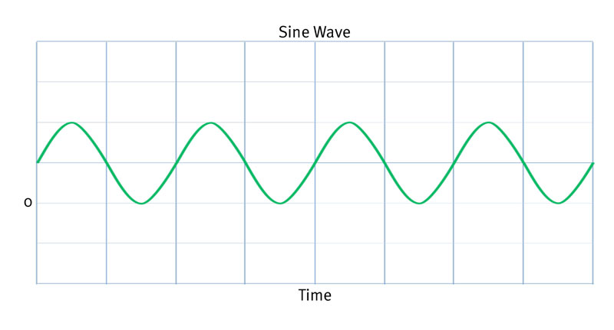
Positive Clamper Output

Slide 19
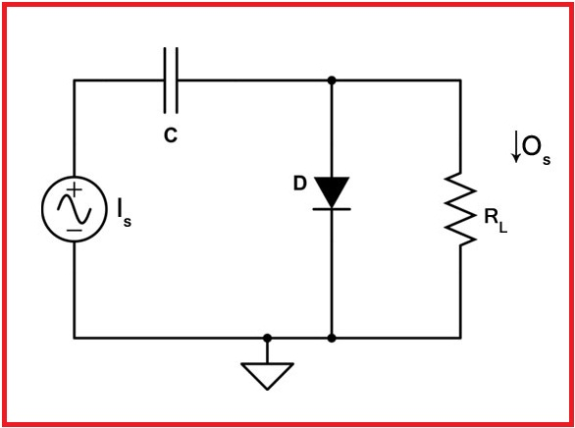
Negative Clampers

Slide 20
Negative Clamper
Figure below shows the circuit of a negative clamper.
The input signal I_{s} to the circuit is a sine waveform.
The output signal O_{s} will be obtained across the load resistor.
Here C represents the capacitor, D a diode, V voltage supply and R_{L} represents the load resistor.

Slide 21
Negative Clamper Operation
During Positive Half Cycle
  D is forward biased.
  D is short.
  Charging Time Constant z= R_{f} C is small.
  R_{f} represents forward resistance of the diode.
  Capacitor charges to V volts.
  Voltage across R_{L} is zero.
During Negative Half Cycle
  D is reverse biased.
  D is open.
  Discharging time very large.
  Capacitor remains at V volts.

Slide 22
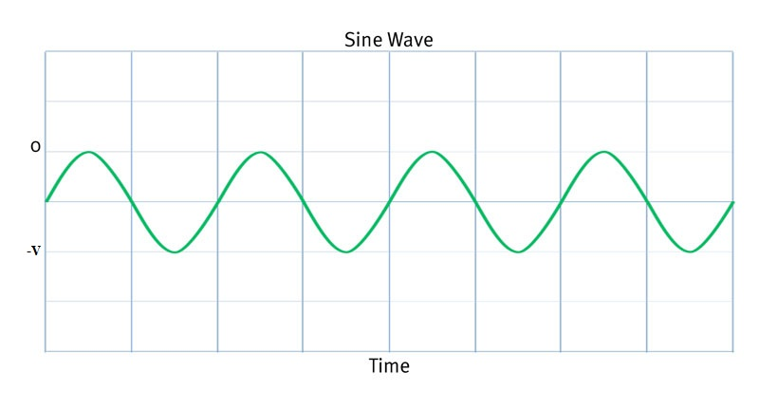
Negative Clamper Output

Slide 23
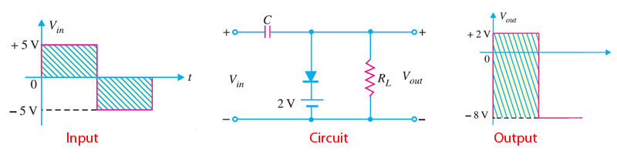
Example for Clamper Circuits
Consider the circuit shown in the figure below and find its output waveform.
  Here input voltage is 5V.
  During positive cycle:
    D is forward biased.
    D is short.
    Vout= 2V.
    Using Kirchoffs Law:
    Vin – Vc – Vout= 0
    5- Vc- 2 = 0
    Vc =3V.
The output waveform tells that the circuit given is a negative clamper and the dc reference level here is 2V.
During negative cycle:
  D is reverse biased.
  D is open.
  Using Kirchoffs Law:
  Vin-Vc-Vout = 0
  Vout= - 8V.

Slide 24
Tips and Tricks for Clamper Circuits
To identify the type of clamper circuit, just look at the diode. If the diode points in the upward direction, it is a positive clamper. While if the diode points in the downward direction, it forms a negative clamper.
Use Kirchoffs Law to find Vc and Vout.

Slide 25
Book Source: A

