Slide 1
Capacitors
Engr. Muhammad Waqas

Slide 2
Capacitors
Capacitors are simple passive device that can store an electrical charge on their plates when connected to a voltage source

Slide 3
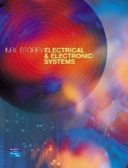
Introduction
13.1
We noted earlier that an electric current represents a flow of charge
A capacitor can store electric charge and can therefore store electrical energy
Capacitors are often used in association with alternating currents and voltages
They are a key component in almost all electronic circuits

Slide 4
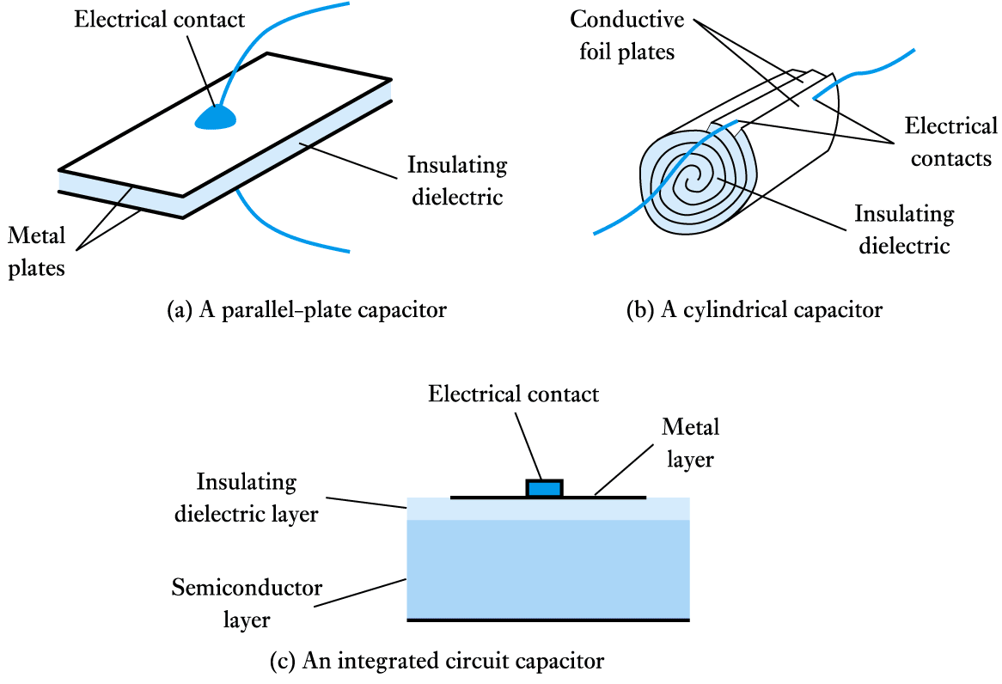
Capacitors and Capacitance
13.2
Capacitors consist of two conducting surfaces separated by an insulating layer called a dielectric

Slide 5
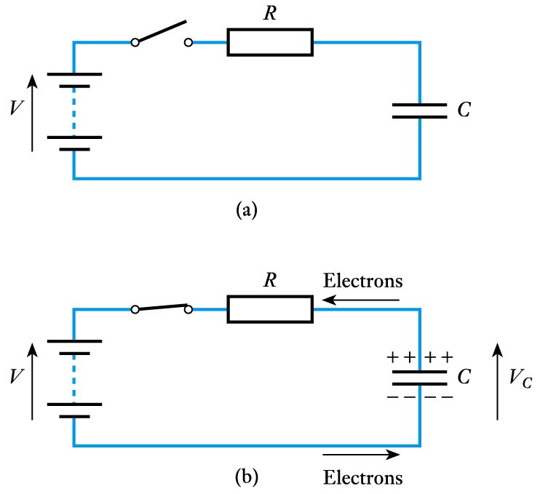
A simple capacitor
circuit
  when switch is closed electrons flow from top plate into battery and from battery onto bottom plate
  charge produces an electric field across the capacitor and a voltage across it

Slide 6
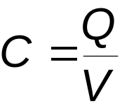
For a given capacitor the stored charge q is directly proportional to the voltage across it V
The constant of proportionality is the capacitance C and thus
If the charge is measured in coulombs and the voltage in volts, then the capacitance is in farads

Slide 7
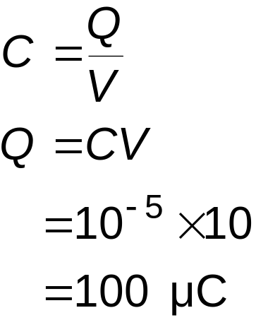
Example – see Example 13.1 in course text
A 10 μF capacitor has 10 V across it. What quantity of charge is stored in it?
From above

Slide 8
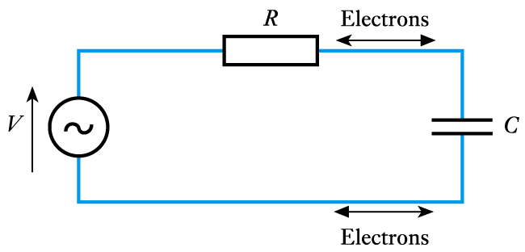
Alternating Voltages and Currents
13.3
A constant current cannot flow through a capacitor
  however, since the voltage across a capacitor is proportional to the charge on it, an alternating voltage must correspond to an alternating charge, and hence to current flowing into and out of the capacitor
  this can give the
  impression that an
  alternating current
  flows through the
  capacitor

Slide 9
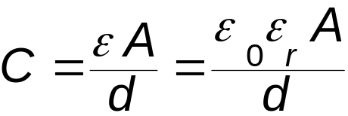
The Effect of a Capacitor’s Dimensions
13.4
The capacitance of a capacitor is directly proportional to its area A, and inversely proportional to the distance between its plates d. Hence C ∝ A/d
  the constant of proportionality is the permittivity ε of the dielectric
  the permittivity is normally expressed as the product of the absolute permittivity ε₀ and the relative permittivity ε_{r} of the dielectric used

Slide 10
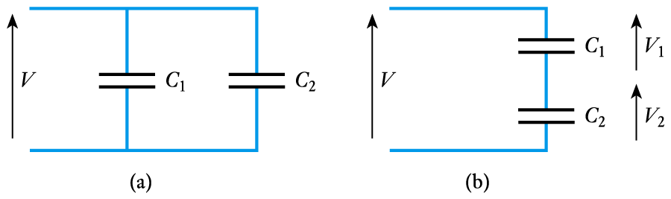


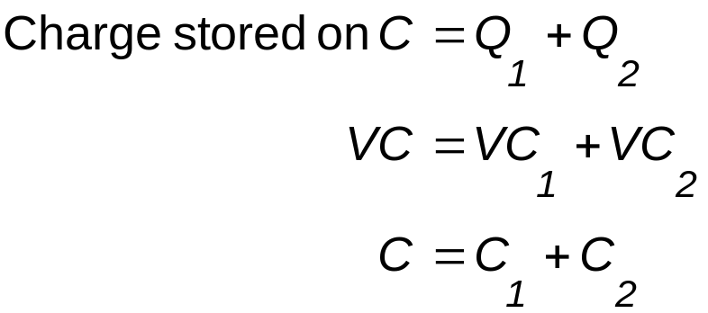
Capacitors in Series and Parallel
13.6
Capacitors in parallel
  consider a voltage V applied
  across two capacitors
  then the charge on each is
  if the two capacitors are replaced with a single capacitor C which has a similar effect as the pair, then

Slide 11
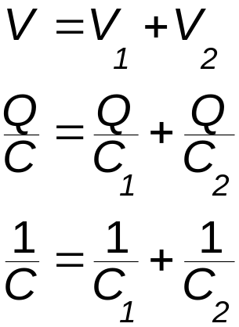
Capacitors in series
  consider a voltage V applied
  across two capacitors in series
  the only charge that can be
  applied to the lower plate of C₁
  is that supplied by the upper plate
  of C₂. Therefore the charge on
  each capacitor must be identical.
  Let this be Q, and therefore if a
  single capacitor C has the same
  effect as the pair, then

Slide 12
Time constant
  charging current is determined by R and the voltage across it
  increasing R will increase the time taken to charge C
  increasing C will also increase time taken to charge C
  time required to charge to a particular voltage is determined by the product CR
  this product is the time constant Τ (greek tau)

Slide 13
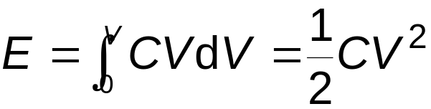
Energy Stored in a Charged Capacitor
13.9
To move a charge Q through a potential difference V requires an amount of energy QV
As we charge up a capacitor we repeatedly add small amounts of charge ΔQ by moving them through a voltage equal to the voltage on the capacitor
Since Q = CV, it follows that ΔQ = CΔV, so the energy needed E is given by

Slide 14
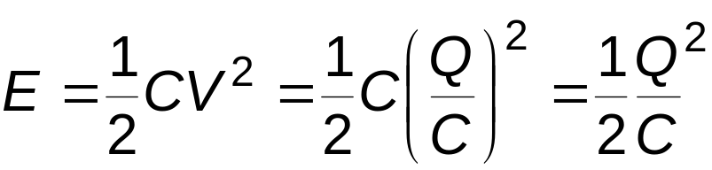
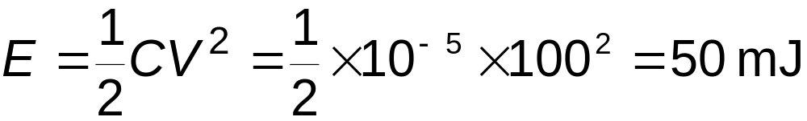
Alternatively, since V = Q/C
Example
Calculate the energy stored in a 10 μF capacitor when it is charged to 100 V.
From above:

Slide 15
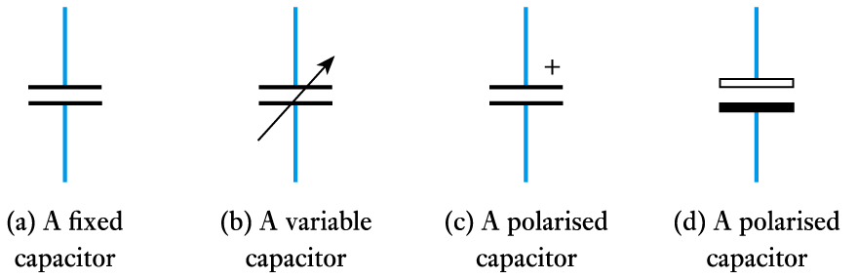
Circuit Symbols
13.10

Slide 16
Key Points
A capacitor consists of two plates separated by a dielectric
The charge stored on a capacitor is proportional to V
A capacitor blocks DC but appears to pass AC
The capacitance of several capacitors in parallel is equal to the sum of their individual capacitances
The capacitance of several capacitors in series is equal to the reciprocal of the sum of the reciprocals of the individual capacitances
In AC circuits current leads voltage by 90° in a capacitor
The energy stored in a capacitor is ½CV² or ½Q²/C

Slide 17
END OF COURSE
☺

