Slide 1
Chapter 15
Oscillatory Motion

Slide 2
Part 2 – Oscillations and Mechanical Waves
Periodic motion is the repeating motion of an object in which it continues to return to a given position after a fixed time interval.
The repetitive movements are called oscillations.
A special case of periodic motion called simple harmonic motion will be the focus.
  Simple harmonic motion also forms the basis for understanding mechanical waves.
Oscillations and waves also explain many other phenomena quantity.
  Oscillations of bridges and skyscrapers
  Radio and television
  Understanding atomic theory
Section Introduction

Slide 3
Periodic Motion
Periodic motion is motion of an object that regularly returns to a given position after a fixed time interval.
A special kind of periodic motion occurs in mechanical systems when the force acting on the object is proportional to the position of the object relative to some equilibrium position.
  If the force is always directed toward the equilibrium position, the motion is called simple harmonic motion.
Introduction

Slide 4
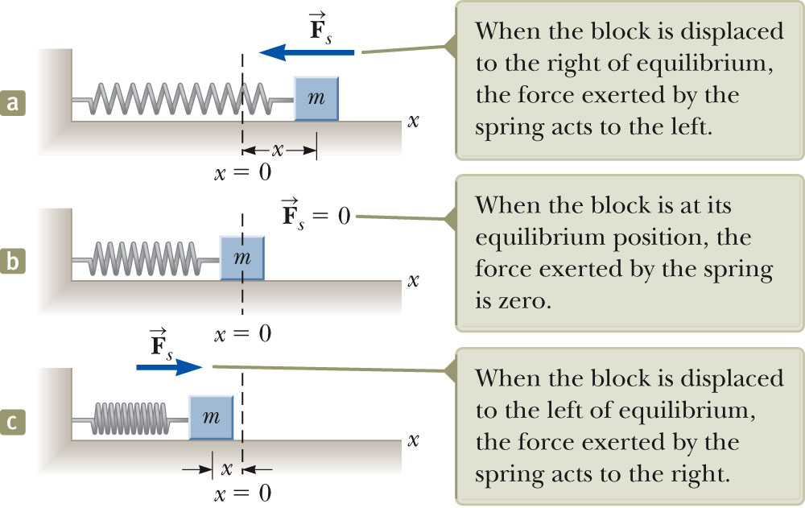
Motion of a Spring-Mass System
A block of mass m is attached to a spring, the block is free to move on a frictionless horizontal surface.
When the spring is neither stretched nor compressed, the block is at the equilibrium position.
  x = 0
Such a system will oscillate back and forth if disturbed from its equilibrium position.
Section 15.1

Slide 5
Hooke’s Law
Hooke’s Law states F_{s} = - kx
  F_{s} is the restoring force.
    It is always directed toward the equilibrium position.
    Therefore, it is always opposite the displacement from equilibrium.
  k is the force (spring) constant.
  x is the displacement.
Section 15.1

Slide 6
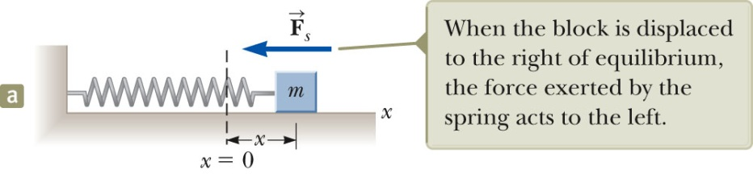
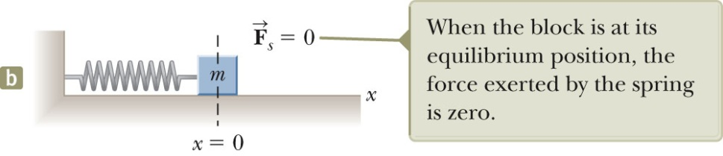
Restoring Force and the Spring Mass System
In a, the block is displaced to the right of x = 0.
  The position is positive.
  The restoring force is directed to the left.
In b, the block is at the equilibrium position.
  x = 0
  The spring is neither stretched nor compressed.
  The force is 0.
Section 15.1

Slide 7
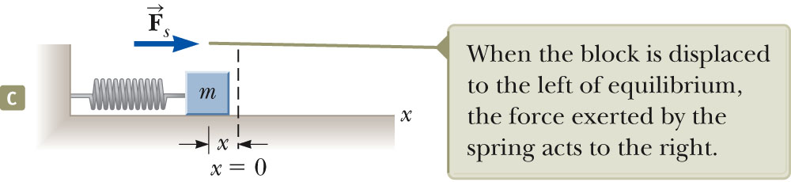
Restoring Force, cont.
The block is displaced to the left of x = 0.
  The position is negative.
  The restoring force is directed to the right.
Section 15.1

Slide 8
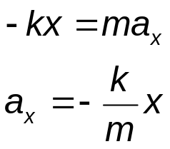
Acceleration
When the block is displaced from the equilibrium point and released, it is a particle under a net force and therefore has an acceleration.
The force described by Hooke’s Law is the net force in Newton’s Second Law.
The acceleration is proportional to the displacement of the block.
The direction of the acceleration is opposite the direction of the displacement from equilibrium.
An object moves with simple harmonic motion whenever its acceleration is proportional to its position and is oppositely directed to the displacement from equilibrium.
Section 15.1

Slide 9
Acceleration, cont.
The acceleration is not constant.
  Therefore, the kinematic equations cannot be applied.
  If the block is released from some position x = A, then the initial acceleration is –kA/m.
  When the block passes through the equilibrium position, a = 0.
  The block continues to x = -A where its acceleration is +kA/m.
Section 15.1

Slide 10
Motion of the Block
The block continues to oscillate between –A and +A.
  These are turning points of the motion.
The force is conservative.
In the absence of friction, the motion will continue forever.
  Real systems are generally subject to friction, so they do not actually oscillate forever.
Section 15.1

Slide 11
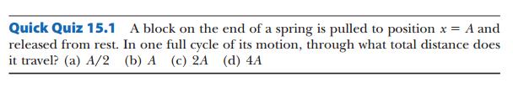

Slide 12
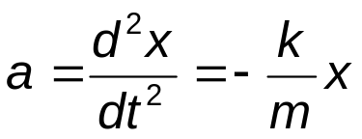
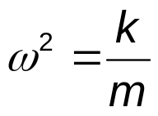
Analysis Model: A Particle in Simple Harmonic Motion
Model the block as a particle.
  The representation will be particle in simple harmonic motion model.
Choose x as the axis along which the oscillation occurs.
Acceleration
We let
Then a = -ω²x
Section 15.2

Slide 13
A Particle in Simple Harmonic Motion, 2
A function that satisfies the equation is needed.
  Need a function x(t) whose second derivative is the same as the original function with a negative sign and multiplied by ω^{2.}
  The sine and cosine functions meet these requirements.
Section 15.2

Slide 14
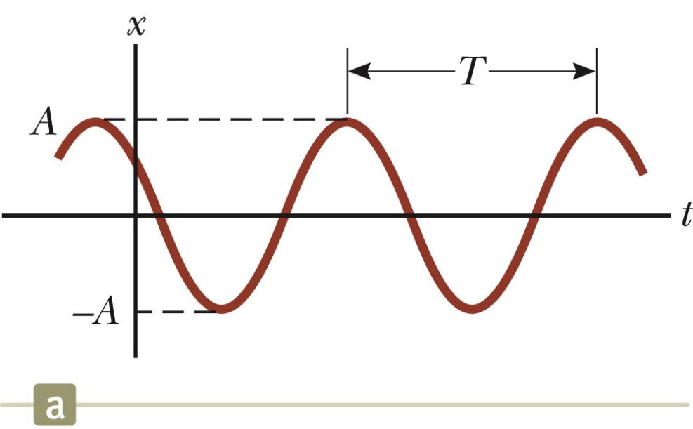
Simple Harmonic Motion – Graphical Representation
A solution is x(t) = A cos (ω t + φ)
A, ω, φ are all constants
A cosine curve can be used to give physical significance to these constants.
Section 15.2

Slide 15
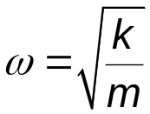
Simple Harmonic Motion – Definitions
A is the amplitude of the motion.
  This is the maximum position of the particle in either the positive or negative x direction.
ω is called the angular frequency.
  Units are rad/s
φ is the phase constant or the initial phase angle.
Section 15.2

Slide 16
Simple Harmonic Motion, cont.
A and φ are determined uniquely by the position and velocity of the particle at t = 0.
  If the particle is at x = A at t = 0, then φ = 0
The phase of the motion is the quantity (ωt + φ).
x (t) is periodic and its value is the same each time ωt increases by 2π radians.
Section 15.2

Slide 17
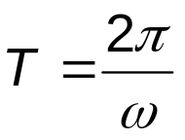
Period
The period, T, of the motion is the time interval required for the particle to go through one full cycle of its motion.
  The values of x and v for the particle at time t equal the values of x and v at t + T.
Section 15.2

Slide 18
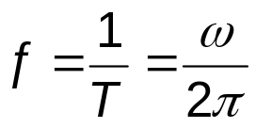
Frequency
The inverse of the period is called the frequency.
The frequency represents the number of oscillations that the particle undergoes per unit time interval.
Units are cycles per second = hertz (Hz).
Section 15.2

Slide 19
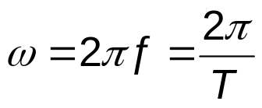
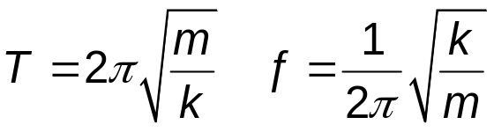
Summary Equations – Period and Frequency
The frequency and period equations can be rewritten to solve for ω.
The period and frequency can also be expressed as:
The frequency and the period depend only on the mass of the particle and the force constant of the spring.
They do not depend on the parameters of motion.
The frequency is larger for a stiffer spring (large values of k) and decreases with increasing mass of the particle.
Section 15.2

Slide 20
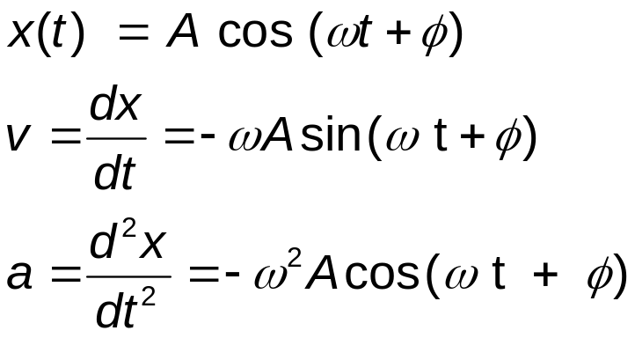
Motion Equations for Simple Harmonic Motion
Simple harmonic motion is one-dimensional and so directions can be denoted by + or - sign.
Remember, simple harmonic motion is not uniformly accelerated motion.
Section 15.2

Slide 21
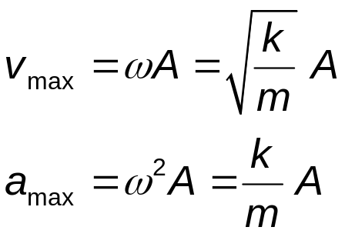
Maximum Values of v and a
Because the sine and cosine functions oscillate between ±1, we can easily find the maximum values of velocity and acceleration for an object in SHM.
Section 15.2

Slide 22
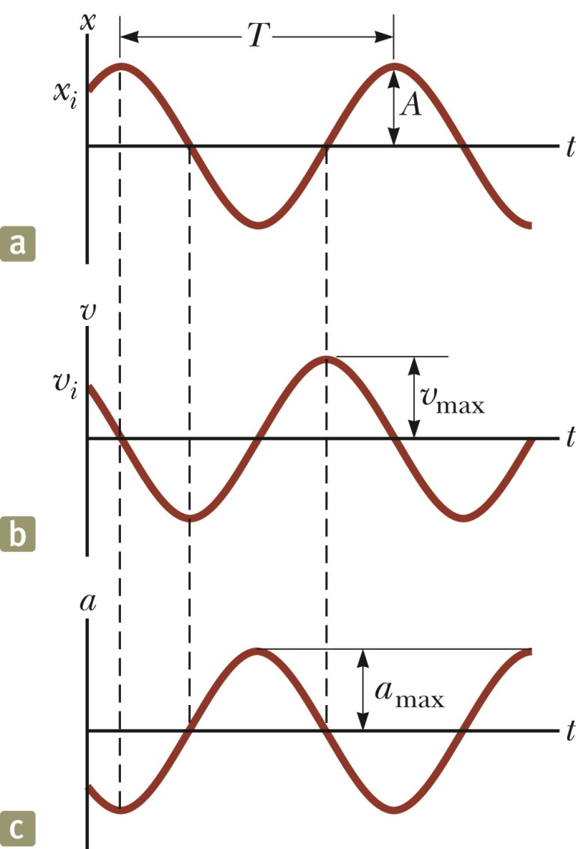
Graphs
The graphs show:
  (a) displacement as a function of time
  (b) velocity as a function of time
  (c ) acceleration as a function of time
The velocity is 90º out of phase with the displacement and the acceleration is 180º out of phase with the displacement.
Section 15.2

Slide 23
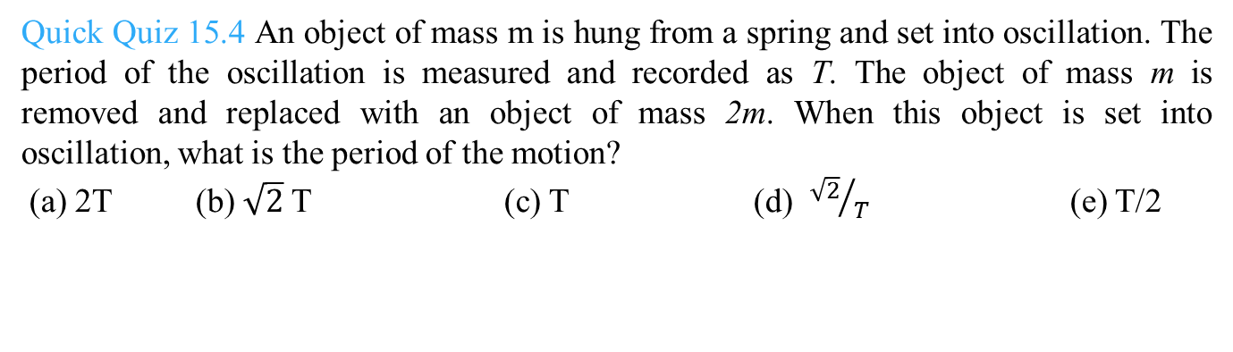

Slide 24
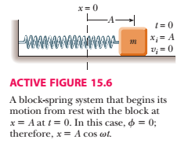

Slide 25
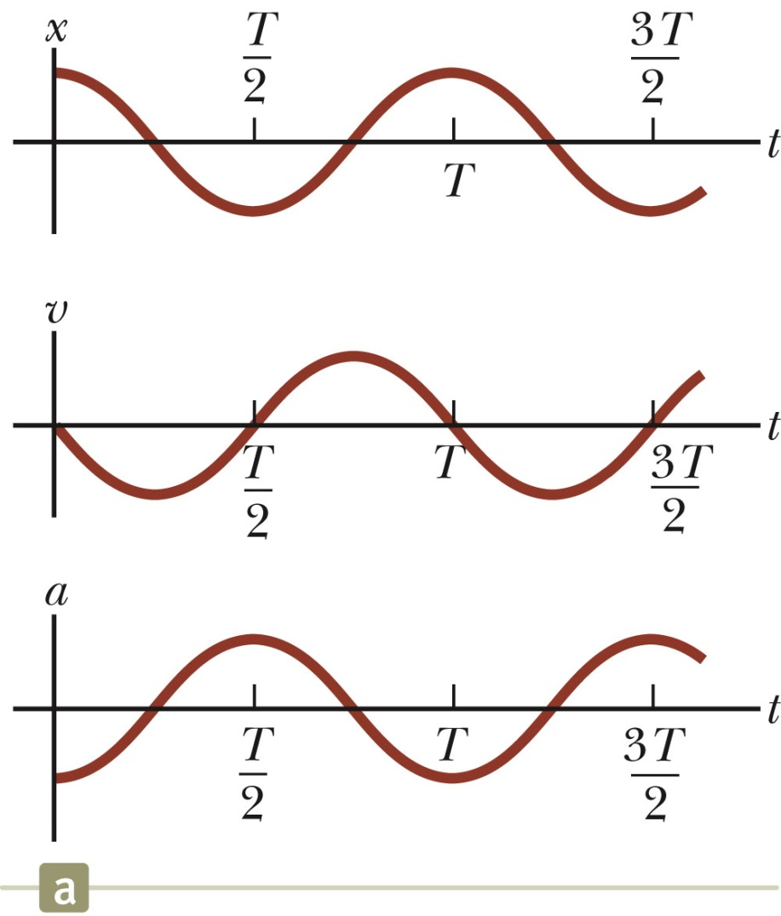
SHM Example 1
Initial conditions at t = 0 are
  x (0)= A
  v (0) = 0
This means φ = 0
The acceleration reaches extremes of ± ω²A at ±A.
The velocity reaches extremes of ± ωA at x = 0.
Section 15.2

Slide 26
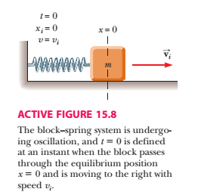

Slide 27
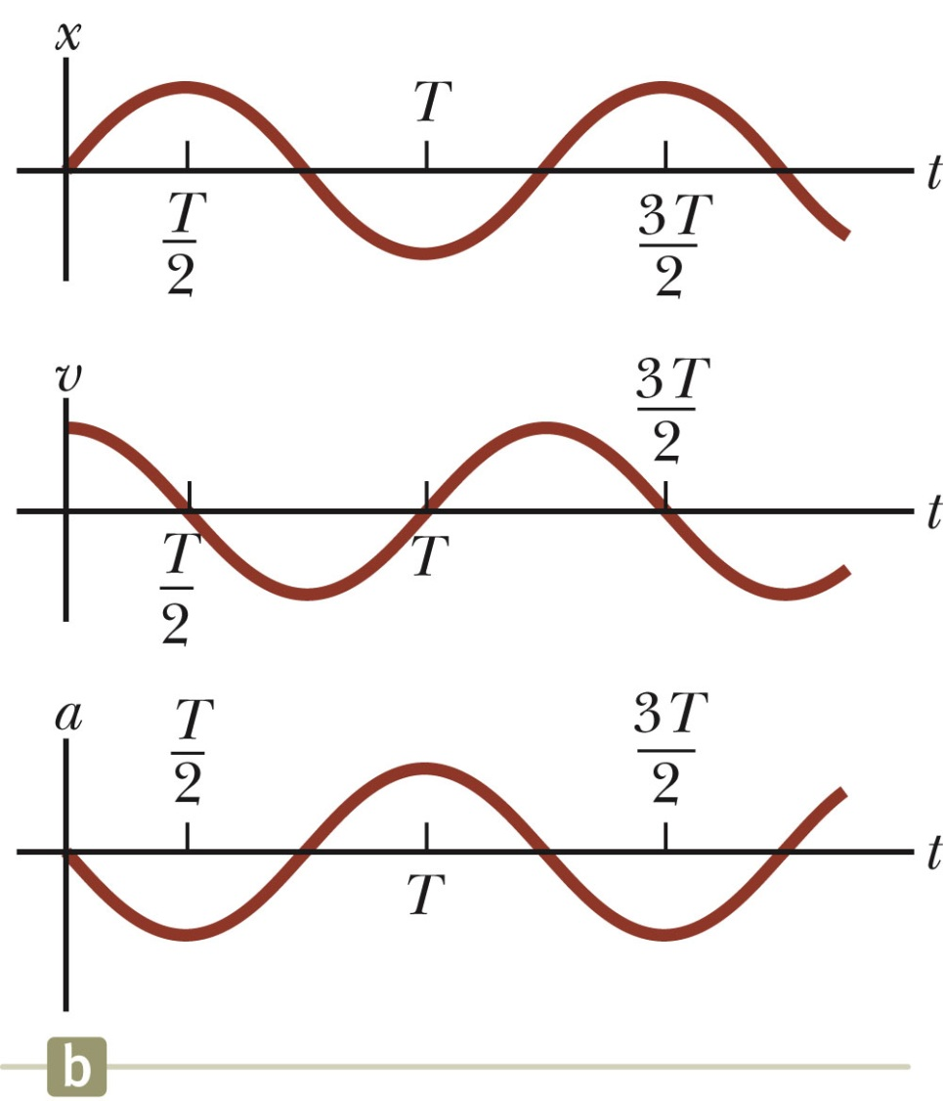
SHM Example 2
Initial conditions at t = 0 are
  x (0)=0
  v (0) = v_{i}
This means φ = − π / 2
The graph is shifted one-quarter cycle to the right compared to the graph of x (0) = A.
Section 15.2

Slide 28
Energy of the SHM Oscillator
Mechanical energy is associated with a system in which a particle undergoes simple harmonic motion.
  For example, assume a spring-mass system is moving on a frictionless surface.
Because the surface is frictionless, the system is isolated.
  This tells us the total energy is constant.
The kinetic energy can be found by
  K = ½ mv ² = ½ mω² A² sin² (ωt + φ)
    Assume a massless spring, so the mass is the mass of the block.
The elastic potential energy can be found by
  U = ½ kx ² = ½ kA² cos² (ωt + φ)
The total energy is E = K + U = ½ kA ²
Section 15.3

Slide 29
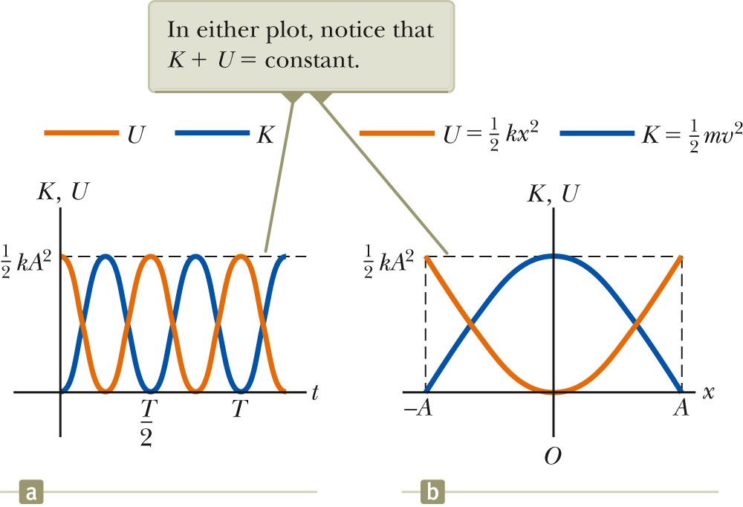
Energy of the SHM Oscillator, cont.
The total mechanical energy is constant.
  At all times, the total energy is
  ½ k A²
The total mechanical energy is proportional to the square of the amplitude.
Energy is continuously being transferred between potential energy stored in the spring and the kinetic energy of the block.
In the diagram, Φ = 0
.
Section 15.3

Slide 30
Energy of the SHM Oscillator, final
Variations of K and U can also be observed with respect to position.
The energy is continually being transformed between potential energy stored in the spring and the kinetic energy of the block.
The total energy remains the same
Section 15.3

Slide 31
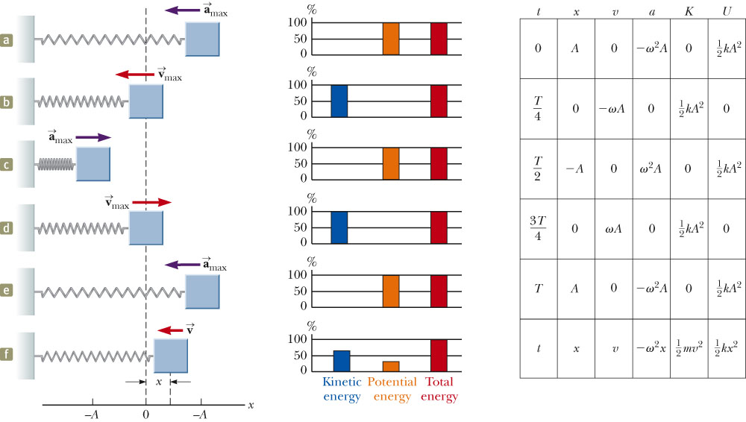
Energy in SHM, summary
Section 15.3

Slide 32
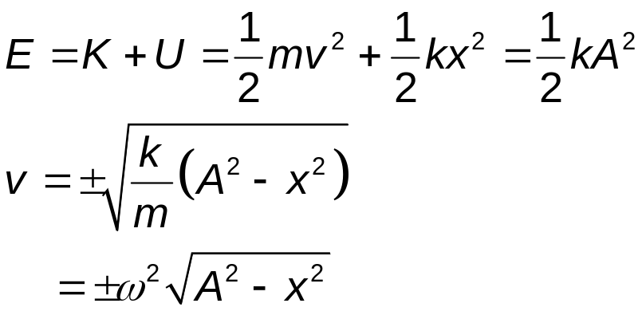
Velocity at a Given Position
Energy can be used to find the velocity:
Section 15.3

Slide 33
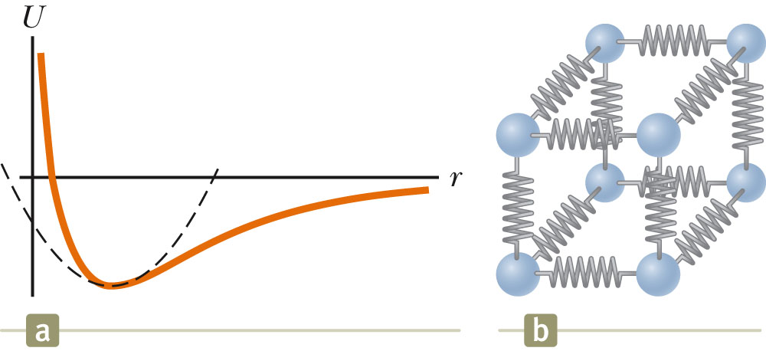
Importance of Simple Harmonic Oscillators
Simple harmonic oscillators are good models of a wide variety of physical phenomena.
Molecular example
  If the atoms in the molecule do not move too far, the forces between them can be modeled as if there were springs between the atoms.
  The potential energy acts similar to that of the SHM oscillator.
Section 15.3

Slide 34
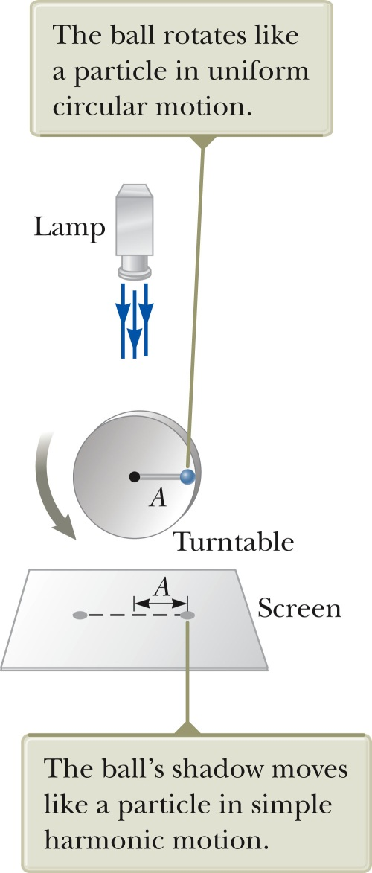
SHM and Circular Motion
This is an overhead view of an experimental arrangement that shows the relationship between SHM and circular motion.
As the turntable rotates with constant angular speed, the ball’s shadow moves back and forth in simple harmonic motion.
Section 15.4

Slide 35
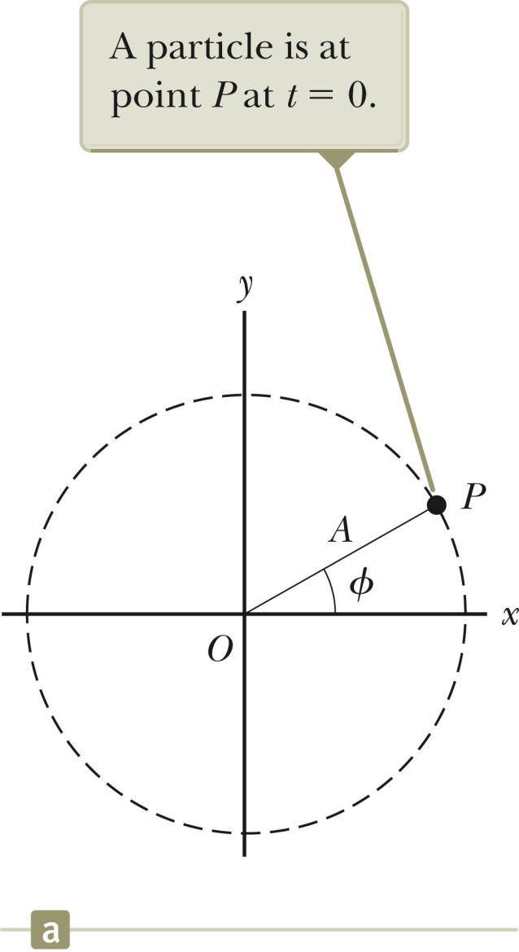
SHM and Circular Motion, 2
The circle is called a reference circle.
  For comparing simple harmonic motion and uniform circular motion.
Take P at t = 0 as the reference position.
Line OP makes an angle φ with the x axis at t = 0.
Section 15.4

Slide 36
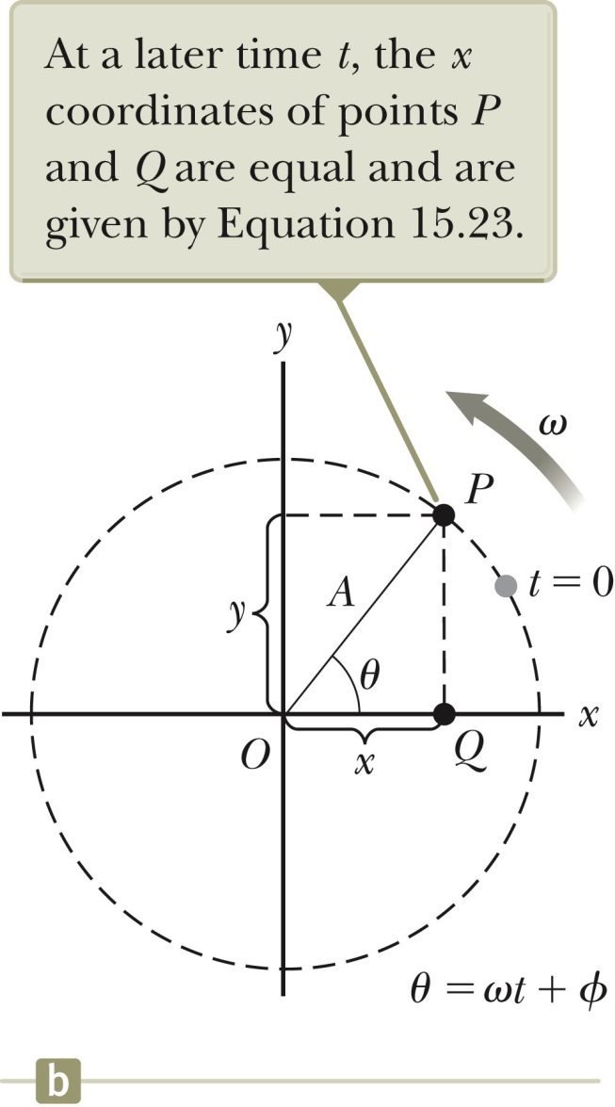
SHM and Circular Motion, 3
The particle moves along the circle with constant angular velocity ω.
OP makes an angle θ with the x axis.
At some time, the angle between OP and the x axis will be θ = ωt + φ.
The points P and Q always have the same x coordinate.
x (t) = A cos (ωt + φ)
This shows that point Q moves with simple harmonic motion along the x axis.
Section 15.4

Slide 37
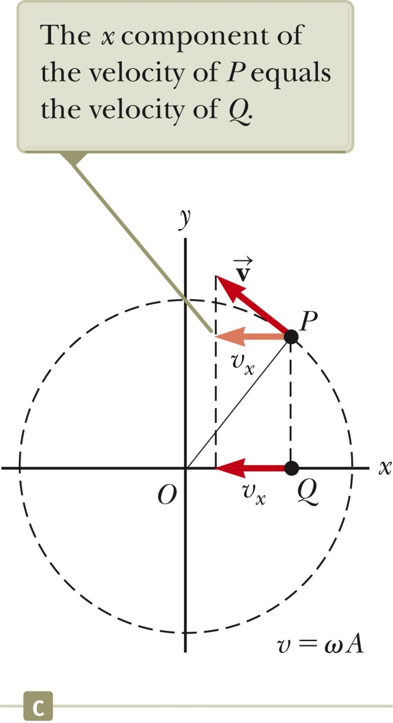
SHM and Circular Motion, 4
The angular speed of P is the same as the angular frequency of simple harmonic motion along the x axis.
Point Q has the same velocity as the x component of point P.
The x-component of the velocity is
v = -ω A sin (ω t + φ)
Section 15.4

Slide 38
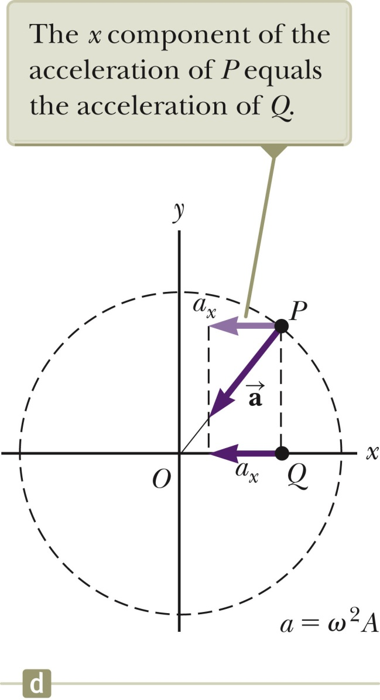
SHM and Circular Motion, 5
The acceleration of point P on the reference circle is directed radially inward.
P ’s acceleration is a = ω²A
The x component is
–ω² A cos (ωt + φ)
This is also the acceleration of point Q along the x axis.
Section 15.4

Slide 39
Simple Pendulum
A simple pendulum also exhibits periodic motion.
It consists of a particle-like bob of mass m suspended by a light string of length L.
The motion occurs in the vertical plane and is driven by gravitational force.
The motion is very close to that of the SHM oscillator.
  If the angle is <10º
Section 15.5

Slide 40
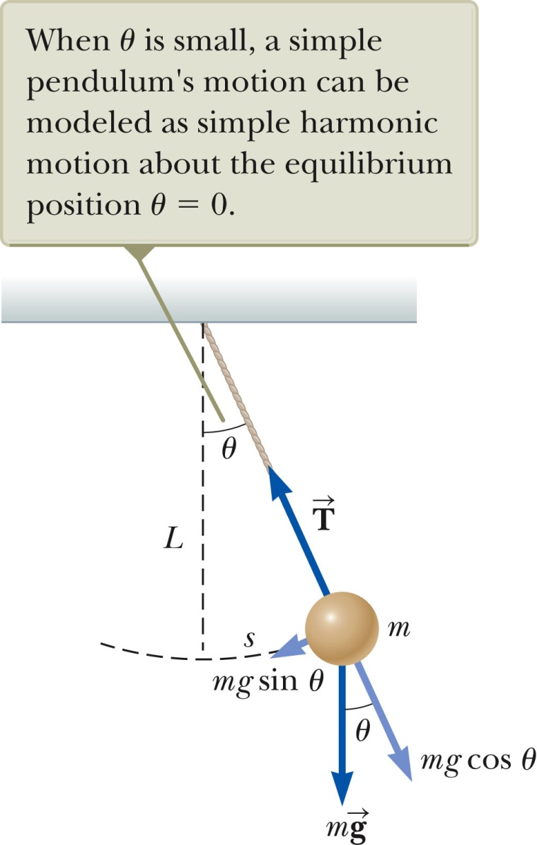


Simple Pendulum, 2
The forces acting on the bob are the tension and the weight.
  is the force exerted on the bob by the string.
  is the gravitational force.
The tangential component of the gravitational force is a restoring force.
Section 15.5

Slide 41
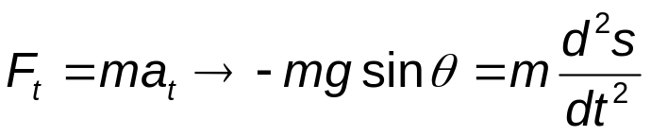
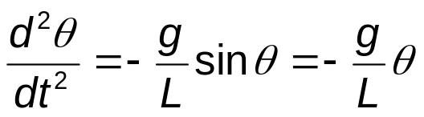
Simple Pendulum, 3
In the tangential direction,
The length, L, of the pendulum is constant, and for small values of θ.
This confirms the mathematical form of the motion is the same as for SHM.
Section 15.5

Slide 42
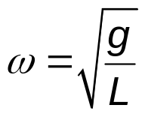
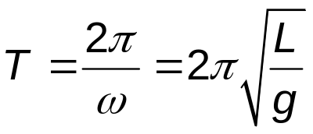
Simple Pendulum, 4
The function θ can be written as θ = θ_{max} cos (ωt + φ).
The angular frequency is
The period is
Section 15.5

Slide 43
Simple Pendulum, Summary
The period and frequency of a simple pendulum depend only on the length of the string and the acceleration due to gravity.
The period is independent of the mass.
All simple pendula that are of equal length and are at the same location oscillate with the same period.
Section 15.5

Slide 44
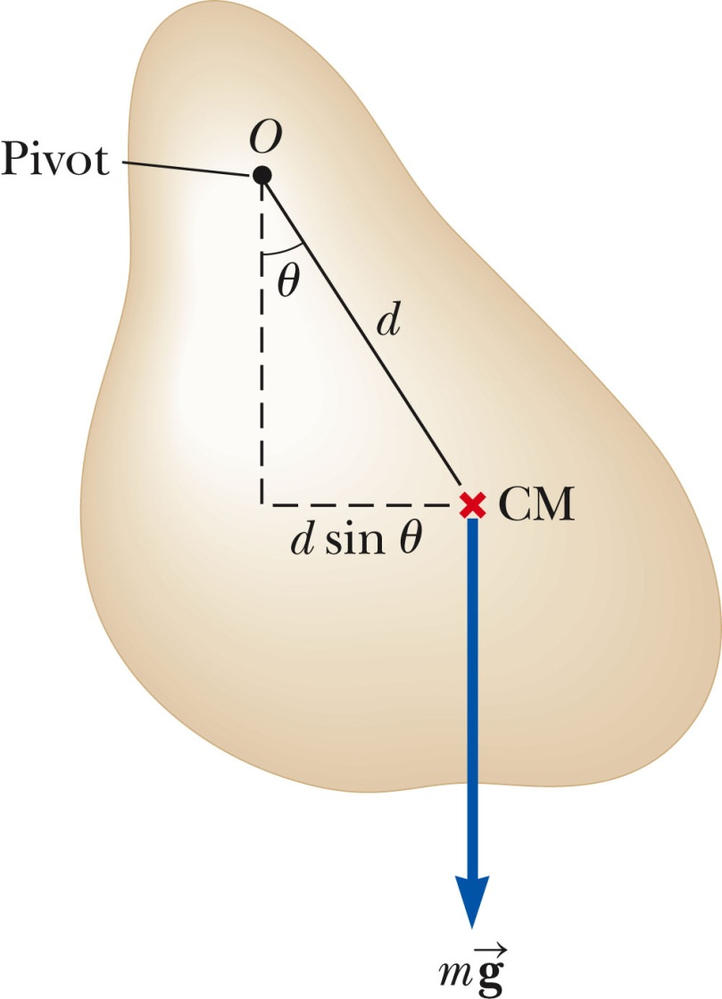
Physical Pendulum, 1
If a hanging object oscillates about a fixed axis that does not pass through the center of mass and the object cannot be approximated as a point mass, the system is called a physical pendulum.
  It cannot be treated as a simple pendulum.
The gravitational force provides a torque about an axis through O.
The magnitude of the torque is
m g d sin θ
Section 15.5

Slide 45
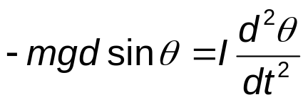
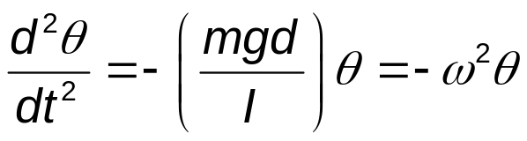
Physical Pendulum, 2
I is the moment of inertia about the axis through O.
From Newton’s Second Law,
The gravitational force produces a restoring force.
Assuming θ is small, this becomes
Section 15.5

Slide 46
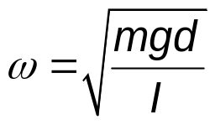
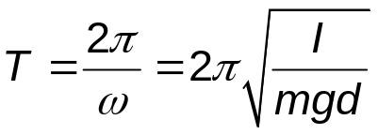
Physical Pendulum, 3
This equation is of the same mathematical form as an object in simple harmonic motion.
The solution is that of the simple harmonic oscillator.
The angular frequency is
The period is
Section 15.5

Slide 47
Physical Pendulum, 4
A physical pendulum can be used to measure the moment of inertia of a flat rigid object.
  If you know d, you can find I by measuring the period.
If I = m d² then the physical pendulum is the same as a simple pendulum.
  The mass is all concentrated at the center of mass.
Section 15.5

Slide 48
Torsional Pendulum
Assume a rigid object is suspended from a wire attached at its top to a fixed support.
The twisted wire exerts a restoring torque on the object that is proportional to its angular position.
Section 15.5

Slide 49
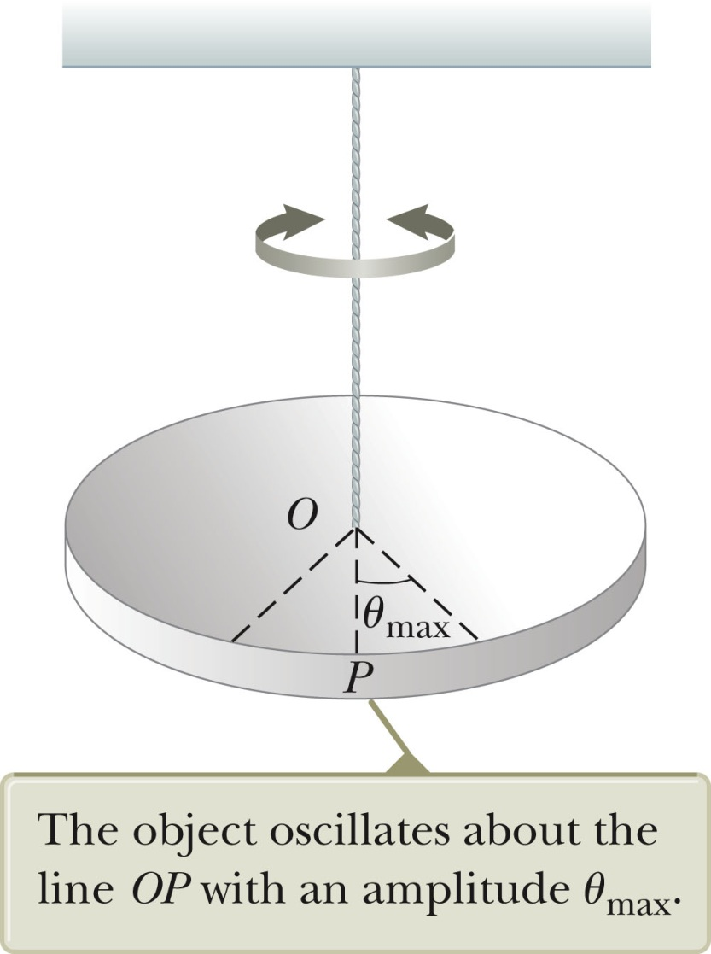
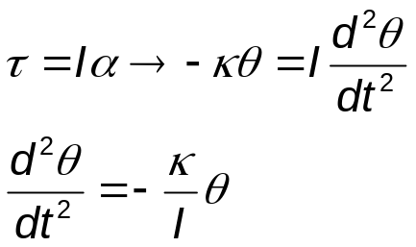
Torsional Pendulum
Assume a rigid object is suspended from a wire attached at its top to a fixed support.
The twisted wire exerts a restoring torque on the object that is proportional to its angular position.
The restoring torque is τ = −κ θ.
  κ is the torsion constant of the support wire.
Newton’s Second Law gives
Section 15.5

Slide 50
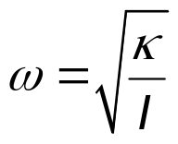
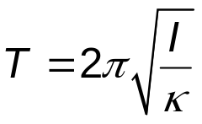
Torsional Period, cont.
The torque equation produces a motion equation for simple harmonic motion.
The angular frequency is
The period is
  No small-angle restriction is necessary.
  Assumes the elastic limit of the wire is not exceeded.
Section 15.5

Slide 51
Damped Oscillations
In many real systems, non-conservative forces are present.
  This is no longer an ideal system (the type we have dealt with so far).
  Friction and air resistance are common non-conservative forces.
In this case, the mechanical energy of the system diminishes in time, the motion is said to be damped.
Section 15.6

Slide 52
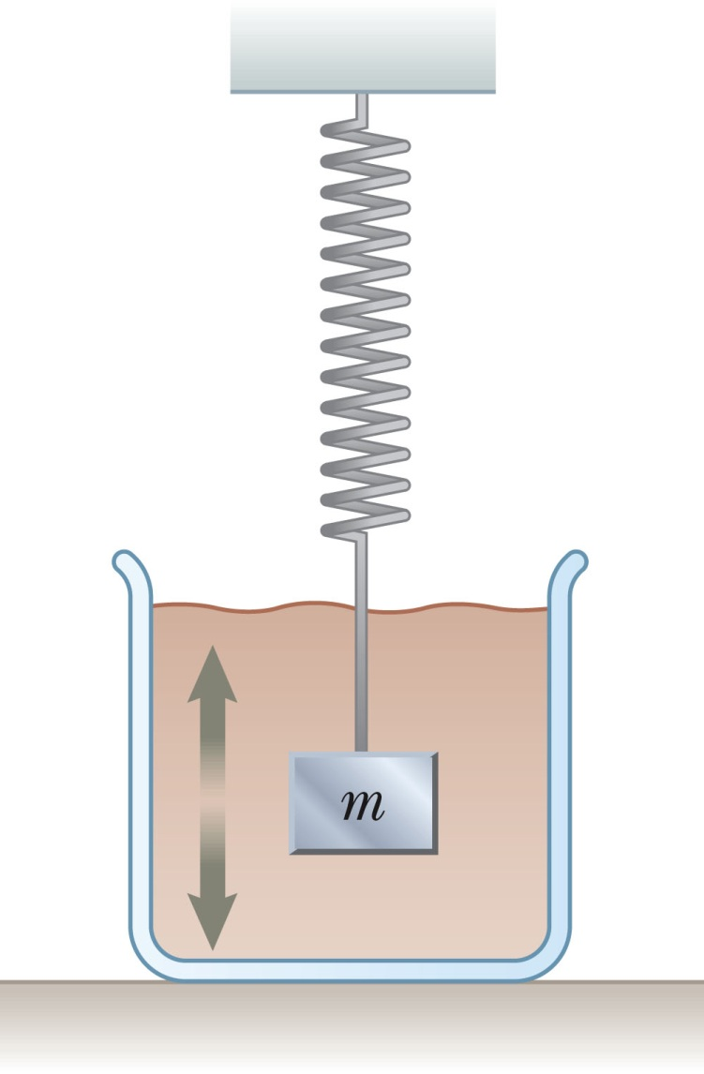

Damped Oscillation, Example
One example of damped motion occurs when an object is attached to a spring and submerged in a viscous liquid.
The retarding force can be expressed as
  b is a constant
  b is called the damping coefficient
Section 15.6

Slide 53
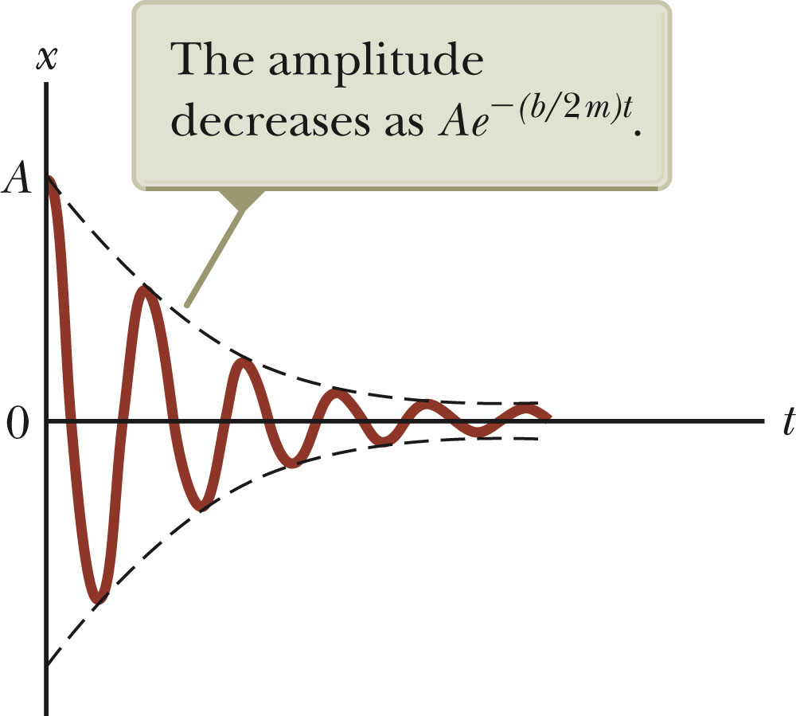
Damped Oscillations, Graph
A graph for a damped oscillation.
The amplitude decreases with time.
The blue dashed lines represent the envelope of the motion.
Use the active figure to vary the mass and the damping constant and observe the effect on the damped motion.
The restoring force is – kx.
Section 15.6

Slide 54
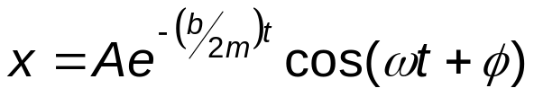
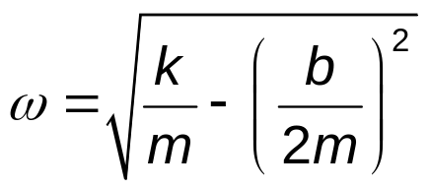
Damped Oscillations, Equations
From Newton’s Second Law
ΣF_{x} = -k x – bv_{x} = ma_{x}
When the retarding force is small compared to the maximum restoring force we can determine the expression for x.
  This occurs when b is small.
The position can be described by
The angular frequency will be
Section 15.6

Slide 55
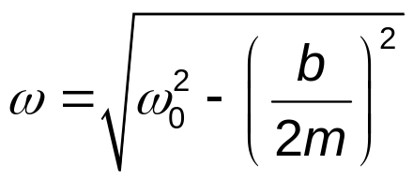

Damped Oscillations, Natural Frequency
When the retarding force is small, the oscillatory character of the motion is preserved, but the amplitude decreases exponentially with time.
The motion ultimately ceases.
Another form for the angular frequency:
  where ω₀ is the angular frequency in the absence of the retarding force and is called the natural frequency of the system.
Section 15.6

Slide 56
Types of Damping
If the restoring force is such that b/2m < ω_{o}, the system is said to be underdamped.
When b reaches a critical value b_{c} such that b_{c} / 2 m = ω₀ , the system will not oscillate.
  The system is said to be critically damped.
If the restoring force is such that b/2m > ω_{o}, the system is said to be overdamped.
Section 15.6

Slide 57

Types of Damping, cont
Graphs of position versus time for
  An underdamped oscillator – blue
  A critically damped oscillator – red
  An overdamped oscillator – black
For critically damped and overdamped there is no angular frequency.
Section 15.6

Slide 58
Forced Oscillations
It is possible to compensate for the loss of energy in a damped system by applying a periodic external force.
The amplitude of the motion remains constant if the energy input per cycle exactly equals the decrease in mechanical energy in each cycle that results from resistive forces.
After a driving force on an initially stationary object begins to act, the amplitude of the oscillation will increase.
After a sufficiently long period of time, E_{driving} = E_{lost to internal}
  Then a steady-state condition is reached.
  The oscillations will proceed with constant amplitude.
Section 15.7

Slide 59

Forced Oscillations, cont.
The amplitude of a driven oscillation is
  ω₀ is the natural frequency of the undamped oscillator.
Section 15.7

Slide 60

Resonance
When the frequency of the driving force is near the natural frequency (ω ≈ ω₀) an increase in amplitude occurs.
This dramatic increase in the amplitude is called resonance.
The natural frequency ω₀ is also called the resonance frequency of the system.
At resonance, the applied force is in phase with the velocity and the power transferred to the oscillator is a maximum.
  The applied force and v are both proportional to sin (ωt + φ).
  The power delivered is
    This is a maximum when the force and velocity are in phase.
    The power transferred to the oscillator is a maximum.
Section 15.7

Slide 61

Resonance, cont.
Resonance (maximum peak) occurs when driving frequency equals the natural frequency.
The amplitude increases with decreased damping.
The curve broadens as the damping increases.
The shape of the resonance curve depends on b.
Section 15.7

