Slide 1
“READING STRATEGIES”
English Composition & Comprehension
Department of Computer Science

Slide 2
WHAT IS READING COMPREHENSION?
Ability to understand information presented in written form

Slide 3
REASONS FOR POOR COMPREHENSION
Inability to understand a word
Inability to understand a sentence
Inability to understand how sentences relate to each other
Inability to understand how information fits together in a meaningful way (organization)
Lack of interest or concentration

Slide 4
NON-VERBAL SIGNALS
Heading
Title
Subheading
Photographs
Captions
Division into Paragraphs
Figures, Graphs, Bar, Bar Charts, etc

Slide 5
PUNCTUATION
Lets eat, grandpa.
Lets eat grandpa.
A woman, without her, man is nothing.
A woman, without her man, is nothing.

Slide 6
AUTHOR’S VIEWPOINT (INFERENCE)
Making inferences or assumptions about the authors viewpoint
Authors can add words like luckily or unfortunately to show approval or disapproval
Surprise: unexpectedly, regrettably, pity
Level of certainty: undoubtedly, naturally, always, often, never
Adding value to words: tiny, huge, gigantic

Slide 7
READING STRATEGIES
Skimming
  To get main idea
Scanning
  To scan for something particular
Intensive Reading
Extensive Reading

Slide 8
SKIMMING
Skimming is reading rapidly in order to get a general overview of the material.

Slide 9
WHY DO WE SKIM?
See what is in the news
Browse through a book to see if you want it
Flick through a catalogue to see what is on offer
Revision before exam

Slide 10
HOW TO SKIM?
Read the title and headings
Read carefully the introductory paragraph
Read carefully the first one or two sentences of each paragraph, as well as the concluding sentence or sentences.
Do read summaries, heading and subheadings.
Look at tables, diagrams, illustrations, etc.
Don't read every word.
Read examples.
Pay attention to diagrams, pictures, charts and figures

Slide 11
CONTINUED…
Let your eyes move over it quickly looking out for important words. Don’t bother with little words like ‘the’, ‘to’ and ‘are’ or the descriptive words like ‘very’.
Table of content, proper noun, unusual words, words underlined or written in bold.
Tips
  Don’t read every word.
  Don’t read every sentence.
  Let your eyes move quickly.
  Keep thinking about the meaning.

Slide 12
SKIMMING ACTIVITY
Read the words that are in larger print in the following slide.

Slide 13
LOST CAT
We lost our cat, Sam on Thursday 2nd October. She has never run away before and we think that she has wandered out and got lost.
BLACK AND WHITE
She’s large, round and healthy looking. She is a well looked after and much loved pet. She was last seen in the
CHAPEL STREET AREA.
If you have seen her or think you know where she might be
Contact:
JULIUS JORDAN
as soon as possible on 727 2496.
REWARD
available for anyone who gives us useful information.
Thank you.

Slide 14
NOW ANSWER THE FOLLOWING:
1. Put into your own words what you think this is about before reading the whole notice.
2. Read the whole notice.
3. What extra information did you get?
4. Did you already have a good idea what the notice was about?

Slide 15
SKIMMING ACTIVITY NO. 2
Read the headlines .
Read the first and last paragraph only.
Read them as quickly as you can.
Think what the newspaper article is about.
Answer the questions at the end of the article.

Slide 16
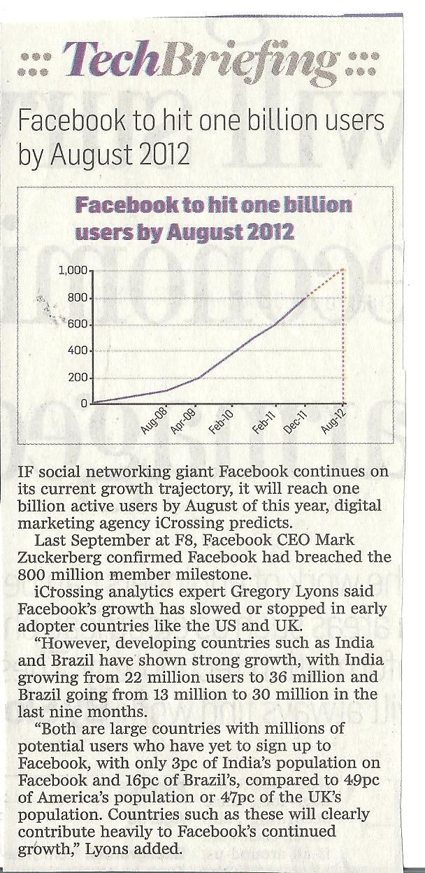

Slide 17
1. From reading the first and last paragraphs, what do you think the article is about?
2. What specific information does it give you?
3. Now read the whole article. What extra information did you get?
4. Did it change your idea of what you thought the article was about?

Slide 18
SCANNING
Scanning is reading rapidly in order to find specific facts.

Slide 19
WHY DO WE SCAN?
Look up a word in a dictionary
Find an address or phone number
Check timings
Check prices in catalogue

Slide 20
HOW TO SCAN?
Anticipate form of information( number, name etc)
Don’t read whole text
Pay attention to anything unusual

Slide 21
SCANNING ACTIVITY NO. 1
Although poetry was Dante Gabriel Rossetti’s first love, as was his sister’s, Christina Rossetti (who was one of the most remarkable poets of her time) he decided on an artistic career. In September 1848, he formed a ‘secret society’ with other painters called the Pre-Raphaelite Brotherhood (PRB). The group aimed to produce work with both aesthetic and moral values.
What was the name of Rossetti’s sister?
What was the title of Rossetti’s secret society?
When was the secret society formed?

Slide 22
SCANNING ACTIVITY NO. 2
How many European countries are in the report on the next slide?
Remember to underline your key words.
What is your key word? Number

Slide 23
ARTICLE
In recent years, evidence has been collected which suggests that the proportion of British children and teenagers who are unhappy is higher than in many other developed countries around the world. For example, a recently published report set out to measure ‘ well-being’ among young people in nineteen European countries, found that the United Kingdom came bottom. The report was based on statistics and surveys in which young people answered questions on a wide range of subject. The United Kingdom is a relatively unequal country with a relatively high proportion of young people living in households. With less than half the national average income. This seems to have a negative effect on how they feel about themselves.

Slide 24
INTENSIVE READING
Intensive reading calls attention to grammatical forms and other surface structure details for the purpose of understanding literal meaning, implications, and the like.

Slide 25
HOW IS INTENSIVE READING DONE?
Every word that is not understood is translated
Thinking about the meaning of what was written
Understanding language structure
Deconstruction of grammar
Comprehension
Syntax

Slide 26
EXTENSIVE READING
Extensive reading involves learners reading texts for enjoyment and to develop general reading skills.

Slide 27
PRINCIPLES OF EXTENSIVE READING
Students read a great deal, quite quickly (at least 150-200 words a minute) and often.
The reading material is relatively easy for the level of the students. Too much unknown language prevents students from reading quickly and fluently.
It is the student, not the teacher, who chooses what to read.
Students have a wide variety of genres and topics to choose from.

Slide 28
Students read for pleasure, information or general understanding.
Reading is individual and silent.

Slide 29
BENEFITS OF EXTENSIVE READING
Students become better reader
Students improve writing
Students become more motivated to read
Students become more empathic

