Slide 1
“COHERENCE IN WRITING”
English Composition & Comprehension
Department of Computer Science

Slide 2
COHERENCE
Arranging Ideas
  Time Order
  Space Order
  Order of Importance
Connecting Ideas
  Repetition of Keywords and Ideas
  Repetition of Structure
  Transition words and Phrases
Unifying Ideas

Slide 3
ARRANGING IDEAS
Logical patterns of arrangement
The most common patterns are general to specific or specific to general
Other most frequently used patterns are time order, space order, and order of importance

Slide 4
TIME ORDER
Chronological order or time wise
Mostly used in narrative essays
Reference to specific times or dates
Includes transition words such as first, then, and last to indicate the passage of time

Slide 5
The beginning of each school term marks a period of rebirth for college campuses. Before the term begins, the campus is strangely vacant and quiet. Then students begin to move into the dorms, carrying suitcases, trunks, and boxes from their cars to their assigned rooms. Shouts of laughter, yells of greeting, and wave of excitement rings across the campus as students resume their interrupted relationships and establish new ones. Meanwhile, maintenance crews move busily around the campus. A few days later, teachers arrive, coming to their offices to plan for their classes, going to the library to complete a last bit of research. Finally, on the day classes begin, all the students flood the campus.

Slide 6
SPACE ORDER
Passages describing place or people are arranged in space order
Objects or details arranged in the order in which they were observed
For example, in a description of the room, the writer may describe objects from left to right, from floor to ceiling, or from the outside walls to the center of the room.
In description of a landscape, the writer could move visually from far to near or from near to far
Composition arranged in space order often includes reference to direction such as right, left, up, down, beyond or behind

Slide 7
The view from the front door was breathtaking. Immediately in front of the house, to the west, was a small dirt road, and beyond this road the land dropped sharply so that the entire valley was visible. The broad valley was cut down the center by the river, a curving blue-white scar across the pale green belt that covered most of the valley. Rising above the cliffs were the distant mountains.

Slide 8
ORDER OF IMPORTANCE
Arranged according to their order of importance
Writers may begin with most important supporting points and end with the least important.
Some may begin with least important and end with the most important, allowing them to build a high point, or climax

Slide 9
Several considerations should influence your choice of a career. First, you should choose a career that will provide the lifestyle you want. If living in an expensive house and driving a big car are your goals, you should decide to be a schoolteacher or an engineer. Although it is possible to make a good living in these professions, most teachers and engineers make rather modest salaries, especially at the beginning of their careers. Second, and more important, you should choose a career for which you have an aptitude. Even though you may love art, if you have no talent as an artist, you will not be successful. Finally, and most important, you should choose a career you will enjoy.

Slide 10
CONNECTING IDEAS
Second important method of achieving coherence is to use various types of transitions to connect ideas clearly and logically.
Transition can be defined as the clues, or signals, a writer provides to help a reader see the connections between ideas.
Ideas can be connected by:
  Repetition of key words and ideas
  Repetition of structure
  Transition words and phrases

Slide 11
REPETITION OF KEYWORDS AND IDEAS
Ideas can be connected with the help of:
  Repeating the same word
  Using a more specific word or phrase for the same idea
  Using a word or phrase with a similar meaning (a synonym)
  Substituting a pronoun

Slide 12
  Repeating the same word
  The sea can be beautiful, but the sea can also be dangerous.
  Using a more specific word or phrase for the same idea
    In Literature, birds often appear as symbols. For example, the robin may symbolize hope.
  Using a word or phrase with a similar meaning (a synonym)
  The candidate made an attempt to convince voters, but his try was unsuccessful.
  Substituting a pronoun
    The professor started her lecture on the Arts, but she was unable to finish it before the bell rang.

Slide 13
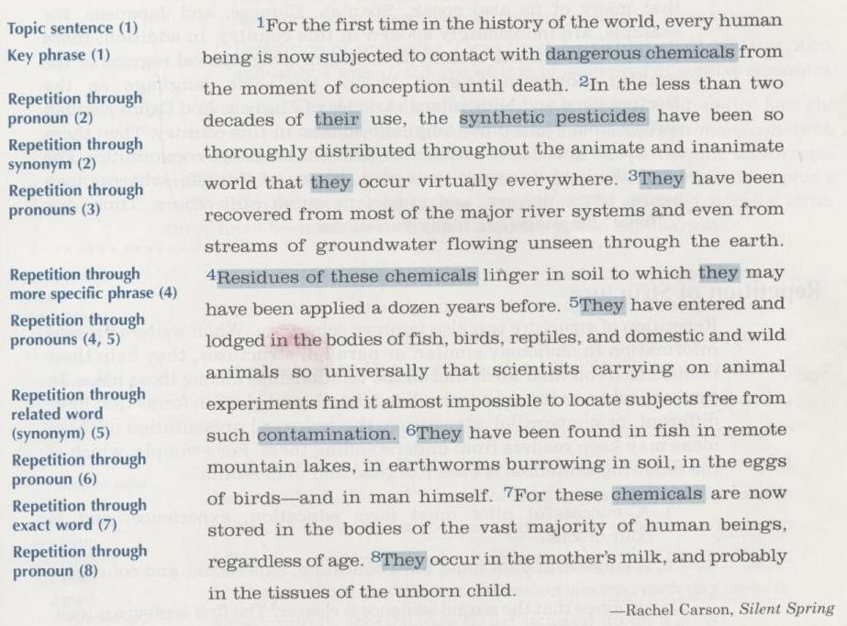

Slide 14
REPETITION OF STRUCTURE
Parellel structure
A successful pilot must have education, experience, and is courageous.
A successful pilot must have education, experience, and courage.
Coherence can be achieved by the following major types of structural repetitions:
  Word forms
  Phrases
  Clauses
  Sentences.

Slide 15
Repetition of word form:
The coach fired the punter, traded a running back, and hired a new receiver. (repetition of verbs of similar structure)
Repetition of Phrases:
The child looked everywhere for the missing ball-in the closet, behind the door, and under the bed.
Repetition of Clauses:
  It was obvious that I had failed and that she had succeeded.
Repetition of Sentences:
I was tired. I was hungry. I was lost. And suddenly I was afraid.

Slide 16
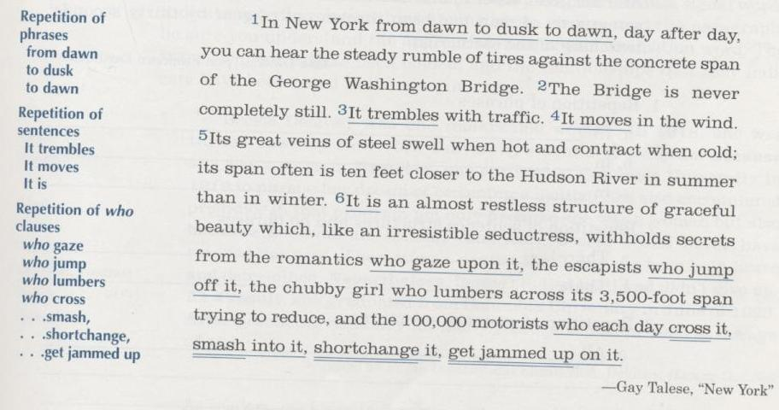

Slide 17
TRANSITION WORDS AND PHRASES
Signal change
Alerts readers to “shift gears”
The word “however” signals contrast
The words “next” or “then” signal progression

Slide 18
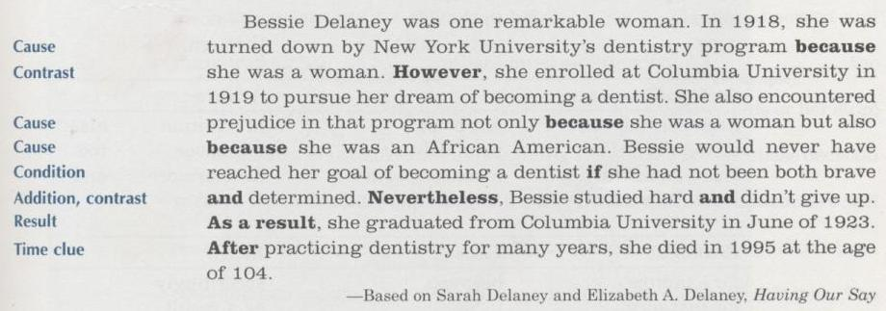

Slide 19
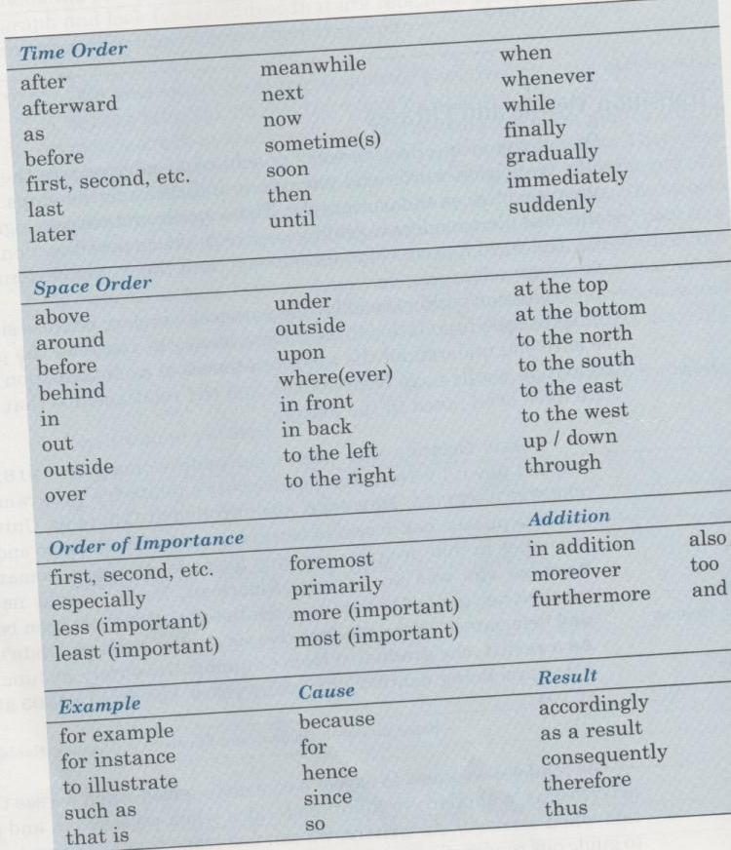

Slide 20
UNIFYING IDEAS
Major points should relate clearly to the main idea
Each detail should be clearly connected to the point it is intended to develop

Slide 21
Several important advances toward democracy have occured under trees. King John signed the Magna Carta under the giant Arkenwyke. To save their charter from their cruel governor, the people of Hartford hid it in what has came to be known as the Charter Oak. My own grandfather was born under an oak tree as his family travelled to California. Finally, it was under an elm tree, later known as the Washington Elm, that George Washington accepted the command of the Revolutionary Army that fought for the colonies.

