Slide 1
“Paragraph Writing”
English Composition & Comprehension
Department of Computer Science

Slide 2
What is a Paragraph?
A paragraph is often defined as a group of related sentences in which one single, main idea is developed. In a typical paragraph, the first sentence declares the main topic of the paragraph and the rest of the sentences develop or support the main idea. A paragraph is most often a part of a longer composition comprising of several paragraphs.

Slide 3
A Good Paragraph has . . .
▪ Unity
▪ Support
▪ Coherence
▪ Good Language
▪ Variety of Structures m

Slide 4
Unity
One main idea
Topic Sentence
Supporting Sentences

Slide 5
Coherence
Well organized details
• Spatial
• Chronological
• Importance
• logical
A clear, sensible connection
Linkers/connectors

Slide 6
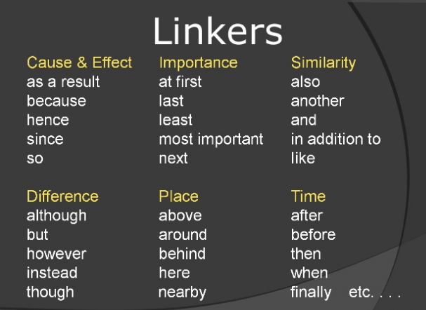

Slide 7
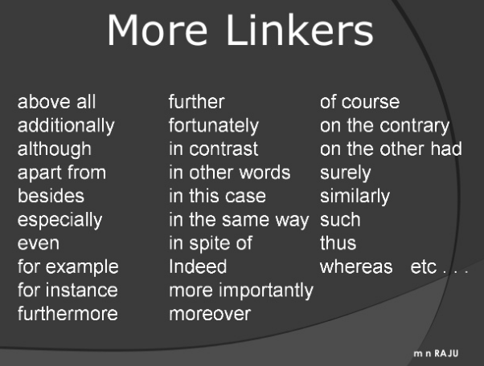

Slide 8
Parts of a Good Paragraph
TOPIC SENTENCE
SUPPORTING DETAILS
CLOSING SENTENCE
TRANSITION SENTENCE

Slide 9
TOPIC SENTENCE!
What is it?
Usually the first sentence in a paragraph
What does it do?
It introduces the main idea of the paragraph
How do I write one?
Summarize the main idea of the paragraph

Slide 10
SUPPORTING DETAILS
What are supporting details?
They come after the topic sentence
They make up the body of the paragraph
What do they do?
They give details and support the main idea
How do I write them?
Give supporting facts, details, and examples

Slide 11
CLOSING SENTENCE
What is it?
The last sentence in a paragraph
What does it do?
It restates the main idea
How do I write one?
Restate the main idea but using different words. The closing sentence should be very similar to the topic sentence.

