Slide 1


CS118: Programming Fundamentals Square Root Execution
Dr. Mohammad Nauman
Assistant Professor (CS), National University of Computer and Emerging Sciences
mohammad.nauman@nu.edu.pk
http://recluze.net

Slide 2
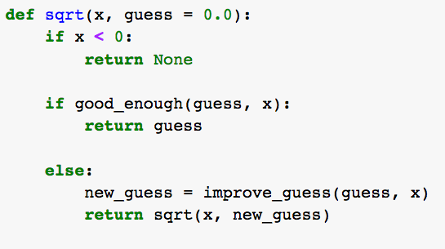
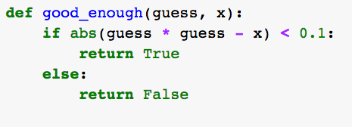
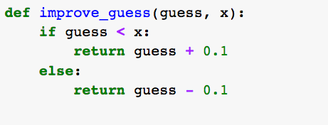
1

Slide 3
2

Slide 4
3

