Slide 1
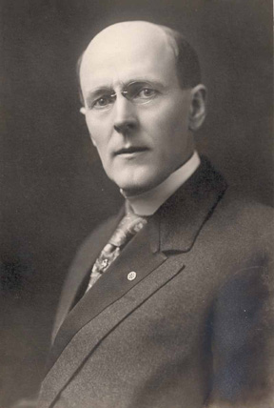
RI Strategic Plan
2008-09 Zone Institutes
November 8, 2026
“What Rotary will be one hundred years hence, none living can imagine. There is nothing impossible to Rotary now.”
    Paul Harris, Feb. 1915
Notes:
RI Strategic Plan Update, 2008 Zone Institutes
Greetings, my fellow Rotarians and the Family of Rotary,
Today, I will provide you an update on the RI Strategic Plan and will ask you to help me promote the message to your fellow Rotarians, club and district leaders, and, even more importantly, prospective members and your non-Rotarian associates.
Our founder saw the importance of having a vision and taking the necessary actions to make it happen. More than 100 years later, the RI Strategic Plan recognizes this also. The RI Strategic Plan outlines that vision today with its emphasis on the most critical aspects to help Rotary make the impossible possible.

Slide 2
Integrated Planning Efforts
RI &
Board
RI Committees, Coordinators
and Senior Leaders
Rotary Clubs & Districts
Impacting Local and International Communities
Notes:
RI Strategic Plan Update, 2008 Zone Institutes
Long-range planning is a tremendous challenge for any organization—and Rotary is no different. Our significant challenges can be addressed through long-range planning—focusing on consistency and continuity. The current plan is an initiative that the Board feels can set the stage for more long-term successes and take advantage of the unique history and image of Rotary.
The Board recognized the necessary integration within RI for a long-term plan to be successful. If the key “stakeholders” in our organization are aware of the plan and understand their roles, we have a greater chance for success. With your help, we can provide greater assurance that the plan will be successful.

Slide 3
Endorsed Mission & Vision
…to provide service to others, promote high ethical standards, and advance world understanding, goodwill, and peace through its fellowship of business, professional, and community leaders
…universally recognized for our commitment to Service Above Self to advance world understanding, goodwill, and peace.
Notes:
RI Strategic Plan Update, 2008 Zone Institutes
In June 2007, the RI Board of Directors endorsed the mission and vision statements. Of course, the key historical characteristic of our organization remain relevant
Service—specifically, Service Above Self
High Ethical Standards
World Understanding
Goodwill
Peace
Through its grass-root members
The hope is that through our service efforts Rotary will gain greater recognition and public understanding of our movement which will help us achieve the goals of our organization.

Slide 4
Leadership
Diversity
Service
Rotarian Core Values
Fellowship
Integrity
Definitions at www.rotary.org
Notes:
RI Strategic Plan Update, 2008 Zone Institutes
The Board agreed to address in the RI Strategic Plan the core values that Rotarians hold dearest. The Board and Strategic Planning Committee agreed that these are the non-negotiable characteristics that define Rotarian values and make them unique. The more detailed definitions and how they relate to the RI Strategic Plan are provided at www.rotary.org in the plan documents.

Slide 5
Endorsed Priorities
Eradicate Polio
Advance recognition and public image of RI
Increase capacity to serve others
Expand membership globally
Emphasize unique vocational service commitment
Optimize leadership talents within RI
Implement strategic planning process throughout organization
Notes:
RI Strategic Plan Update, 2008 Zone Institutes
Here is a list of the priorities. Of course, the Board will continue to emphasize that eradication of polio is the highest priority of the organization—as endorsed by the COL. All of the other priorities collectively are of equal importance.
SPEAKER REVIEWS THE PRIORITIES ON SLIDE
Each priority is supported by a series of goals that are available in the plan documents on www.rotary.org.

Slide 6

Highlights & Successes
Polio eradication grant from Gates
Help End Polio Now!
Promote Rotarian and general giving www.rotary.org/endpolio
Notes:
RI Strategic Plan Update, 2008 Zone Institutes
Everyone knows that polio eradication has been and continues to be our #1 priority. With the help from the Gates Foundation and our other partners, we are closer than ever…and the future is very exciting.
Polio can be eradicated:
Cases worldwide have fallen by 99% since 1985
Infusion of new money from the Bill & Melinda Gates Foundation provides much needed funds for additional rounds of national immunization days in the four polio endemic and other high risk countries.
Funds from Rotary’s US$100 Million Challenge will bring us even closer to finally eradicating polio.
Rotarian and the general public are being asked to help the organization achieve its top priority by helping end polio now. We ask for your support by promoting the initiative and creating excitement about this extraordinary opportunity.
Find out more at www.rotary.org/endpolio.

Slide 7



Highlights & Successes
Continued focus on public relations
Make Dreams Real through Membership
Leadership Development Guide online
Public relations grants (due 1 Oct)
Notes:
RI Strategic Plan Update, 2008 Zone Institutes
Public relations efforts help achieve several of the goals of Rotary International—increasing membership and advancing recognition of the efforts of Rotary International and Rotary clubs around the world. The Board has continued its emphasis on the importance of public relations by committing US 2 million dollars to Rotary districts in 2008-09 through public relations grants. Recent surveys of the general public will serve as a baseline to measure the success of our efforts.
Membership is a critical priority of the organization. Past initiatives by the president’s office are being re-emphasized again this year by President D.K. Lee. He is promoting, encouraging, and rewarding membership growth during his year. His twelve scheduled international presidential conferences will focus on identifying practices for member recruitment and retention. Club members will be recognized with the 2008-09 New Member Sponsor Pin. Additionally, clubs and districts should utilize the Membership Development Resource Guide, a comprehensive handbook for recruiting, retaining, orienting, and inducting club members. RI’s priorities can be achieved by any club or district that makes membership a priority.

Slide 8

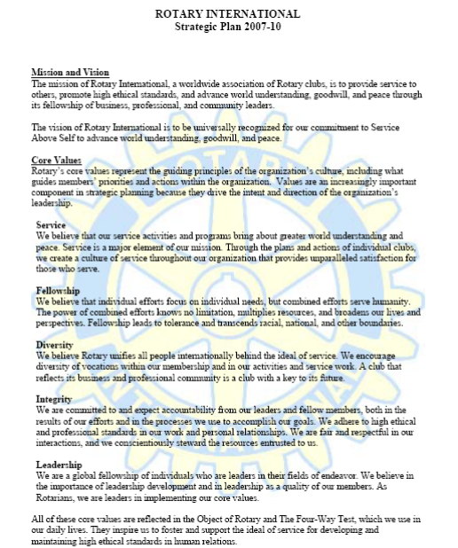
Highlights & Successes
E-Learning Center
Governance structure committing to Strategic Plan
Notes:
RI Strategic Plan Update, 2008 Zone Institutes
Rotary International's center for online learning provides for the independent study of RI information. Learning modules, which are in PowerPoint, are available for
New member information
RI programs information
Club officer information Club and district administration tutorials
Online evaluation
We are seeing a significant commitment to strategic approaches at the leadership level. The board of directors is committed to a consistent, continuous focus on the significant issues facing the organization.

Slide 9
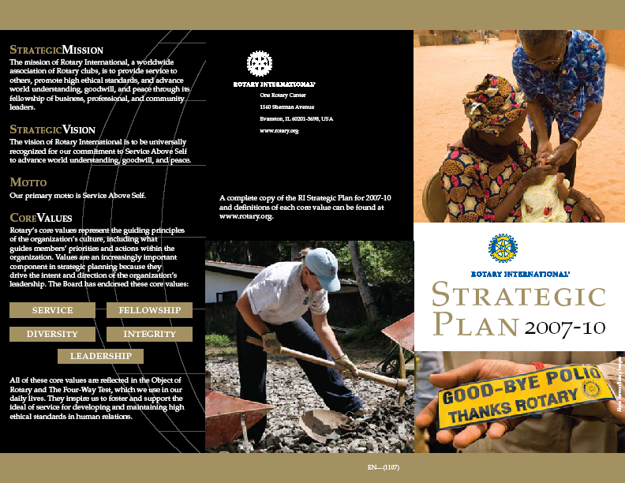
Highlights & Successes
Future Vision Plan progress
Dissemination of plan via web, articles, brochures, presentations
…to enable Rotarians to advance world understanding, goodwill, and peace through the improvement of health, the support of education, and the alleviation of poverty
Notes:
RI Strategic Plan Update, 2008 Zone Institutes
In recent years, many Rotarians have questioned the efficiency of our programs, activities, processes, and systems. Others contend that Rotary’s humanitarian work is not getting the public attention that it deserves. The Rotary Foundation Future Vision Plan offers us a way to address such issues by streamlining our programs, activities, and processes and focusing our efforts on those areas where we can make the greatest impact.
Like all visionary endeavors, this plan requires change—change in the focus of our projects, in the way we distribute funds, and, most important, in our overall culture. I think we can all agree that transforming our culture presents a greater challenge than making cosmetic changes to our programs and processes. But an organization that refuses to change and fails to grow and develop becomes not a thriving force for the future but a footnote in history.
Look for current and future updates about the RI Strategic Plan and the Foundation Future Vision Plan in many communications from Rotary, especially at www.rotary.org.

Slide 10
Next Steps
Survey of Rotary world
Review of Governance Practices
Update on Progress / Actions
Continue Promotion & Communication of Plan
Notes:
RI Strategic Plan Update, 2008 Zone Institutes
The RI Board and the Strategic Planning Committee still has much work to do as long-range planning is an iterative process. The expectations and needs of our fellow Rotarians will be obtained in the future through a focused survey. We will continue to assess our governance practices to put in place the most effective practices of leading organizations. And, we will continue to update and communicate progress on the goals of the organization.

Slide 11
Major Challenges & Opportunities
Qualified membership development and retention
Successful, interesting meetings to attract and retain members
Involvement in all Four Avenues of Service
Reaching outside of the Family of Rotary for membership opportunities
Improve continuity and consistency—utilize the concepts in the Club Leadership Plan
What’s in it for me? Addressing the needs of tomorrow’s business, professional and community leaders
Notes:
RI Strategic Plan Update, 2008 Zone Institutes
Here are just some of the major challenges we are hearing about that the organization is trying to address. (SPEAKER—Highlight the bullets)
We continue to address these challenges to ensure Rotary maintains its relevance but also evolves in the competing industry of volunteerism.

Slide 12
Together We Can
Achieve Our Mission
Promote the plan
Inform your fellow Rotarians
Align your club and district plans accordingly
Learn more at www.rotary.org
“Whatever Rotary may mean to us, to the world it will be known by the results it achieves.”
  Paul Harris, Message to 1914 RI Convention, Houston, Texas, USA
Notes:
RI Strategic Plan Update, 2008 Zone Institutes
So, how can you help?
The Board is asking for your help in educating your fellow Rotarians on the responsibility they have at the local level. You can help the Board gain consensus throughout the Rotary world on the key goals by promoting the plan and informing your fellow Rotarians about the strategic direction of the organization. Utilize tools like the Club and District Leadership Plans to create an environment of consistency and continuity in your clubs and districts.
And, remember, it is Rotarians and Rotary clubs that will achieve the results that our organization will be known for throughout the world. Our founding father recognized that in the early stages Rotary International.

