Slide 1
The Rotary Foundation of
Rotary International

Slide 2
Mission Statement
The mission of The Rotary Foundation is to enable Rotarians to advance world understanding, goodwill, and peace through the improvement of health, the support of education, and the alleviation of poverty.

Slide 3
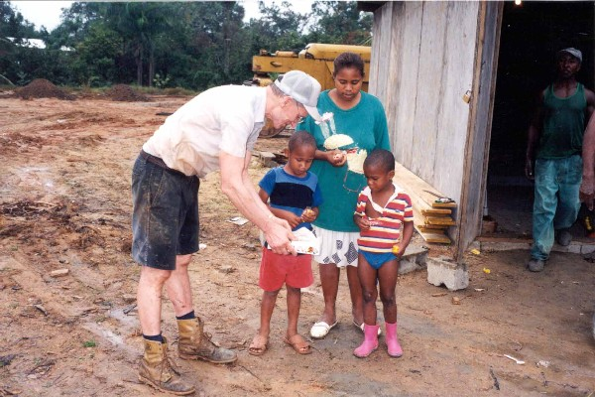
Your Foundation
Your Foundation operates because of both program participation and Rotarian financial contributions.

Slide 4
Programs and Funding
The Rotary Foundation programs include:
  Humanitarian Grants Program
  Educational Programs
  PolioPlus
Support for these programs comes from:
  The Annual Programs Fund
  The Permanent Fund
  The PolioPlus Fund

Slide 5
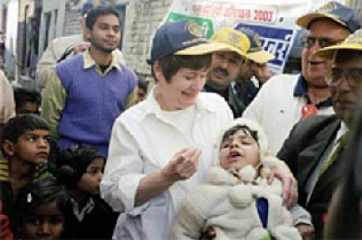
PolioPlus Program
PolioPlus is Rotary's priority program that supports global efforts to eradicate polio.

Slide 6
Get Involved
There are several ways to get involved with PolioPlus:
Promote awareness of Rotary's polio eradication efforts in the media.
Help end polio by contributing to Rotary’s US$100 Million Challenge.
Request a club program on PolioPlus

Slide 7
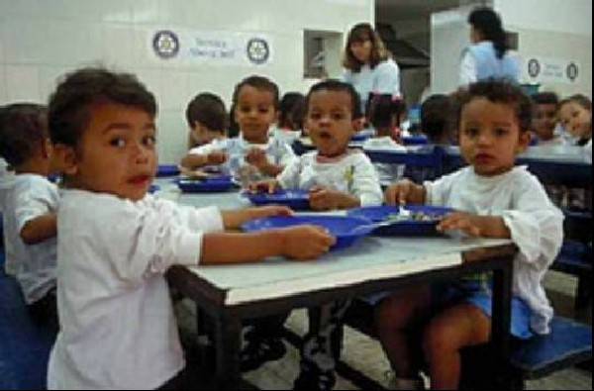
Humanitarian Grants Program
The Humanitarian Grants Program provides grants to fund club and district service projects in local and international communities.

Slide 8
Humanitarian Grants Program
Matching Grants support international service projects involving Rotary clubs or districts in two or more countries.
Volunteer Service Grants subsidize travel for humanitarian service in Rotary countries.
District Simplified Grants support short-term humanitarian projects that benefit the community.
Health, Hunger, and Humanity Grants (3-H) fund long-term, self-help, and grassroots development projects.

Slide 9
Get Involved
There are several ways to get involved with the Humanitarian Grants Program:
Initiate a Matching Grant project.
Sponsor a Volunteer Service Grant applicant.
Ask your district to support a local project with a District Simplified Grant.

Slide 10
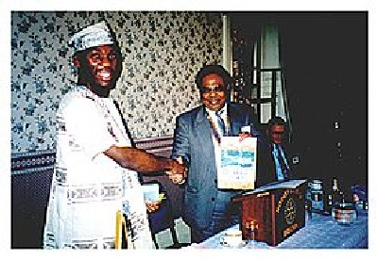
Educational Programs
Educational Programs provide funding for students, faculty, and young professionals to serve abroad.

Slide 11
Educational Programs
Group Study Exchange provides a unique cultural and vocational exchange opportunity for young professionals.
Ambassadorial Scholarships provide opportunities for students to study abroad and serve as ambassadors of goodwill.
Rotary Centers for International Studies provide opportunities for fellows to study international relations and peace and conflict resolution.
Rotary Grants for University Teachers provide opportunities for higher education faculty to teach at colleges and universities in developing countries.
Rotary Peace and Conflict Studies Program provides a course in peace studies, conflict resolution, and mediation aimed at professionals.

Slide 12
Foundation Alumni
Participants in the Foundation’s Educational Programs are considered alumni, along with certain recipients of Humanitarian Grants. Rotary Foundation alumni are a valuable resource to Rotary and should be considered:
For Rotary club membership
As potential contributors to the Foundation
Potential speakers at club and district events
As partners in service for Rotary club projects

Slide 13
Get Involved
There are several ways to get involved with Educational Programs:
Sponsor a scholarship applicant to compete at the district level.
Host a visiting GSE team member in your home or business.
Recommend alumni for membership.
Invite a current scholar or alumnus to speak to your club.

Slide 14




Financial Support
Rotarian contributions fund Rotary Foundation programs. Gifts can be made to two funds:
For support
today
To secure tomorrow

Slide 15
SHARE
SHARE is the system which districts use to participate in Rotary Foundation programs.
Each district's contributions to the Annual Programs Fund are split, with 50 percent going to the district (District Designated Fund), which can be spent on programs of the district’s choice, and 50 percent going to The Rotary Foundation (World Fund), which funds programs for which every district may apply.

Slide 16




Rotary Foundation Funding
District Designated Fund
(DDF)
TRF Program Funding
Rotarian
Donations
World Fund
Spendable Earnings

Slide 17
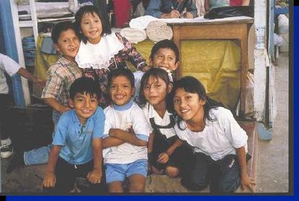
Your Foundation
Makes a Difference
Rotarian financial support and active involvement result in:
  Vaccinations against polio
  Clean drinking water
  Education
  International understanding
  Sustainable agriculture
  Life-saving surgery
  and medical care

Slide 18
Resources
The following resources are available on the RI Web site:
  Rotary Foundation Facts
  Rotary Foundation Quick Reference Guide
  Rotary Foundation Annual Report
  Rotary E-Learning Center

