Slide 1

A Guide to Membership Retention

Slide 2

Retention of members is critical to Rotary’s ability to meet the growing demand for humanitarian needs and volunteer services throughout the world.

Slide 3
Retention Pilot Program
The RI Board-approved Retention Pilot Program, which ran 1 July 2003 through 30 June 2006, determined effective activities that support and sustain membership retention at the club level. Seven action steps for successful retention were identified:
Seven Action Steps
1.) Identify
2.) Introduce
3.) Invite
4.) Induct
5.) Inform or Orient
6.) Involve
7.) Educate

Slide 4

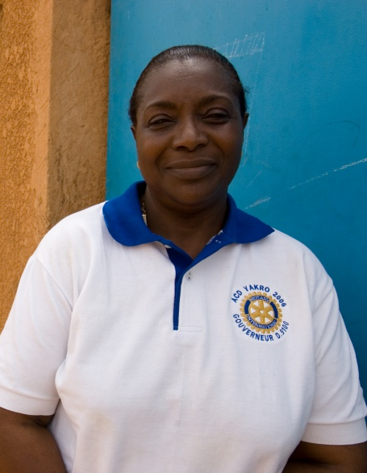

Step 1 - Identify
Identify well-qualified members of your community. These individuals should be professional or community leaders of strong character who have a commitment to service. Ask them to be your guest at a Rotary club meeting.

Slide 5
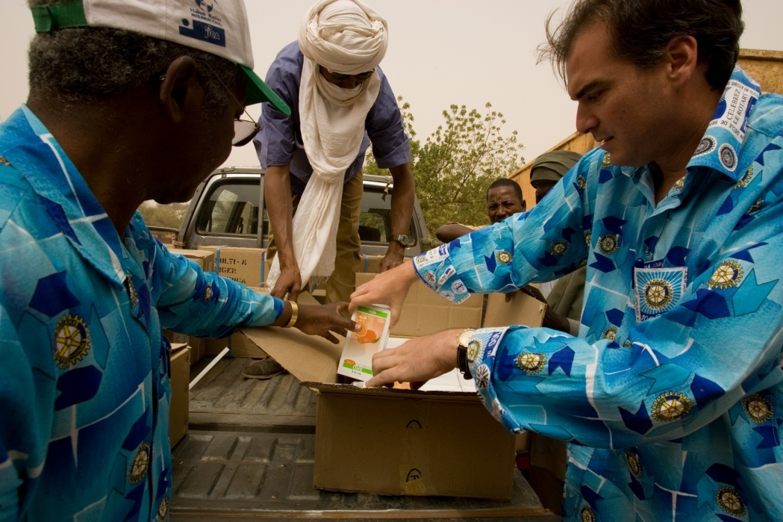
Step 2 - Introduce
Introduce prospective members to Rotary by informing them about Rotary International’s programs and your club’s service projects.

Slide 6
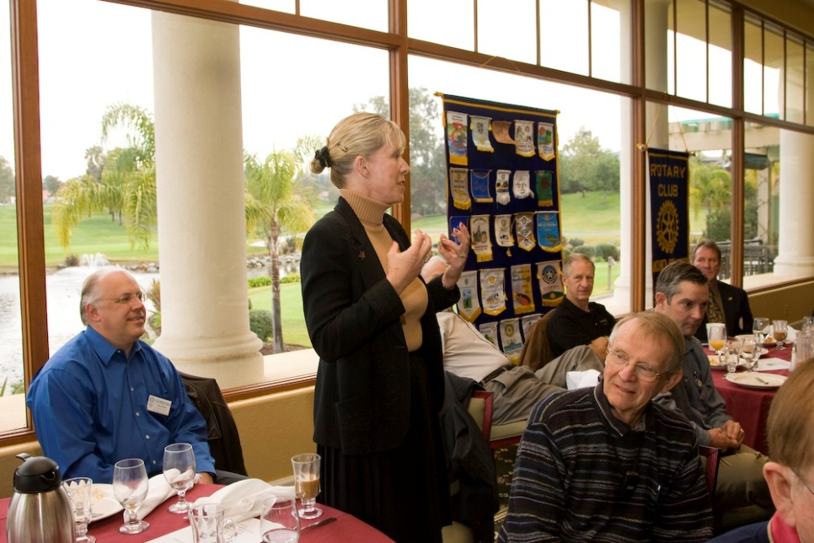
Step 3 - Invite
Invite prospective members to join your club with a personal visit. Highlight potential areas of involvement in the club and RI based on the prospective member’s personal interests.

Slide 7
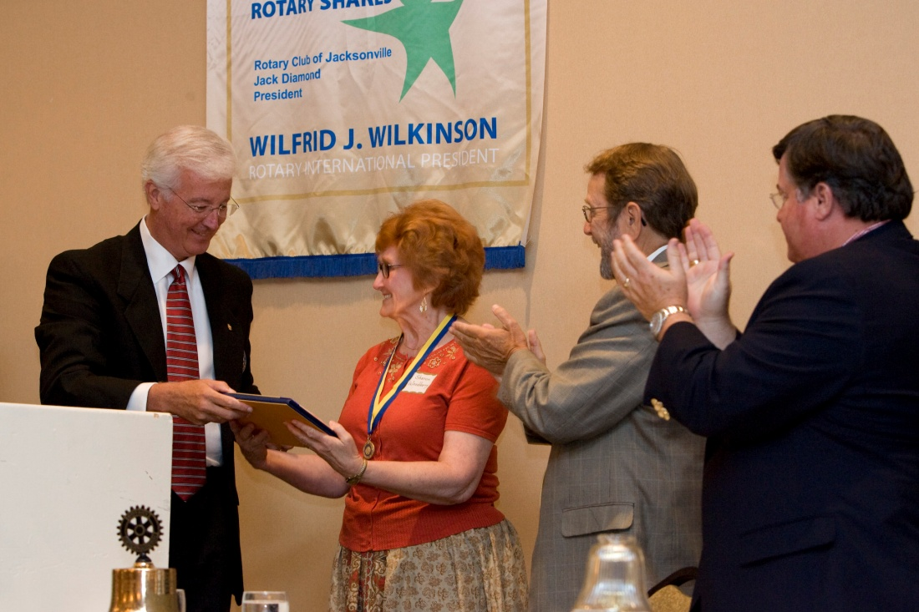
Step 4 - Induct
Induct new members in a dignified and meaningful manner. Invite spouses, partners, and family members to attend.

Slide 8
Step 5 – Inform & Orient
Inform new members about your club and RI by focusing on:
  Opportunities for Service
  Rotary policies and Procedures
  Rotary history and achievements
Consider distributing the New Member Information Kit (426-EN) to new members.

Slide 9

Information Programs
Suggested session outlines, resources, and action steps for conducting new member information programs are included in New Member Orientation: A How-to Guide for Clubs (414-EN).

Slide 10

Step 6 - Involve
Immediately involve new members in:
Club committees
Service projects
Weekly club meetings
Social activities

Slide 11
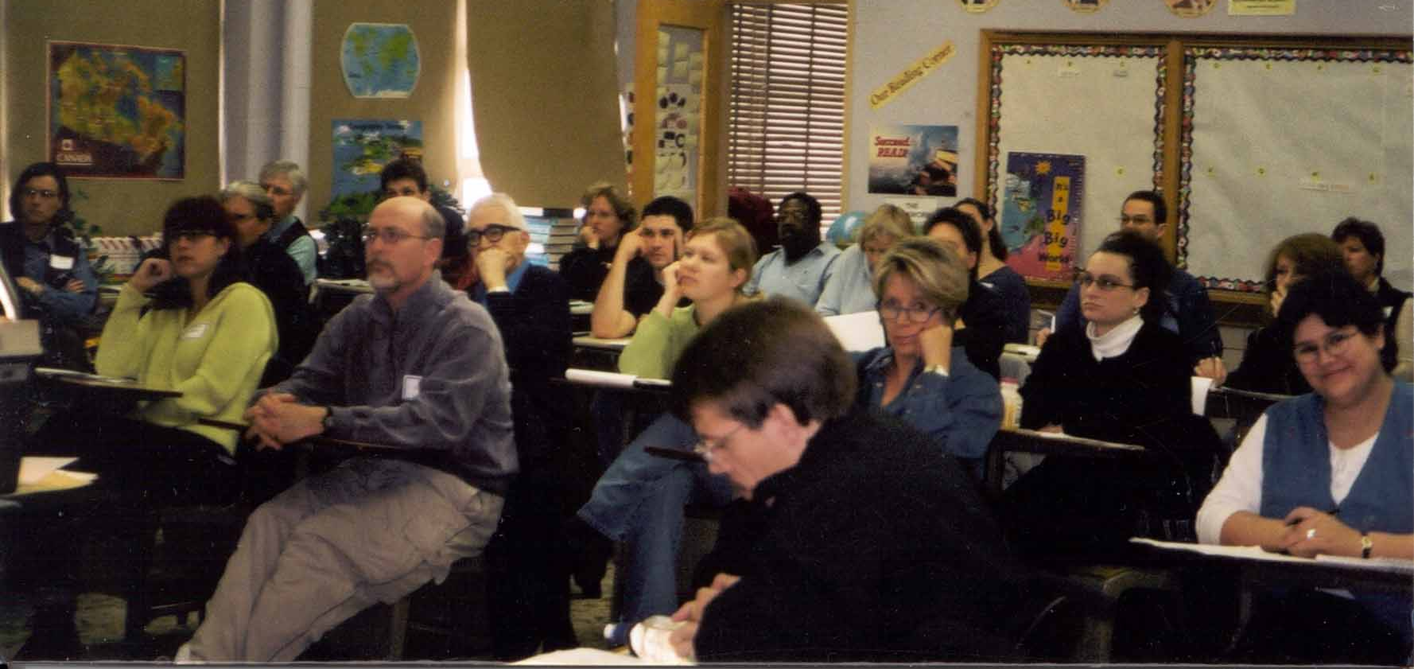
Step 7 - Educate
There are two approaches a new member can take to acquire a Rotary education: self-education and continuing education offered by the club.

Slide 12
Self-education
Self-education activities include:
Informational reading such as
    The ABC’s of Rotary (363)
    Rotary Foundation Facts (159)
    THE ROTARIAN or regional magazines
    Exploring club, district, and RI Web sites
Attending a board or committee meeting
Attending a district meeting, such as a Rotary Foundation Seminar

Slide 13
Continuing Education
A continuing education plan offered by the club includes
  Frequent communication of Rotary news
  and information
  Club programs focused on
  continuing education
  District-level seminars on
  continuing education

Slide 14
Resources
Welcome to Rotary video
New Members Web page
RI Programs
The Rotary Foundation
Rotary E-Learning Center
Shop.rotary.org
New Member Orientation: A How-to Guide for Clubs (414-EN)
Membership DVD Set (427-MU)
Prospective Member Information Kit (423-EN)
Membership Development Resource Guide (417-EN)

