Slide 1
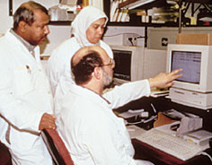
Vocational Service

Slide 2
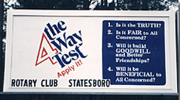
Vocational Service
Vocational Service, the second Avenue of Service, promotes high ethical standards in businesses and professions, recognizes the worthiness of all dignified occupations, and fosters the ideal of service in the pursuit of all vocations. The role of members includes conducting themselves and their businesses in accordance with Rotary’s principles.

Slide 3
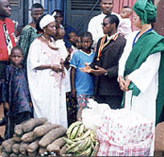
Vocational Service Focus
One of the priorities of the RI Strategic Plan is to revitalize the advantage of Rotary’s unique vocational basis by:
Influencing ethical decision making by encouraging Rotarians to join and take leadership roles in business and vocational associations
Finding new ways to develop vocational skills of others, especially people without jobs by fully utilizing Rotarian expertise and experience
Developing more vocational forums for learning and information exchange to encourage professional development

Slide 4
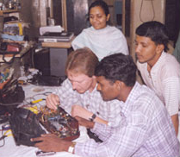
Rotarians and Vocational Service
When professionals join a Rotary club, they do so as a representative of their particular business or profession.
Rotarians have the dual responsibility of representing their vocation within the club and exemplifying the ideals of Rotary within the workplace.

Slide 5
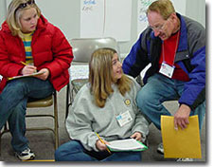
Vocational Service Project Areas
Vocational Service opportunities include:
Mentoring
Career days
Vocational awards
Business assistance
Rotary club presentations

Slide 6
District Structure
The district Vocational Service chair coordinates and promotes club vocational service projects within the district. The chair
Works with clubs
Encourages district-wide participation
Shares project information and ideas with Rotarians worldwide

Slide 7
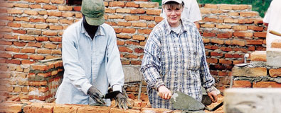
Vocational Service Month
Every October, Rotarians are encouraged to focus their attention on Vocational Service. Clubs celebrate with a variety of activities ranging from discussions about business ethics to awards to community projects. It is also an opportunity to begin year-long Vocational Service activities.

Slide 8
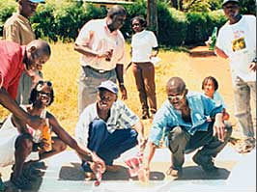
Participate
Participating in RI and Foundation programs can enhance a Rotary club’s Vocational Service efforts. Consider the following:
  Rotary Volunteers
  Group Study Exchange
  Humanitarian Programs
  Rotary Fellowships
  Open World

Slide 9
Resources
The following resources are available on the RI Web site:
Vocational Service section
Vocational Service in your Community
Communities in Action: A Guide to Effective Projects
Menu of Service Opportunities
Community Assessment Tools
ProjectLINK Service Project Resource Center
Rotary E-Learning Center
Contact RI Programs Division staff with your questions.

