Slide 1

World Community Service

Slide 2
Elements of World Community Service (WCS)
The WCS Projects Exchange
Donations-in-kind
Disaster Relief

Slide 3
World Community Service Project Criteria
1) Project is humanitarian in nature
2) Rotary clubs in two or more countries are involved
3) One of the countries contains the site of the project

Slide 4
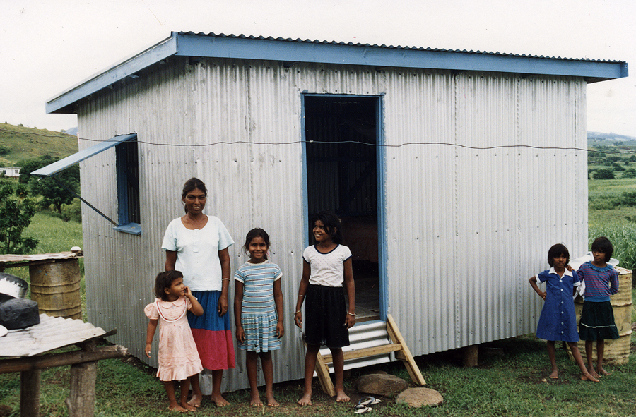
How you can participate in WCS
Get Involved with an international service project by supporting one of many deserving projects listed on the WCS projects Exchange
Advertise your project’s needs to the more than 31,000 Rotary clubs worldwide by listing your project on the WCS Projects Exchange

Slide 5
WCS Projects Exchange
Available as a searchable database in English on the RI Web site at www.rotary.org
Includes short descriptions of over 400 Rotary club projects
Lists a local project coordinator for each project

Slide 6
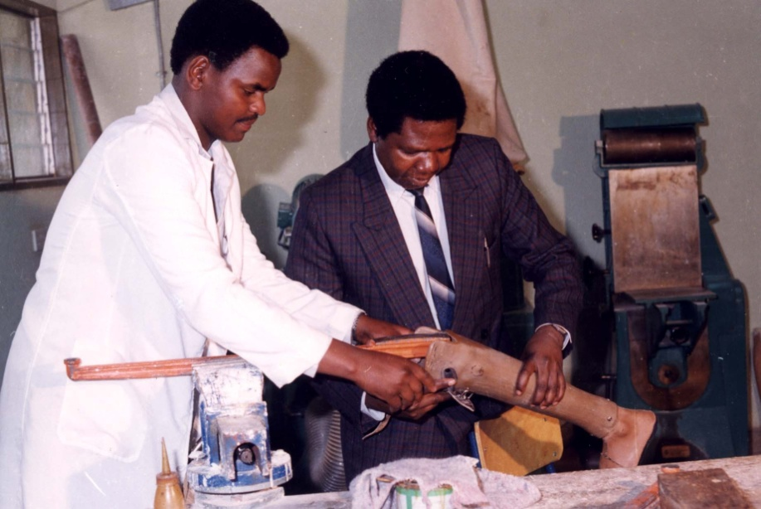
Important Guidelines
Project sponsor must be in the project country
Register project using official Project Data Form
Notify RI of changes
Up to five projects per club may be registered at a time

Slide 7
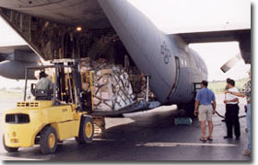
Donations-in-kind
Ideas for locating shipping assistance
Tips for packing and inventorying items collected
Resource Organizations

Slide 8
Disaster Relief
Implement long-term disaster recovery efforts
Current disaster relief projects are posted on the WCS Web pages
For emergency relief efforts work with Rotary grassroots projects and other organizations
  The Red Cross
  Shelter box
  Aqua Box
  Doctors without Borders

Slide 9
Project Fairs
To help establish partnerships between clubs in two countries, Rotarians are encouraged to hold and attend project fairs worldwide
Check out upcoming fairs on the RI Web site

Slide 10

Why Participate in WCS?
Greater financial, material and human resources
Develop ties with Rotarians abroad
Learn about another country and its people
Create a favorable image of your country and Rotary
Address global concerns
Make a difference!

Slide 11
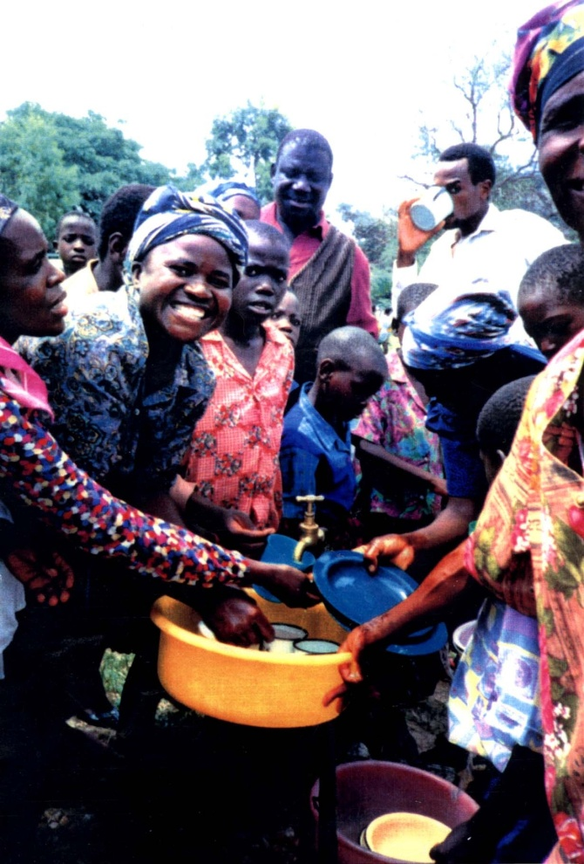
Materials and Resources
WCS Handbook: A Guide to Action (742-EN)
WCS Projects Exchange
WCS Remittance Form

Slide 12
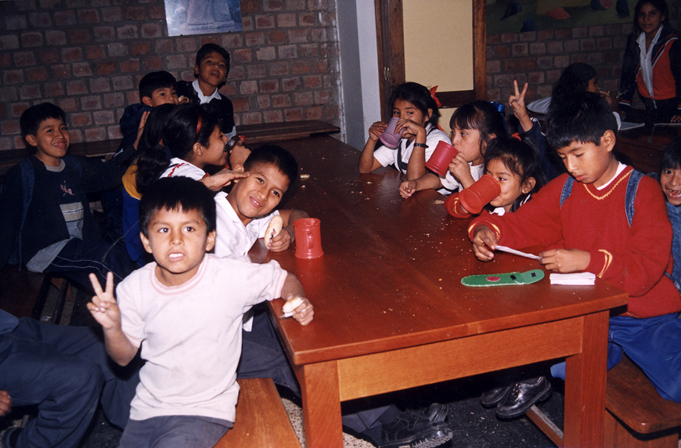
Thank you!

