Slide 1





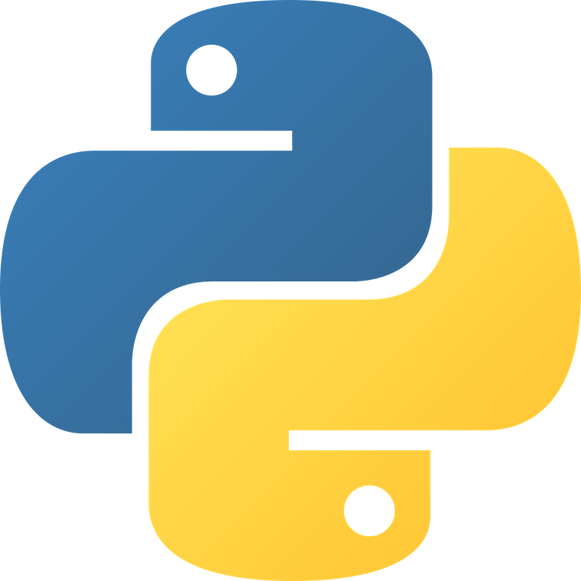

PYTHON PROGRAMMING
PRESENTATION BY SRINIVASA SAI CHAVA
MODULE 1 OF ESSENTIALS OF AI

Slide 2



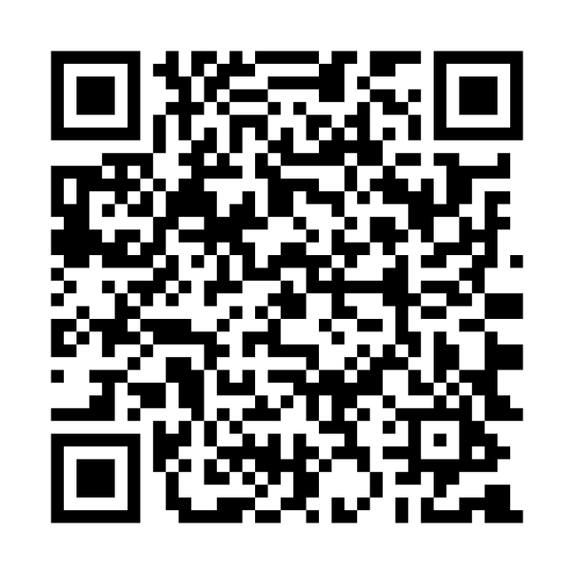







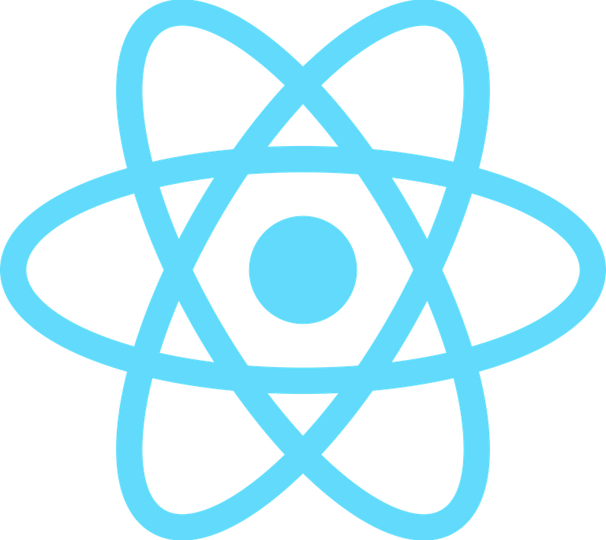



ABOUT ME
•M.S. Artificial Intelligence student at Boston University
•Building production-focused AI systems across ML/DL, NLP, Computer Vision, and RAG
•Delivering end-to-end full-stack AI deployment from research to production
•Focused on practical impact in accessibility, trust, and social good
BOSTON
UNIVERISTY
INDIAN INSTITUTE OF INFORMATION TECHNOLOGY
DHARWAD
https://github.com/essentials-of-artificial-intelligence

Slide 3
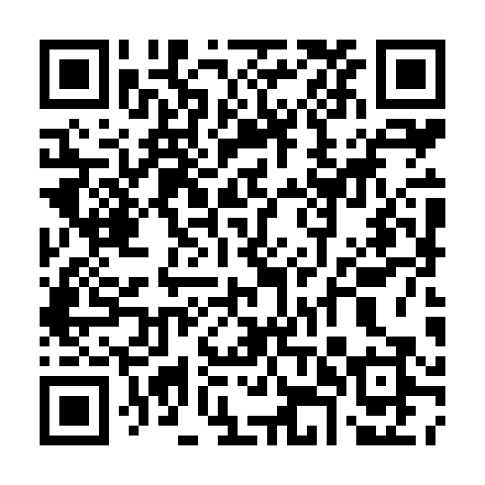
GITHUB
ORGANIZATION
https://github.com/essentials-of-artificial-intelligence

Slide 4

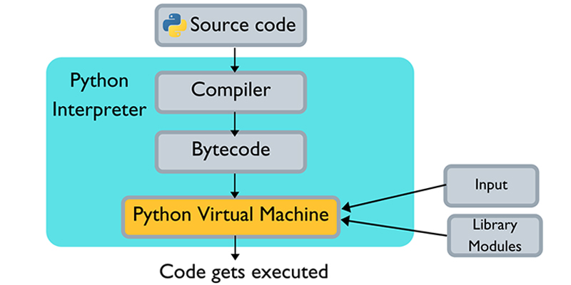

HOW PYTHON ACTUALLY RUNS
Python is interpreted but uses a compiler step first (compiles to .pyc bytecode).
The bytecode runs on the Python Virtual Machine (CPython).
Why it matters for AI: Python acts as the "glue" that triggers high-speed C/C++ binaries in libraries like NumPy and TensorFlow.
Source Code --> Compiler --> Bytecode --> Virtual Machine.

Slide 5

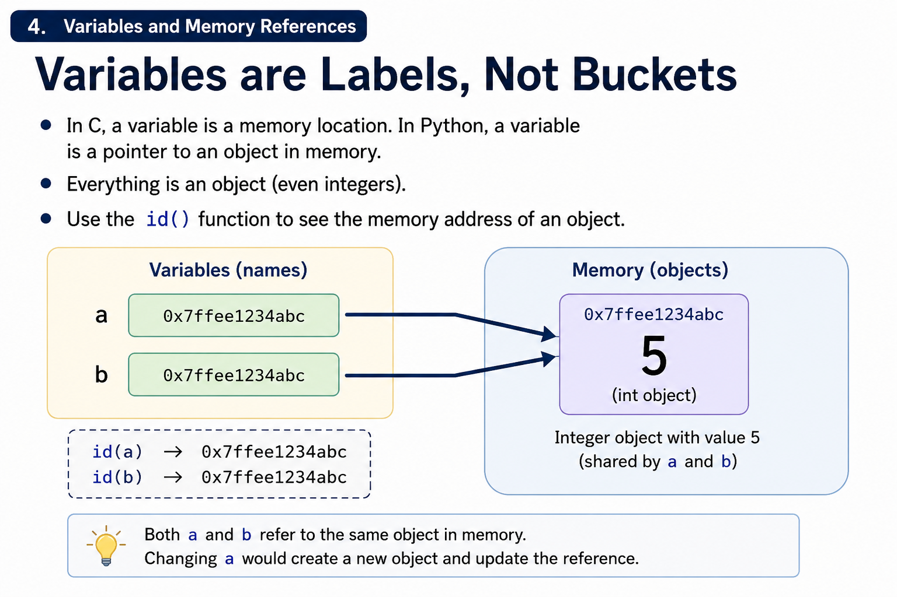
VARIABLES ARE LABELS, NOT BUCKETS
In C, a variable is a memory location. In Python, a variable is a pointer to an object in memory.
Everything is an object (even integers).
Use the id() function to see the memory address of an object.

Slide 6
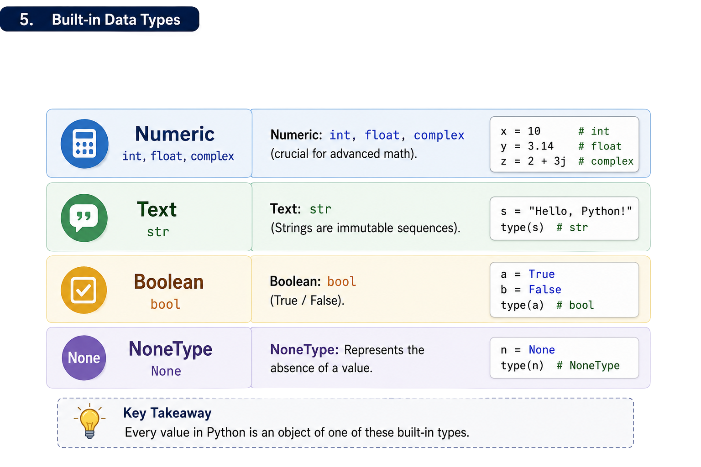
PRIMITIVE AND COLLECTIONS
D
A
T
A
T
Y
P
E
S

Slide 7

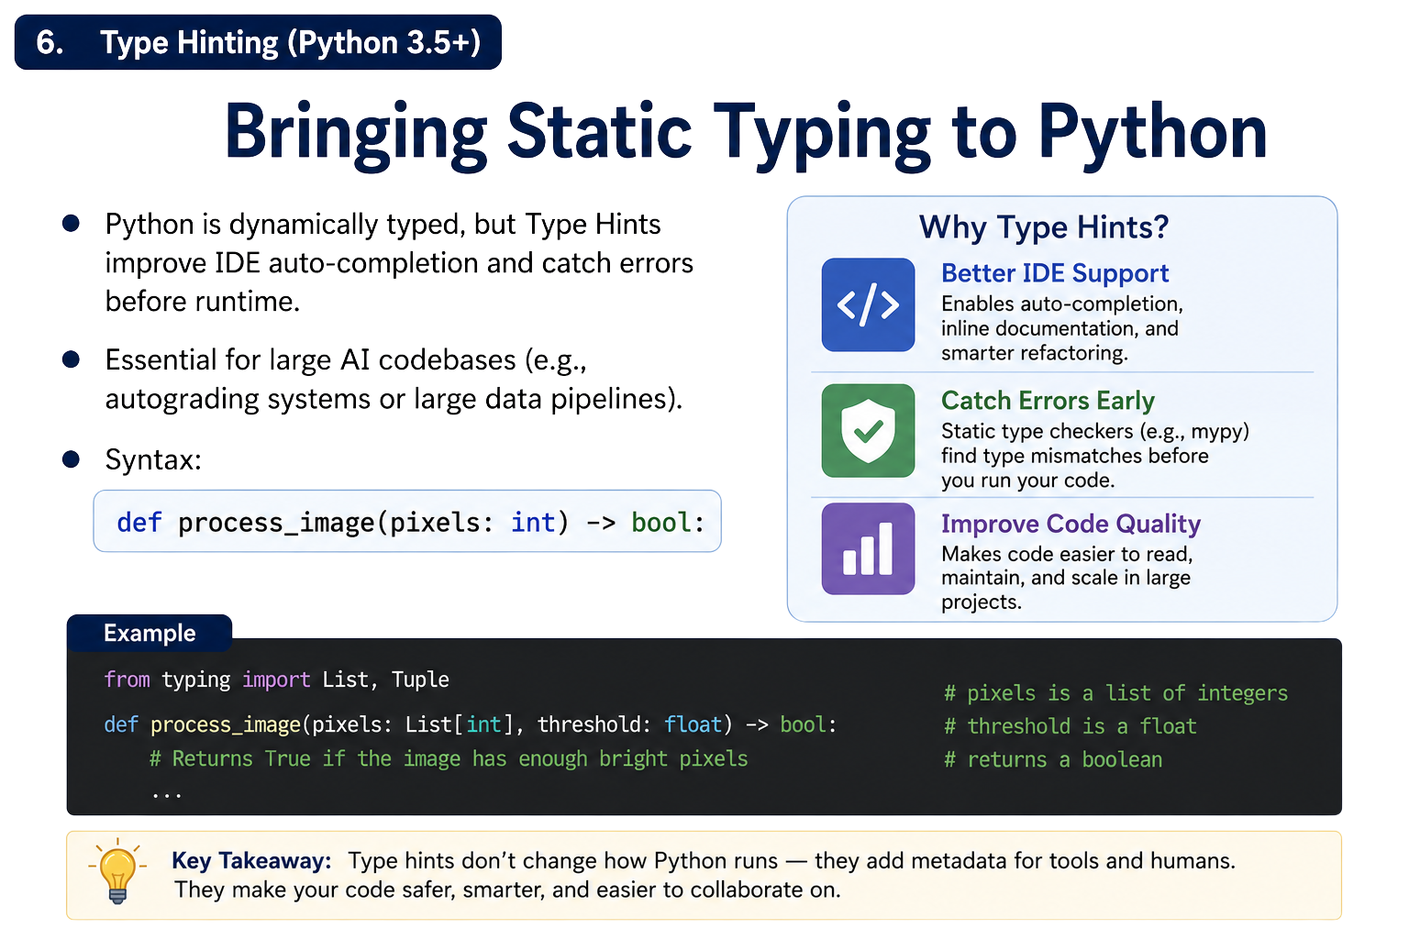

Slide 8
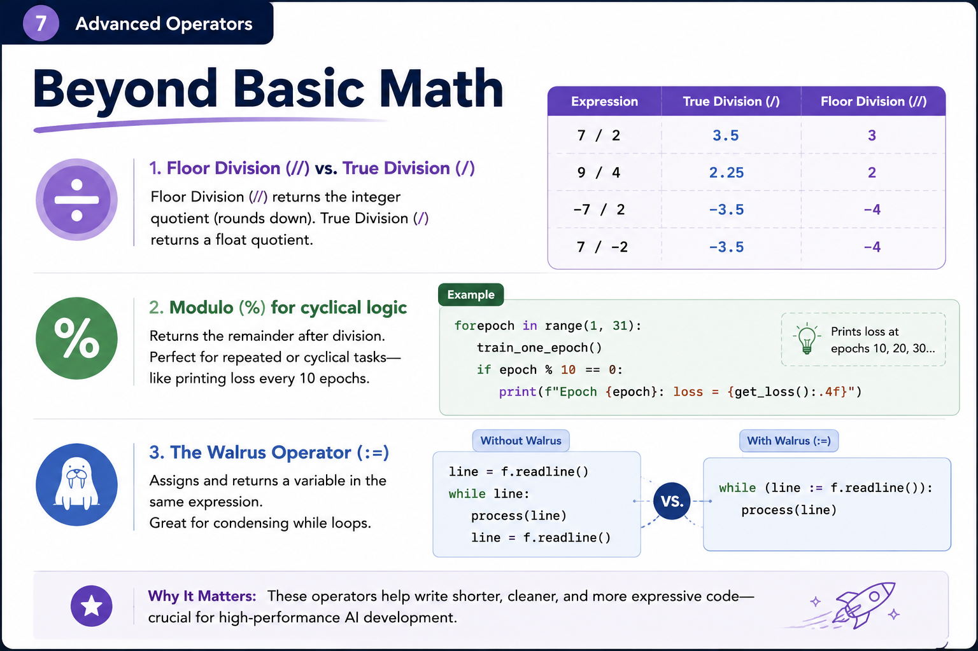

Slide 9

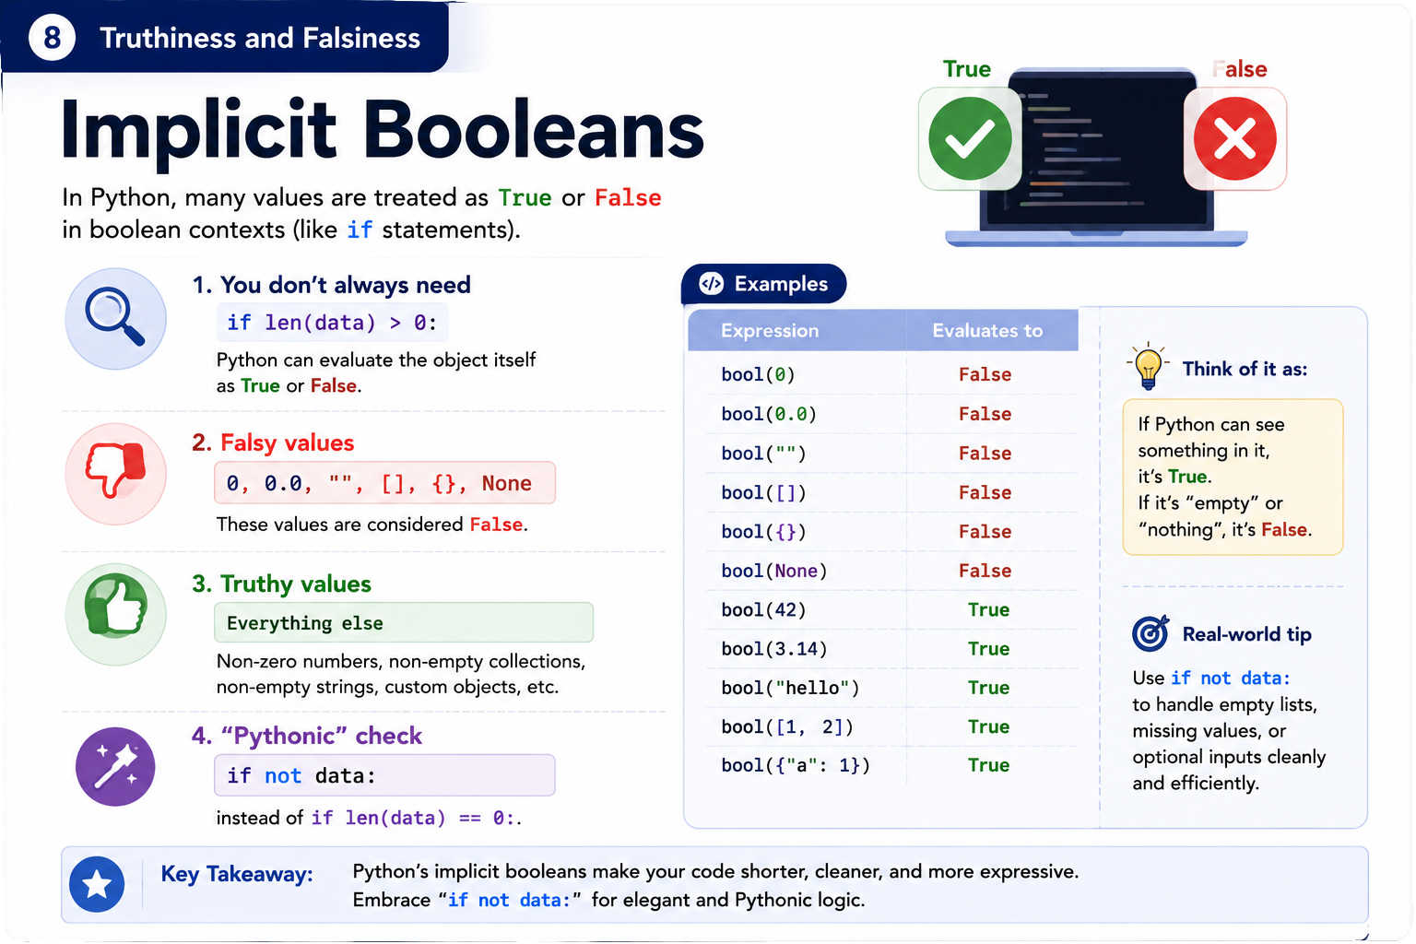

Slide 10
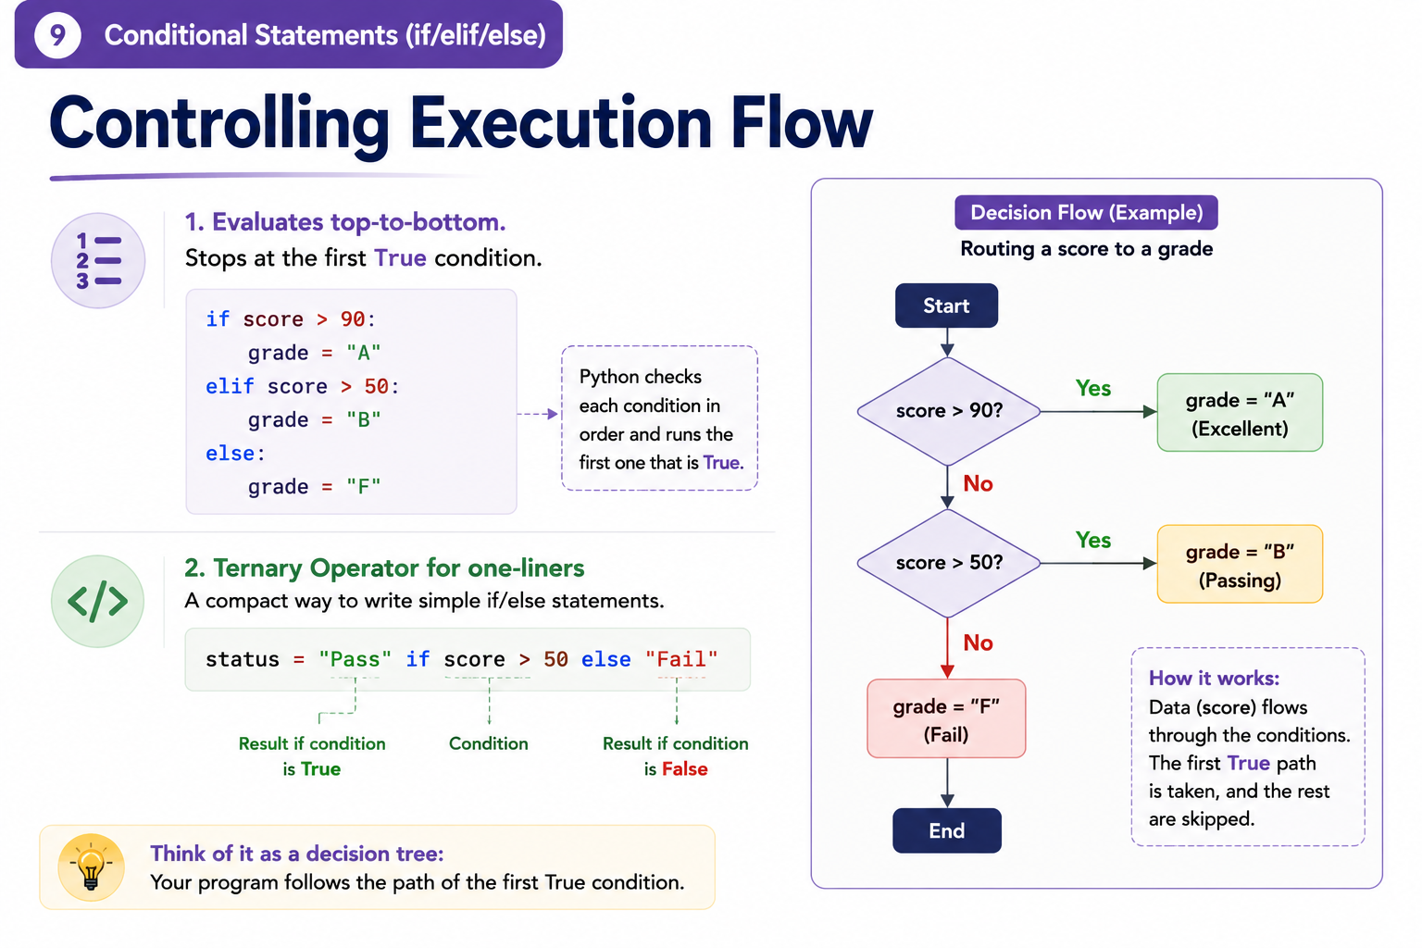

Slide 11
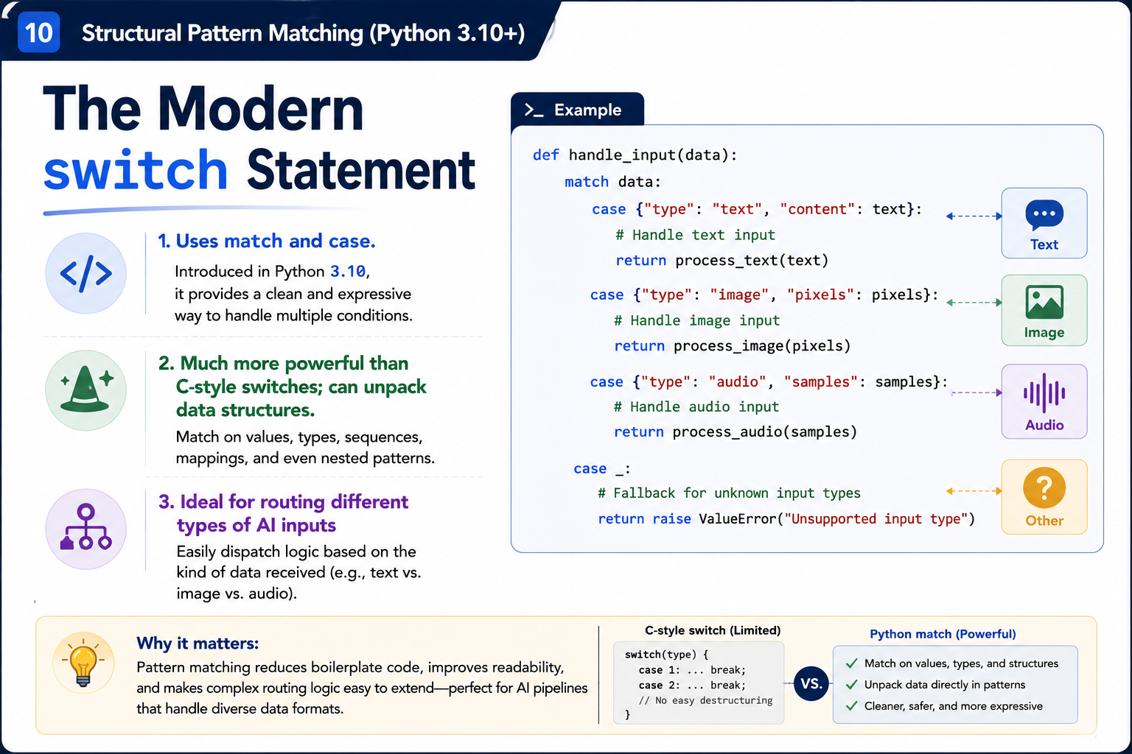


Slide 12
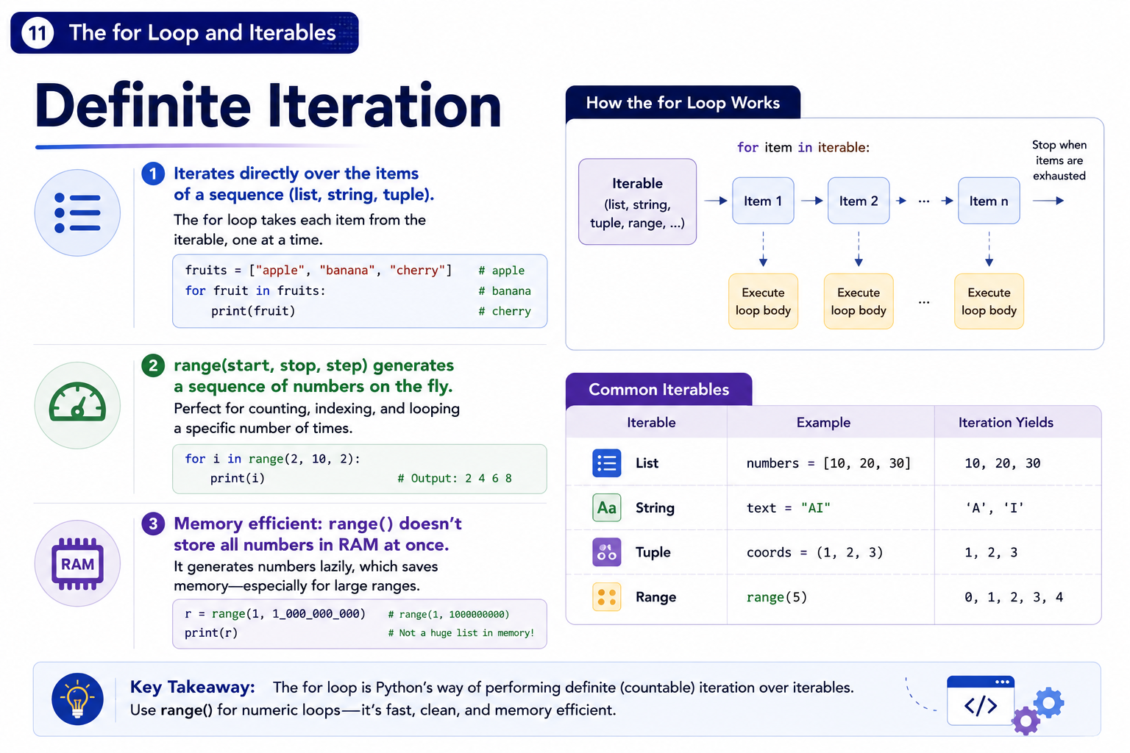

Slide 13
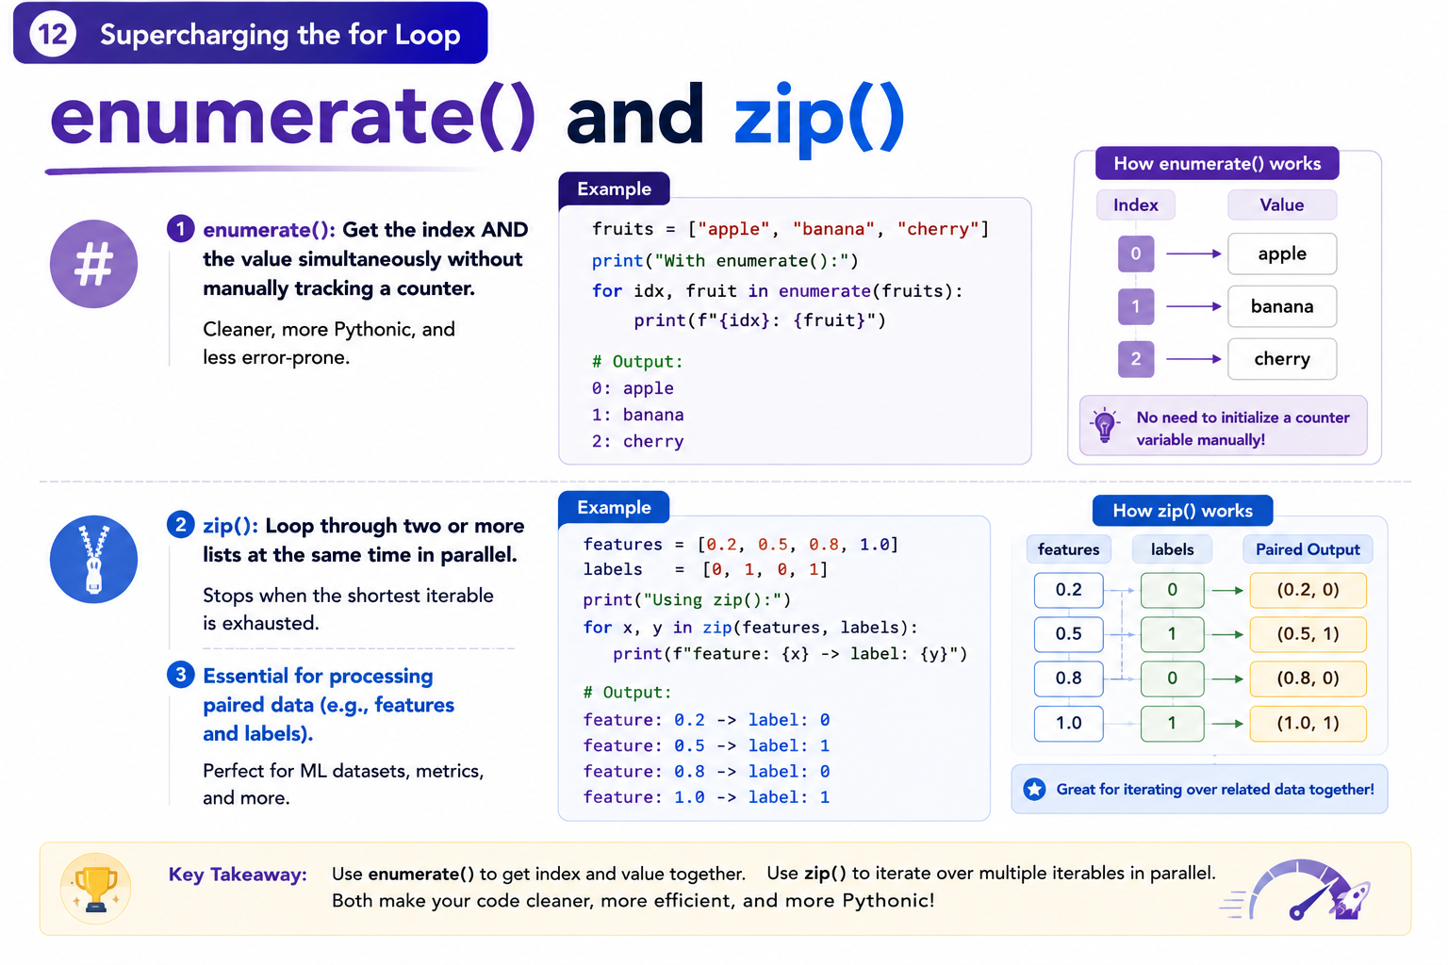

Slide 14
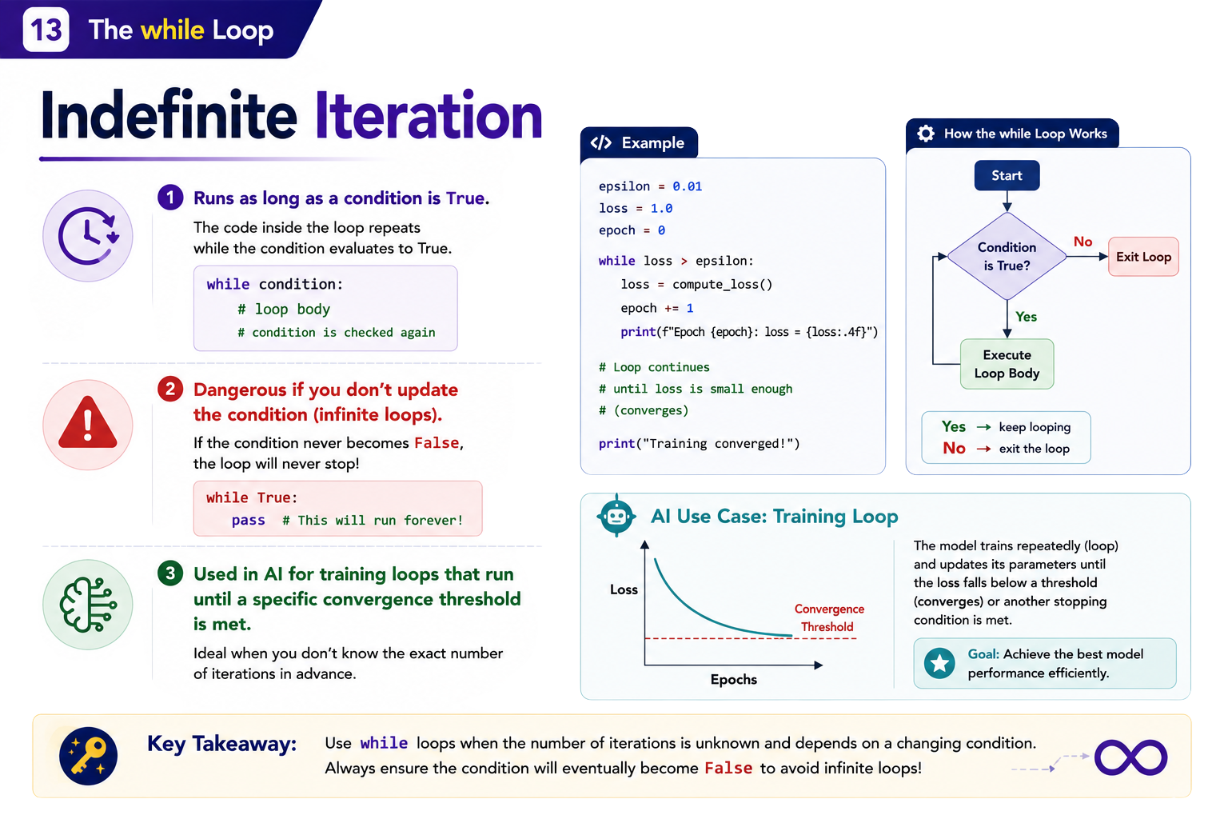
W
H
I
L
E
L
O
O
P

Slide 15
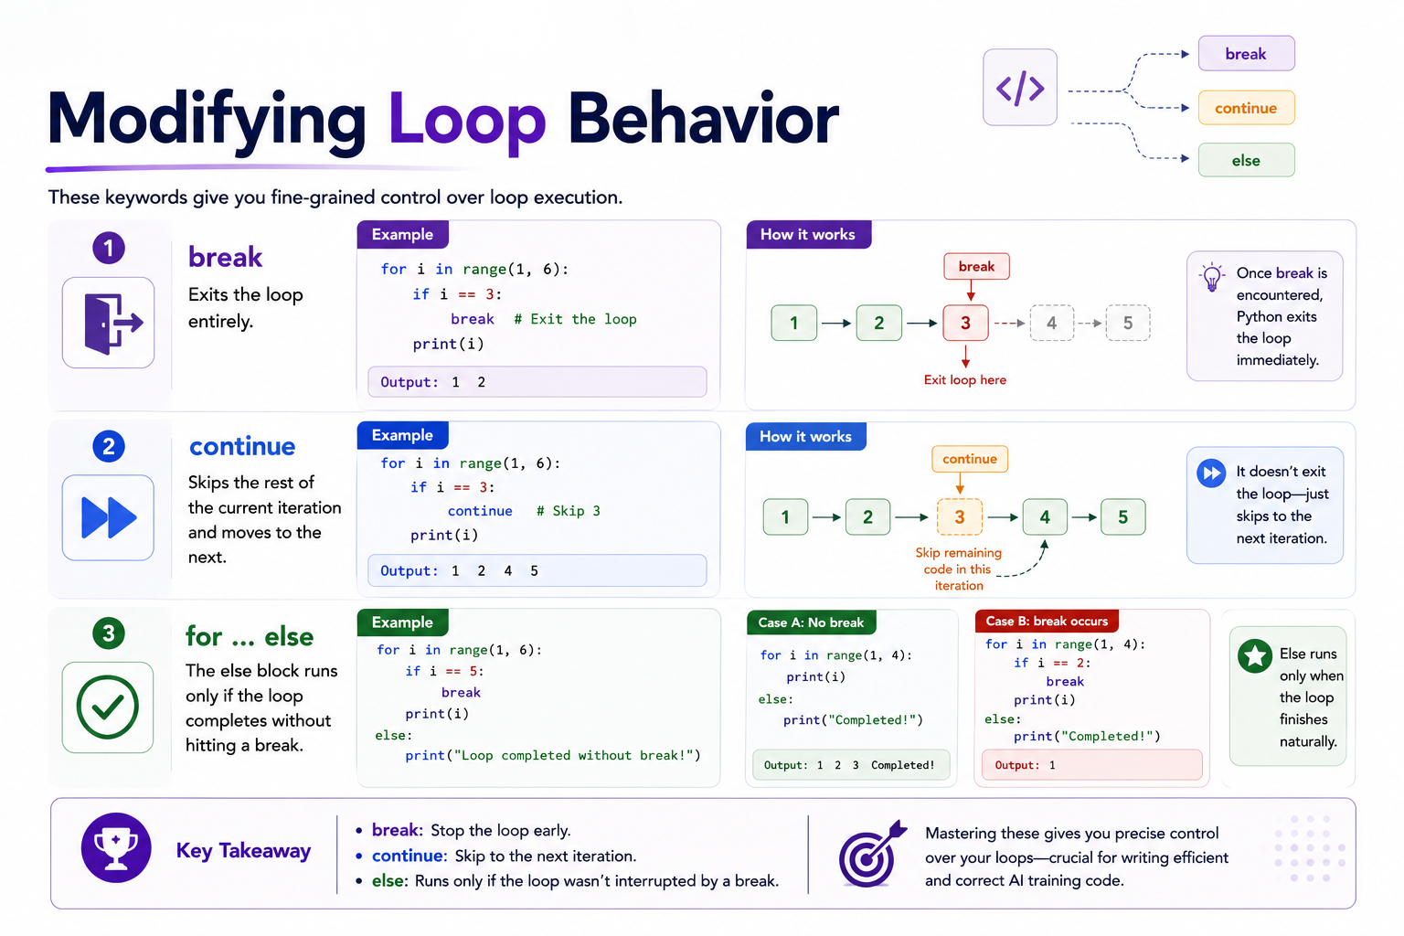
L
O
O
P
C
O
N
T
R
O
L

Slide 16
