Slide 1







Technology Trend Analysis
Essey Tesfamichael Araya
Sep 10, 2022

Slide 2



OUTLINE
Executive Summary
Introduction
Methodology
Results
Visualization – Charts
Dashboard
Discussion
Findings & Implications
Conclusion
Appendix

Slide 3

EXECUTIVE SUMMARY
Relevant skills in the IT and Business industry are ever-changing and evolving.
It is important to identify future trends in technology to keep pace with evolving technologies and remain competitive.
This presentation will show current and future trends in programming languages, databases, platforms and web frameworks

Slide 4

INTRODUCTION
This presentation has been created for stakeholders and decision makers within the IT and business consulting services firm.
Purpose
This presentation will help to identify future skill requirements necessary for the global IT and business consulting services firm to keep pace with ever-changing technologies and remain competitive.

Slide 5

METHODOLOGY
Data was collected using APIs and web scaping. Sources used: Stack overflow developer 2019 survey, GitHub job postings.
Data was wrangled to remove duplicates, impute missing values and normalize the data.
Data underwent exploratory analysis to find the distribution, presence of outliers and correlation.
Visualizations and Dashboards were created using Matplotlib, Seaborn and IBM Cognos Dashboard Embedded (CDE).

Slide 6
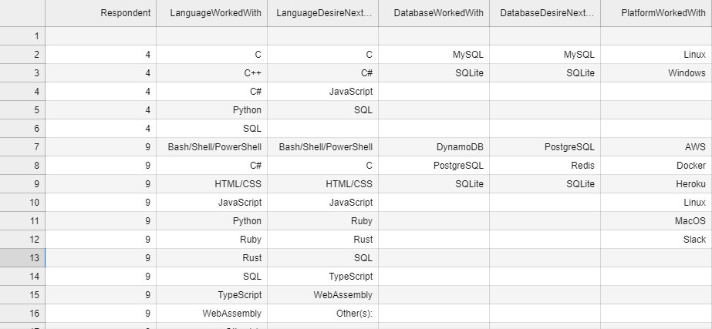
RESULTS

Slide 7
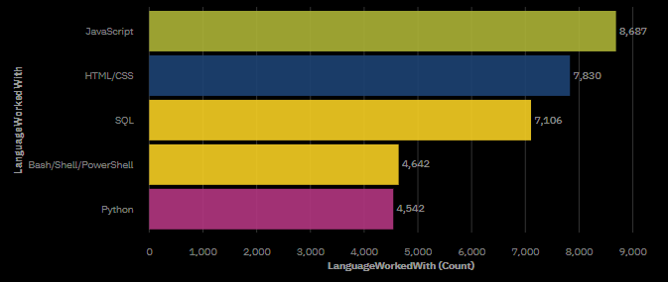
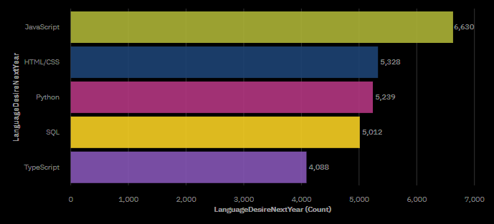
PROGRAMMING LANGUAGE TRENDS
Top 5 Languages This Year
Top 5 Languages Next Year

Slide 8
PROGRAMMING LANGUAGE TRENDS – FINDINGS & IMPLICATIONS
Findings
JavaScript and HTML/CSS continue to be top two most popular for this year and next year.
Python and Typescript have gained more interest for next year.
Interest in SQL and Bash/Shell/PowerShell has decreased for next year.
Implications
Continue employment of web developers skilled in JavaScript and HTML/CSS.
Employ more people skilled in Python and Typescript.
Employ less people skilled in SQL and Bash/Shell/PowerShell.

Slide 9
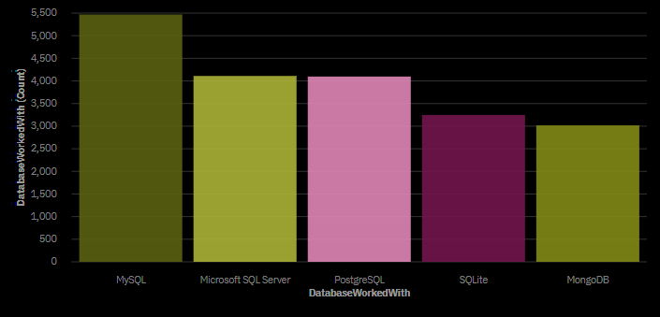
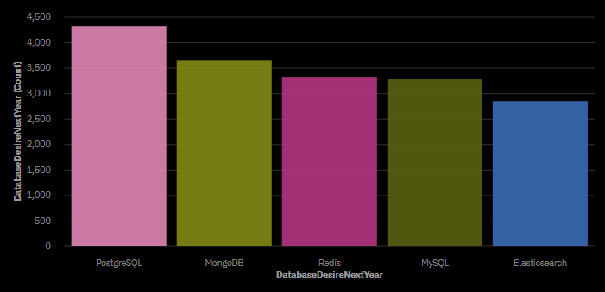
DATABASE TRENDS
Top 5 Databases This Year
Top 5 Databases Next Year

Slide 10
DATABASE TRENDS – FINDINGS & IMPLICATIONS
Findings
Interests in PostgreSQL and MongoDB has increased for next year.
Interest in MySQL, Microsoft SQL Server and SQLite has decreased for next year.
Redis and Elasticsearch have gained more interest for next year.
Implications
Employ more people skilled in PostgreSQL and MongoDB.
Employ less people skilled in MySQL, Microsoft SQL Server and SQLite.
Employ more people skilled in Redis and Elasticsearch.

Slide 11

DASHBOARD
Click here to view the Dashboard

Slide 12
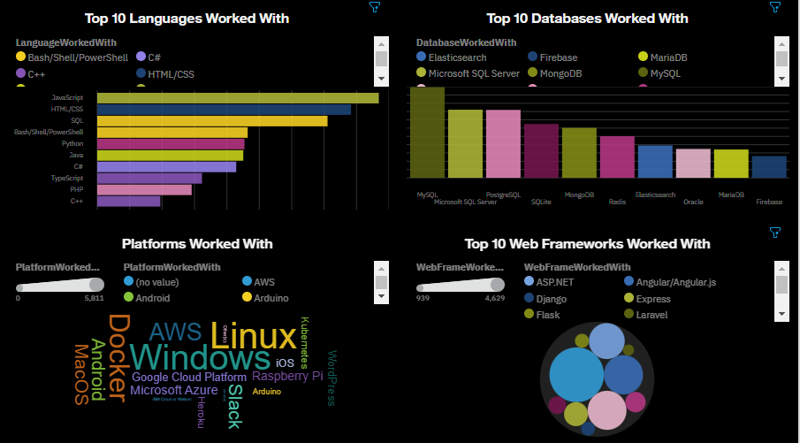
Current Technology Usage

Slide 13
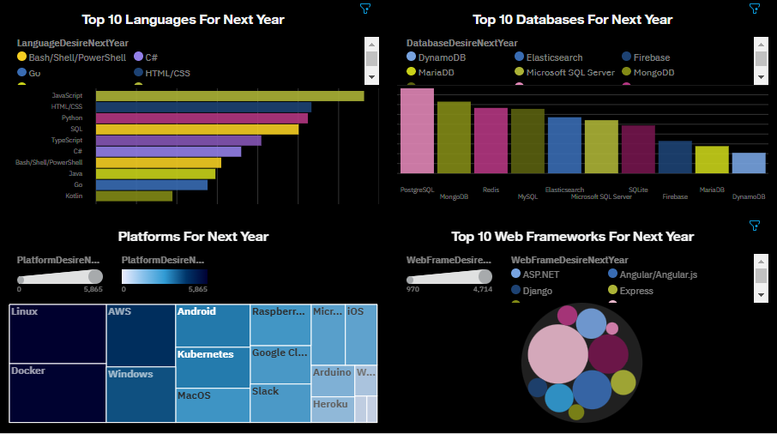
Future Technology Trend

Slide 14
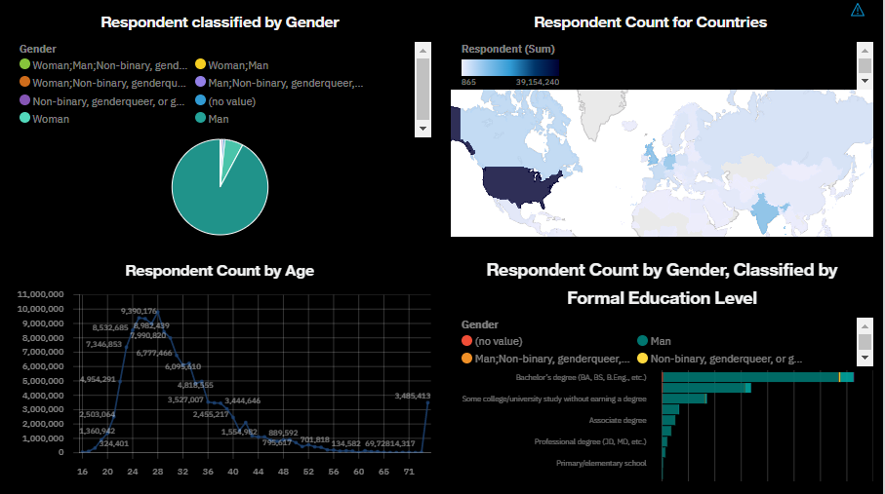
Demographics

Slide 15
DISCUSSIONS

Slide 16
OVERALL FINDINGS & IMPLICATIONS
Findings
Languages: Typescript and Python are gaining significant interests while JavaScript remains top.
Databases: PostgreSQL, MongoDB, Redis and Elasticsearch are gaining more interests
Platforms: Interest in Slack and Windows are dropping significantly.
Web frameworks: Vue.js is gaining interest significantly while React.js continues to grow as well.
Implications
Continue to staff enough JavaScript but employ more people skilled in Typescript and Python.
Employ more people skilled in PostgreSQL, MongoDB, Redis and Elasticsearch.
Continue to staff enough Linux but employ less people skilled in Slack and Windows.
Employ more people skilled in Vue.js and React.js

Slide 17

CONCLUSION
Set aside budget to hire additional staff with skills needed to fill any gaps.
Create a program to upskill those already employed.
Reduce budget for skills with reductions in demand.
Make adjustments in staff for those skills no longer in demand.

Slide 18

APPENDIX

Slide 19
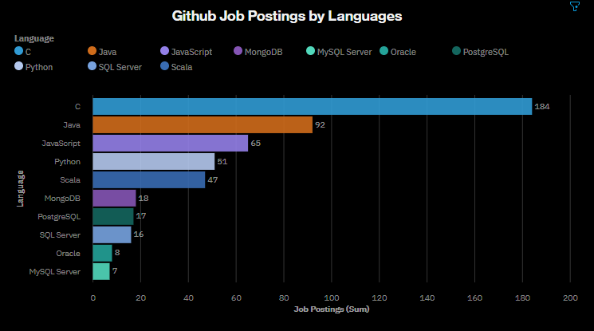
GITHUB JOB POSTINGS

Slide 20
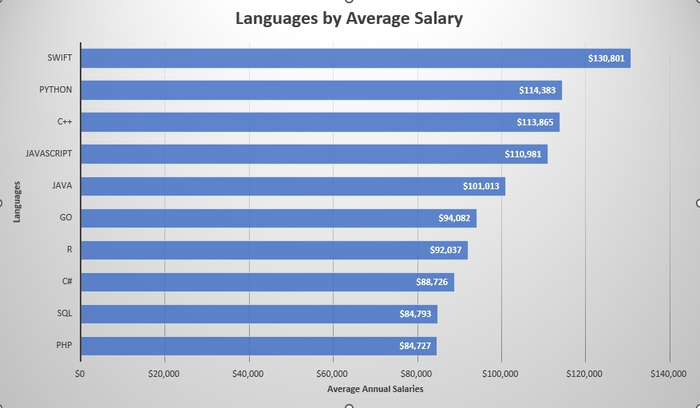
POPULAR LANGUAGES

