Slide 1
Why F# ?
by Aly-Bocar CISSE on November 2021
Updated on October 2024

Slide 2
“Point of view is worth 80 IQ points”
Alan Key

Slide 3
What is F# ?
General purpose language on .NET designed by Don Syme, from Microsoft Research

Slide 4
What is F# ?
Strongly, statically typed, open sourced and cross platform language from Microsoft with deep inference
1.0 appeared on 2005 ( older than: GO, Rust, Kotlin, Typescript ...)
Heavily influenced by ML, OCaml, Haskell, C# & others
Multi-paradigm language : functional (by default), imperative and object-oriented
Fully supported by .NET & Mono. Also compiles to JavaScript

Slide 5
About functional paradigm…
Before going further…

Slide 6
Functional vs Object is a myth
Those are two different things with pros and cons…

Slide 7
Functional paradigm is old
Theory around since the 30’s and first language appeared in the 50’s.

Slide 8
No need for math
…to deliver production ready software
…to use most functional programming languages, especially F#

Slide 9
Functional paradigm focus on data
…while Object Oriented paradigm focus on structure

Slide 10
5 reasons to have a hard look at F#
...when coming from C#

Slide 11
#1 - F# is still .NET
F# in my C# and C# in my F#...

Slide 12
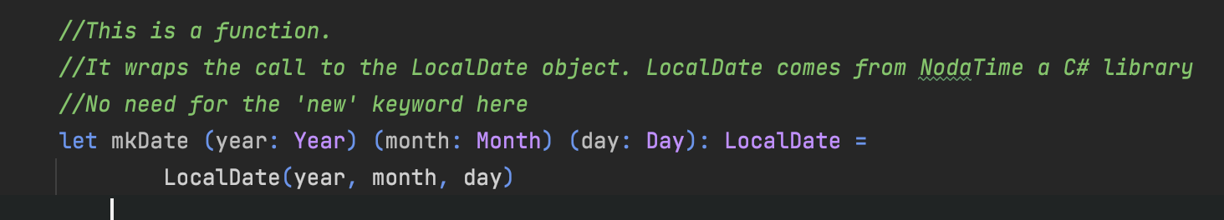
#1 - F# is still .NET
Same constraints as VB.NET
Anything written in C# can be used in F#
The reverse is true for all F# features not depending on the compiler
Notes:
Show SharpLab

Slide 13
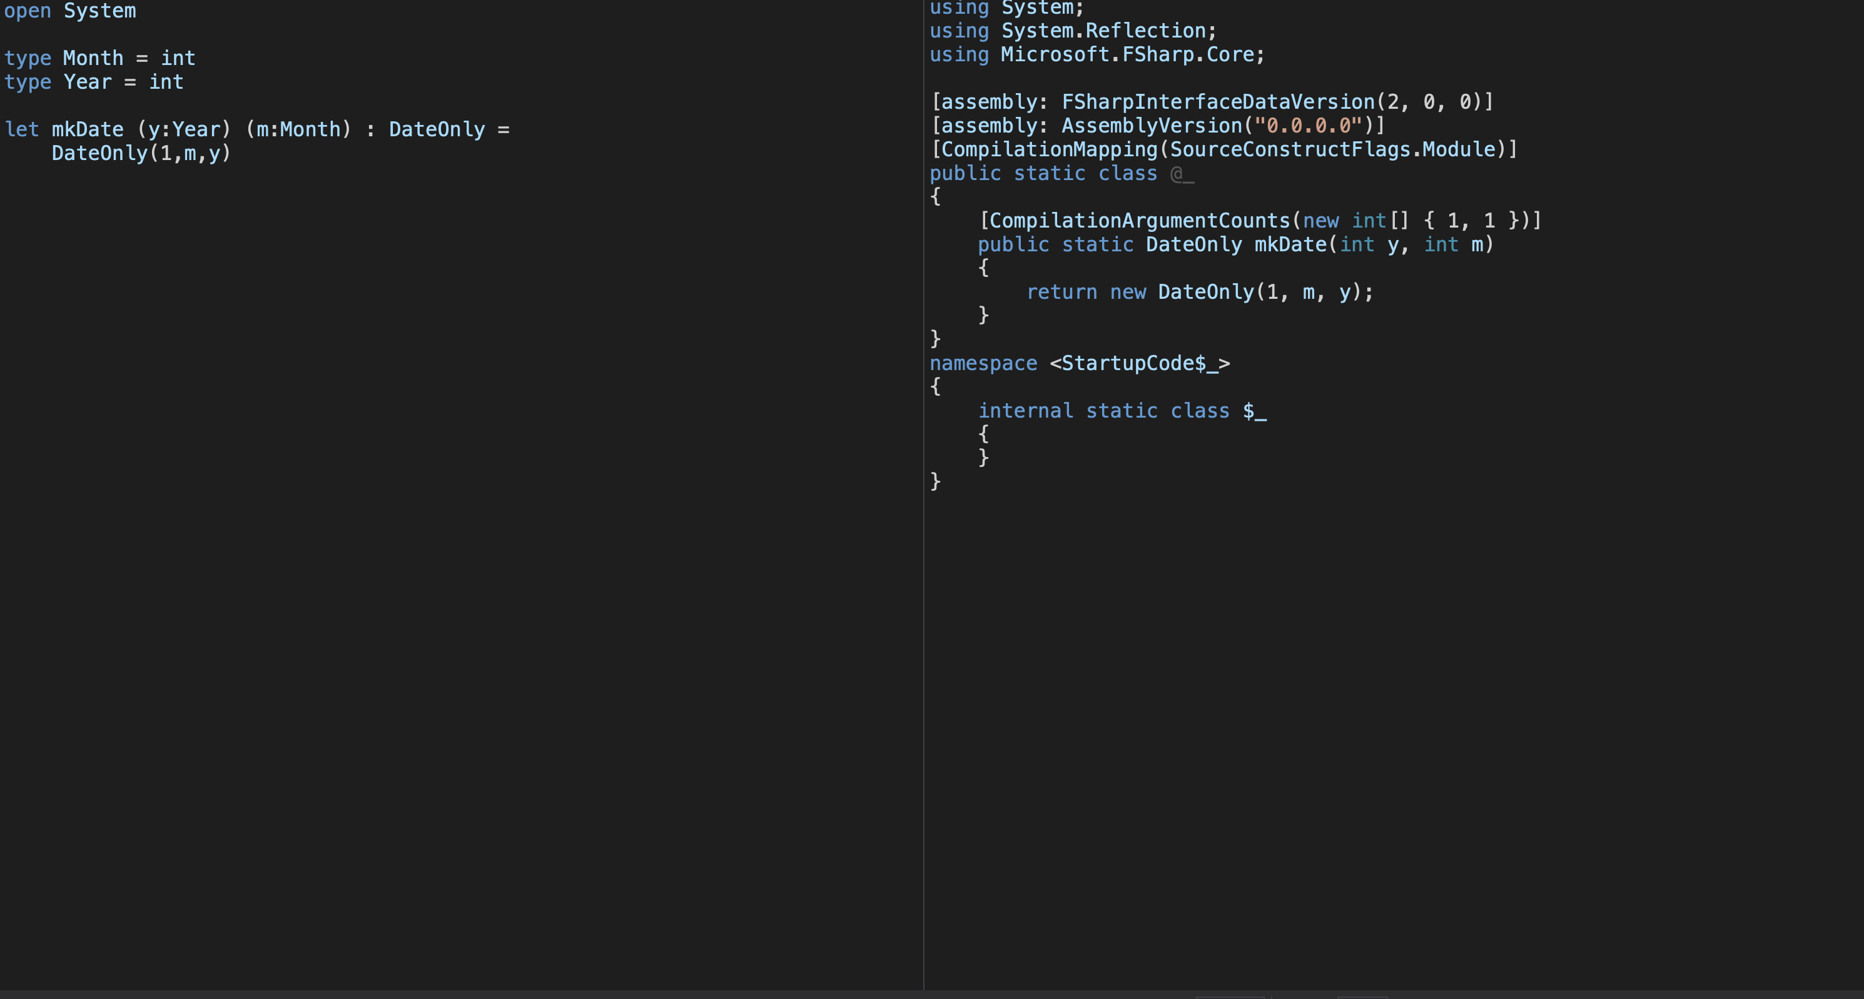
#1 - F# is still .NET
Let’s have a look deeper look here
Notes:
Show SharpLab

Slide 14
#2 - F# modern type system
Not my opinion, just have a look at the language space for the last 15 to 20 years…

Slide 15
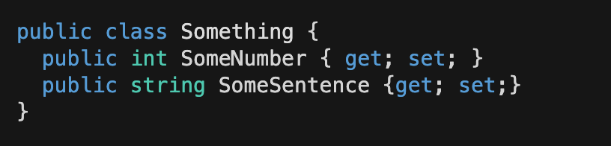
#2 – Product type
An instance of class Something, can have any combination of int AND string values
We say that Something is a product type of int and string, like (int*string) or Tuple<int,string>

Slide 16
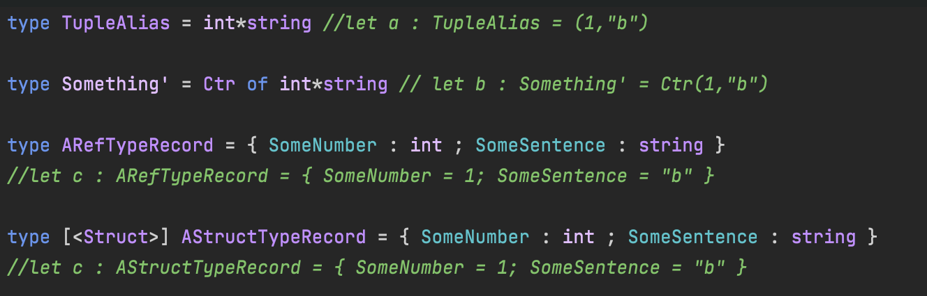
#2 – Product type

Slide 17
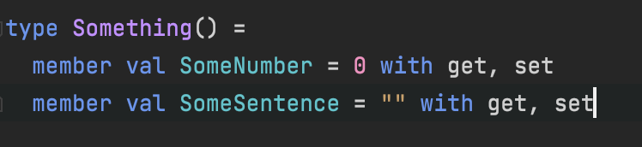
#2 – Product type
If you wish for a class…

Slide 18
#2 – Sum type
A sum type allows for DIFFERENT representations for a type
For example, you can represent in math a complex number as follow :
𝚛 𝜃𝚒
𝚊 + 𝚋 𝚒

Slide 19
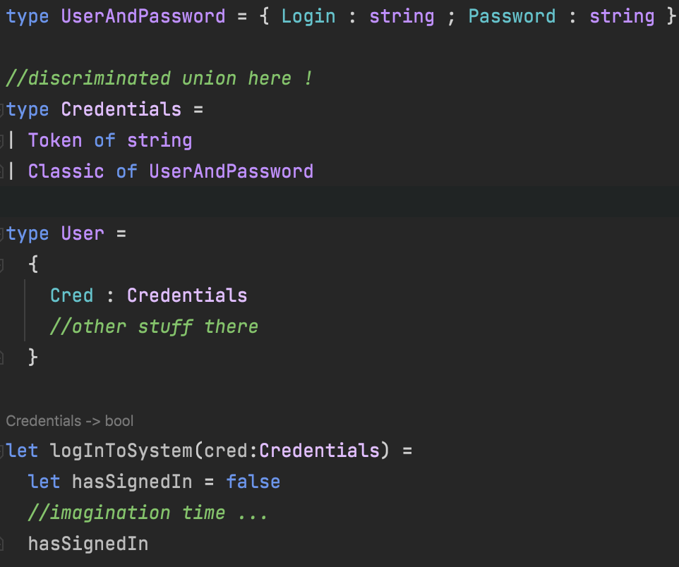
#2 – Sum type

Slide 20
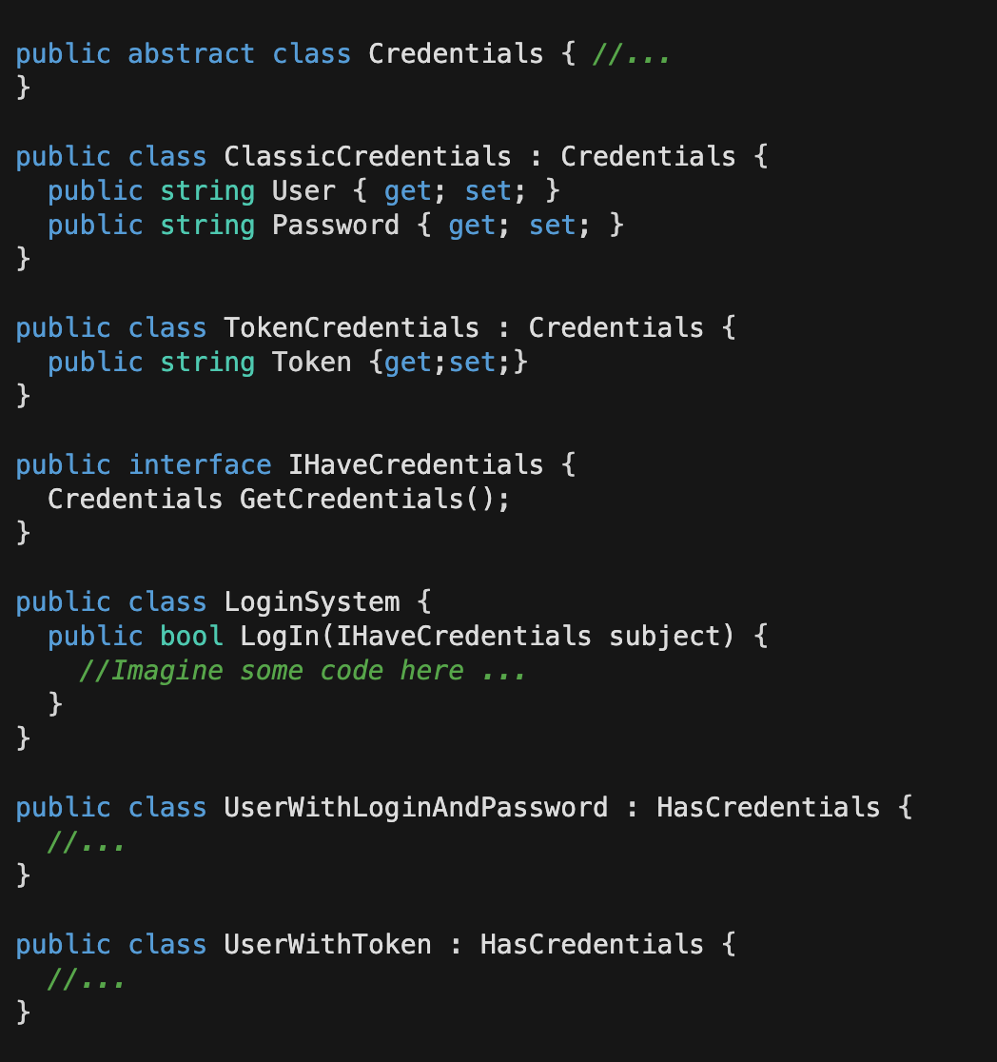
#2 - Sum type
No sum type in C#, but you got Polymorphism…

Slide 21
#2 – Sum type
In short, a sum type is a type with multiple representations
They are called Discriminated Union in F#
Not a new concept, you’ll find them in TypeScript, Rust, Kotlin…

Slide 22
#3 - F# is immutable by default
…yes, it’s a very big deal, have a look at C# 9 records or Immutable collections…

Slide 23
#3 - F# is immutable by default
Far less complicated to write concurrent code in F#
Initialisation is at declaration
F# supports null for compatibility with the .NET runtime
no implicit null assignation is done
only pure F# types are not nullable (still usable in C#)

Slide 24
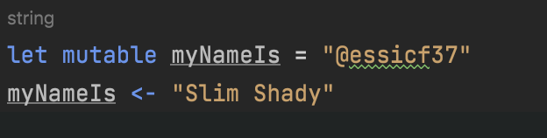
#3 - F# is immutable by default
If mutability is what you want or need ...
Immutability have very nice properties but also some cons, have a look at @KevlinHenney presentation at Ncraft 2018 on the subject…

Slide 25
#4 - Pattern matching
…powerful and expressive !

Slide 26
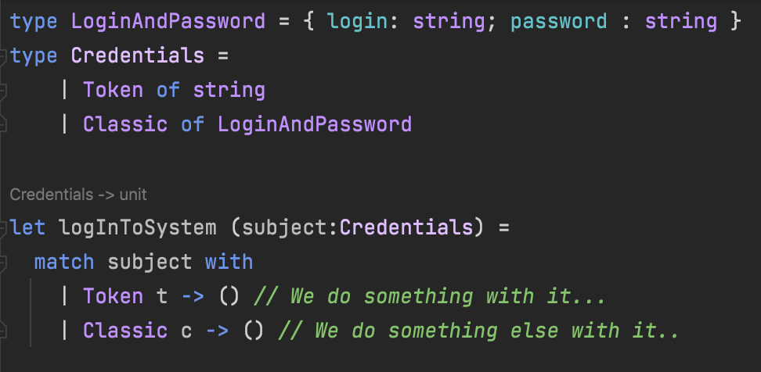
#4 - Pattern matching

Slide 27
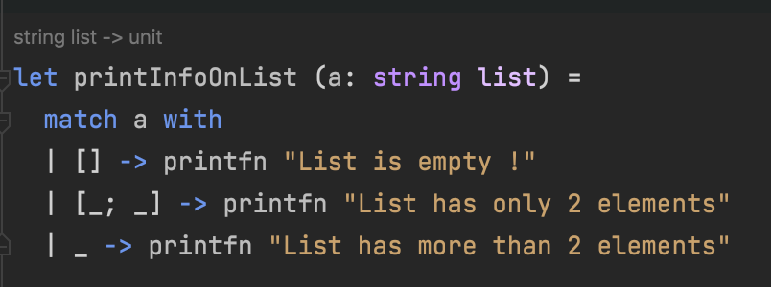
#4 - Pattern matching

Slide 28
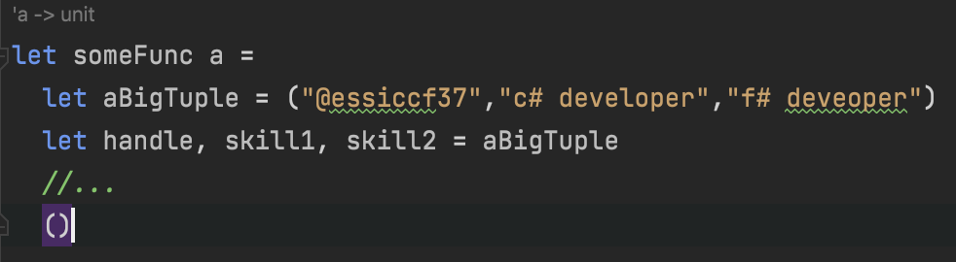
#4 - Pattern matching
F# allows for much more, you can check out Microsoft doc or the excellent site of Scott Wlaschin : F# for fun and profit for more

Slide 29
#5 – F# is interactive
…work on .NET while feeling like a JS developer

Slide 30
#5 – F# is interactive
F# has a REPL call FSI
FSI is supported on all major IDE for a while now
REPL is useful: ask Python and JavaScript developers or just dig into the history of the CScript initiative from MS…
You can create scripts (FAKE)
You can write code and try it directly
You can test use cases with DLLs from production to see what's happening

Slide 31
Let’s see some code!

Slide 32
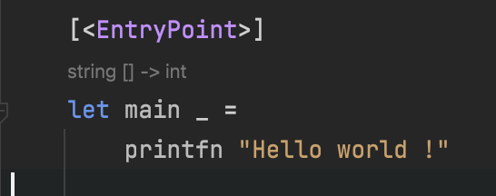
F# Samples

Slide 33
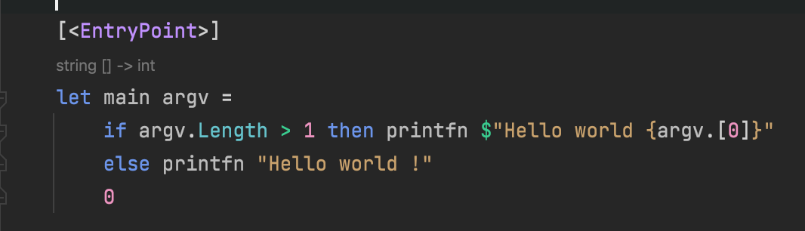
F# Samples

Slide 34
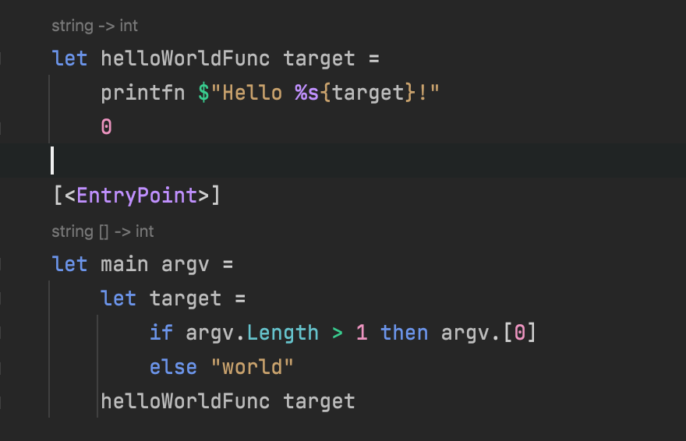
F# Samples

Slide 35
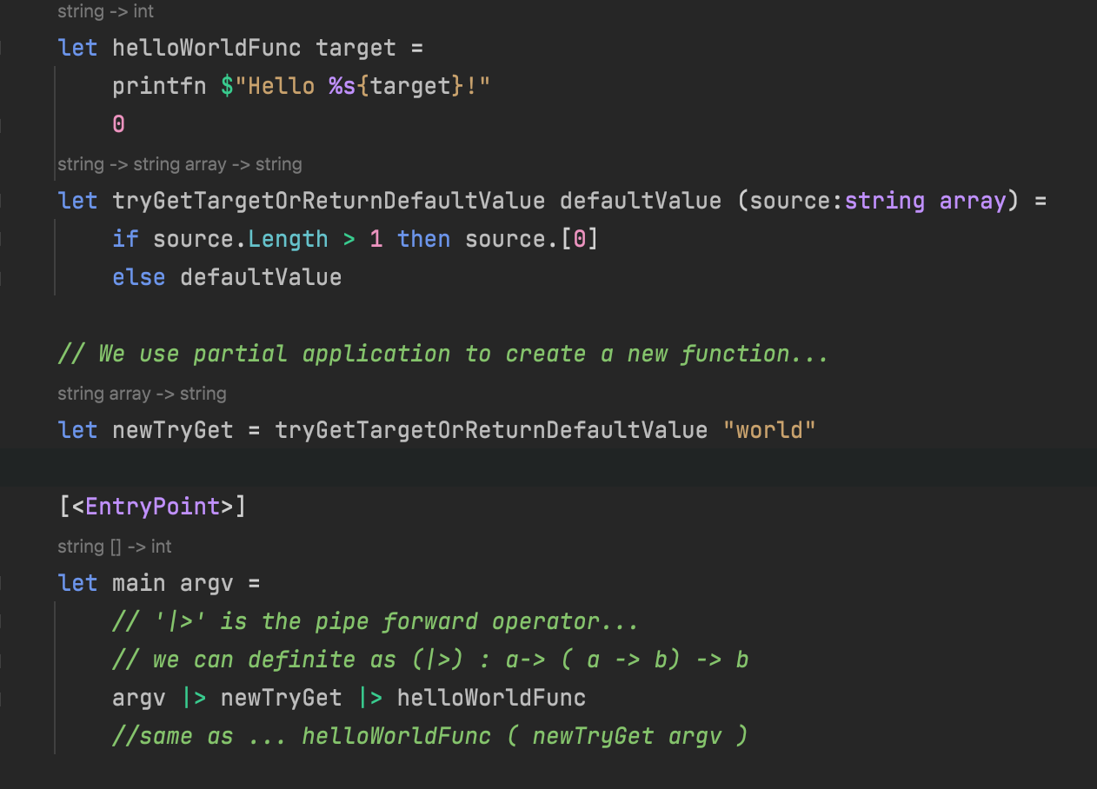
F# Samples

Slide 36
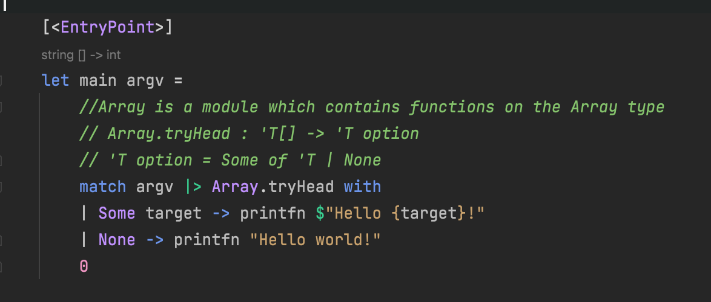
F# Samples

Slide 37
In short…
F# has been production ready for a while now…
C# is not dead and will continues to evolve… F# is just another option on the .NET platform
F# has influenced C# for at least a decade now…

Slide 38
Thank you !
Questions ?

Slide 39
Want to code?

Slide 40
F# Workshop !
Let’s code something simple in a realistic production ready software architecture

Slide 41
What is it about ?
We will implement a simple use case of a Time Tracker api in F# of course.
We aim here :
- to show a software architecture which take full advantage of the functional paradigm
- to show what it’s like to write C# code in a real life (like) scenario
- to show how to work alongside C#

Slide 42
Project Architecture
We are using here Functional Core/Imperative Shell pattern (or architecture)
Functional Core is where the business logic (domain) resides. It must be:
free of side effects
fully synchronous
Imperative Shell is where use cases are implemented using functions from the Core. It’s also where side effects are handled.

Slide 43
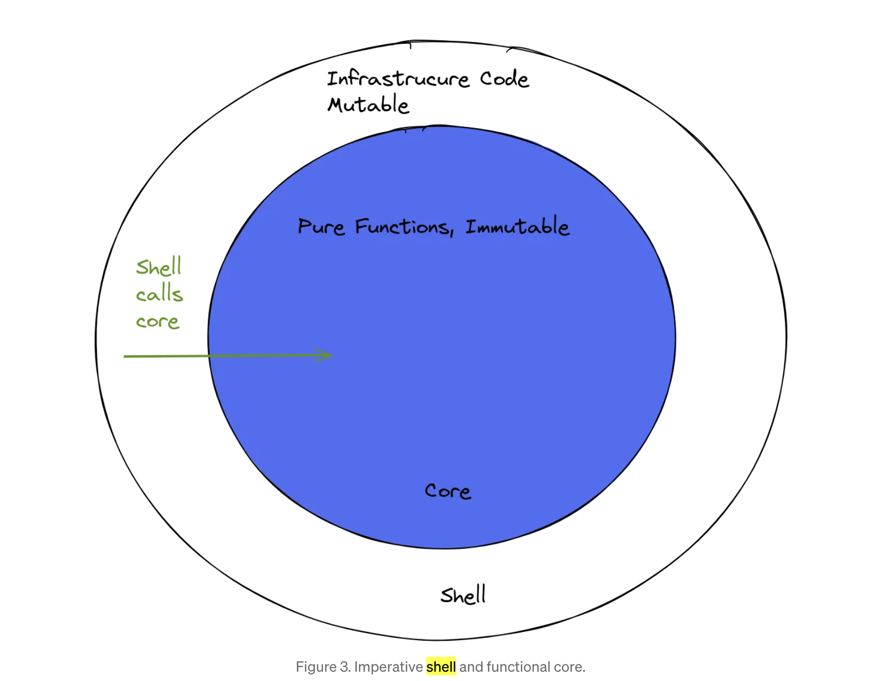
From a blog post by Mario Bittencourt

Slide 44
Let’s do this !

