Slide 1
Why F# ?
by @essiccf37

Slide 2
“Point of view is worth 80 IQ points”
Alan Key

Slide 3
What is F# ?
General purpose language that on the .NET runtime designed by Don Syme, from Microsoft Research

Slide 4
What is F# ?
Strongly, statically typed, open sourced and cross platform language from Microsoft with deep inference
1.0 appeared on 2005 ( older than: GO, Rust, Kotlin, Typescript ...)
Heavily influenced by ML, OCaml, Haskell, C# & others
Multi-paradigm language : functional (by default), imperative and object-oriented
It compiles to executable or you can script with it
Fully supported by .NET & Mono. Also compiles to Javascript.

Slide 5
About functional paradigm…

Slide 6
Functional vs Object is a myth
Those are two different things with pros and cons…

Slide 7
Functional paradigm is old
Theory has been around since 1930’s and first programming language appeared in the 50’s, also it’s been spreading for a while now : C#, Java, Kotlin, Rust …

Slide 8
No need for math, to deliver in production
…you do not need math to use most functional programming languages, F# included

Slide 9
Functional paradigm focus on data
…while Object Oriented paradigm focus on structure

Slide 10
5 reasons to have a hard look at F#
...when coming from C#

Slide 11
#1 - F# is still .NET
F# in my C# and F# in my C#... #ception :p

Slide 12
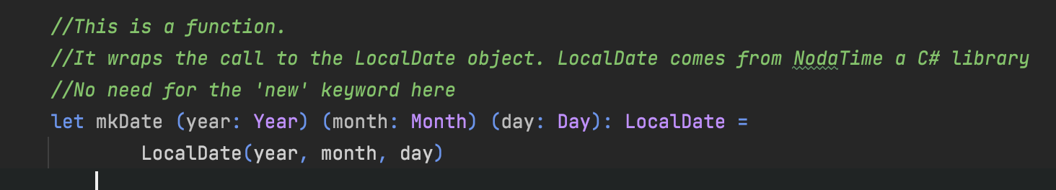
#1 - F# is still .NET
Anything written in C# can be used in F#
The reverse is true for all F# features not depending on the compiler
In short, same constraints as VB.NET

Slide 13
#2 - F# modern type system
Not my opinion, just have a look at the language space for the last 10 years…

Slide 14
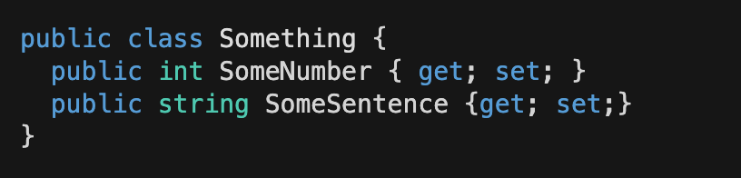
#2 – Product type
Any value of int can be affected into SomeNumber
Any value of string can be affected to SomeSentence
=> An object of class Something, can have any combination of int AND string values
We say that Something is a product type of int and string ( int*string )
The same is true for Tuple<int,string>

Slide 15
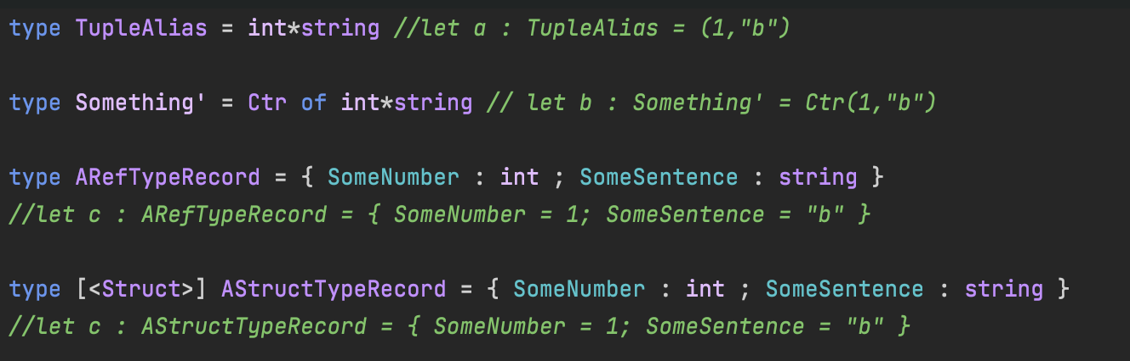
#2 – Product type

Slide 16
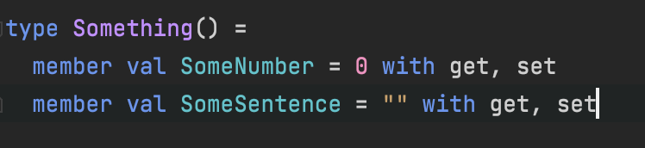
#2 – Product type
If you wish for a class…

Slide 17
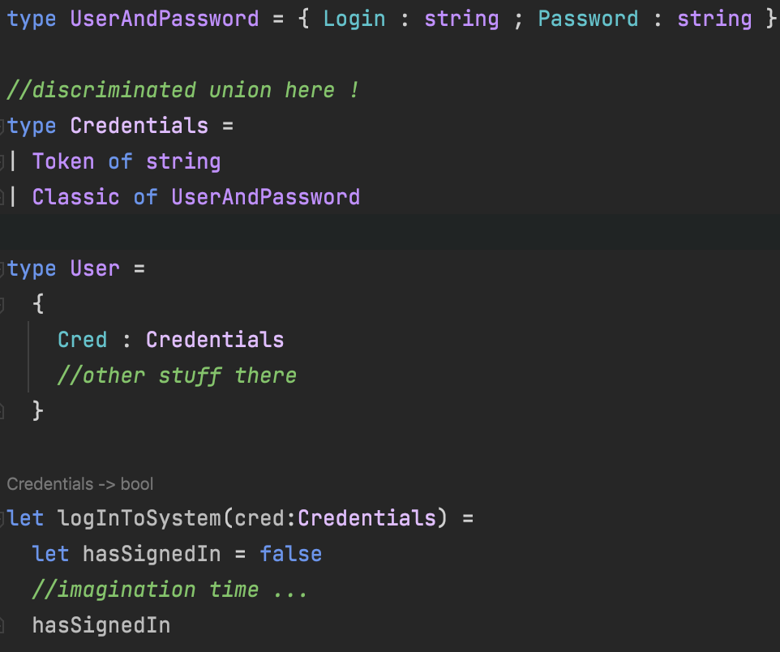
#2 – Sum type
In short, a sum type is a type with multiple representations
They are called Discriminated Union in F#
Not a new concept, you’ll find them in TypeScript, Rust, Kotlin…

Slide 18
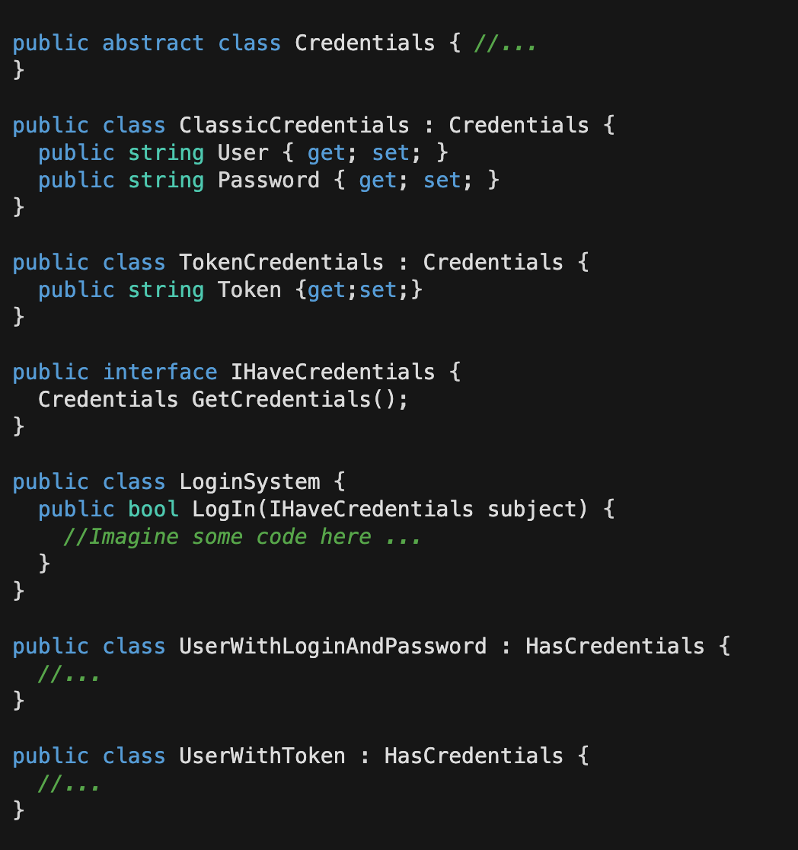
#2 - Sum type
No sum type in C#, but you got Polymorphism…

Slide 19
#3 - F# is immutable by default
Or why declaring fields / properties as readonly is not enough.
…yes, it’s a very big deal, go have a look at C# 9 records or Immutable collections…

Slide 20
#3 - F# is immutable by default
Far less complicated to write concurrent code in F#
Declaration is initialisation => In F#, you never question if the value is present but only what the value is
F# supports null for compatibility with C# and the .NET platform
no implicit null assignation is done => You want a null value, you make it explicit
pure F# types are not nullable (still usable in C#)

Slide 21
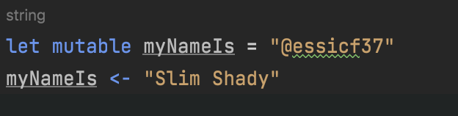
#3 - F# is immutable by default
Of course if mutability is what you want ...
Why the 'buzz' on immutability ? Please watch @KevlinHenney presentation on Ncraft 2018

Slide 22
#4 - Pattern matching
…it’s also a very big deal, that’s why C# 8 introduced it as well.

Slide 23
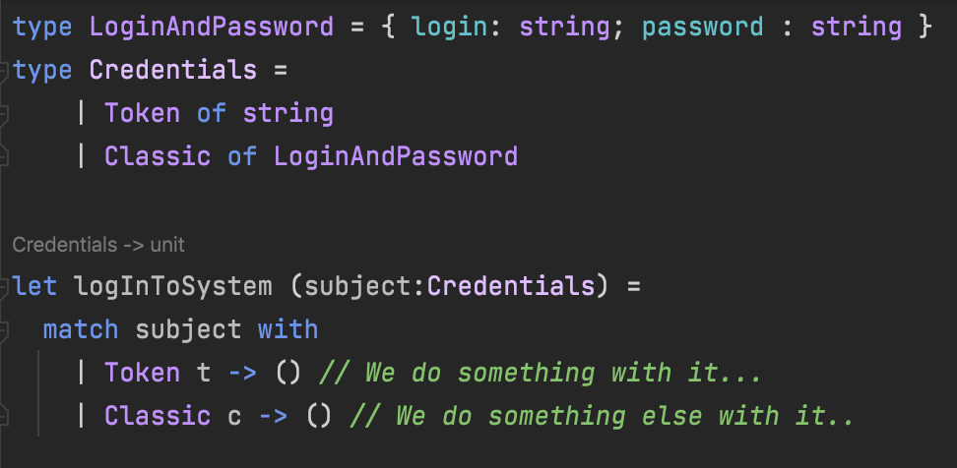
#4 - Pattern matching

Slide 24
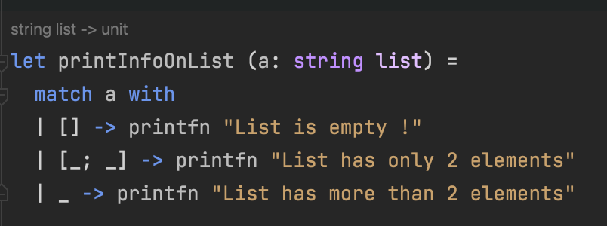
#4 - Pattern matching

Slide 25
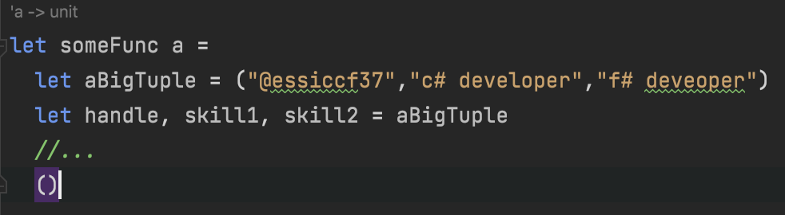
#4 - Pattern matching

Slide 26
#4 - Pattern matching
F# allows for much more, you can check out Microsoft doc on this or the excellent site of Scott Wlaschin : F# for fun and profit on the subject

Slide 27
#5 – F# is interactive
…work on .NET while feeling like a JS developer.

Slide 28
#5 – F# is interactive
F# has a REPL call FSI for F# Interactive
FSI has full on all major IDE for a while now
Visual Studio, Rider, VsCode
REPL is useful: ask Python and Javascript developers or just watch the CScript initiative from MS…
Useful how
You can create scripts
You can write code to test some cases and load production DLLs to see exactly what's happening
You can write code, load it and try it directly

Slide 29
Let’s code!

Slide 30
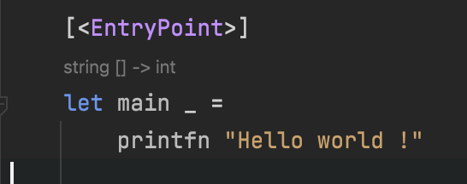
F# Samples

Slide 31
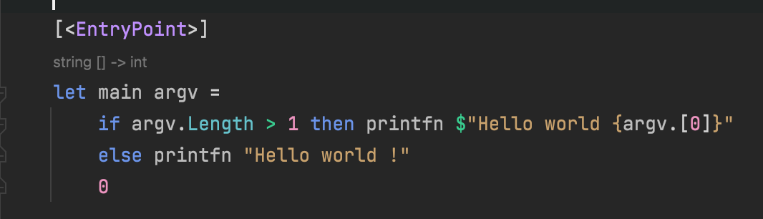
F# Samples

Slide 32
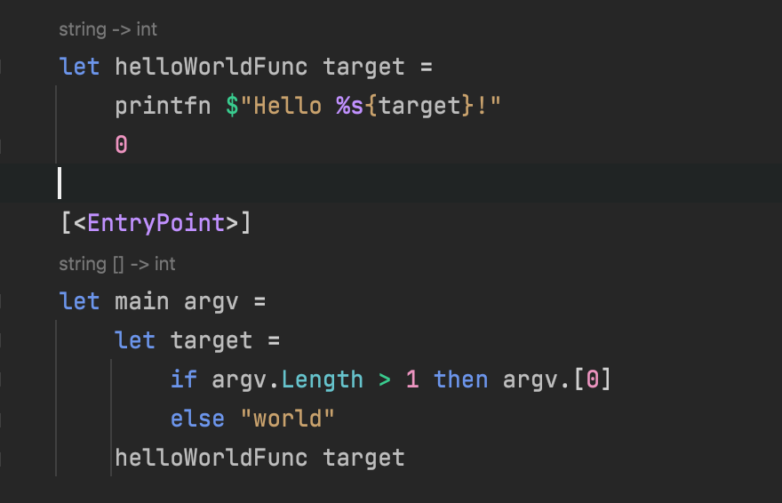
F# Samples

Slide 33
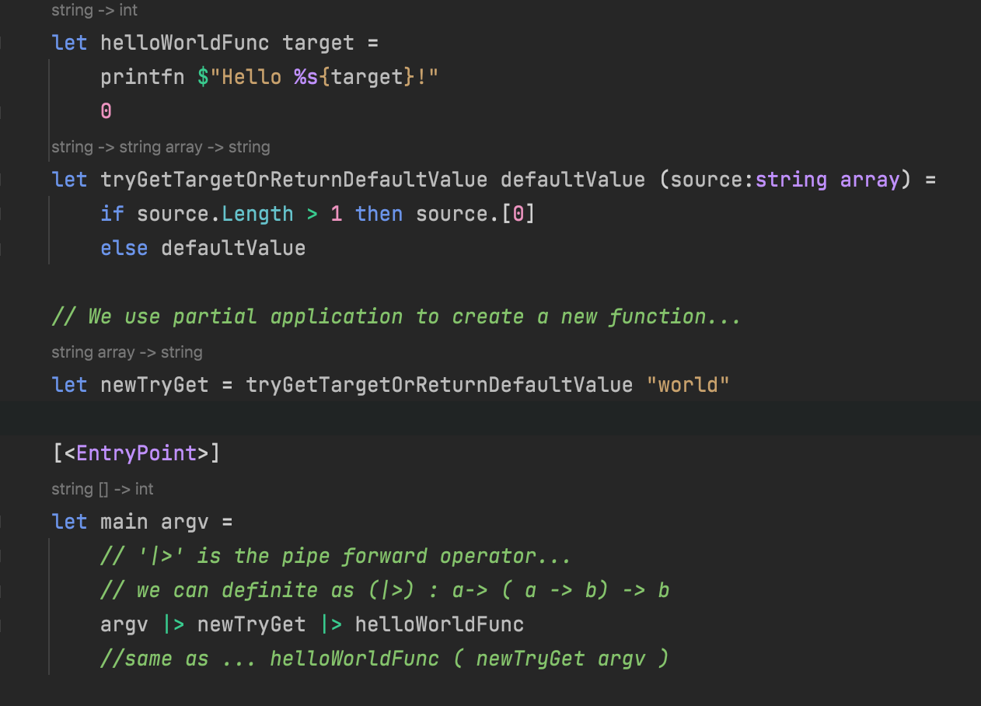
F# Samples

Slide 34
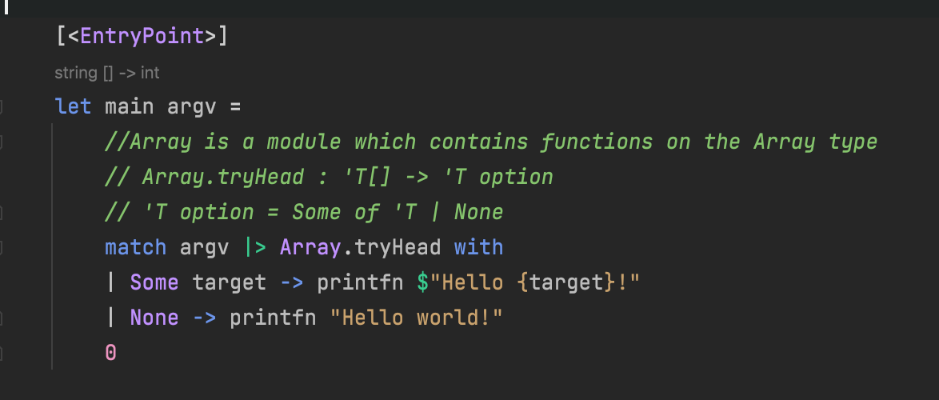
F# Samples

Slide 35
In short…
Basics of Functional Programming are everywhere, it is not an option to be blind to it anymore
C# is not dead and it continues to evolve… however having another point of view can only make you better at what you do…
F# is not that big of a stretch since it is still .NET and it is has really mature ecosystem

Slide 36
Thank you !

