Slide 1
Why F# ?
by @essiccf37
November 2021

Slide 2
“Point of view is worth 80 IQ points”
Alan Key

Slide 3
What is F# ?
General purpose language on .NET designed by Don Syme, from Microsoft Research

Slide 4
What is F# ?
Strongly, statically typed, open sourced and cross platform language from Microsoft with deep inference
1.0 appeared on 2005 ( older than: GO, Rust, Kotlin, Typescript ...)
Heavily influenced by ML, OCaml, Haskell, C# & others
Multi-paradigm language : functional (by default), imperative and object-oriented
Fully supported by .NET & Mono. Also compiles to JavaScript

Slide 5
About functional paradigm…
Before going further…

Slide 6
Functional vs Object is a myth
Those are two different things with pros and cons…

Slide 7
Functional paradigm is old
Theory around since the 30’s and first language appeared in the 50’s.

Slide 8
No need for math
…to deliver production ready software
…to use most functional programming languages, F# included

Slide 9
Functional paradigm focus on data
…while Object Oriented paradigm focus on structure

Slide 10
5 reasons to have a hard look at F#
...when coming from C#

Slide 11
#1 - F# is still .NET
F# in my C# and C# in my F#...

Slide 12
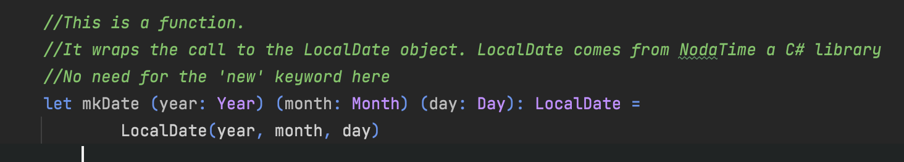
#1 - F# is still .NET
In short, same constraints as VB.NET
Anything written in C# can be used in F#
The reverse is true for all F# features not depending on the compiler
Let’s have a look deeper look here
Notes:
Show SharpLab

Slide 13
#2 - F# modern type system
Not my opinion, just have a look at the language space for the last 15 years…

Slide 14
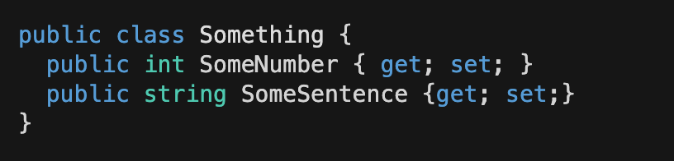
#2 – Product type
An object of class Something, can have any combination of int AND string values
We say that Something is a product type of int and string, like (int*string) or Tuple<int,string>

Slide 15
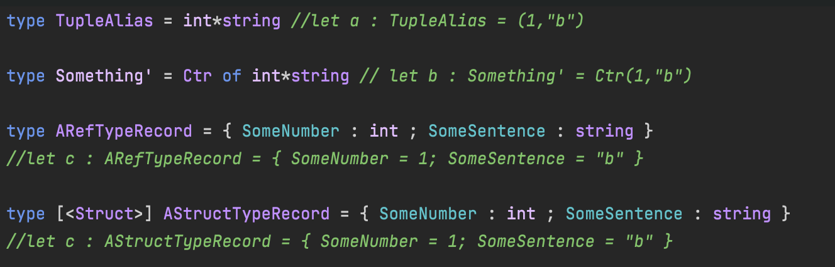
#2 – Product type

Slide 16
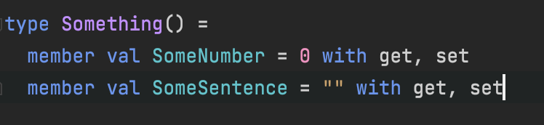
#2 – Product type
If you wish for a class…

Slide 17
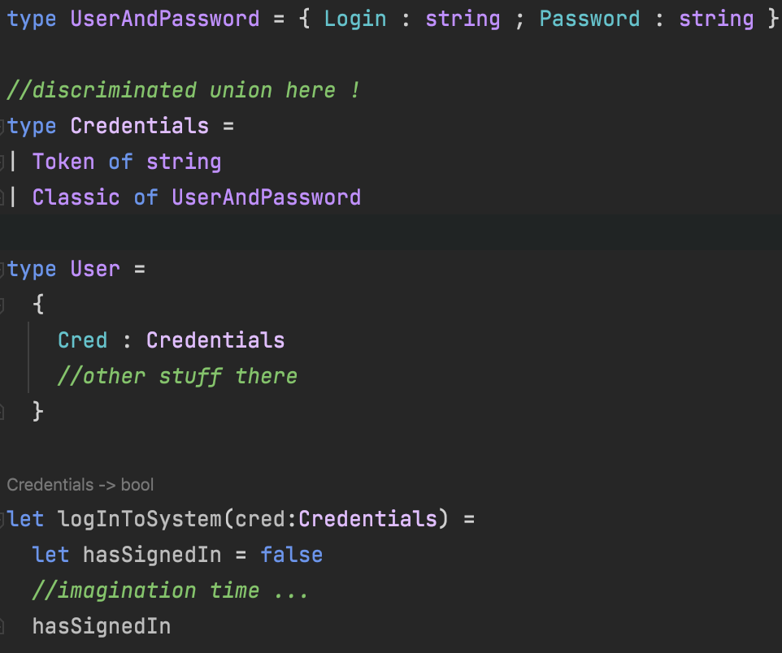
#2 – Sum type

Slide 18
#2 – Sum type
In short, a sum type is a type with multiple representations
They are called Discriminated Union in F#
Not a new concept, you’ll find them in TypeScript, Rust, Kotlin…

Slide 19
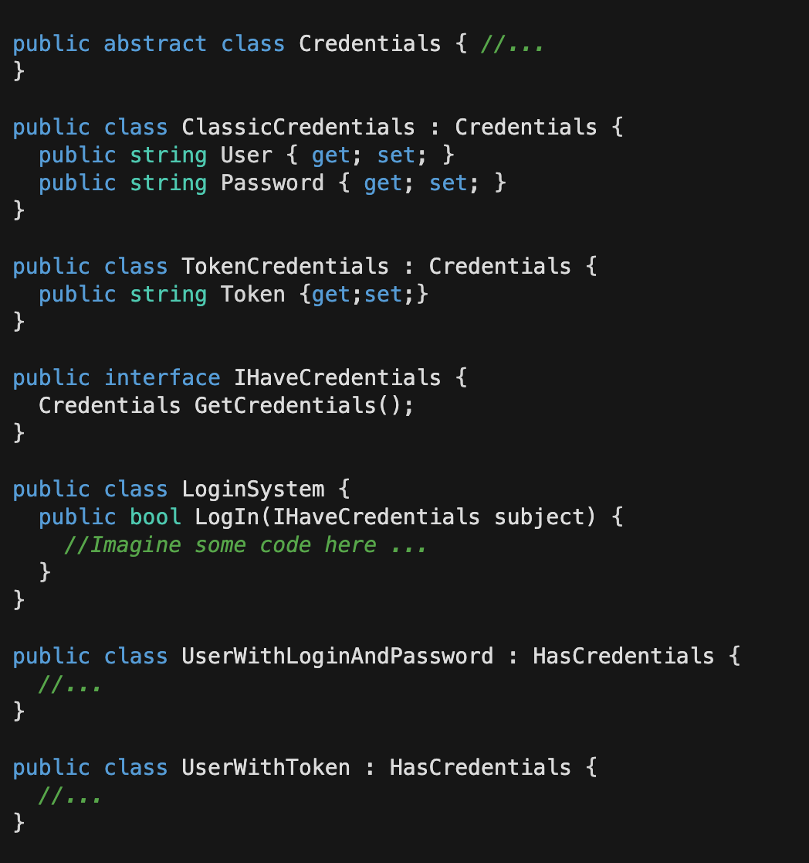
#2 - Sum type
No sum type in C#, but you got Polymorphism…

Slide 20
#3 - F# is immutable by default
…yes, it’s a very big deal, have a look at C# 9 records or Immutable collections…

Slide 21
#3 - F# is immutable by default
Far less complicated to write concurrent code in F#
Declaration is initialisation => In F#, you never question if the value is present but only what the value is
F# supports null for compatibility with the .NET runtime
no implicit null assignation is done => You want a null value, you make it explicit
pure F# types are not nullable (still usable in C#)

Slide 22
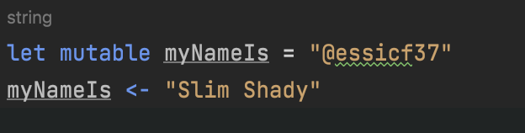
#3 - F# is immutable by default
Of course if mutability is what you want ...
Immutability have very nice properties but also some cons, have a look at @KevlinHenney presentation at Ncraft 2018 on the subject…

Slide 23
#4 - Pattern matching
powerful one… with fundamentals features

Slide 24
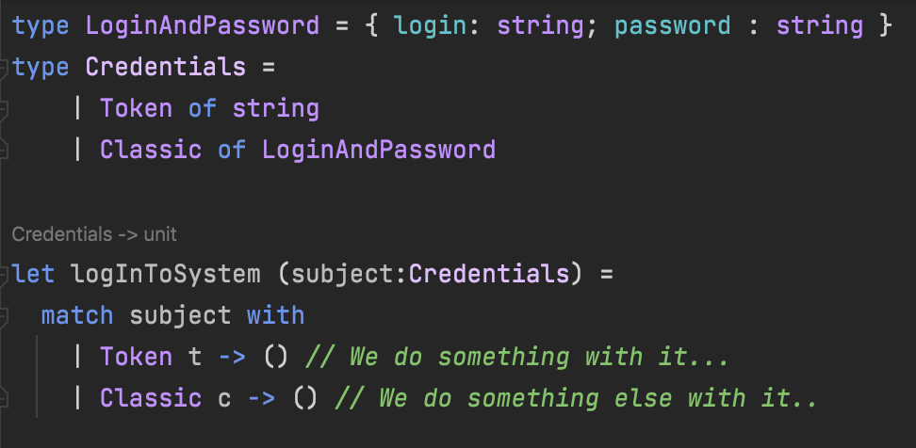
#4 - Pattern matching

Slide 25
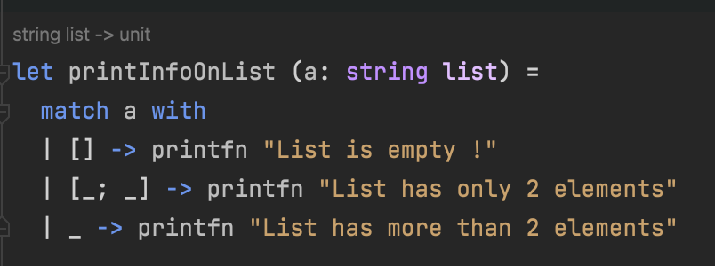
#4 - Pattern matching

Slide 26
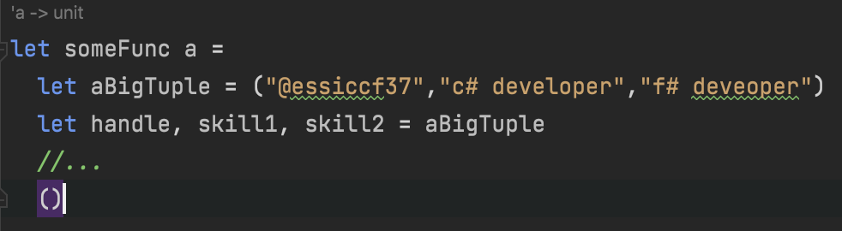
#4 - Pattern matching
F# allows for much more, you can check out Microsoft doc or the excellent site of Scott Wlaschin : F# for fun and profit for more

Slide 27
#5 – F# is interactive
…work on .NET while feeling like a JS developer

Slide 28
#5 – F# is interactive
F# has a REPL call FSI for F# Interactive
FSI is supported on all major IDE for a while now
REPL is useful: ask Python and JavaScript developers or just dig into the history of the CScript initiative from MS…
You can create scripts (FAKE)
You can write code and try it directly
You can test use cases with DLLs from production to see what's happening

Slide 29
Let’s code!

Slide 30
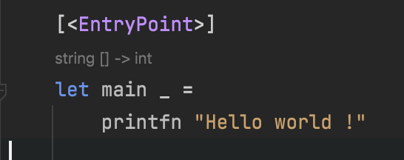
F# Samples

Slide 31
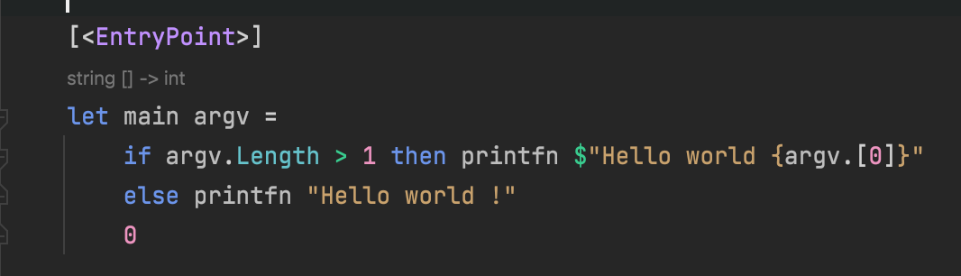
F# Samples

Slide 32
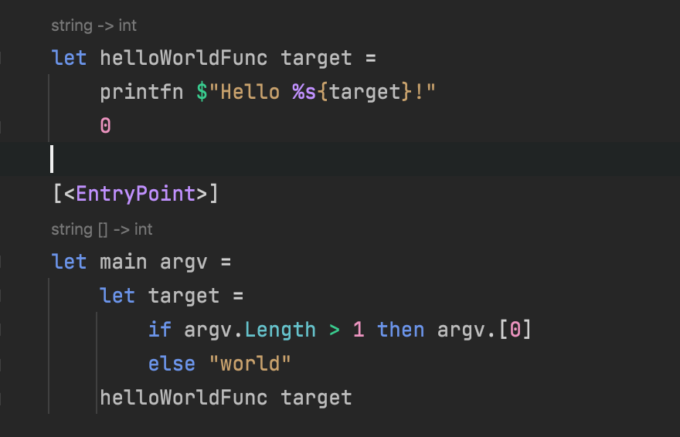
F# Samples

Slide 33
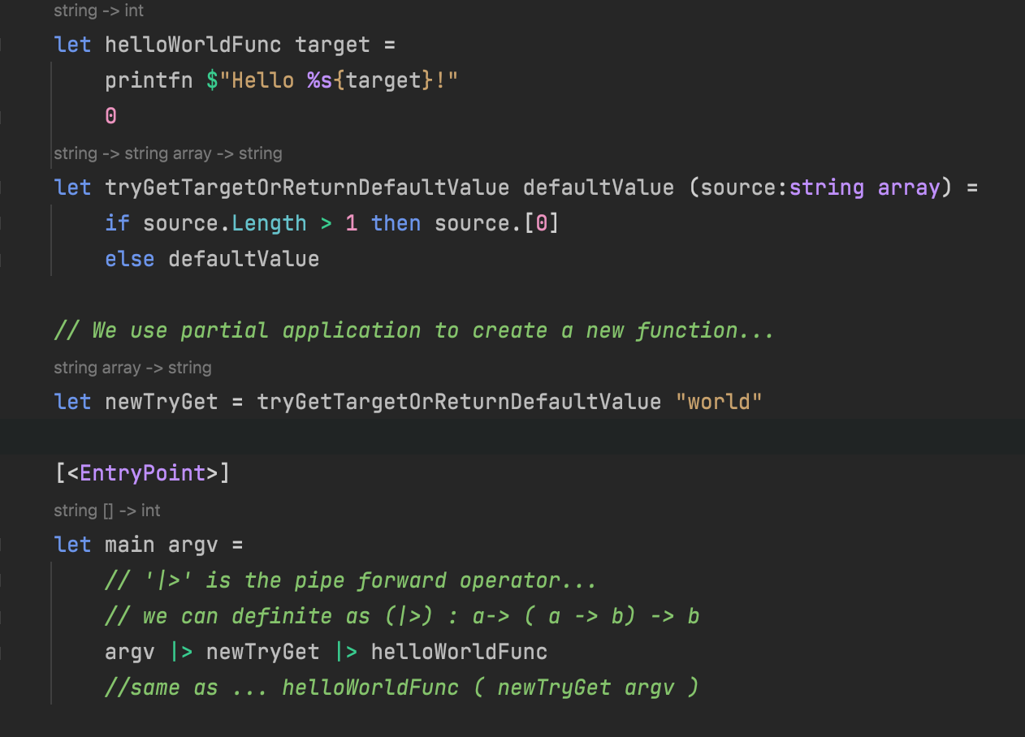
F# Samples

Slide 34
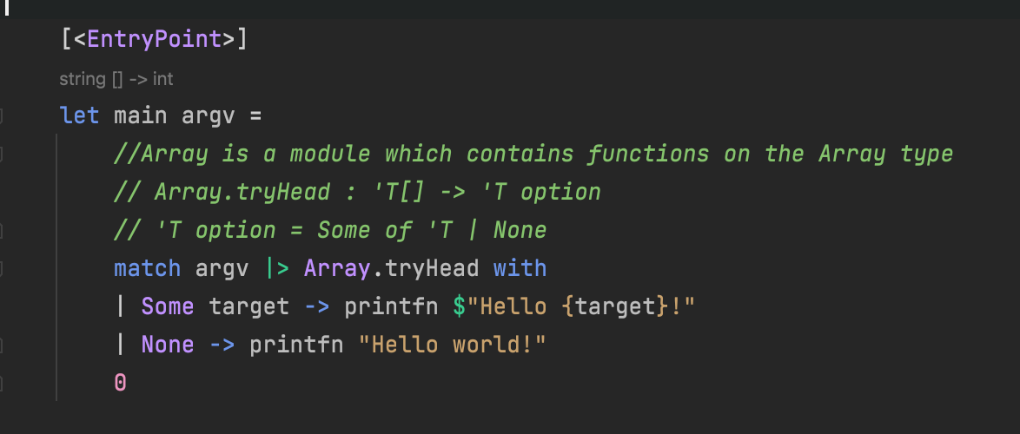
F# Samples

Slide 35
In short…
Functional Programming is here to stay, there’s only advantages to understand this point of view
C# is not dead and it continues to evolve… F# is just another option on the .NET platform
F# is mature, this is not a toy language by any means
F# has influenced C# for the last 6 years (at least)

Slide 36
Thank you !

