Slide 1
Build Phase
Democratic/Republican Primary Debate Transcripts
Fitted SVM Classifier Algorithm
Feature Vectors
Words = features
Documents = instances
Operational Phase
RSS News Feed Data
Predictive Model
Prediction
Feature Vectors
Words = features
Documents = instances

Slide 2
3
TF-IDF Sparse Matrix
1
2
Data Bunch
One paragraph per text document
Removed moderator remarks
 | Word 1 | Word 2 | Word 3 | Word 4
Doc 1 | TF-IDF: 0.124 | 0 | 0 | TF-IDF: 0.115
Doc 2 | 0 | 0 | TF-IDF: .104 | 0
Doc 3 | 0 | TF-IDF: 0.82 | 0 | 0
Debate Transcripts
Full HTML Documents
blue
red
4
5
Evaluate Three Classifier Models
Fitted SVM Classifier Algorithm
Remove stop words
Logistic Regression (LR)
Remove non-predictive features: truncated singular value decomposition (TSVD)
Support Vector Machine (SVM)
Multinomial Naïve Bayes (MNB)
Feature Engineering

Slide 3
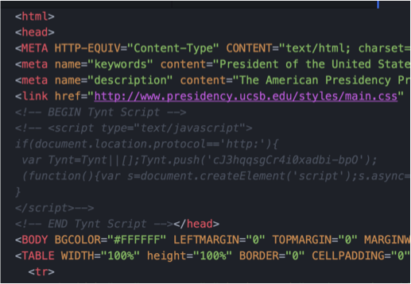
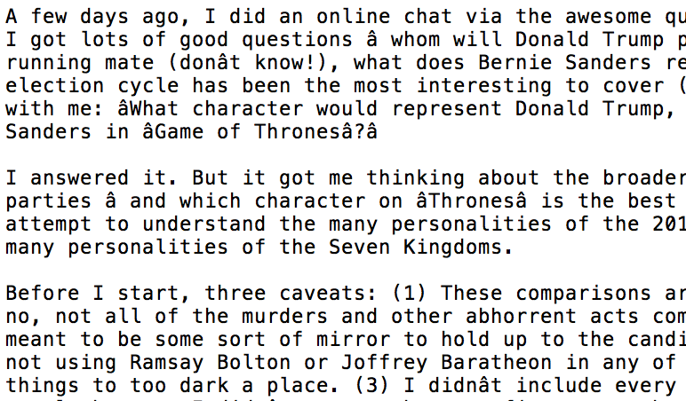
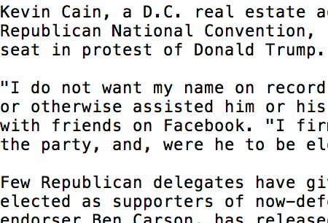
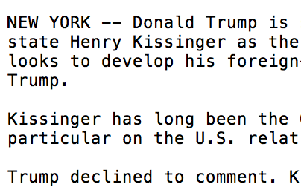
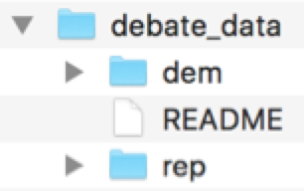
Training Data Bunch
One paragraph per text document
Removed moderator remarks
blue
red
HTML Documents:
UCSB American Presidency Project
presidency.ucsb.edu
dem_parse.py rep_parse.py
BeautifulSoup, requests, os

Slide 4
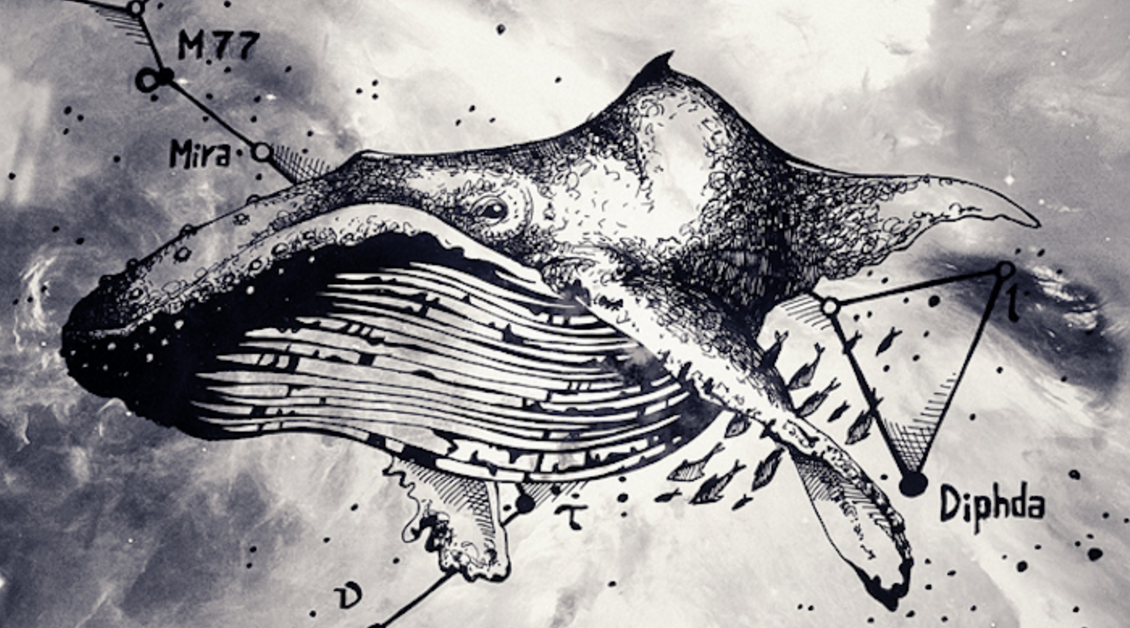

OPML
Baleen
MongoDB
Baleen WSJ
Baleen NYT
Baleen Reuters
Script with directions for sourcing RSS feeds
Automated ingestion service for NLP research (by Prof. Bengfort)
(etc.)
Fitted SVM Classifier Model
transform.py
BeautifulSoup, codecs
Text
HTML
Notes:
OPML: Outline Processor Markup Language

Slide 5
Red/Blue Term Frequency Spectrum
Washington Post
Associated Press
WSJ
Drudge Report
CNN
Reuters
The Nation
NYT
Fox News
USA Today
The Economist
MSNBC
Washington Post
MSNBC
USA Today
Fox News
NYT
The Economist
CNN
WSJ
Drudge Report
Pew Political Spectrum

