Slide 1

Ride Cancellation Prediction
Claire Schlesinger

Slide 2
Data Processing
Time To Pickup – Too long may cause increase in cancellation
Walk Distance - If the pickup distance is farther than the location it wouldn’t make sense to use it.
Destination Location – People may go to places further away rather than closer
Time to Dropoff – If the ride includes many stops and it would take longer than another service, they will probably cancel.

Slide 3
Data Processing
Request Month/Day – Useful for determining patterns like usage over holidays.
Request Day of Week – Distinguishes between week and weekend.
Request Time – People may cancel less as it gets later and more dangerous.
Request Status – This is the label that tells if the user completed or cancelled their ride.

Slide 4

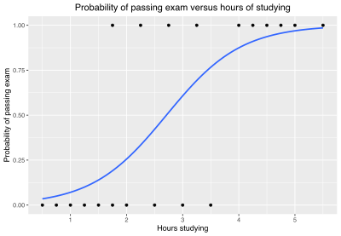
Models
Random Forest
Logistic Regression

Slide 5
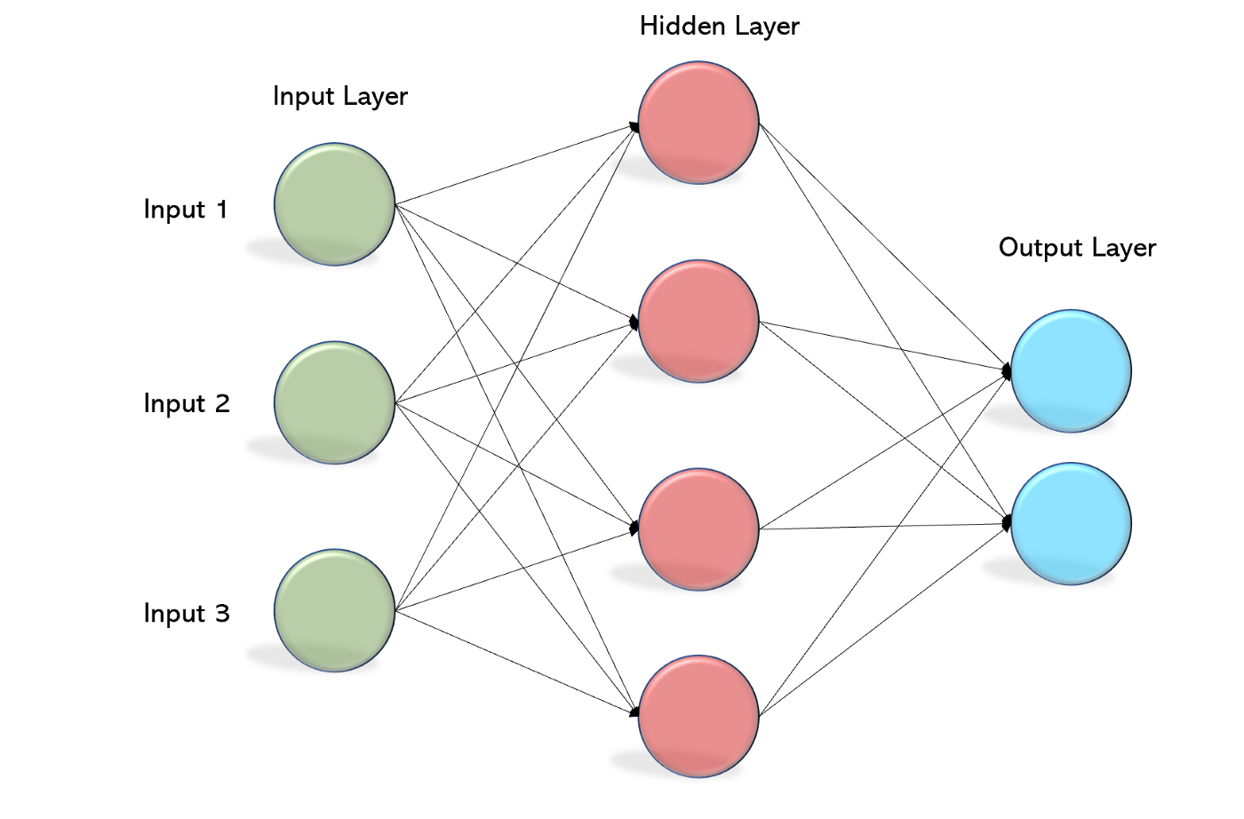
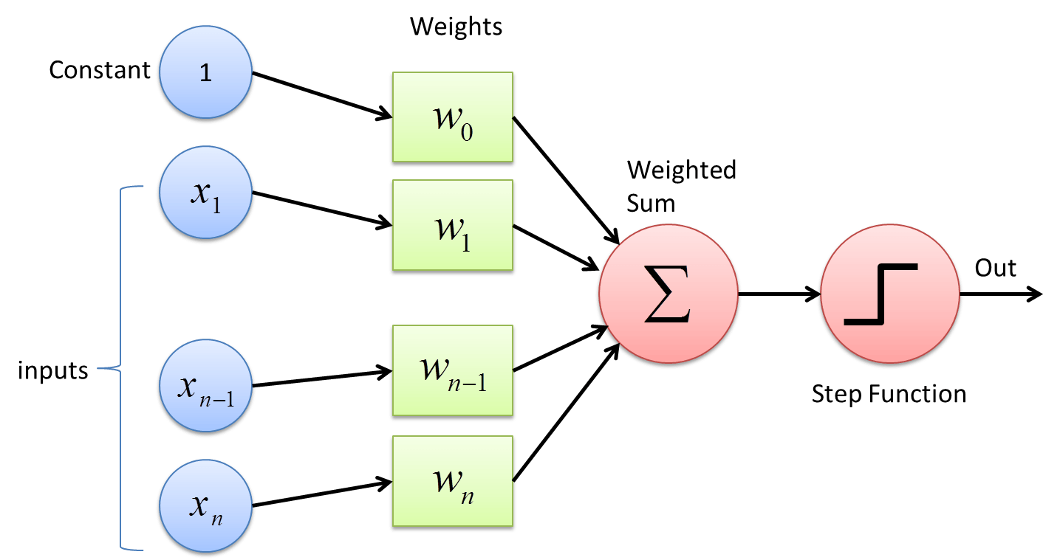
Models
Perceptron
Multi Layer Perceptron

Slide 6
Model Evaluation
Assessed their accuracy with K-Fold cross validation.
Ensures robustness over varied data.
Accuracy determines its ability to correctly classify these objects.

Slide 7
Results: Accuracy

Slide 8
Results: Training Time

Slide 9
Results: Testing Time

