Slide 1
EDES 301 Pomodoro Prism: Light-up Study Timer Project Proposal
Updated March 7, 2025
Eleanor Tucker

Slide 2
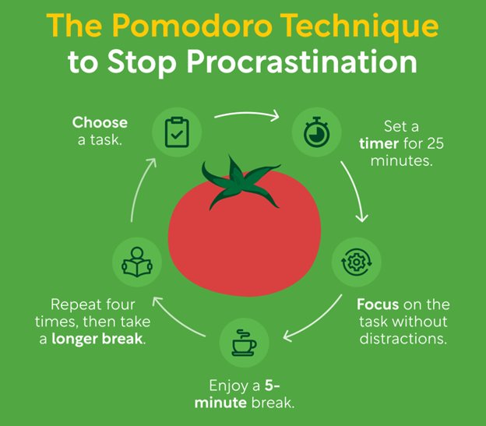
Background Information
Pomodoro technique for time management
4 x [25 minutes work, 5 minutes break]
15 to 30-minute break
Supposed to reduce burnout and improve focus
The creator used a tomato-shaped kitchen timer (hence the name pomodoro)
https://bharatividyapeethonline.com/what-is-the-pomodoro-technique/

Slide 3
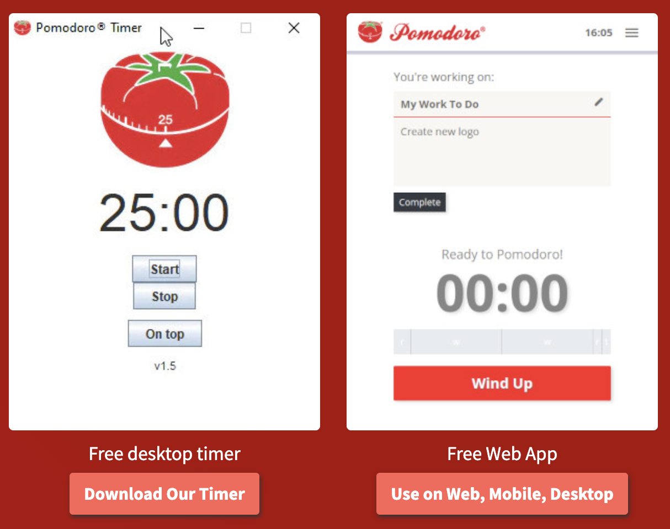
Background Information
Many pomodoro apps exist, but they have drawbacks:
Using phone or computer leads to distractions
Harsh alarm sounds can be unpleasant
https://www.pomodorotechnique.com/

Slide 4
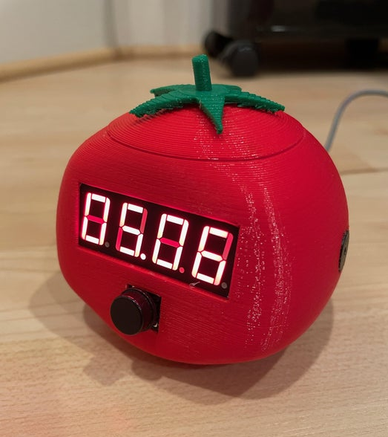
Background Information
3D printed pomodoro tomato clock/timer by user Prusteen on Instructables
Features
Clock mode
Pomodoro mode
25-minute timer, buzzer, 5-minute timer, buzzer, repeat
One button
https://www.instructables.com/The-Pomodoro-Tomato/

Slide 5
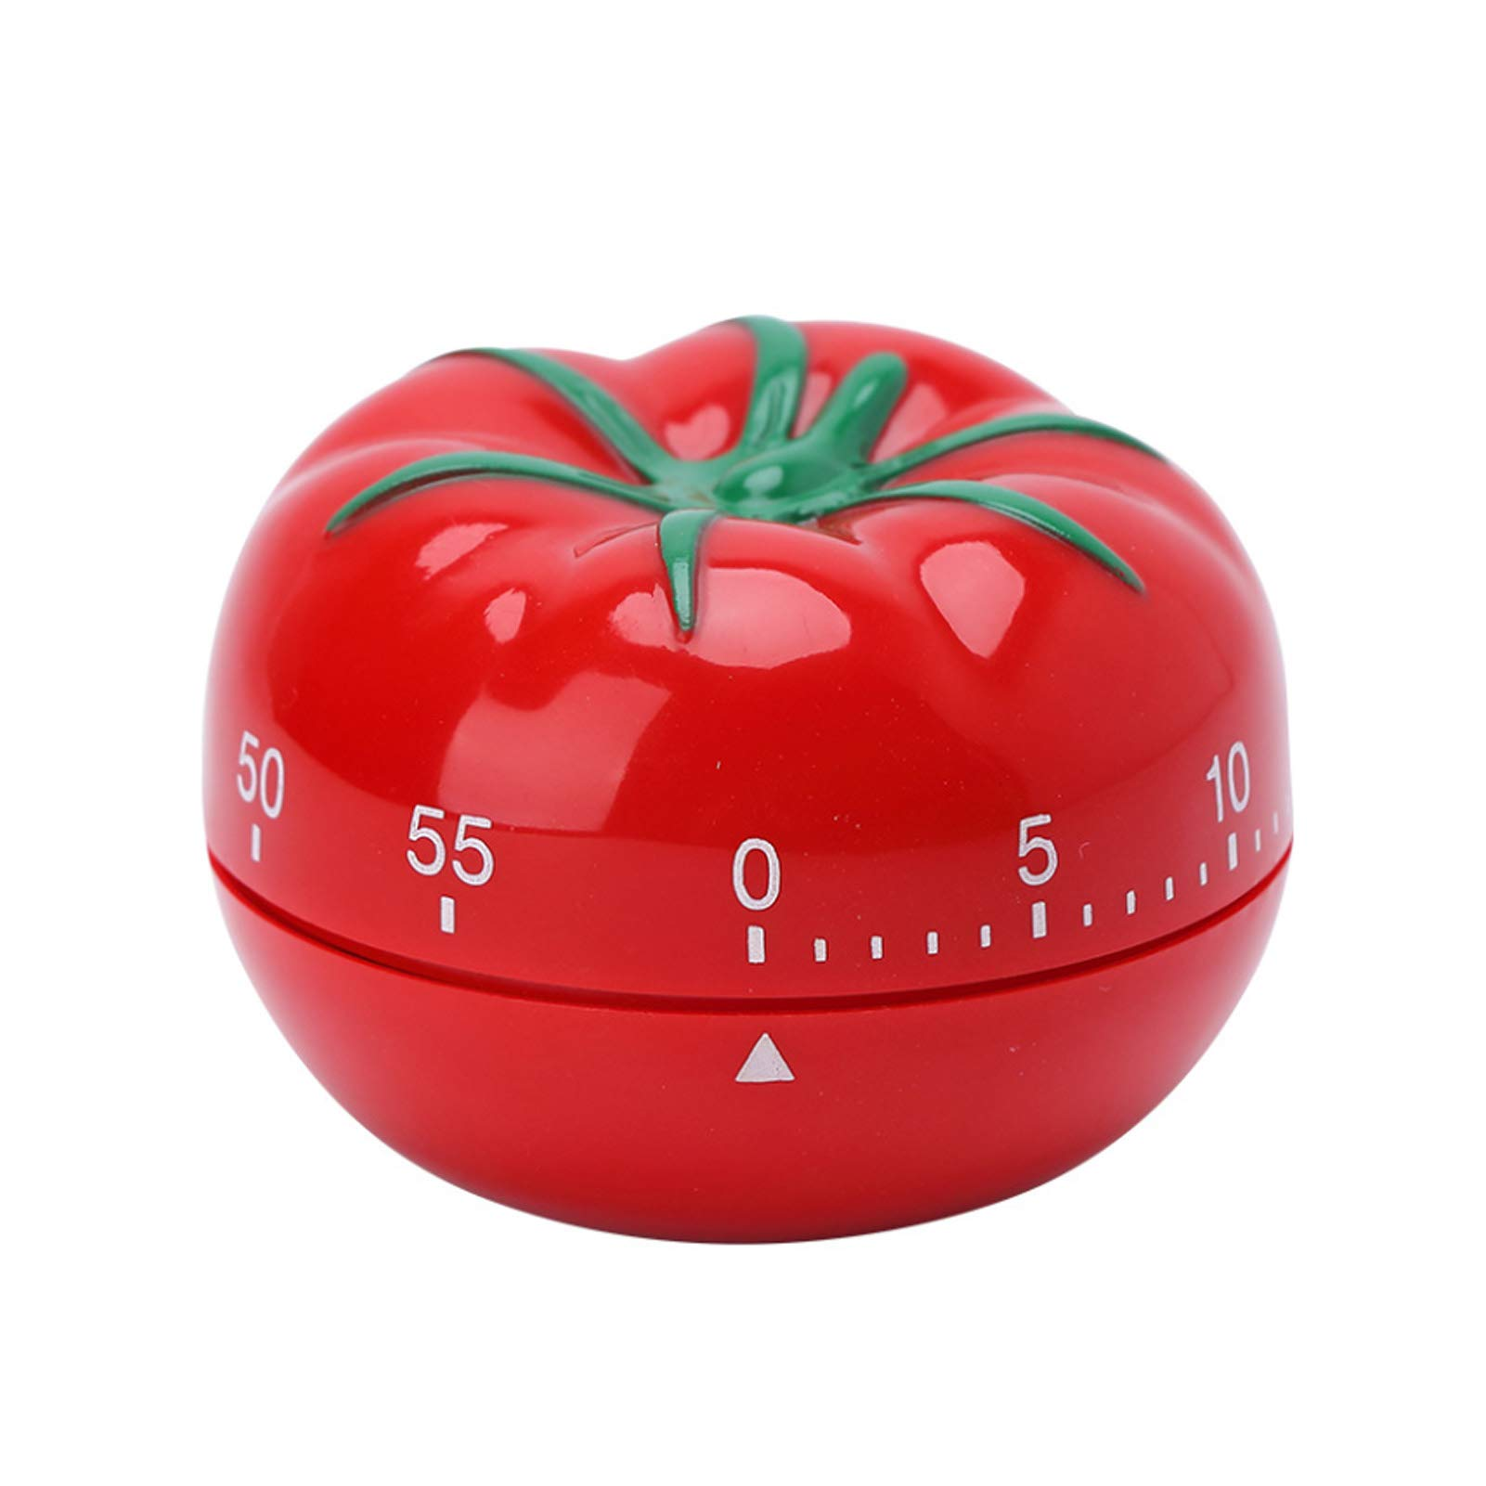
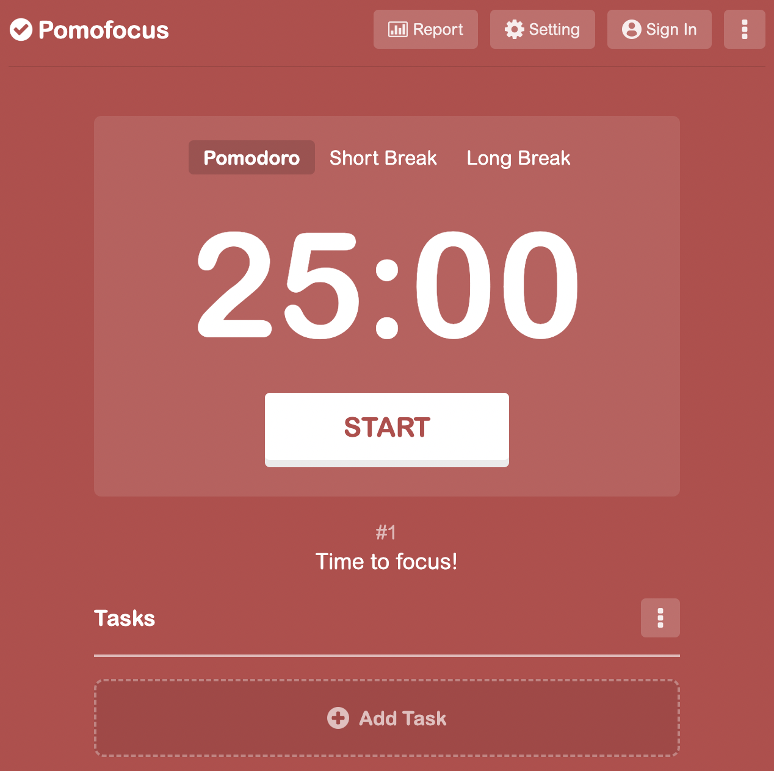
Background Information
Room for improvement in one crucial aspect: fun!

Slide 6


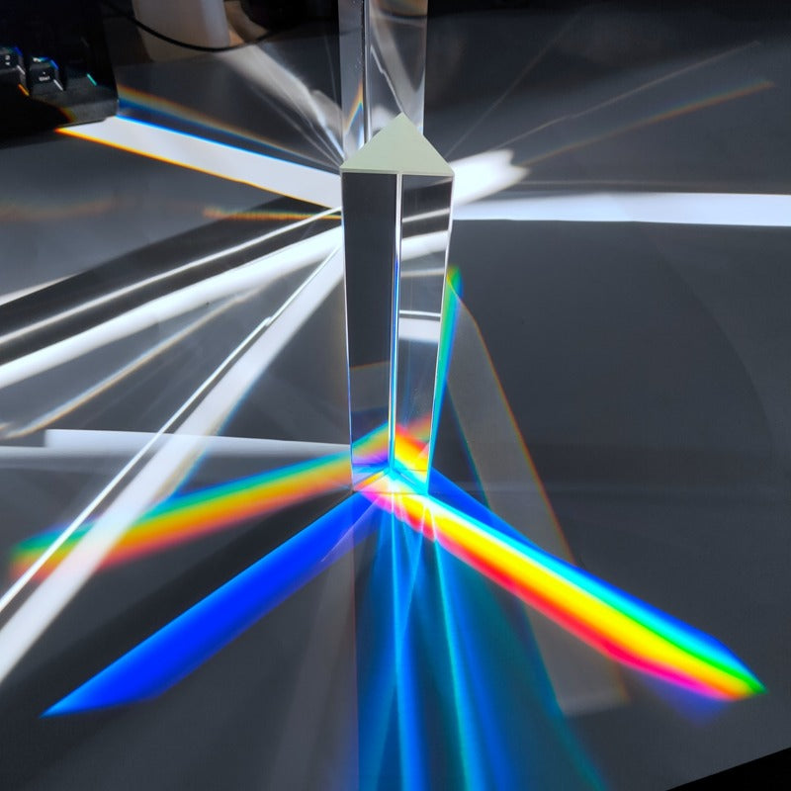
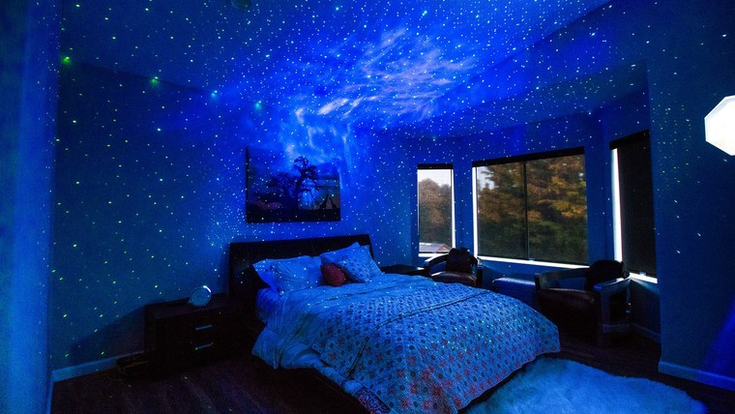
Background Information
Inspiration:
Disco ball
Suncatcher
Kaleidoscope
Star projector
Instead of sounding a buzzer, the timer will light up the room when it is time for a break!

Slide 7
Proposed Improvements over Existing Projects
Software:
Ability to set duration of study session and breaks
Motivational messages to print on LCD
Hardware:
Spinning motor and LED pixel matrix (to make light patterns through a prism) that activate during break time

Slide 8
System Block Diagram
PocketBeagle
SPI
Level Shifter
Adafruit 3444
LED Matrix
FS90RZ
Servo continuous rotation motor
PWM
I2C or SPI
HD44780 LCD
I2C
7-segment display
GPIO
Buttons

Slide 9
Power Block Diagram
FS90RZ
Servo continuous rotation motor
PocketBeagle
5V
HD44780 LCD
7-segment display
5V power connector
5V
Level Shifter
5V
Adafruit 3444
LED Matrix
3.3V
Buttons

Slide 10
Components / Budget
Component | EDES301 to Buy? | Cost
FS90RZ Continuous Rotation Servo Motor | Yes | $26.99
HD44780 LCD 16x2 | Yes | $9.95
Adafruit 3444 DotStar LED Pixel Matrix | Yes | $24.95
Level shifter | Yes | $1.25
Prism crystal ball | No | $14.99
7-segment display | In parts kit | --
Buttons | In parts kit | --
Resistors, potentiometer | In parts kit | --

Slide 11
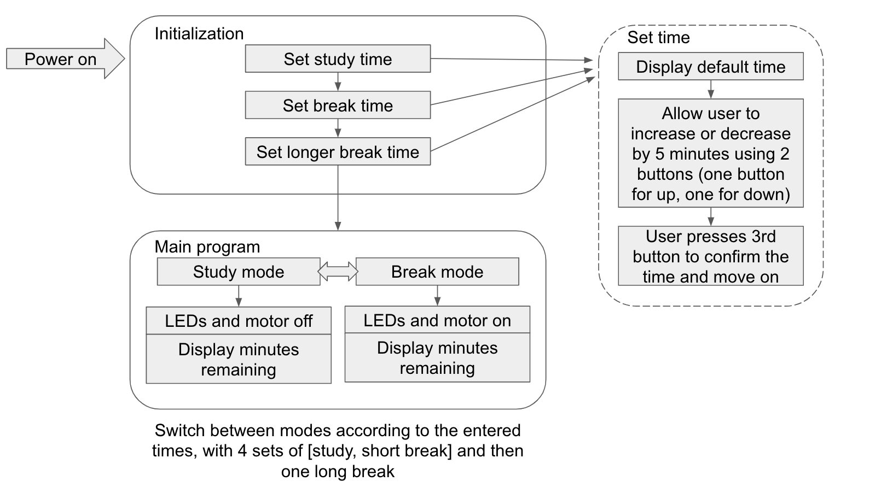
Software Diagram

Slide 12
Python Classes
System inputs
3 buttons (up, down, power/multipurpose)
System outputs
LCD screen
Servo
LED pixel matrix

