Slide 1


Crypto Punk!
Chenchen Liu

Slide 2
Crypto Punk!
Table of Content
Motivation
NFT Market
Crypto Punk
Data Structure
Analysis
Challenge
Future Steps

Slide 3

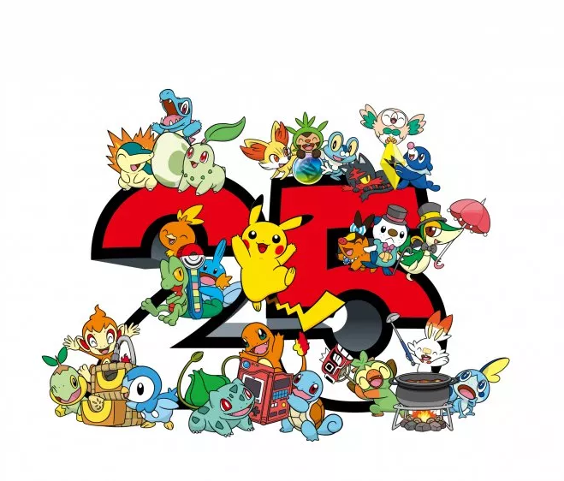
Motivation

Slide 4
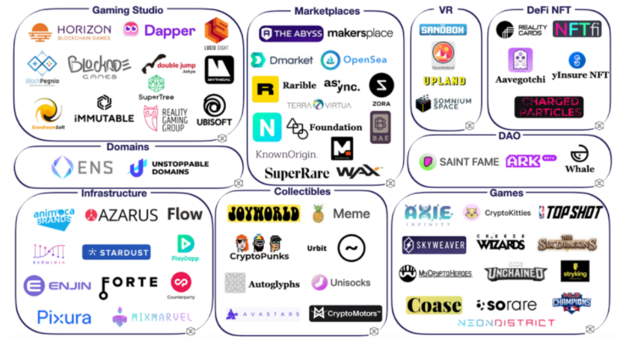
NFT(non-fungible token) Ecosystem
Notes:
Source: https://niftycryptonomad.com/nft-ecosystem-overview/

Slide 5
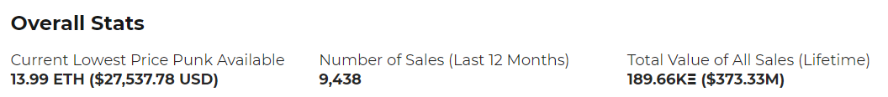
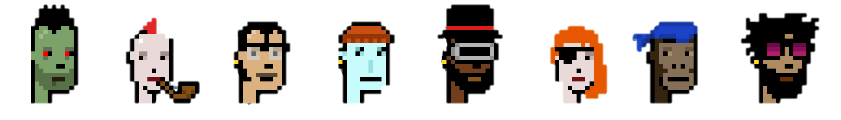

Crypto Punk!
10,000 uniquely characters
24x24 pixel art images, generated algorithmically
First NFT on Ethereum
Originally Free

Slide 6
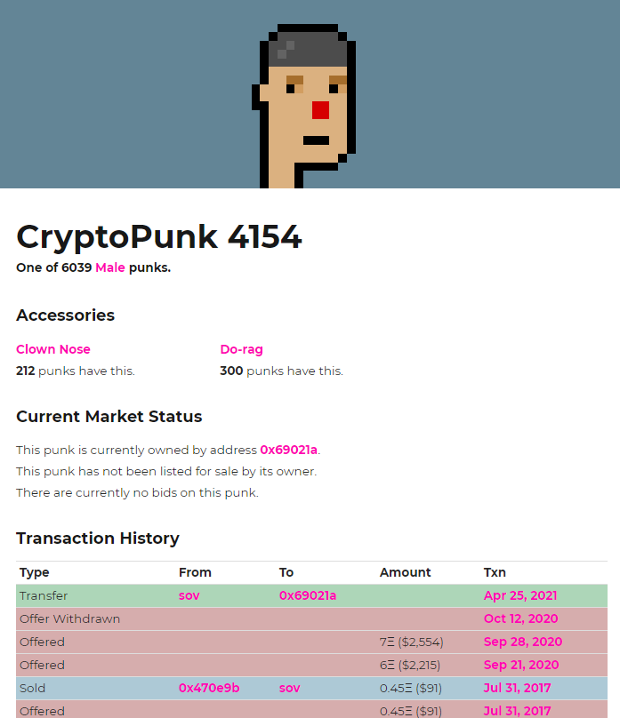
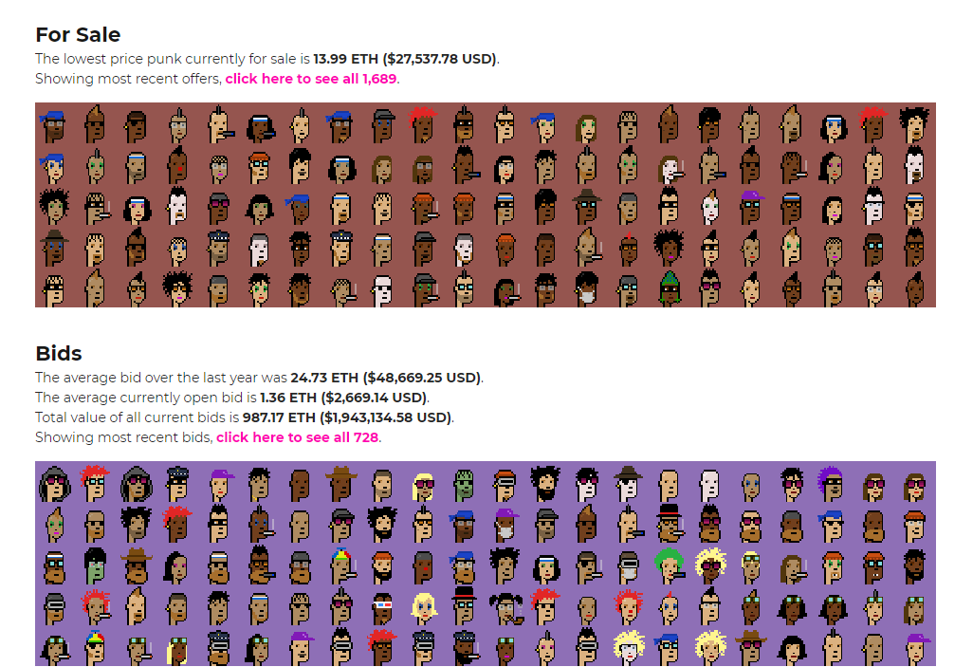
Website
Notes:
Source: https://niftycryptonomad.com/nft-ecosystem-overview/

Slide 7
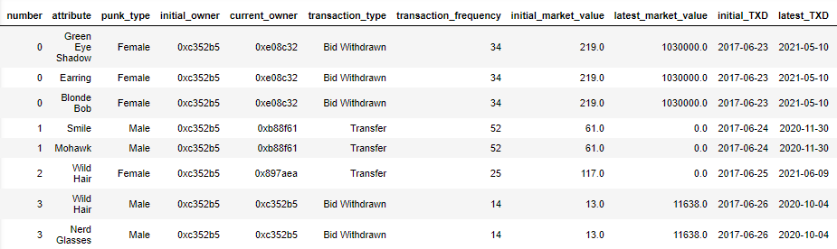
Data Structure
10,000 crypto punks
IRR=9960%
Notes:
Source: https://niftycryptonomad.com/nft-ecosystem-overview/

Slide 8
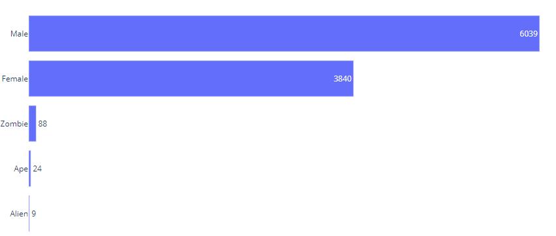





Crypto Punk Type
Average market value:0.1M
Average market value:0.1M
Average market value:0.6M
Average market value:1.3M
Average market value:2.6M
Notes:
Source: https://niftycryptonomad.com/nft-ecosystem-overview/

Slide 9
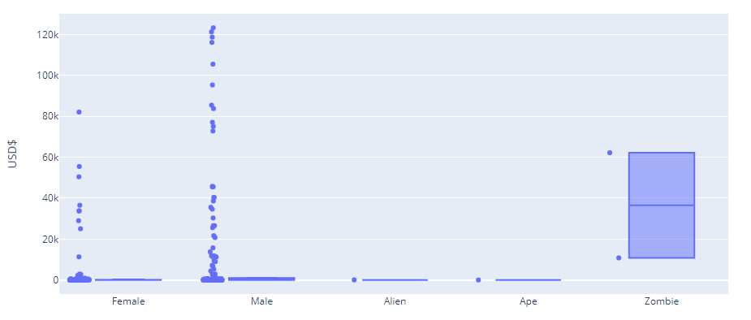
Bid - Market Value Distribution per Punk Type
Notes:
Source: https://niftycryptonomad.com/nft-ecosystem-overview/

Slide 10
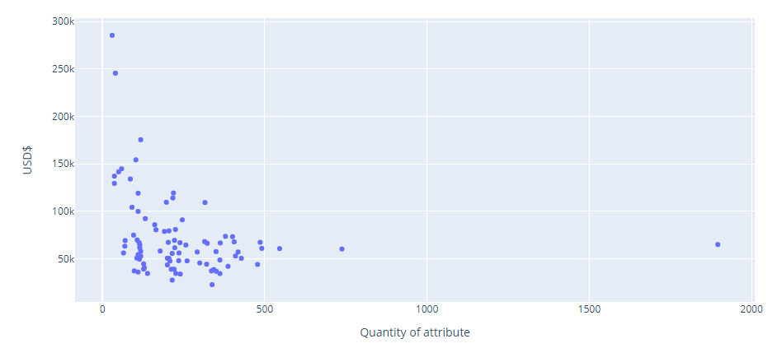
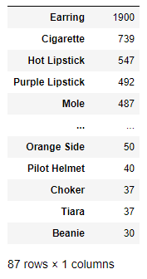
Crypto Punk Attribute
Attribute #
Beanie
Pilot helmet
Earring
Cigarette
Notes:
Source: https://niftycryptonomad.com/nft-ecosystem-overview/

Slide 11
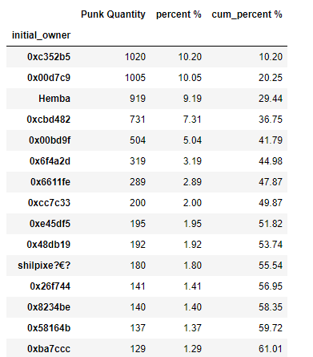
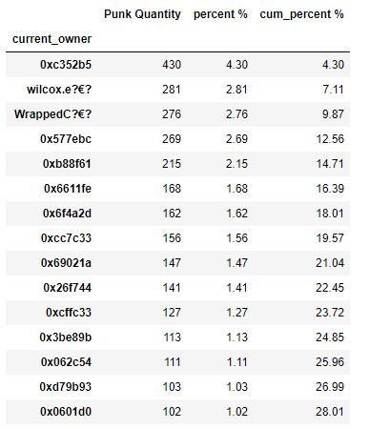
Crypto Punk Ownership
Notes:
Source: https://niftycryptonomad.com/nft-ecosystem-overview/

Slide 12
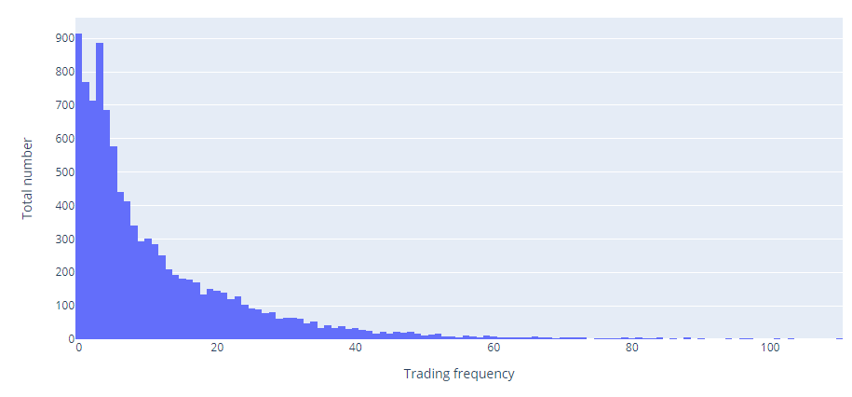
2017-2021 Transaction Frequency
Notes:
Source: https://niftycryptonomad.com/nft-ecosystem-overview/

Slide 13
Crypto Punk!
Conclusion
Early winners game
Pricing premium given to rare types
Low liquidity market
Winner criteria:
- Female
- Attribute quantity < 250
- Attribute value < $50k
- 15< Transaction frequency < 25

Slide 14
Crypto Punk!
Challenge
Blocked by website
Sleep time
Extreme value
Remember your code

Slide 15
Crypto Punk!
Next Step
Add transaction details
Apply Sankey diagram
Correlation of NFT transactions and crypto currency value
Web scraping other NFT websites

Slide 16
Thank you!

