Slide 1
TEST

Slide 2
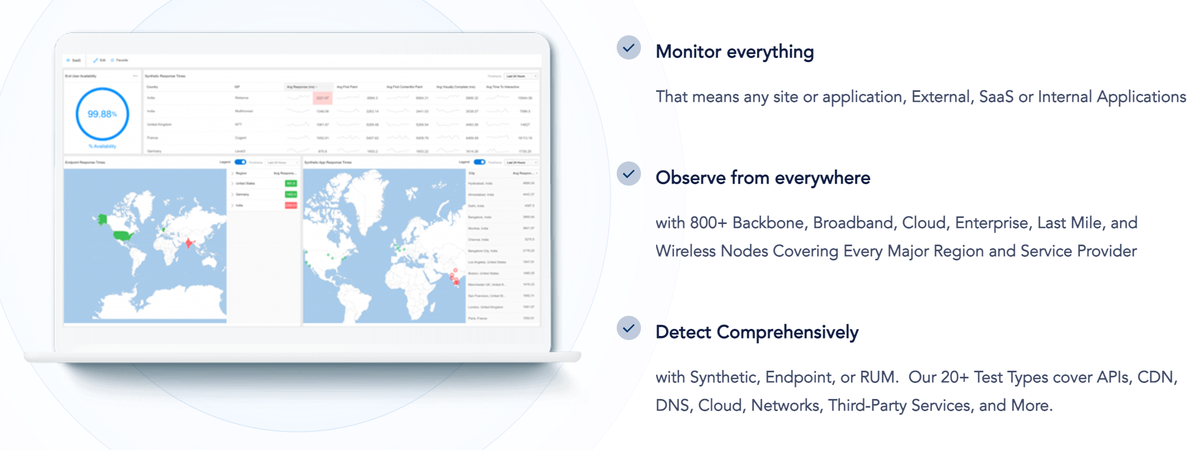

Slide 3
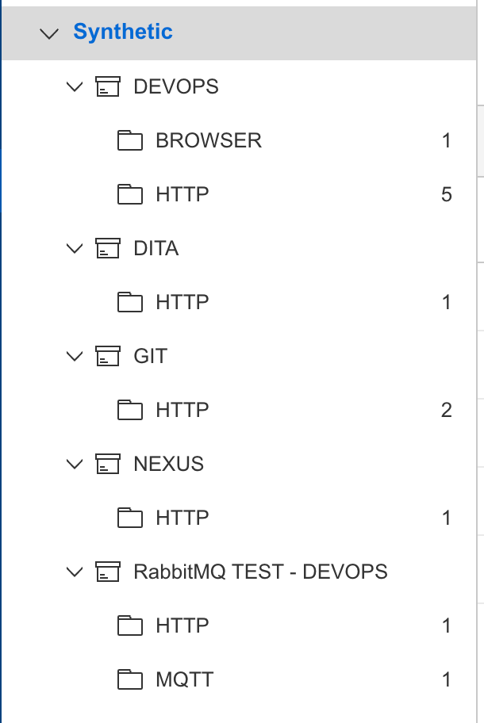
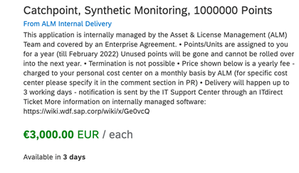
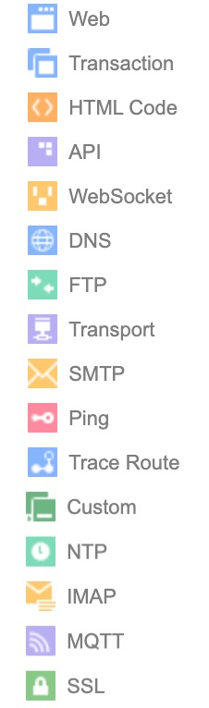






Motivation | Redundant checks in the current VH scenarios in parallel from Dynatrace
2021 Q3
2021 Q4
2022 Q1
2022 Q1
PoC with CX
Enablement
Catchpoint Points (Ariba)
Http/s Configuration
Include in Monitoring & Observability Setvice
Collaboration Customer Experience
Testing Scenarios
GCP
XXXXX CC (eu-de1, eu-de2)
Price Definition
Internal node VM
Possible use cases
RabbitMQ (in XXXXX CC)
Sideras SSL

