Slide 1
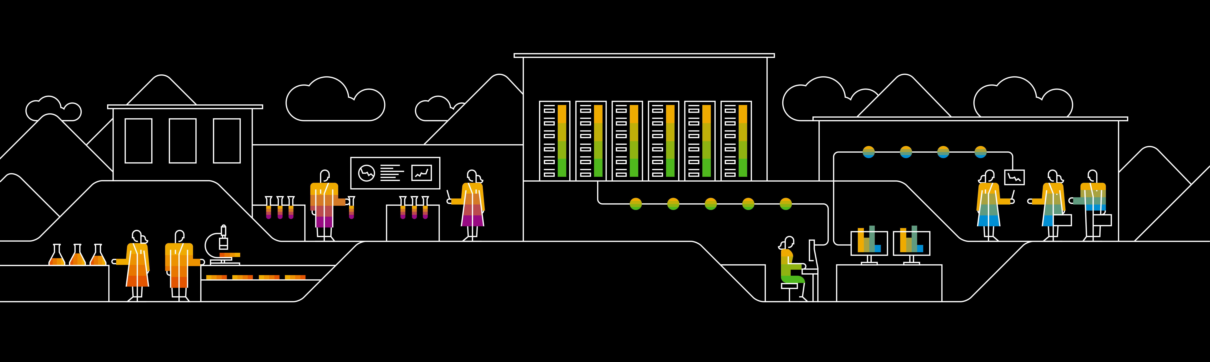
Research: Consulting Service - Monitoring & Observability SOSIVIO
Carlos Estala

Slide 2
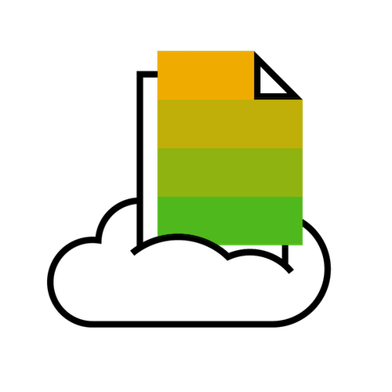
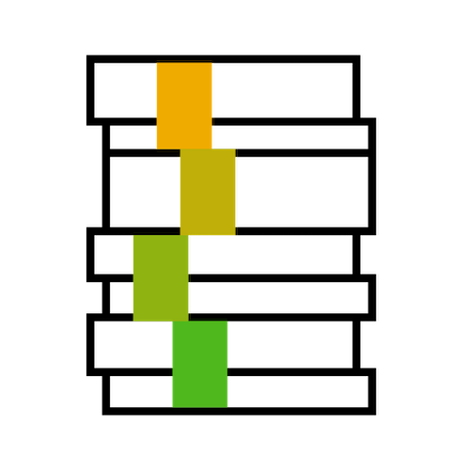
SOSIVIO – “Eliminate ambiguity in Kubernetes with a tightly coupled data collection and AI tool. Predict and prevent performance issues”
In terms of benefits:
The simplicity of the UI could help teams with minimum k8s knowledge to monitor their environments.
Sosivio used application profiling (kind of AI) to suggest a “recommendation” to improve the performance which could be applied live (in most of the cases) directly from the UI (*)
Sosivio claims that it has several levels of analysis that will identify potential errors before it happens, unfortunately in our test cases we did not see this prediction. But in their demo they showed a prepared scenario.
In terms of technical usage:
Sosivio, it’s an on-prem tool and not a SAAS.
Sosivio requires to be installed on any K8s that needs to be monitored and it consumes around 2% to 5% of the total resources in the cluster, which is very low comparing with other tools.
Sosivio is not intrusive to applications running in the K8S (there is no injection of code )
The installation/uninstall process is very simple as all microservices are deployed on its own namespace
Sosivio do not require additional storage as it’s only showing live Metrics (-2 min) and do not collect history metrics
CONS:
Currently SOSIVIO is not integrated to a Pipeline (CI/CD) to approve the recommendations (*), therefore the recommendations are not permanent and will be lost if the deployment or pod is recreated, they mentioned that in the future it can be integrated to GitOps Pipeline.
In the current release-1.4.1.1, there is limited information for Network performance.
Notes:
Support for the opentelemetry:
Cross-Product Architecture: https://pages.github.tools.sap/CPA/landing-page/working-groups/
Refence: North StarArchitecture Integration
MAIA-Prometheus user guide in SAPCC : https://github.com/sapcc/maia/blob/master/docs/users-guide.md

Slide 3


SOSIVIO – Research conclusion
Do you think there is a valid use case for us (GLDS or any other team in SAP) with this solution?
Probably yes, if we (GLDS ) are planning to have first level support team for K8S, then SOSIVIO could be useful for this team.
only if your team wants to focus in K8S information as SOSIVIO is not capable to get BareMetal, VM’s, etc. existing GLDS landscapes included VMs not just K8S.
Out of the Box, Gardener provides Grafana dashboards & Kubernetes dashboards for analysis, but this requires having some deeper knowledge or expertise on K8S.
For development teams in SAP, I don’t think they will be interested as they already have the tools, e.g., Prometheus, Grafana, Octobus, BTP CLS, Kubernetes Dashboard, etc.
Do you think Gardener team will be interest ?
Probably No as Gardener team is responsible to provide the framework to deploy standard K8S ( via automation in the different cloud providers), so they do not monitor K8S environments themselves, this is an activity for the LoBs who runs the applications.
Notes:
Support for the opentelemetry:
Cross-Product Architecture: https://pages.github.tools.sap/CPA/landing-page/working-groups/
Refence: North StarArchitecture Integration
MAIA-Prometheus user guide in SAPCC : https://github.com/sapcc/maia/blob/master/docs/users-guide.md

Slide 4
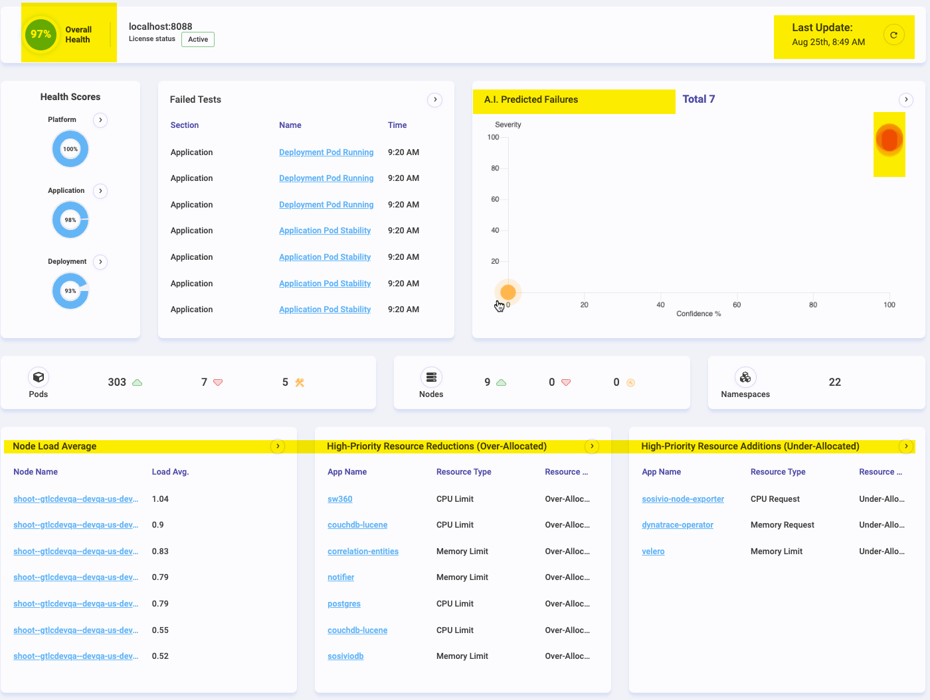
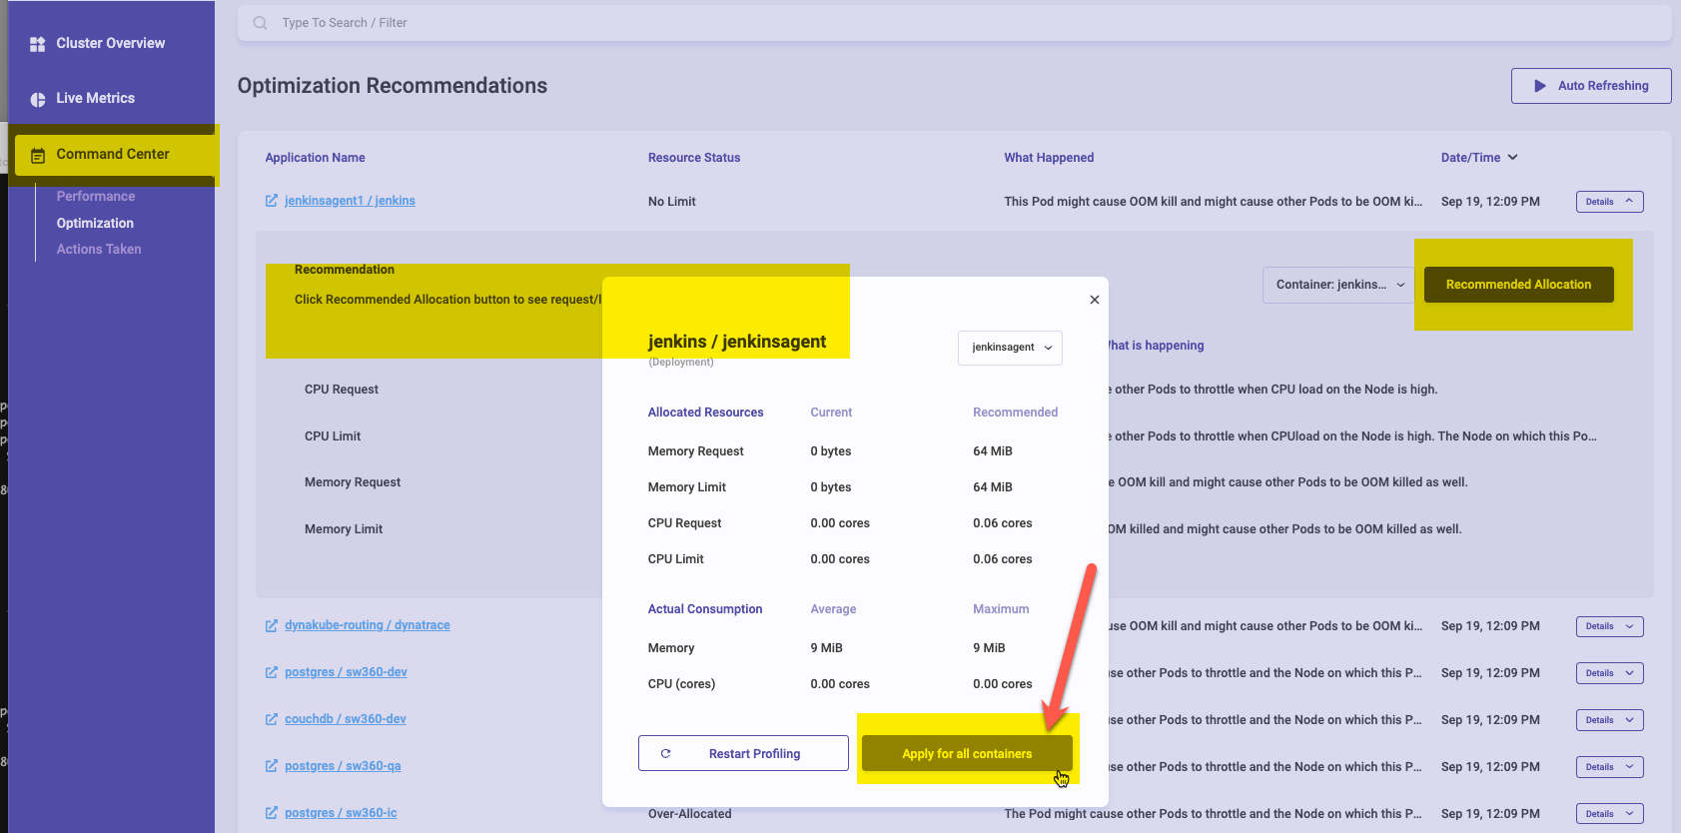

Slide 5
SOSIVIO contacts
COO Adam Weiner located in SF
Stephen Thorn solution architects located in the US east coast.
COO liran cohen <liran@sosiv.io>
Notes:
Support for the opentelemetry:
Cross-Product Architecture: https://pages.github.tools.sap/CPA/landing-page/working-groups/
Refence: North StarArchitecture Integration
MAIA-Prometheus user guide in SAPCC : https://github.com/sapcc/maia/blob/master/docs/users-guide.md

