Slide 1
UCP API
Benefits: - Audit logs,
Visualization of the orders
Service account to count this activities
SAP CC API

Slide 2
CC environments (chef - Readymade – cookbooks, recipes)
STOP / Start --> API SAP CC (parameters)
CREAte VM, → rundeck/worker → python script
DELETE VM → API SAP CC (parameters)
GCP Public Environment ( K8s CC – gardener – OS replacement , Message server – rabbitmq → automation Ansible )
STOP / Start --> API GCP (parameters)
CREAte VM, → rundeck/worker → python script
DELETE VM / Start --> API GCP (parameters)

Slide 3
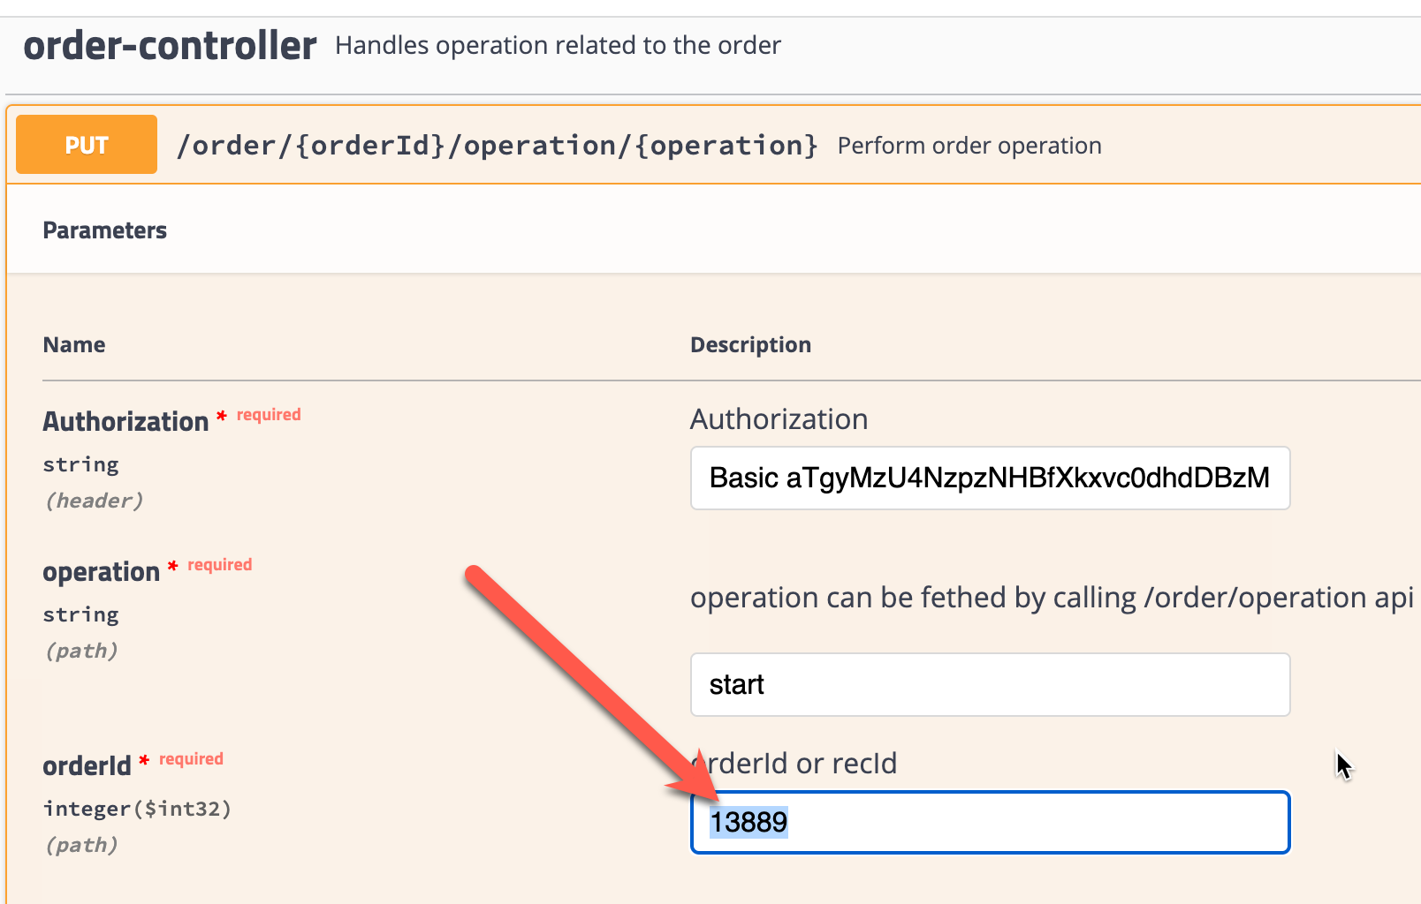
CC environments (chef - Readymade – cookbooks, recipes)
STOP / Start --> API SAP CC (parameters) --> FQDN
SAP CC ID , UCP Order ID →API ?? Pending
CREAte VM, → rundeck/worker → python script
DELETE VM → API SAP CC (parameters)
GCP Public Environment ( K8s CC – gardener – OS replacement , Message server – rabbitmq → automation Ansible )
STOP / Start --> API GCP (parameters)
CREAte VM, → rundeck/worker → python script
DELETE VM / Start --> API GCP (parameters)
@Carlos to create a service account for SAP CC and GCP , one for each
@

