Slide 1

Camille Birch Michael Wang
Alex Vrhel Diana Wang

Slide 2
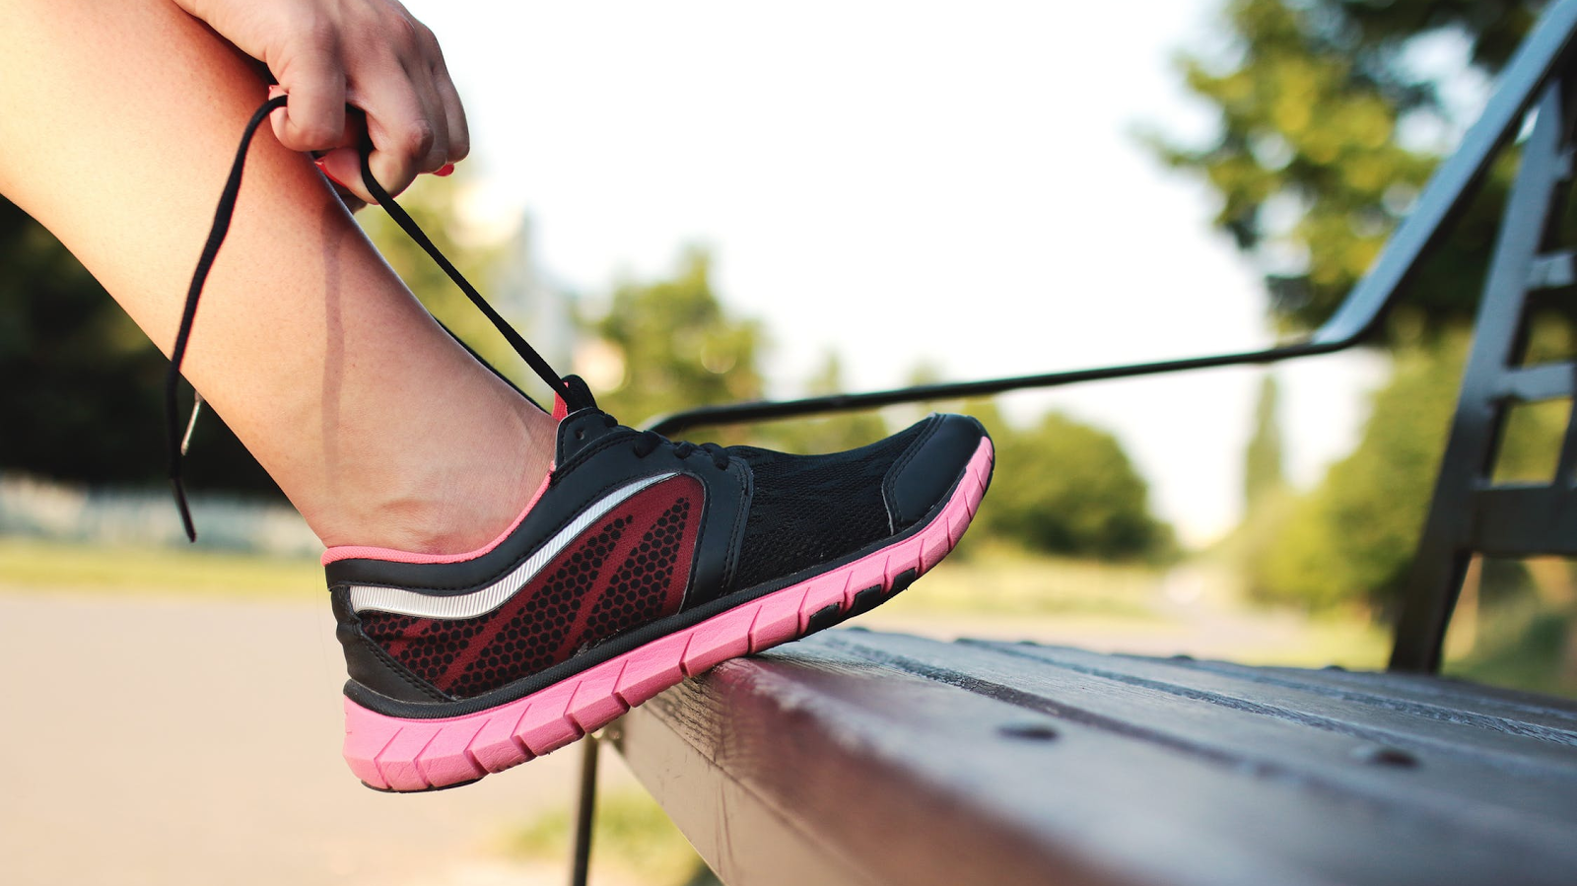
Many people run for exercise
. . . but stress injuries are common
Stress Injury:
Injury caused by repetitive motion, often with forceful exertion

Slide 3
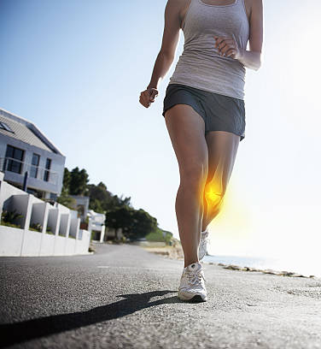
Pain tracking is a known method for recovery and prevention
There are no pain tracking solutions widely available to amateur runners

Slide 4
Research Goals
Learn more about attitudes and behaviors of amateur runners
Specifically interested in experience with injury
Current tracking tools and habits

Slide 5

Design Research
METHOD & PARTICIPANTS
Semi-structured interviews
3 Athletes (2 primary, 1 cross-trainer)
1 Coach
1 Physical therapist

Slide 6
Design Research
TAKEAWAYS
Enjoy injury decision autonomy
See the value in and would consider tracking pain
Have varied views on sharing data with others
Use multiple methods of workout tracking

Slide 7

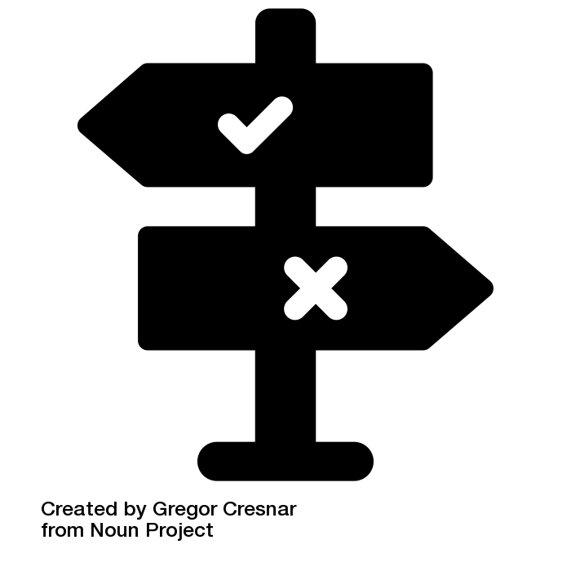
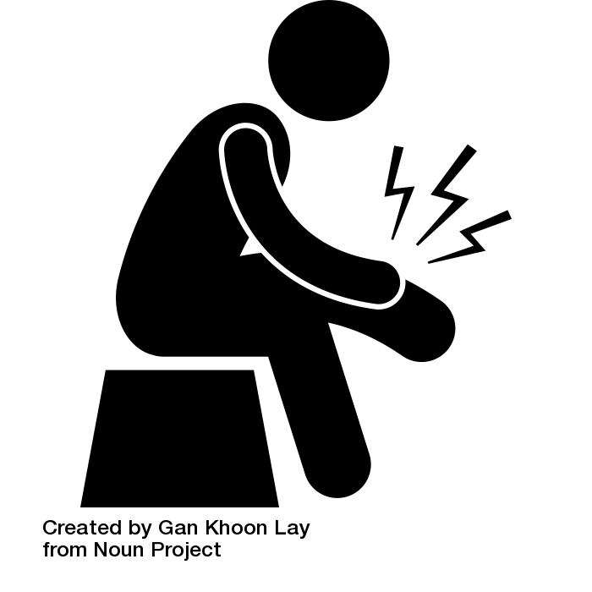

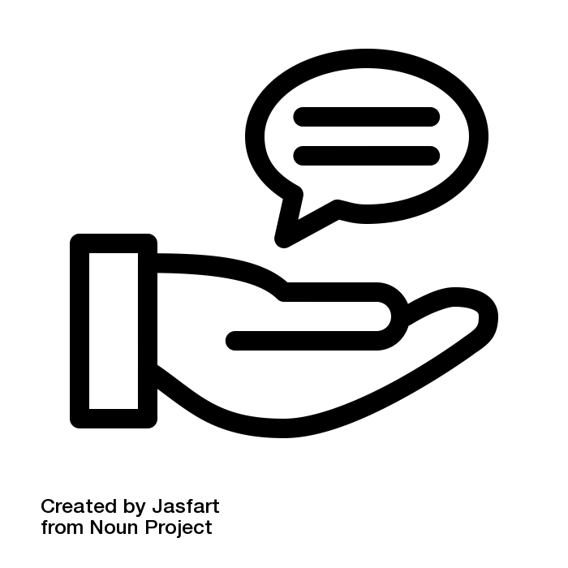

Tasks
Track workouts for reflection
Decide whether to seek treatment
Seek information on existing injury
Educate self about prevention
Give advice to other athletes
Share activity history with a professional
Icons: Noun Project (Notepad - Aneeque Ahmed; Decision, Learn - Gregor Cresnar; Leg Pain - Gan Khoon Lay; Advice – Jasfart; Doctor And Nurse - Artem Kovyazi)

Slide 8
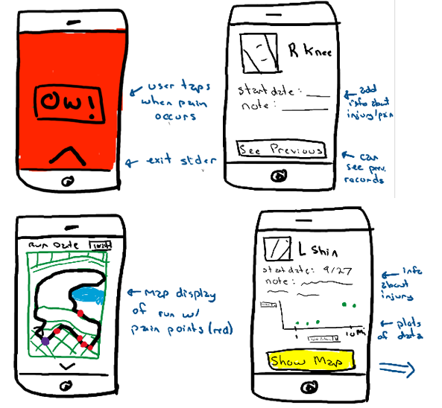
Design A: Real-time Pain Tracking

Slide 9
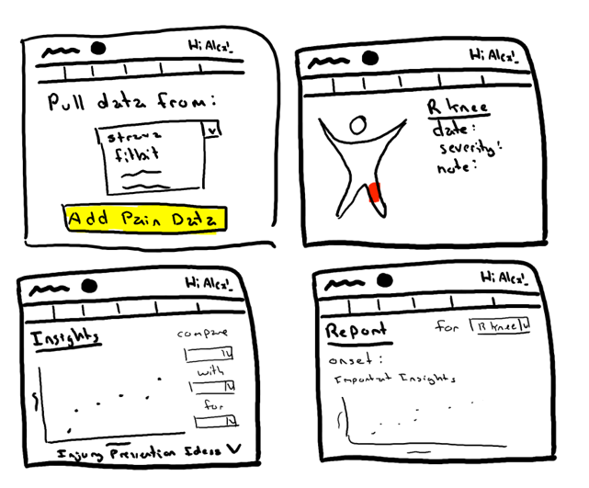
Design B: Third Party Integration

Slide 10
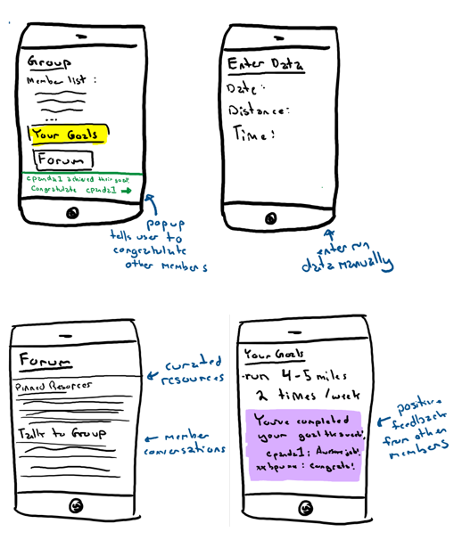
Design C: Social Injury Prevention Platform

Slide 11
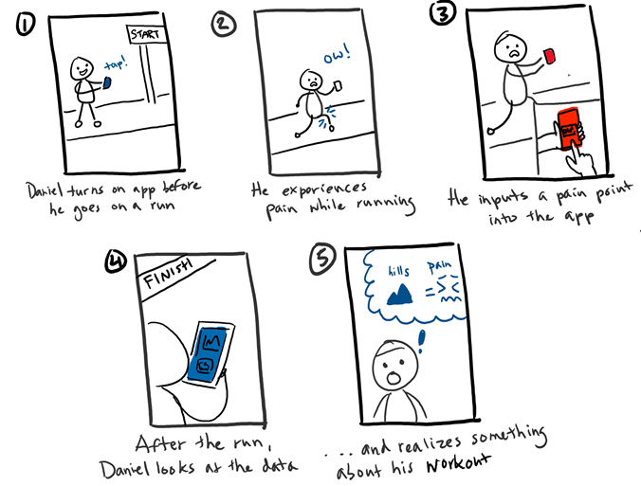
Real-time Pain Tracking

Slide 12
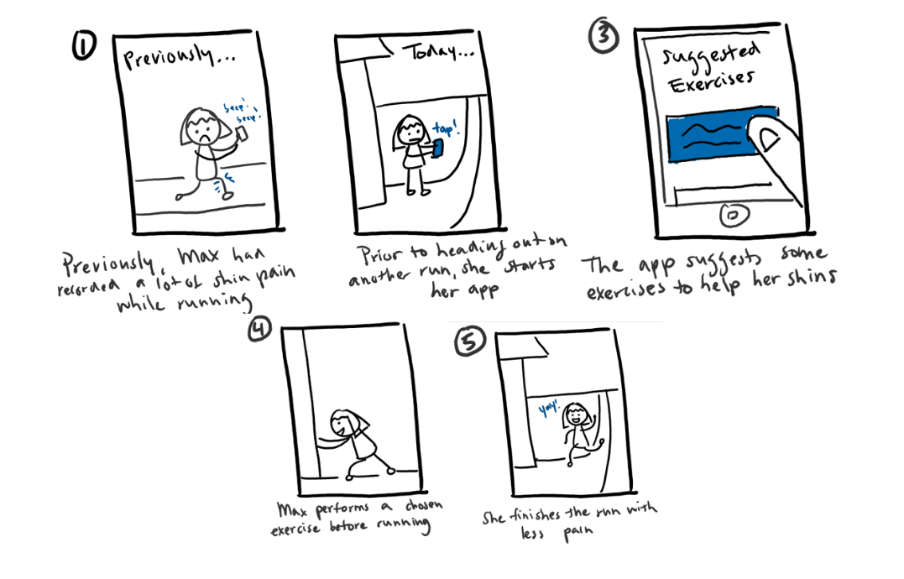
Pre-workout Suggestions

Slide 13
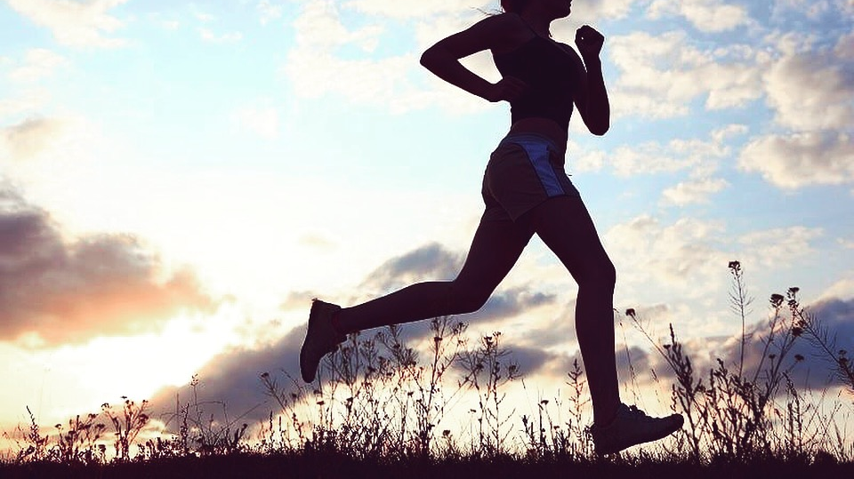
Lessons Learned
Reluctance to acknowledge injury
Strong existing habits for workout tracking and handling injury
Prioritize efficiency

Slide 14
Camille Birch Michael Wang
Alex Vrhel Diana Wang

