Slide 1
'omics' Data Analysis
1. Biology in a nutshell

Slide 2
Cells and organisms
09/02/12
Organisms
  Unicellular: One single cell (or simpler)
    Archaea
    Prokaryotes: Bacteria, Yeast
    Eukaryote: Protozoos
  Pluricellular: Eukaryote cells
    Different organitation levels (e.g. tissues)
    Diversity in number, type and syze
  Viruses are not properly organisms

Slide 3
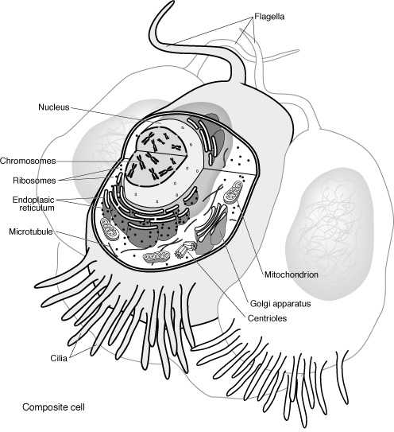
Eukaryotes
“Eu” good,
“Karyo” nut or kernel →
Presence of nucleous separated from del cytoplasm by the nucleous envelope.
DNA: double-stranded, it is organized in chromosomes
The cell contains other membrane-bound organelles
Sexual reproduction is common

Slide 4
Key biomolecules
09/02/12
The basic components of biological systems are
  Sugars (carbohydrates)
  Fats (lipids)
  Nucleic acids
  Proteins
Sugars and lipids have no important role regarding “biological information”
Not discussed here

Slide 5
Nucleic acids and proteins
09/02/12
Molecules that contain and transport information are
  DNA (4 different nucleotides)
  Contains encoded biological information
  RNA (4 different nucleotides)
  Carries information from DNA to proteins
  Proteins (20 different amino acids)
  Function and structure of living beings

Slide 6
Nucleotides
09/02/12
Basic components of nucleic acids
Consisting of
  A sugar (Ribose or Deoxyribose)
  A nitrogen base
  A phosphate group
In biological parlance we speak of "bases" instead of nucleotides to describe a string (3000bp = 3000 bp)

Slide 7
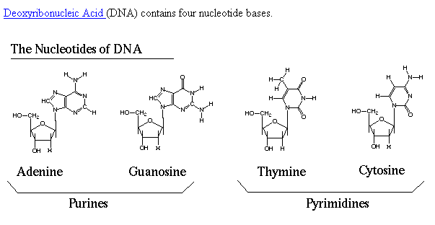
DNA nucleotides
09/02/12

Slide 8
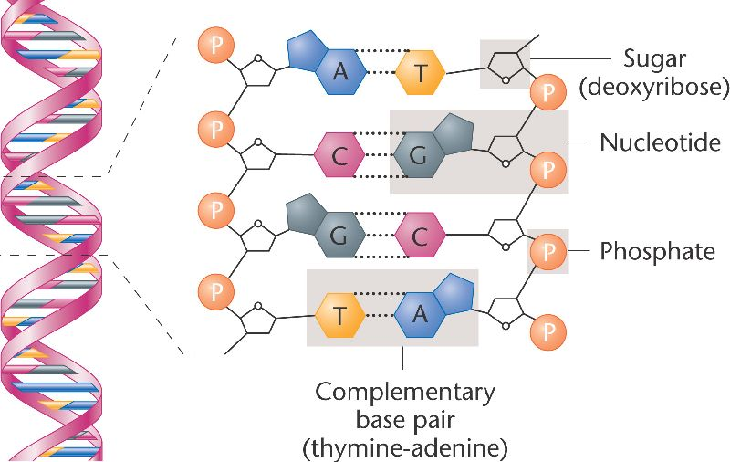
The pairing between complementary bases
09/02/12

Slide 9
The primary structure of DNA
09/02/12
Sequence of nuceotides
Forms an unbranched polymer
Organized in a double-stranded
atgaatcgta ggggtttgaa cgctggcaat
acgatgactt ctcaagcgaa cattgacgac
ggcagctgga aggcggtctc cgagggcgga

Slide 10
DNA vs RNA
09/02/12
DNA is organized into a complementary double helix. RNA does not.
One of the four bases are different
  DNAA, C, G, T
  RNA: A, C, G, U
Differ from the nucleotide sugar
  DNA Deoxyribose
  ARN: Ribose

Slide 11
DNA strands sense
09/02/12
Each DNA strand has a polarity:
  The strand begins with the 1st nucleotide 5'-hydroxyl (or 5'-phospho) group, and
  Ends with the last nucleotide 3'-hydroxyl group
  The strand goes 5' to 3' ("Five prime to three prime")
The two DNA strands are antiparallel
  One goes 5' -->3' and the other goes 3' → 5'.

Slide 12
Proteins
09/02/12
Amino acid sequence
Forms an unbranched polymer
There are 20 different amino acids (AA)
The key function of proteins is in its three dimensional structure

Slide 13
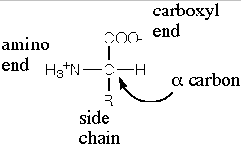
Amino acids
09/02/12

Slide 14
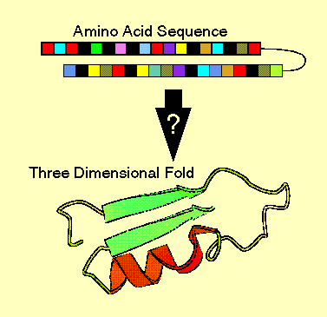
Proteins “fold” into conformational structure
09/02/12

Slide 15
Protein's structure
09/02/12
Proteins fold into lowest to highest complexity level:
Primary structure: amino acid sequence
Secondary structure: regularly repeating local structures stabilized by hydrogen bonds.
Tertiary structure: fold into 3-dimensional structures.
Quaternary structure: structure formed by several protein molecules (protein complex).

Slide 16
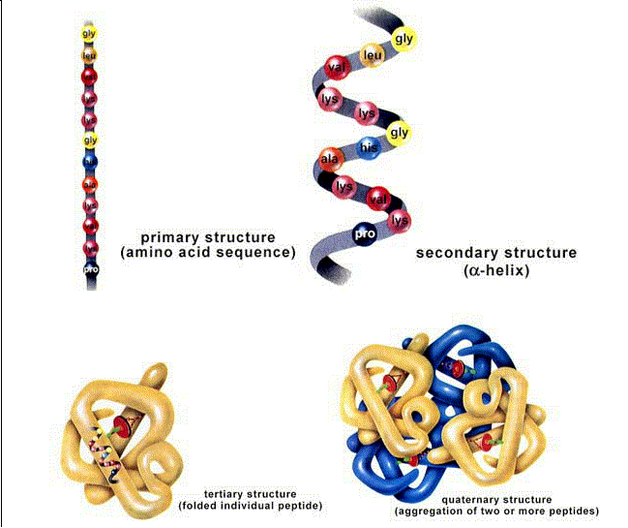
09/02/12

Slide 17
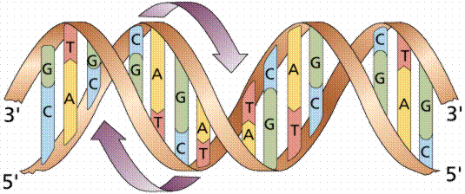
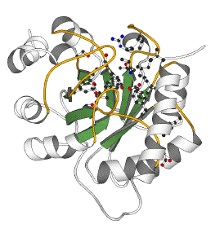
The central dogma of molecular biology
DNA
CCTGAGCCAACTATTGATGAA
transcription
mRNA
CCUGAGCCAACUAUUGAUGAA
translation
Protein
PEPTIDE

Slide 18
From DNA to proteins
09/02/12
DNA is replicated in a complex process involving many enzymes: replication
DNA is copied in a string of complementary messenger RNA (mRNA): transcription transcription
In eukaryotic cells, the mRNA is processed splicing eliminating coding fragments (“splicing”) and migrates from the nucleous to the cytoplasm.
The mRNA carries coded information to ribosomes (ribosomal RNA) that "read" and perform protein synthesis: translation

Slide 19
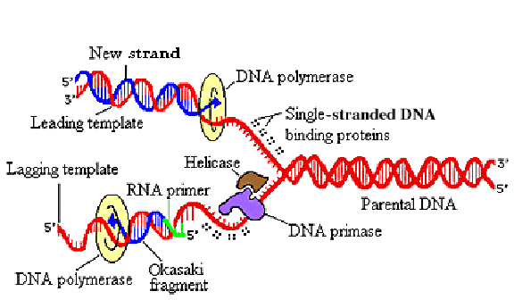
1. Replication
Animations (1), (2), (3)
Notes:
The major types of proteins, which must work together during the replication of DNA, are illustrated,
showing their positions.
When DNA replicates, many different proteins work together to accomplish the following steps:
The two parent strands are unwound with the help of DNA helicases.
Single stranded DNA binding proteins attach to the unwound strands, preventing them from winding back together.
The strands are held in position, binding easily to DNA polymerase, which catalyzes the elongation of the leading and lagging strands. (DNA polymerase also checks the accuracy of its own work!).
While the DNA polymerase on the leading strand can operate in a continuous fashion, RNA primer is needed repeatedly on the lagging strand to facilitate synthesis of Okazaki fragments. DNA primase, which is one of several polypeptides bound together in a group called primosomes, helps to build the primer.
Finally, each new Okazaki fragment is attached to the completed portion of the lagging strand in a reaction catalyzed by DNA ligase

Slide 20
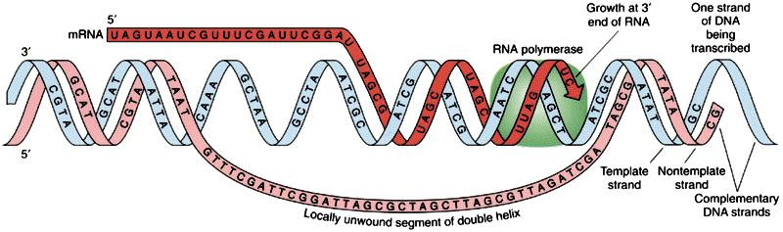
2. Transcription
09/02/12
Notes:
Transcription
Before the synthesis of a protein begins, the corresponding RNA molecule is produced by RNA transcription. One strand of the DNA double helix is used as a template by the RNA polymerase to synthesize a messenger RNA (mRNA). This mRNA migrates from the nucleus to the cytoplasm.
During this step, mRNA goes through different types of maturation including one called splicing when the non-coding sequences are eliminated.
The coding mRNA sequence can be described as a unit of three nucleotides called a codon.

Slide 21
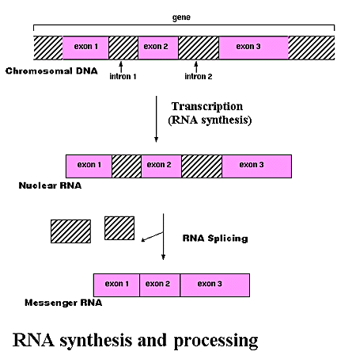
3. RNA processing or splicing
09/02/12
Notes:
Process by which non-coding sequences of base pairs (introns) are subtracted from the coding sequences (exons) of a gene in order to transcribe DNA into messenger RNA (mRNA.)
In chromosomes, DNA acts as a template for the synthesis of RNA in a process called transcription. In most mammalian cells, only 1% of the DNA sequence is copied into a functional RNA (mRNA). Only one part of the DNA is transcribed to produce nuclear RNA, and only a minor portion of the nuclear RNA survives the RNA processing steps.
One of the most important stages in RNA processing isRNA splicing. In many genes, the DNA sequence coding for proteins, or "exons", may be interrupted by stretches of non-coding DNA, called "introns". In the cell nucleus, the DNA that includes all the exons and introns of the gene is first transcribed into a complementary RNA copy called "nuclear RNA," or nRNA. In a second step, introns are removed from nRNA by a process called RNA splicing. The edited sequence is called "messenger RNA," or mRNA.

Slide 22
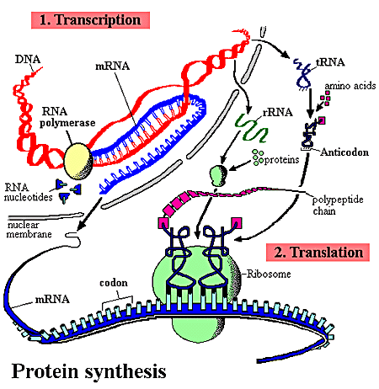
4. Protein synthesis
The mRNA goes to the cytoplasm where it binds to ribosomes.
Codon: mRNA information unit.
The tRNA brings the complementary AA tRNA.
The AA are bound to the protein to complete the sequence.
Animations (1), (2)
Notes:
The ribosome binds to the mRNA at the start codon (AUG) that is recognized only by the initiator tRNA. The ribosome proceeds to the elongation phase of protein synthesis. During this stage, complexes, composed of an amino acid linked to tRNA, sequentially bind to the appropriate codon in mRNA by forming complementary base pairs with the tRNA anticodon. The ribosome moves from codon to codon along the mRNA. Amino acids are added one by one, translated into polypeptidic sequences dictated by DNA and represented by mRNA. At the end, a release factor binds to the stop codon, terminating translation and releasing the complete polypeptide from the ribosome.
One specific amino acid can correspond to more than one codon. The genetic code is said to be degenerate.

Slide 23
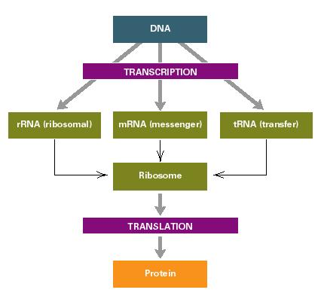
Notice: 1 DNA vs. 3 RNA’s !
09/02/12

Slide 24
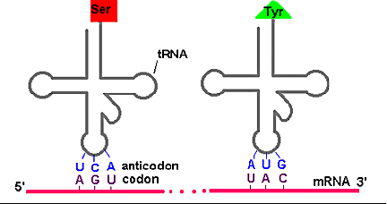
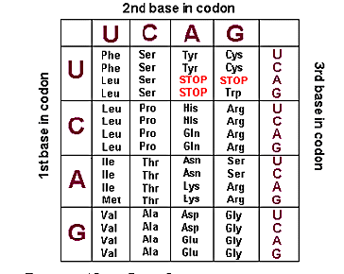
The genetic code
09/02/12
Notes:
Amino acids specified by each codon sequence on mRNA. Key for the above table:
Ala: Alanine Cys: Cysteine Asp: Aspartic acid Glu: Glutamic acidPhe: Phenylalanine Gly: GlycineHis: Histidine Ile: Isoleucine Lys: LysineLeu: Leucine Met: MethionineAsn: AsparaginePro: ProlineGln: GlutamineArg: ArginineSer: SerineThr: ThreonineVal: ValineTrp: TryptophaneTyr: TyrosisneA = adenine G = guanine C = cytosine T = thymine U = uracil
DNA transfers information to mRNA in the form of a code defined by a sequence of nucleotides bases.
During protein synthesis, ribosomes move along the mRNA molecule and "read" its sequence three nucleotides at a time (codon) from the 5' end to the 3' end.
Each amino acid is specified by the mRNA's codon, and then pairs with a sequence of three complementary nucleotides carried by a particular tRNA (anticodon).
Since RNA is constructed from four types of nucleotides, there are 64 possible triplet sequences or codons (4x4x4). Three of these possible codons specify the termination of the polypeptide chain. They are called "stop codons". That leaves 61 codons to specify only 20 different amino acids. Therefore, most of the amino acids are represented by more than one codon. The genetic code is said to be degenerate.

Slide 25
What is a gene? (pre ENCODE)
09/02/12
A gene used to be defined as ...
  The functional and physical unit of heredity,
  transmitted from one generation to their offsprings,
  consisting of DNA fragments,
  with the information needed for the synthesis of a specific protein (most of them...)

Slide 26

The ENCODE project
In September 2003 The National Human Genome Research Institute (NHGRI) launched a public research consortium named ENCODE, the Encyclopedia Of DNA Elements
Its goal was “to carry out a project to identify all functional elements in the human genome sequence”
The findings of the ENCODE project have led to re-consider foundamental ideas such as the definition of gene

Slide 27
What is a gene (post-ENCODE)

Slide 28
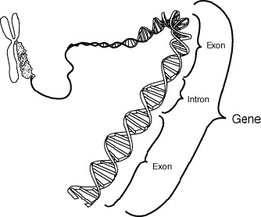
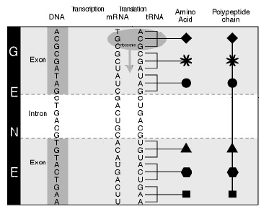
Gene components
09/02/12

Slide 29
Gene expression
09/02/12
Genes can be “turned on” or “off”
When a gene is turned on we say it is expressing or being expressed
  The central dogma implies that when a gene is expressed it is, at least transcribed
  That is: expression → mRNA
Each cell expresses only a fraction of its genes
Remaining genes are repressed ("off")

Slide 30
How genes are regulated?
09/02/12
Gene regulation can occur at any point in the process of expression but often occurs during transcription.
Environmental signs or other cells activate proteins called transcription factor.
They bind to the regulatory regions of genes, increasing or decreasing the level of transcription → They control the amount of gene product produced by the gene in every moment.

Slide 31
Regulation of gene expression
09/02/12
Each cell expresses (or active or "on") only a fraction of their genes.
Remaining genes are repressed ("off").
The process consisting of activating some genes and inhibiting others is globally known as gene regulation.
Gene regulation determines:
  The appearance and different function of different cells types
  The ability of some cells to react quickly to environmental changes

Slide 32
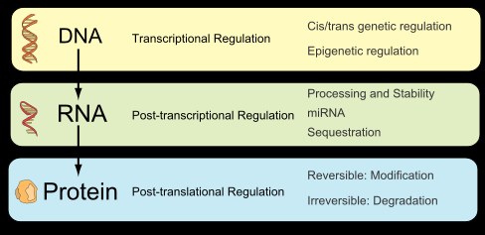
Forms of gene expression regulation
Notes:
The action of the glucocorticoid receptor is illustrated.
On the left is shown a series of genes, each of which has various gene activator proteins bound to its regulatory region. However, these bound proteins are not sufficient on their own to activate transcription efficiently.
On the right is shown the effects of adding an additional gene regulatory protein‹the glucocorticoid receptor in a complex with glucocorticoid hormone‹that can bind to the regulatory region of each gene. The glucocorticoid receptor completes the combination of gene regulatory proteins required for efficient initiation of transcription, and the genes are now switched on as a set.

