Slide 1
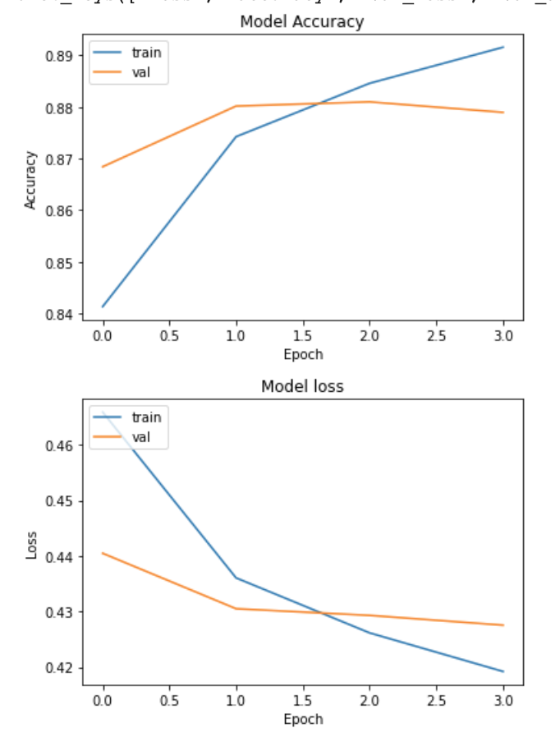
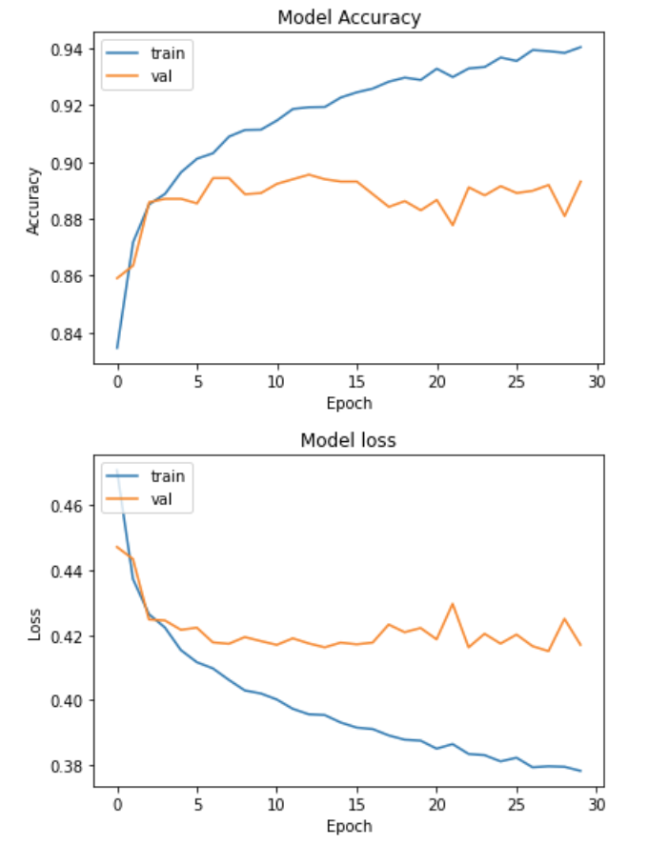
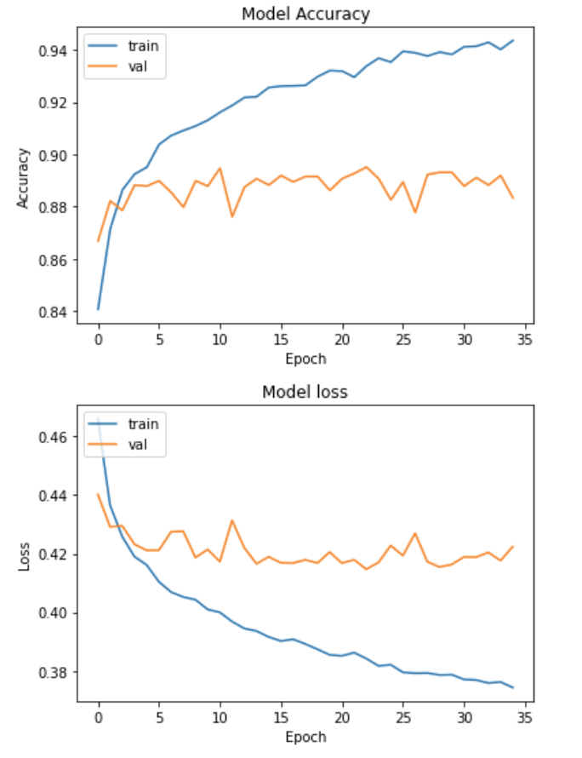
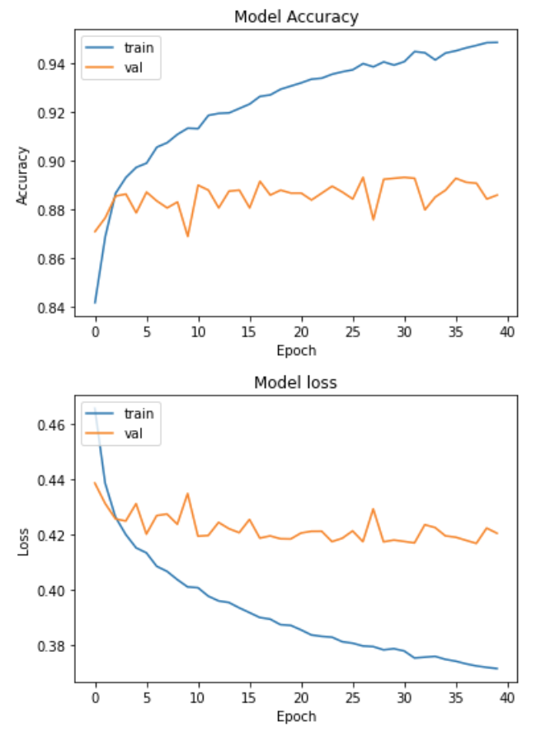
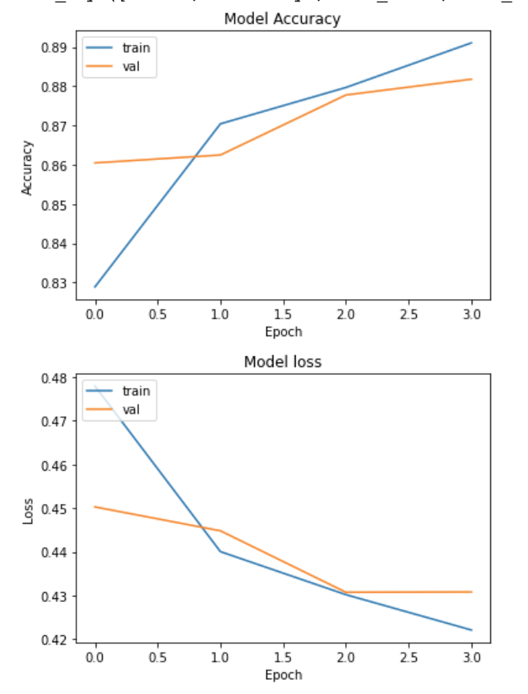
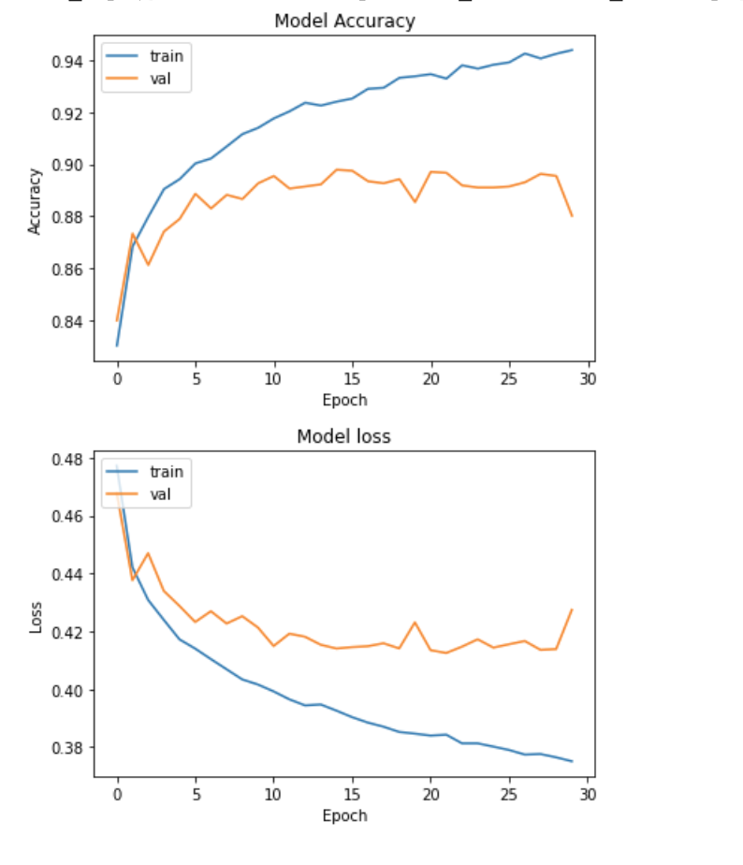
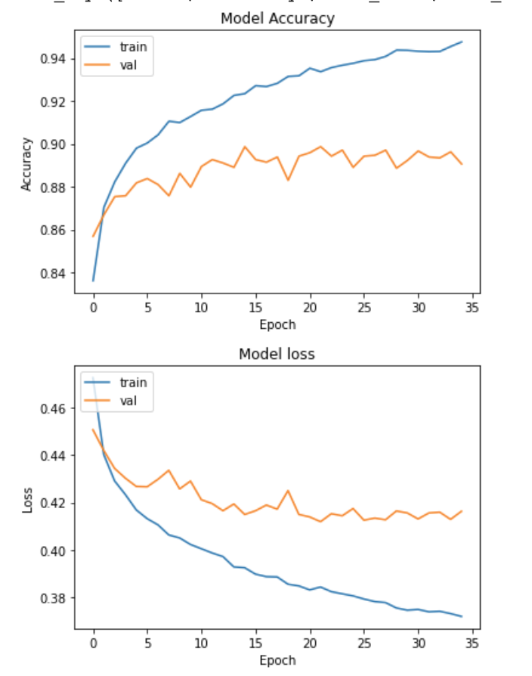
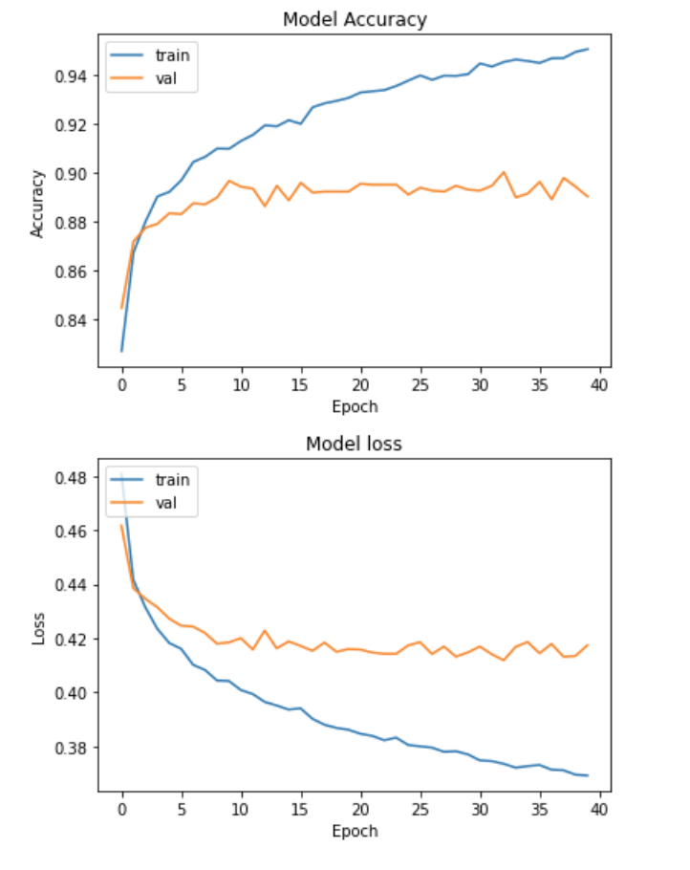
Helipads
4 Epochs
30 Epochs
35 Epochs
40 Epochs
Oil/Gas Facilities
4 Epochs
30 Epochs
35 Epochs
40 Epochs

Slide 2
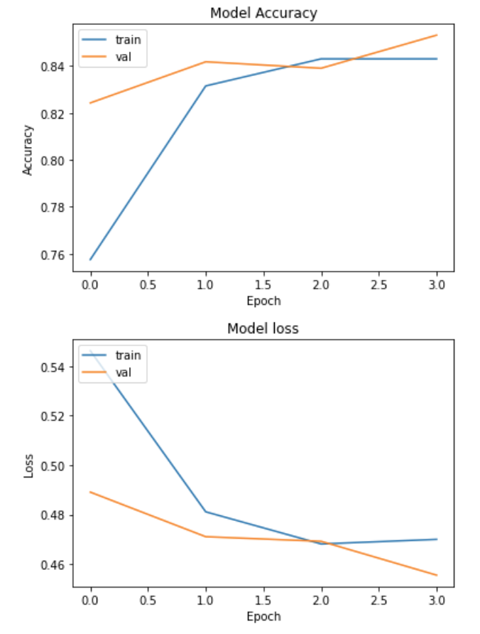
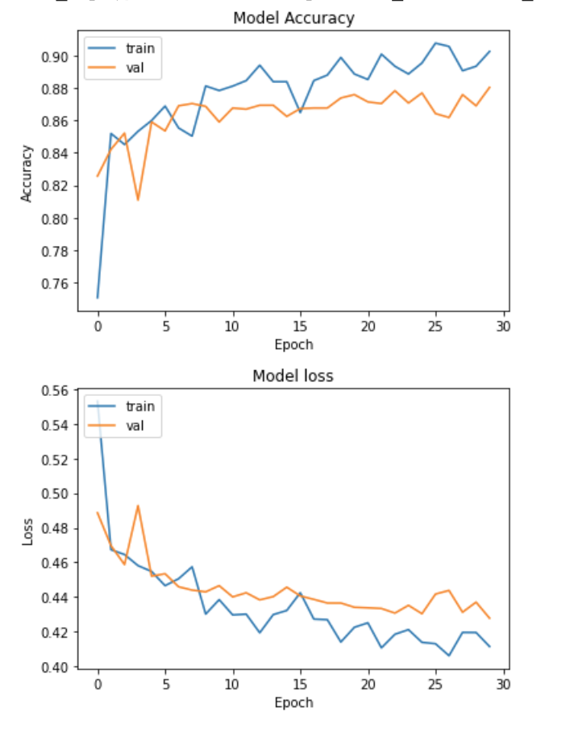
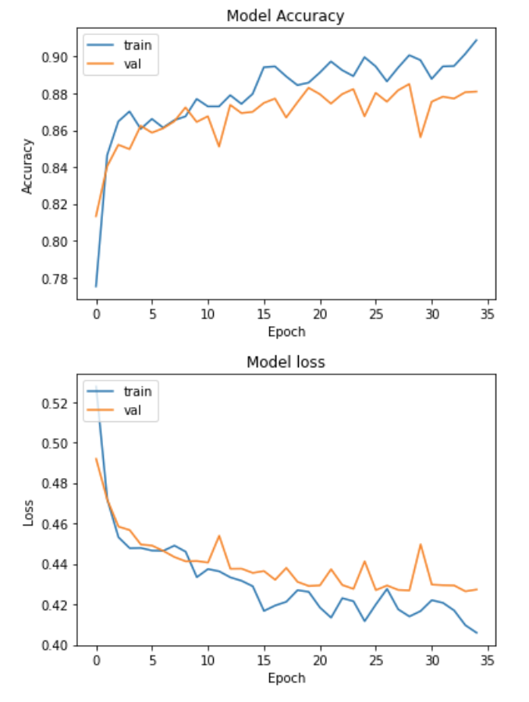
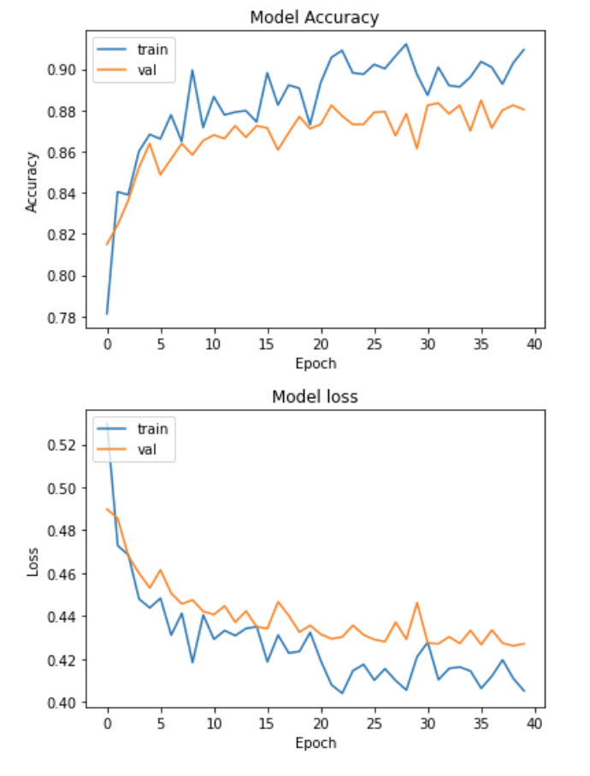
Tunnel Openings
4 Epochs
30 Epochs
35 Epochs
40 Epochs
Notes:
/content/drive/My Drive/Colab Notebooks/Thesis Resources/Training_Sessions/trained_models/1594484954_Combine_tunnelnew_tunnel_4_h5_model.h5
/content/drive/My Drive/Colab Notebooks/Thesis Resources/Training_Sessions/trained_models/1594485272_Combine_tunnel_new_tunnel_30_h5_model.h5
/content/drive/My Drive/Colab Notebooks/Thesis Resources/Training_Sessions/trained_models/1594485317_Combine_tunnel_new_tunnel_35__h5_model.h5
/content/drive/My Drive/Colab Notebooks/Thesis Resources/Training_Sessions/trained_models/1594485612_Combine_tunnel_new_tunnel_40__h5_model.h5

