Slide 1
Exceptions – Use Case

Slide 2
Ariane 5 Accident
Ariane 5 mission 501 ended in failure
  Maiden flight 4 June 1996
  40 sec after lift-off launcher
  veered off flight path and
  broke up
  Mission Control information shown this was due to unexpected shut-down of both copies of Inertial Reference System (IRS)
    Backup IRS unit first shut down
    Active IRS unit shut down immediately after
    No IRS => no altitude information
    IRS units could be retrieved from the debris and analyzed

Slide 3
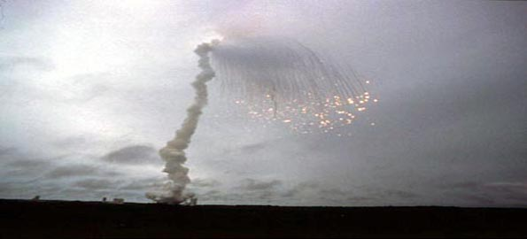
Ariane 5 Accident
Ariane 5 mission 501 ended in failure
  Maiden flight 4 June 1996
  40 sec after lift-off launcher
  veered off flight path and
  broke up
  Mission Control information shown this was due to unexpected shut-down of both copies of Inertial Reference System (IRS)
    Backup IRS unit first shut down
    Active IRS unit shut down immediately after
    No IRS => no altitude information
    IRS units could be retrieved from the debris and analyzed

Slide 4
Commission findings
IRS code was written in Ada
  Reused from Ariane 4
    Different launch properties from Ariane 5
      Much larger initial velocity
    Assignment out of bounds caused exception
  The assignment wasn’t protected against exception
    Deliberate - was assumed (back in Ariane 4 times) that the range is so large the bounds could never be exceeded
  Design guidelines required that unhandled exception results in unit shutdown
    Was assumed (back in Ariane 4 times) that exceptions can only occur because of hardware fault
    Backup unit is available so can “safely” shutdown the faulty one
      (but what if it’s a systemic software error and not a random fault?)

Slide 5

Aftermath
Accident often used by Ada disparagers
Lesson learned (rather, reinforced)
  In mission-critical system silly exception is worse than no exception at all
Problem not in the language but in faulty design techniques
  Unscrupulous code reuse
  Questionable assumptions
  Unreasonable requirements
raised NUMERIC_ERROR

