Slide 1
Tasking with Ravenscar

Slide 2
Overview

Slide 3
What is the Ravenscar profile
Use concurrency in embedded real-time systems
  Verifiable
  Simple (Implemented reliably and efficiently)
Scheduling theory for accurate analysis of real-time behavior
A subset of the Ada tasking model
Defined to help meeting safety-critical real-time requirements
  Determinism
  Schedulability analysis
  Memory-boundedness
  Execution efficiency and small footprint
  Suitability for certification
State-of-the-art concurrency constructs
  Adequate for most types of real-time software

Slide 4
A simple task
Ada implements the notion of a “thread” via the task entity
A task is started when its declaration scope is elaborated
Its enclosing scope exits when all tasks have finished
pragma Ravenscar; with Ada.Text_IO; use Ada.Text_IO; with Ada.Real_Time; use Ada.Real_Time; ...
package P is task T; end P; package body P is task body T is Tick : Time := Clock; begin loop delay until Tick; Put_Line ("T"); Tick := Tick + Seconds (10); end loop; end T; end P;
with P; procedure Main is Tick : Time := Clock; begin loop delay until Tick; Put_Line ("Main"); Tick := Tick + Seconds (10); end loop; end;

Slide 5
Interacting with tasks
Active synchronization
  Client/server model of interaction (“asymmetric rendezvous”)
  Server task declares “entries” for interacting
  Client task makes an “entry call”
  Not available in Ravenscar Profile
Passive synchronization
  Uses data objects with concurrency-safe access semantics
  Implemented with “protected objects” in Ada

Slide 6
Protected objects
Tasks are “active” objects
Synchronization can be achieved through “passive” objects that hold and manage values
A protected object is an object with an interface
  No concurrent modifications are allowed
It is a natural replacement for a lot of cases where a semaphore is needed
protected body O is procedure Set (V : Integer) is begin Local := V; end Set; function Get return Integer is begin return Local; end Get; end O;
protected O is -- Only subprograms are allowed here procedure Set (V : Integer); function Get return Integer; private -- Data declaration Local : Integer; end O;

Slide 7
Protected functions vs. protected procedures
Procedures can modify the state of the protected data
  No concurrent access to procedures can be done
  No procedure can be called when functions are called
Functions are just ways to retrieve values, the protected data is read-only
  Concurrent access to functions can be done
  No function can be called when a procedure is called

Slide 8
Protected object entries (1/2)
Protected entries are a special kind of protected procedures
  Only one entry per PO in Ravenscar
They can be defined using a barrier, a conditional expression allowing the entry to be called or not
  Any Boolean expression in full Ada
  A simple Boolean value only in Ravenscar
The barriers are evaluated…
  Every time a task request to call an entry
  Every time a protected entry or procedure is exited
protected O is procedure Push (V : Integer); entry Pop (V : out Integer); private Buffer : Integer_Array (1 .. 10); Size : Integer := 0; Has_Elements : Boolean := False; end O;
protected body O is procedure Push (V : Integer) is begin Buffer (Size + 1) := V; Size := Size + 1; Has_Elements := True; end Push; entry Pop (V : out Integer) when Has_Elements is begin V := Buffer (Size); Size := Size – 1; Has_Elements := Size > 0; end Pop; end O;

Slide 9
Protected object entries (2/2)
Tasks can be waiting on entries
  Several in full Ada
  At most one in Ravenscar
A task is reactivated when the barrier is relieved
task body T1 is V : Integer; begin O.Pop (V); end T1; task body T2 is begin delay 1.0; O.Push (42); end T3;

Slide 10

Task types
It is possible to create task types
  Task objects can only be instantiated statically in Ravenscar
  Can be instantiated on stack or heap in full Ada tasking model
By default tasks are activated at the end of the elaboration of their library unit’s declarative part
  As if they were declared there
  Activation can be deferred to the end of all elaboration
Tasks are limited objects (no copies allowed)
task type T; type T_A is access all T; task body T is begin null; end T;
V1 : T; V2 : aliased T; V3 : A_T; begin V3 := new T; -- Not allowed in Ravenscar V3 := V2'Access;

Slide 11
Protected object types
Like tasks, protected objects can be defined through types
Instantiation can then be done on library level
Protected object types are limited types
protected type O is procedure Push (V : Integer); entry Pop (V : out Integer); private Buffer : Integer_Array (1 .. 10); Size : Integer := 0; Has_Elements : Boolean := False; end O;
protected body O is procedure Push (V : Integer) is begin Buffer (Size + 1) := V; Size := Size + 1; Has_Elements := True; end Push; entry Pop (V : out Integer) when Has_Elements is begin V := Buffer (Size); Size := Size – 1; Has_Elements := Size > 0; end Pop; end O;
V1, V2 : O;

Slide 12
Scope of a task
In Ada, tasks can be nested in any declarative block
  The scope can’t be exited before all nested tasks terminate
In Ravenscar, tasks can only be declared at library level
  All have to finish before the program terminates
package P is task T; end P; package body P is task body T is loop ... end loop; end T; end P;

Slide 13
Some Advanced Concepts…

Slide 14
Ravenscar patterns
Periodic tasks (cyclic tasks / time triggered)
  Sensor data acquisition
  System monitoring
  Control loops
  Display update
Event driven tasks
  Alarm, Timeout
  Interrupt
  Data from another task
Protected objects to synchronize tasks

Slide 15
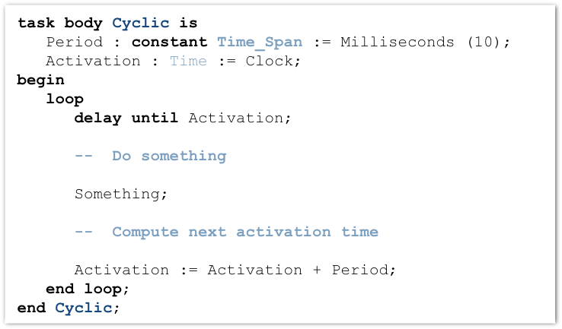
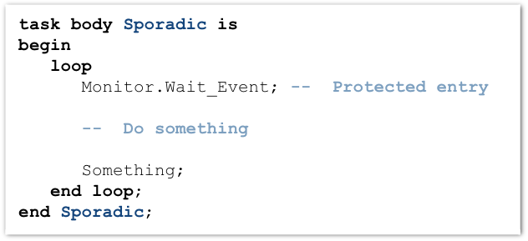
How tasks look like in Ravenscar
Time-triggered task
Event-triggered task

Slide 16
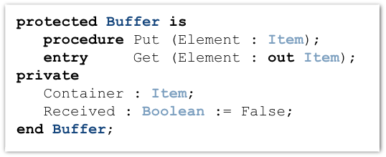
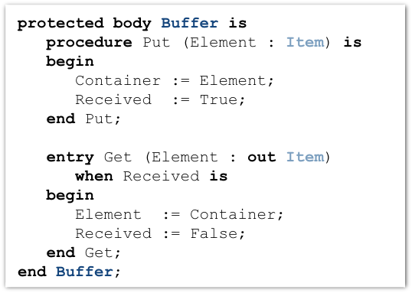
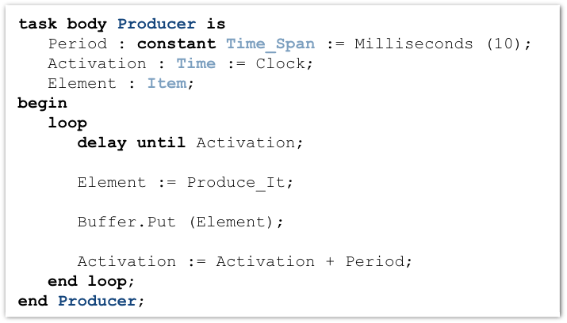
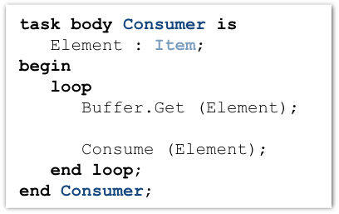
Synchronization in Ravenscar
Pr Buffer
Put
Get
C Producer
S Consumer

Slide 17
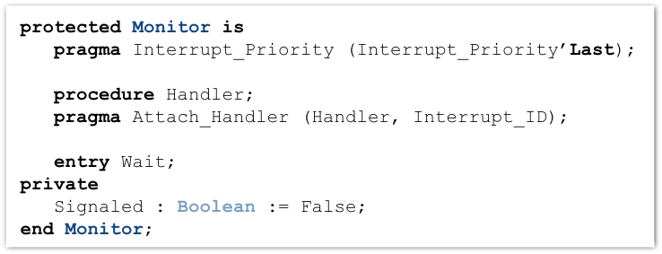

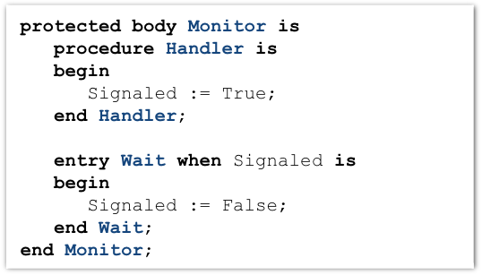
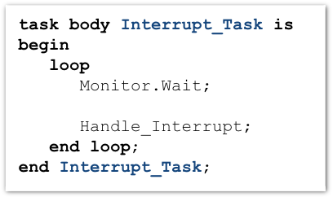
Interrupt support in Ravenscar
Pr Monitor
External Interrupt
Handler
Wait
S Interrupt_Task
Use the right priority level!
  Priority of PO should be greater or equal to priority of the interrupt
  More on that in a bit
Notes:
Priority of PO should be greater or equal than priority of the interrupt

Slide 18
Tasks
Fixed set of tasks
  Only at library level
  No dynamic allocation
  No nested task declarations
  Fixed priority
  Statically created
    Task descriptors, stacks, …
Each task is an infinite loop
  Single “triggering” action (delay or event)
  Tasks never terminate
  No entries, no rendezvous
  No abort
Task creation and activation is very simple
  All tasks are created at initialization
  Then all are executed according to their priorities

Slide 19
Protected objects and interrupt handling
Simple protected operations
  At most one entry
  No queuing
    Only one task can be blocked on the entry
  Ceiling locking on monoprocessor
    Bounded priority inversion
    Efficient locking/unlocking by increasing/decreasing priority
  “Proxy model” for protected entries
    Avoid unneeded context switches
Interrupt handling
  Simple and efficient
    Protected procedures as low level interrupt handlers
    Masking hardware interrupts according to active priority
Notes:
The GPS AE653 Debugging Capability
24 Feb 2005
Interrupt handlers are executed according to their priority.

Slide 20
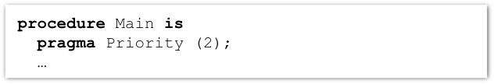
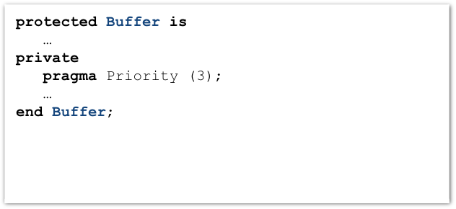
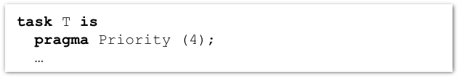
Priorities
Priorities are defined in package System
  Lower values mean lower priority
  Two non-overlapping ranges:
    Priority
    Interrupt_Priority
Priority is set by a pragma Priority or pragma Interrupt_Priority
  Only for Tasks, Protected Types, Protected Objects, Subprograms
  Ignored for non-main Subprograms
    Set the priority of the environment task
  Interrupt_Priority for priorities in the interrupt range

Slide 21
Scheduling
Priority based
No time slicing (quantum)
A task executes until …
  The task is blocked (on delays or on protected object entry)
  A higher priority task is woken up or unblocked

Slide 22

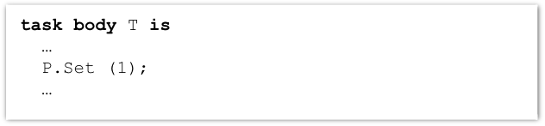
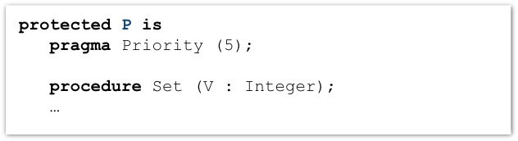
Ceiling Locking
Task priority is increased within a protected object
  Priorities of task must be lower or equal than the priorities of protected objects used
  Blocks other tasks
  Performs locks without using locks
Task T
5
P.Set
4
start

Slide 23
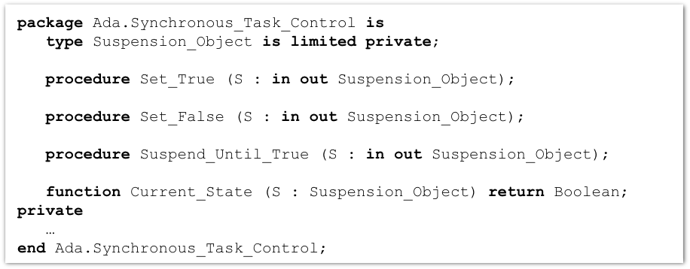
Synchronous Task Control
Provides primitives to construct synchronization mechanisms and two-stage suspend operations
Package exports a Suspension_Object type
  Values are “True” and “False”, initially “False”
  Such objects are awaited by one task but set by other tasks

Slide 24
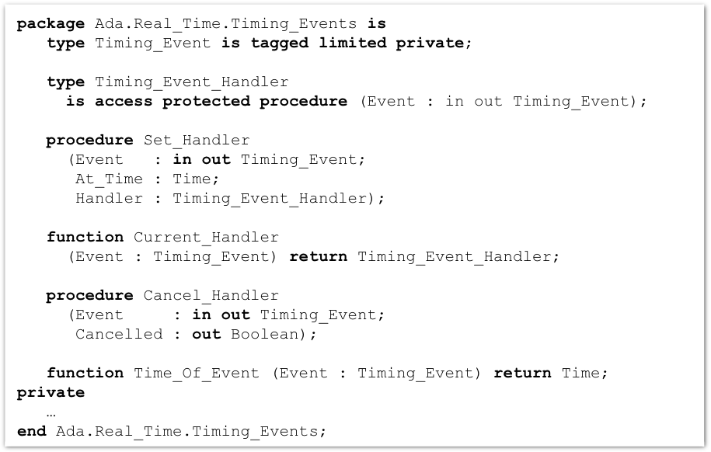
Timing Events
User-defined actions executed at a specified wall-clock time
  Implemented as protected procedures
Do not require a task or a delay statement
Controlled via procedural interface
  Links the protected procedure
  Sets the time
Ravenscar run time interface

Slide 25
Execution Time Clocks
Each task has an associated CPU time clock
  Accessible via function call
Clocks start after creation but before activation
Whenever the task executes the clock increments
Total time includes run-time library & O.S. services executed on its behalf
System and run-time library execution not specific to a given task may be assigned to some task(s)
  Implementation-defined whether it does
  Implementation-defined which task if it does

Slide 26
Partition elaboration control
Library units are elaborated in an undefined order
  They can declare tasks and interrupt handlers
  Once elaborated tasks start executing
  Interrupts occur as soon as hardware is enabled
These are unacceptable race conditions
  Especially for certification!
pragma Partition_Elaboration_Policy
  Controls when activation & attachment happens relative to library unit elaboration completion
  Defined in High Integrity Systems Annex
  Concurrent policy
    Normal semantics: tasks and interrupts are concurrent with remaining library units’ elaboration
  Sequential policy
    Task activation and interrupt handler attachment are deferred until library unit elaboration completes
Notes:
Transitioning to Ada 2005 with GNAT Pro
Real-Time Enhancements
Interrupts are not delivered until the handler is attached???
If any deferred task activation fails, the whole partition dies with Tasking_Error (because the environment task is waiting for activations and attachments to complete and it gets the exception).

Slide 27
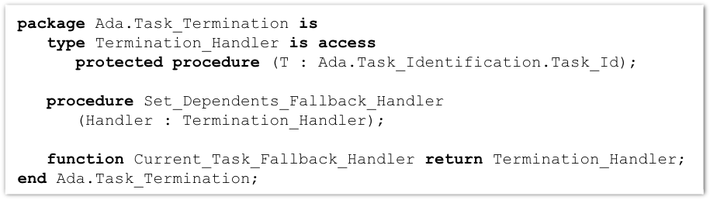
Task termination notification
Tasks silently terminate
  Without notification by default
User-defined handlers for termination
  Essentially a task’s “last wishes”
  Handlers are protected procedures called by the run-time library
States differentiated
  Normal termination
  Termination due to unhandled exception
  Termination due to task abort
Ravenscar run time interface
Notes:
Transitioning to Ada 2005 with GNAT Pro
Real-Time Enhancements

Slide 28
Ravenscar Small FootPrint
Everything is done by the Ada run-time library
  No OS underneath
Simple
  Less than 2800 Logical SLOCs
  Footprint for simple tasking program is 10KB
Static tasking model
  Tasks descriptors and stacks are statically created at compile time
  Task creation and activation is very simple
  All tasks are created at initialization
  Then all activated and executed according to their priority
Simple protected operations
  No queuing
  Locking/unlocking by increasing/decreasing priority
Complex features removed
  Such as exception handling and propagation
ECSS (E-ST-40C and Q-ST-80C) qualification material

Slide 29

Quiz

Slide 30

Is there an error? (1/10)
task body T is begin loop delay 1.0; … end loop; end T;
Notes:
Compilation error. Relative delay statement are not allowed.

Slide 31
What is wrong? (2/10)
task body T is begin loop delay until Clock + Seconds (1); … end loop; end T;
Notes:
Builds ok but loop is not periodic (will drift because the delay is actually 1 sec PLUS the time to execute an iteration)

Slide 32
Is there an error? (3/10)
task body T is Next : Time := Clock; begin loop … Next := Next + Seconds (1); delay until Next; end loop; end T;
Notes:
Correct.

Slide 33
Is there an error? (4/10)
task T is pragma Priority (Interrupt_Priority'First); end T;
Notes:
Compilation error. Priority must be in System.Priority range

Slide 34
Is there an error? (5/10)
task T is pragma Interrupt_Priority (Interrupt_Priority'First); end T;
Notes:
Correct. Note that some interrupts will be masked while the task is running.

Slide 35
Is there an error? (6/10)
task Test_Driver is pragma Interrupt_Priority (System.Interrupt_Priority'First); end Test_Driver; protected P is procedure Inc (Res : out Integer); private pragma Priority (System.Priority'Last); Val : Integer := 0; end P;
task body Test_Driver is V : Integer; begin P.Inc (V); …
Notes:
Runtime error: ceiling locking violation.
Priority of the task is higher than priority of the protected object P.

Slide 36
Is there an error? (7/10)
protected P is procedure Inc (Res : out Integer);
protected body P is procedure Inc (Res : out Integer) is … begin delay until Next_Activation;
Notes:
Runtime error: no blocking action in protected actions.

Slide 37
Is there an error? (8/10)
protected Monitor is procedure Handler; pragma Attach_Handler (Handler, Interrupt_ID); entry Wait; private Signaled : Boolean := False; end Monitor;
Notes:
Correct. An implicit pragma Interrupt_Priority is added.

Slide 38
Is there an error? (9/10)
protected Monitor is pragma Priority (Priority'Last); procedure Handler; pragma Attach_Handler (Handler, Interrupt_ID); entry Wait; private Signaled : Boolean := False; end Monitor;
Notes:
Not correct: priority not in the interrupt_Priority range.

Slide 39
Is there an error? (10/10)
protected Monitor is entry Wait; … end Monitor;
task body T1 is … Monitor.Wait; … end T1;
task body T2 is … Monitor.Wait; … end T2;
Notes:
Certainly not correct, as the maximum entry queue length is 1 (at most one task can be blocked at an entry).
Will work as long as both tasks are not trying to enter Monitor at the same time.

Slide 40
Is there an error? (11/10)
protected Monitor is pragma Priority (Interrupt_Priority'Last); procedure Handler; pragma Attach_Handler (Handler, Interrupt_ID); entry Wait; private Signaled : Boolean := False; end Monitor;
Notes:
Correct but misleading: should use Pragma Interrupt_Priority.

