Slide 1
Narrative Fiscal Shocks for the Pacific
Extending a validated LLM-assisted pipeline beyond the Malaysia pilot
Esteban Degetau and Agustín Samano

Slide 2
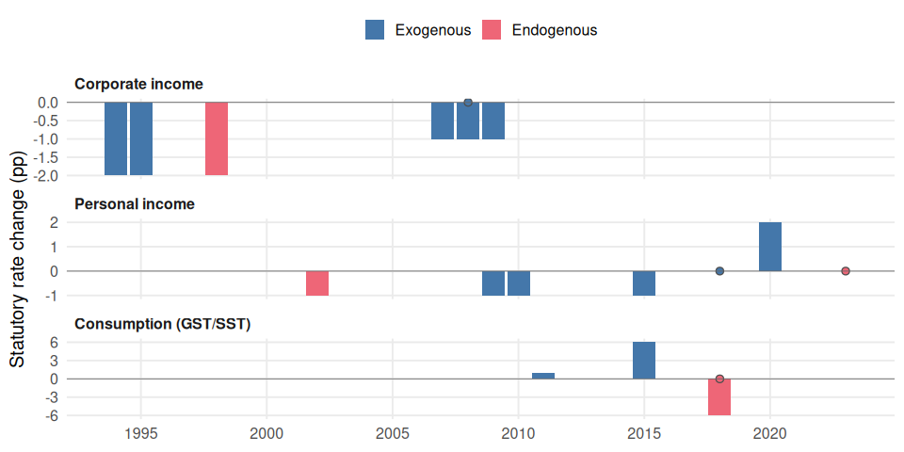
Malaysia: every statutory tax change, read from the budget speech that announced it
Notes:
Corporate, personal and consumption tax changes, 1980-2019, identified from Malaysian primary-source budget documents by the LLM pipeline and stamped by a human reviewer. Bar height is the statutory rate change in percentage points; hollow markers are acts with no headline rate change (regime introductions, one-off levies). Colour is the pipeline’s exogeneity verdict: was the change motivated by something other than the current state of the economy.
Every event traces back to a quoted passage in a named document. That chain is what let a reviewer’s objection to two corporate-tax rows surface a machinery defect earlier this year.

Slide 3
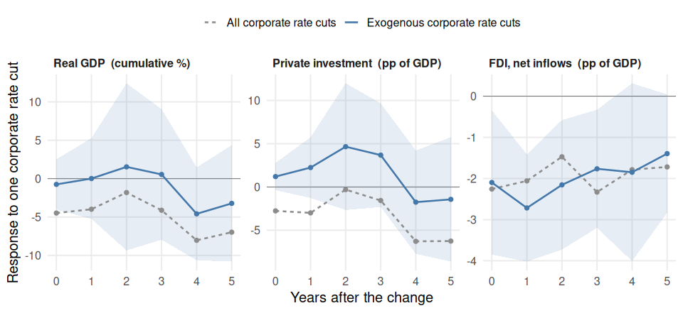
Local projections from a single country are suggestive at most
Notes:
Local projections (Jorda 2005) of each outcome on Malaysian statutory corporate income tax cuts, annual, 1980-2019, dated by the year the change took effect. Shaded band is 90%, Newey-West. Six rate-bearing CIT acts fall in the window; five are classified exogenous. The two lines differ by exactly one act: the 1998 Asian-crisis cut, which the pipeline classifies COUNTERCYCLICAL.
HOW TO READ THE SIGN. In the source data a rate cut is a negative number: delta_pp is rate_to minus rate_from, so 28% to 27% is -1. The shock enters as minus that, so a cut is a positive shock. Every coefficient on this slide is therefore the response to a corporate rate CUT, and a positive value means the outcome is higher after a cut - that is, expansionary. A negative value means the outcome is lower after a cut.
THE UNITS ARE NOT THE SAME ACROSS PANELS, which is why they are on the strips rather than the axis. Real GDP enters as 100 x log, so its numbers are cumulative percent deviations of the level of GDP. Private investment and FDI are already ratios to GDP measured in percent, so their numbers are percentage points of GDP. The dependent variable is the outcome at t+h minus the outcome at t-1, so every point is cumulative from the year before the change and horizon 0 is the impact year.
THE SHOCK IS AN EVENT INDICATOR, NOT A SIZE. Each cut counts once regardless of how many percentage points it moved, so these are average responses per cut, not per percentage point. We began with a percentage-point shock and abandoned it: the five exogenous cuts take only two sizes, 2pp in 1994-95 and 1pp across 2007-09, and those sizes line up with the eras they fell in - the tail of the 1990s boom and the global financial crisis. A continuous specification then measures the gap between two decades and reports it as a dose-response. It returned +3.2% of GDP per percentage point, which is roughly an order of magnitude too large. Removing the size information removes that confound.
NO SYMMETRY CLAIM. All five exogenous events are cuts, so nothing here speaks to what a rate increase would do.
WHAT THE SLIDE CLAIMS, AND WHAT IT DOES NOT. The grey line includes the one cut that was made because output was collapsing, and it runs sharply negative (-4.5% of GDP on impact). The blue line removes that single act and the estimate moves to roughly zero (-0.7% on impact, +1.5% by year two, t = 0.23). So the claim is about the direction and size of the bias that endogenous events introduce, and about the fact that removing them leaves an answer we cannot distinguish from nothing. It is not a finding that corporate tax cuts raise output in Malaysia. Nothing on this slide is statistically significant except the FDI panel, where both lines are negative and we treat the result as unresolved rather than as evidence.
Three of the five exogenous cuts take effect in 2007-09, so the short-horizon response partly reflects the crisis and its rebound. No crisis control is added, because that would be a specification choice made after seeing the result.
ROBUSTNESS. Pooling all three instruments instead - corporate, personal and consumption, 8 exogenous event-years - gives a GDP response of +0.67% at horizon 2 that is stable whether or not magnitude is used. That pooled series mixes percentage points across different tax bases, which is why it is not the headline, but it is the more identified of the two.
This is the argument for the regional programme rather than against the method. The pipeline produced a usable regressor from primary documents; one country’s corporate-tax record is simply too short to estimate a response from. More countries is the fix.

Slide 4
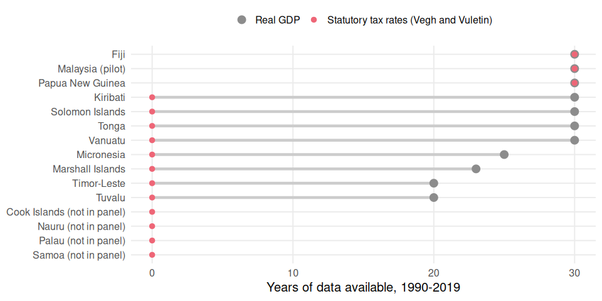
The Pacific is in the growth data, and in no fiscal-shock dataset
Notes:
Years of usable data per country, 1990-2019, in the compiled cross-country panel this project benchmarks against - the same statutory-rate series used by the published cross-country procyclicality literature.
Eight of the ten Pacific countries in the panel have three decades of real GDP and FDI and zero years of statutory tax-rate data. Samoa, Palau, the Cook Islands and Nauru are not in the panel at all. Fiji and Papua New Guinea are the only exceptions.
These countries therefore appear in every cross-country growth study and in no fiscal-shock study. That is not because nobody wants the evidence; it is because the documents have never been read. The Malaysia pilot shows the reading can now be done in weeks rather than months, and most Pacific budget documents are in English, so the corpus cost is below Malaysia’s bilingual case.
What the funding buys: the cross-country variation that turns the middle slide from a sign into a magnitude.

