Slide 1
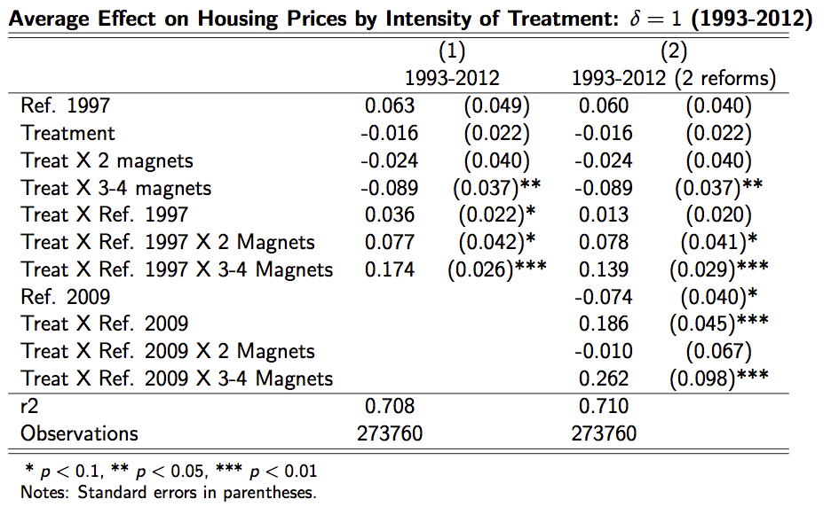
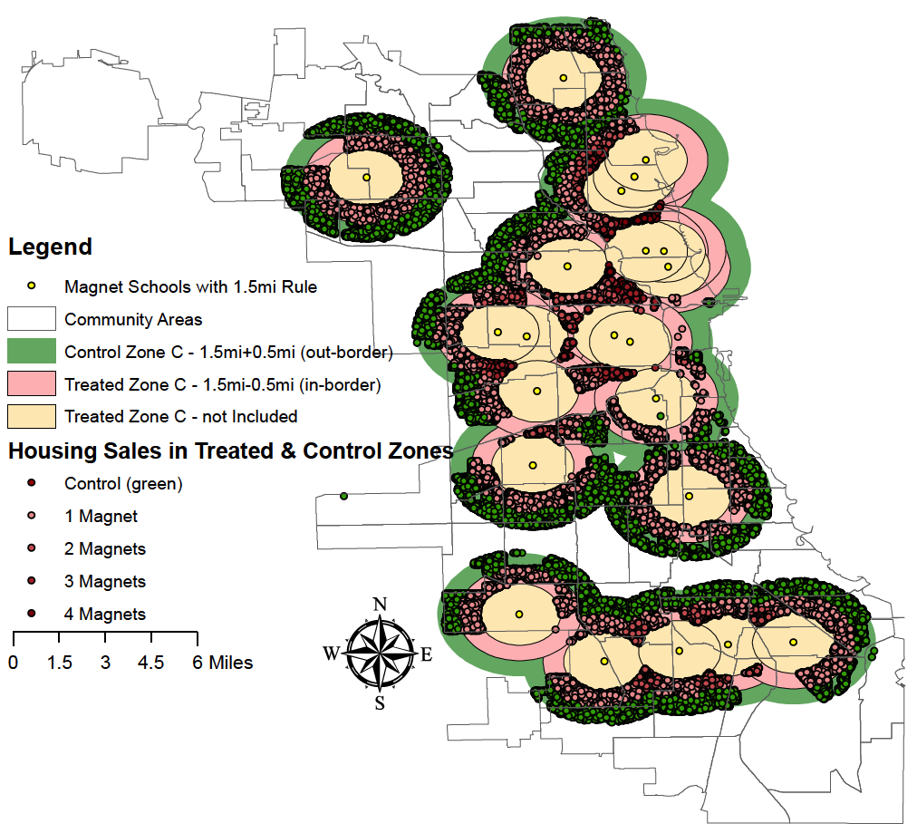

Housing Prices and School Choice:
Evidence from the Chicago magnet schools proximity lottery
Leonardo Bonilla^{a,} Esteban Lopez^{b}, & Daniel McMillenª
ª Department of Economics, ^{b} Department of Urban and Regional Planning - University of Illinois at Urbana-Champaign
Introduction
This paper estimates the effects of school choice provision on housing prices. We use the introduction and further modification of the Chicago elementary magnet schools proximity lottery to identify causality.
Magnet Schools
High performance and high demand.
Created in the early 1980 to address racial segregation.
Two key reforms:
The introduction and further modification of the proximity lottery generates incentives to live close to magnet schools. This should have an effect on housing.
We should expect a housing price discontinuity at 1.5 miles from each magnet elementary school.
Previous literature
School boundaries discontinuity (Black, 1999; Gibbons et al., 2009)
School openings (Fack and Grenet, 2000; Schwartz et al., 2014 )
School Redistricting (Bogart & Cromwell, 2000)
Contribution
Uses a natural experiment to identify causal effects.
Does not rely on school openings that are potentially endogenous.
First paper of its kind for the Chicago area.
Public policy implications for the design of admission policies.
Identification Strategy
Dif-in-dif Model
Exogenous variables include: house attributes (size, number of bathrooms, age, garage and fireplace) and distance to city amenities (hospitals, metro stations and parks).
All regressions include quarter and elementary school district fixed effects.
We also estimate the differences in housing premium depending of the treatment intensity (i.e. more than 1 magnet) (Table bellow)
We tested three different placebo regressions: a. Different set-aside rule; b. Different year policy; and c. Different type of schools.
Discontinuity Design
Treated: Houses at 1.5-δ to 1.5 miles radius around.
Control: Houses at 1.5 to 1.5+δ miles to the closest eligible magnet schools.
For δ={1.5, 1, 0.5}, we have different levels to test the robustness of our results
CONTROL
TREATMENT
1.5 + δ
1.5 -δ
1980-1997
1997 Reform
2009 Reform
Citywide lottery Minority quotas
Siblings (up to 45%)
Siblings (all)
Proximity lottery* Minority quotas
(30% of remaining seats)
Proximity lottery*
(40% of remaining seats)
Citywide lottery Minority quotas (remaining seats)
Citywide lottery
4 tier system
(remaining seats)
* Proximity lottery: Preferential lottery for applicants living in a 1.5 miles radius around elementary magnet schools.
Preliminary Results
Data
Housing
1993-2012 Sale prices and house attributes (269.553 obs.)
Sources: Chicago Assessors Office (DataQuick & Illinois Department of Revenue)
Schools
22 elementary magnet schools that existed before 1997 and have proximity lottery.
School ranking.
Neighborhood School districts.
Sources: Chicago Public Schools and City of Chicago Open Data Portal.
Conclusions
Proximity lottery increases eligible housing prices in about 4% from 1997 policy when having access to 1 magnet.
The housing prices increase from 4 to 17 percent when increasing the number of magnets up to 4.
When estimating the effect of both reforms, the later has larger effects on prices, specially in the case of having access to more than 1 magnet schools.
Extensions:
Spatial Lag of Housing Prices
Inclusion of other outcomes such as teardowns
R | E | A | L
Fig 1. Magnet elementary schools and
proximity lottery treated and control area with δ=0.5
REGIONAL ECONOMICS APPLICATIONS LABORATORY
UNIVERSITY OF ILLINOIS AT URBANA-CHAMPAIGN

