Slide 1
digitale dramenanalyse
sample workflow to standard data set Stephan Schwarz, FUB

Slide 2
intro
I will show you in a few steps an example workflow of how to prepare some base documents of historic sources that enable further analysis of a dramatic text. assumed we start with a plain text file, a lot of work had been done by others yet and we can proceed to the TEI refactoring of the text. if we do not have a text file yet, first will be to transcribe some source of the text, usually a .pdf or collection of .jpegs like the following…

Slide 3
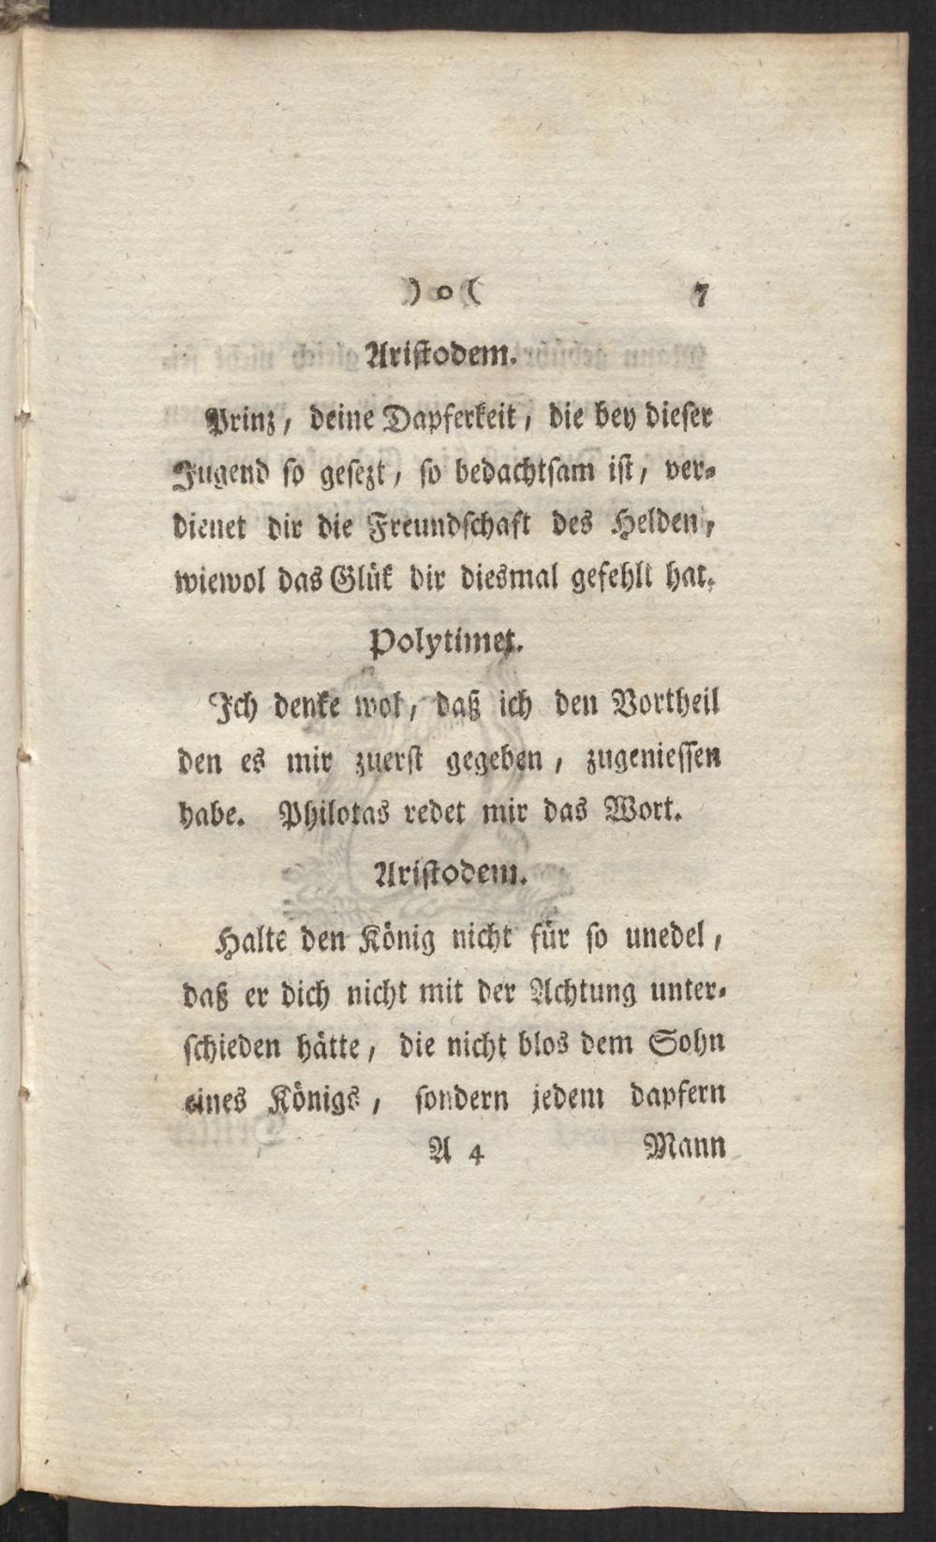
this:
bodmer excerpt

Slide 4
transcription
for that purpose you can either transcribe the text manually, from picture to text, or you use e.g. TRANSKRIBUS (read-coop 2022), a user friendly framework for OCR (optical character recognition). with that half of the work is done by the algorithm, but you still have to check the automatic transcription for recognition failures depending on the quality and the typography of the source.

Slide 5
editing
next step if you have the transcript ready will be to upload the text page by page to WIKISOURCE (Wikimedia n.d.) where it can be proofread by others. if theres two correction runs ready, you can download the proper version of the text from which we proceed to the TEI.

Slide 6
TEI:why
FAIR-Prinzipien für Daten: findable, accessible, interoperable, reusable
TEI: text encoding initiative (TEI 1987)
theres multiple ways of how you can get to the TEI text. one is to wrap text elements which need to be marked up with OXYGEN, a powerful XML editor.

Slide 7
TEI:refactoring
in our drama class, we used a python script (JUPYTER-notebook) written by a friendly geek which allowed easily transforming the preprocessed text into the desired format.

Slide 8
basic auszeichnung:
@title Ham @subtitle A tragedy @author William S ^Dramatis Personae Ham Egg Vikings #Act 1 ##Scene 1 @Ham: Lovely Spam! @Egg: Wonderful Spam! ##Scene 2 $Enter Vikings @Ham: Egg, Spam, Sausage, and Bacon! @Vikings (singing): Spam, Spam, Spam, Spam, Spam, Spam, Spam, and Spam $The end

Slide 9
finalise
if all that is done you possess a finalized TEI text which allows further analysis of the drama again e.g. using python or R for network, semantic etc. analyses. types net

Slide 10
or
X | token | tag | pos | category | funct | case | pers | num | gender | tense | mode
1 | Klagen | N.Reg.Nom.Pl.Fem | N | Reg | NA | Nom | NA | Pl | Fem | NA | NA
2 | , | SYM.Pun.Comma | SYM | Pun | Comma | NA | NA | NA | NA | NA | NA
3 | nichts | PRO.Indef.Subst.-...Neut | PRO | Indef | Subst | NA | NA | NA | Neut | NA | NA
4 | als | CONJ.Comp.- | CONJ | Comp | NA | NA | NA | NA | NA | NA | NA
5 | Klagen | N.Reg.Nom.Pl.Fem | N | Reg | NA | Nom | NA | Pl | Fem | NA | NA
6 | ! | SYM.Pun.Sent | SYM | Pun | Sent | NA | NA | NA | NA | NA | NA
linguistic basics

Slide 11
Slide with R Output
summary(cars)
## speed dist ## Min. : 4.0 Min. : 2.00 ## 1st Qu.:12.0 1st Qu.: 26.00 ## Median :15.0 Median : 36.00 ## Mean :15.4 Mean : 42.98 ## 3rd Qu.:19.0 3rd Qu.: 56.00 ## Max. :25.0 Max. :120.00

Slide 12
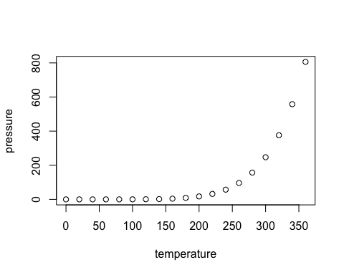
Slide with Plot

Slide 13
read-coop. 2022. “Transkribus.” READ-COOP. https://readcoop.eu/transkribus/.
TEI. 1987. “History – TEI: Text Encoding Initiative.” https://tei-c.org/about/history/.
Wikimedia. n.d. “Wikisource.” Accessed July 22, 2023. https://de.wikisource.org/wiki/Hauptseite.

