Slide 1
Author Identification Using Text Snippets
By:
Suryank Tiwari (MT19019)
Prateek Agarwal (MT19070)

Slide 2
Problem Definition
Shakespeare
Oscar Wilde
Our Motivation:
With each keystroke, each author imparts themselves unto their work; most of this is subconscious.
We propose to train a machine learning model on short text snippets to leverage these properties and identify the author.
Our Goal:
Author identification given multiple short text snippets via using stylometric and lexicographical features.
Generating a dataset for the said problem.
Yet did it not prevail against him, so great was the power of his love
I will run, fiend; my heels are at your commandment;

Slide 3
Building the Dataset
To obtain data regarding various authors, we web scraped all author works from ‘American Literature Website.’
The data of 415 authors was web scraped which consisted of 9416 document works in stories, poems and plays.
Out of all authors we selected - namely
Shakespeare William
Woolf Virginia Allan
Wilde Oscar.
Preprocessing:
Removing junk data.
Tokenization, Lemmatization, Punctuation Removal, Case Folding.
Used TF-IDF vectorizer and Naive Bayes to generate sentence author probabilities.
Higher probability - author unique sentence, and vice versa.
Create a mixture of common and unique sentences with unprocessed sentence author pairs.

Slide 4
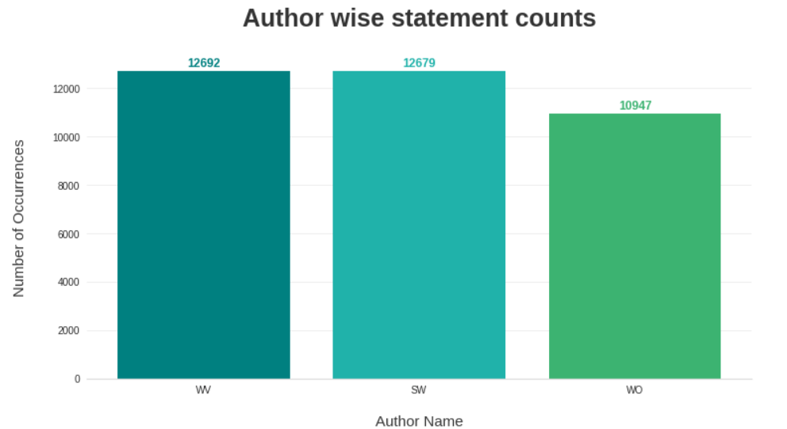
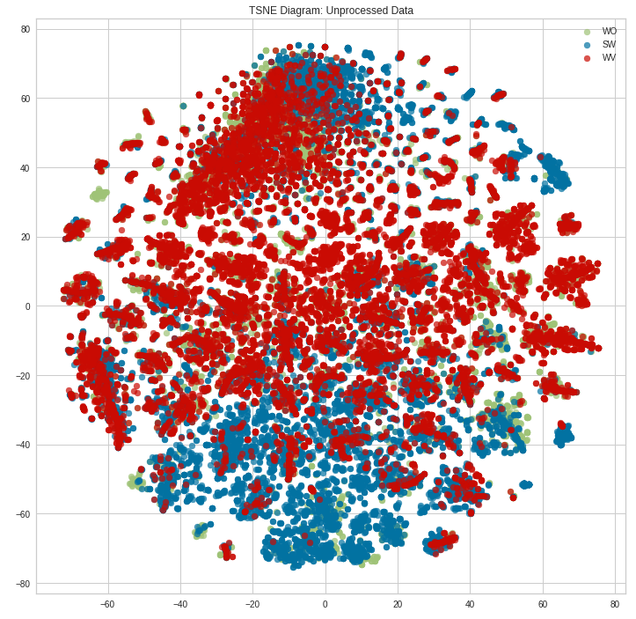
Dataset Statistics
The final dataset contains of 3 authors, ~36,000 training samples and ~9000 testing samples.
TSNE with TF-IDF Vectorizer

Slide 5
Methodology
00
Dataset Creation
Scrap web data
Clean and process data
Sentence-Author pair Confidence heuristics
Final dataset generation
01
Exploratory Data Analysis
TSNE Plots
UMAP Plots
POS Tag Plot
02
Preprocessing
Tokenize, Lemmatize & Stopword Removal
Contraction expanding
Punctuation Removal & Lowercase conversion
03
Feature Engineering
Stylometric features
Tf Idf Features
POS Tag Features
Count Vectorized Features
04
Classification using Machine Learning Techniques
Combination of different features for the application of models
Application of various ML models and pipelines

Slide 6
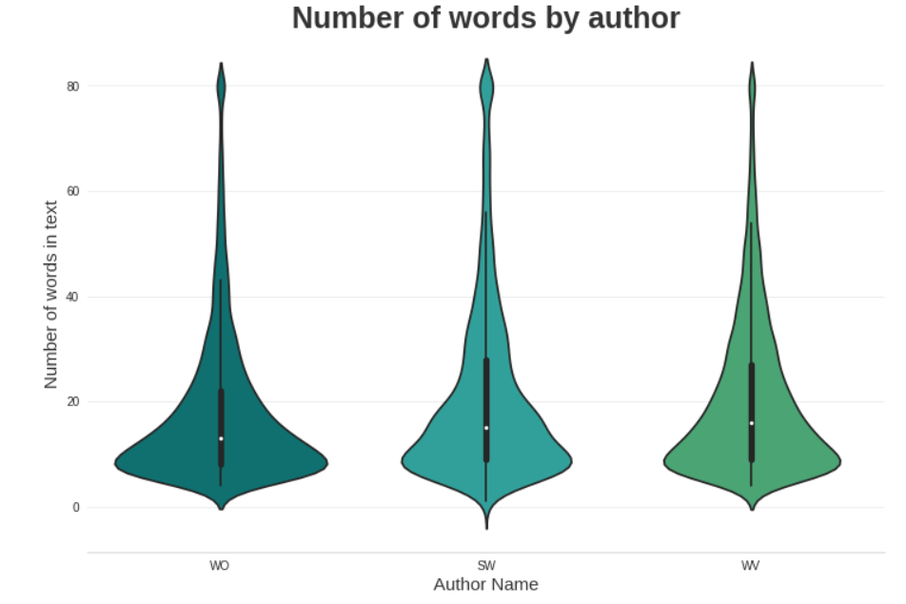
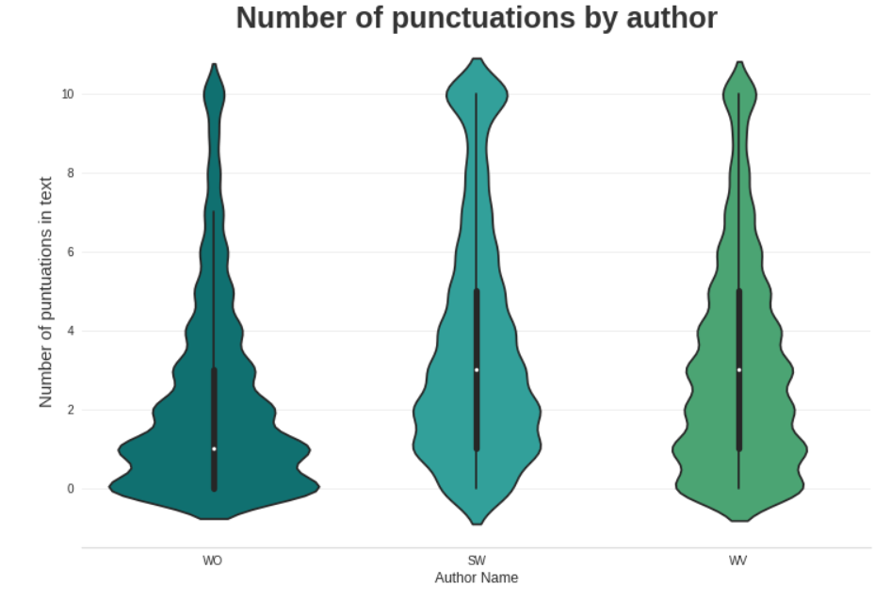
Features
Stylometric:
Syllable Count
Character Count
Word Count
Average Syllable Length
Average Word Length
Unique Word Count
Punctuation Frequency
Stop Word Frequency
Word Counts by Length
Others:
Vader Intensity
Tf-idf vectorized (SVD Truncated to remove sparsity)
Pos Tags Tf-idf vectorized (SVD Truncated to remove sparsity)
Count Vectorized
Violin Plots of some features per author

Slide 7
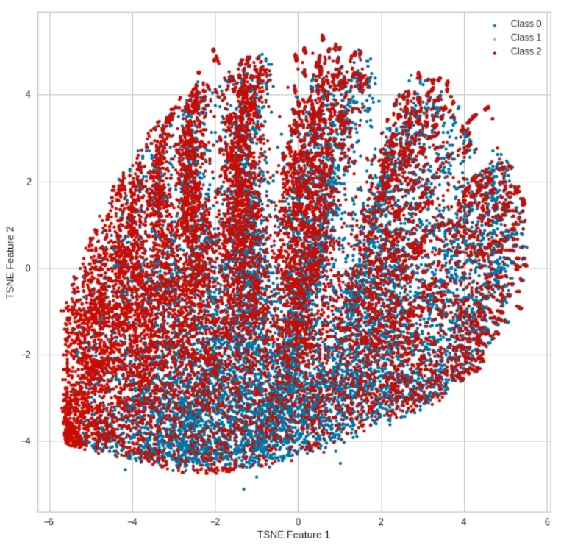
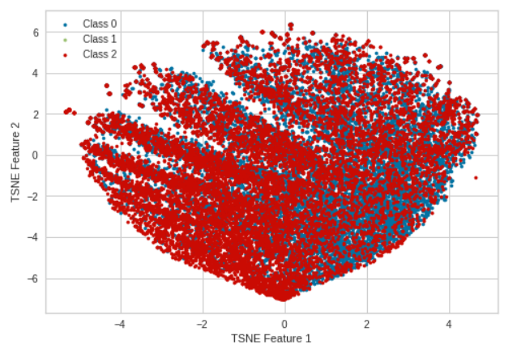
Feature Statistics
TSNE without Count Vectorized
TSNE with all features

Slide 8
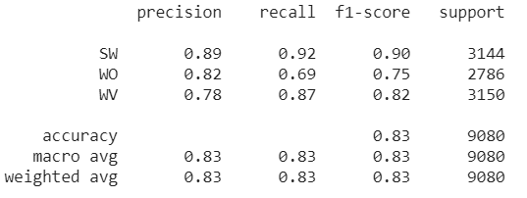

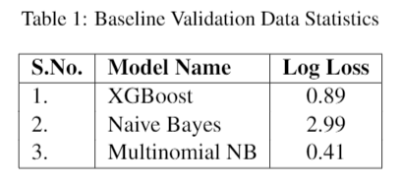
Machine Learning Models
Used Multinomial NB, Logistic Regression, and Passive Aggressive models.
Logistic Regression is implemented with a pipeline to handle the slight class imbalance.
Obtained the best performance by using Multinomial Naive Bayes model with log loss of 0.42 and an accuracy of 83% .
Performance is comparable with the baseline performance but baseline performance is calculated on the validation dataset and our model performed the same on test dataset.
Results: Multinomial NB Model
Baseline Results

Slide 9
Thank You

